Slide 1

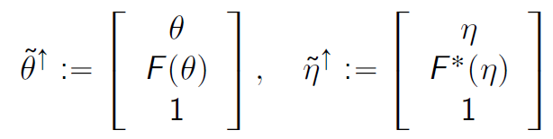
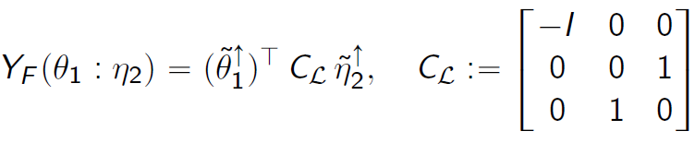
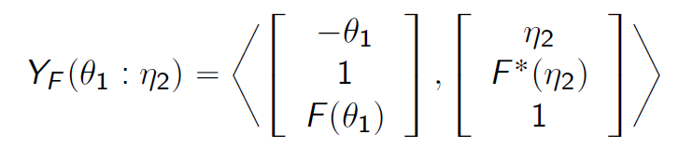
Fenchel-Young divergence interpreted as matrix-vector/inner product operations (GPU friendly)
F a Legendre-type strictly convex function with convex conjugate F*
Fenchel-Young divergence:
Homogeneous vectors of points on the graphs of potential functions:
Rewrite FY divergence using matrix vector/inner products (GPU):
(stems from polarity viewpoint)
Neural Legendre-Fenchel transform with Hessian Preconditioning, arXiv: 2606.09077

Slide 2
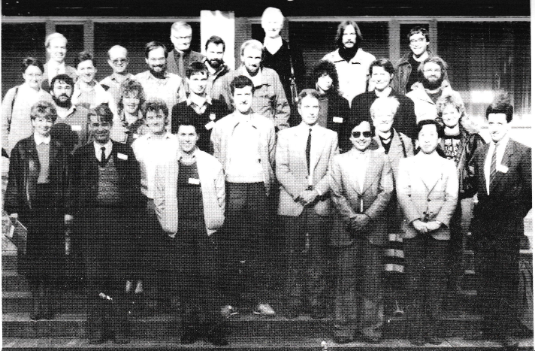
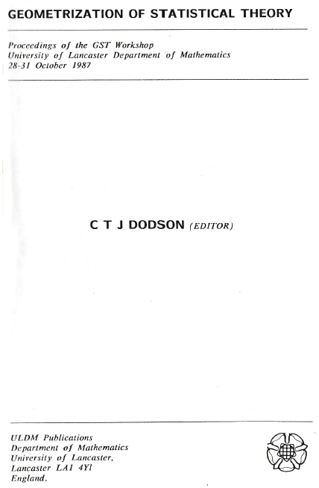
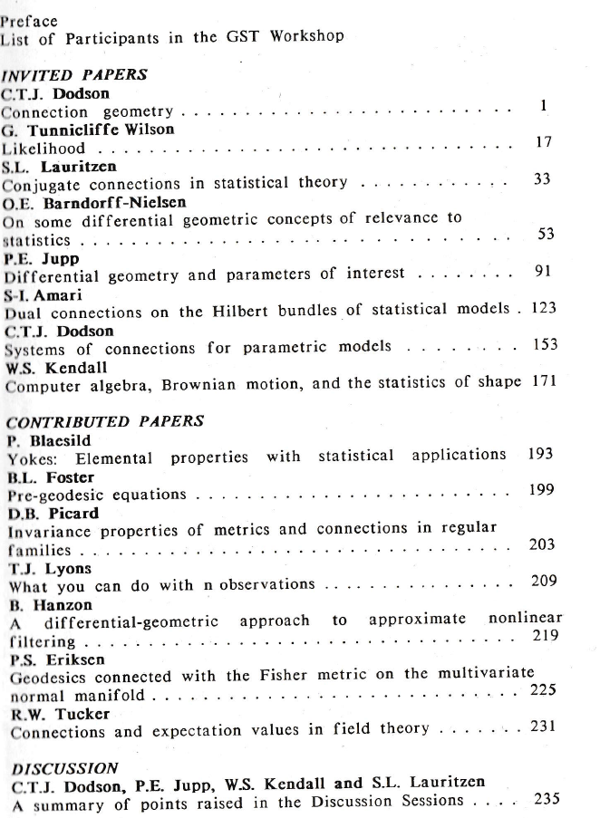
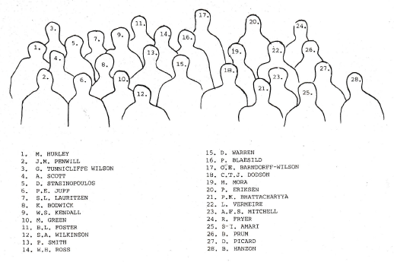

Slide 3
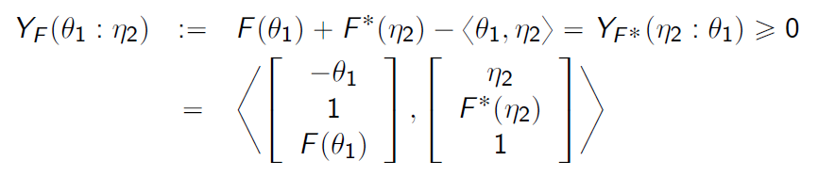
Fenchel-Young divergences as inner products (GPU)
F a Legendre-type strictly convex function with convex conjugate F*, (F*)*=F
Fenchel-Young divergences are equivalent to Bregman divergences:
Geometric interpretation: Legendre transform considered as a polarity
are homogeneous vectors of
points on the graphs of potential functions
where
Neural Legendre-Fenchel transform with Hessian Preconditioning, arXiv: 2606.09077

Slide 4
