Slide 1
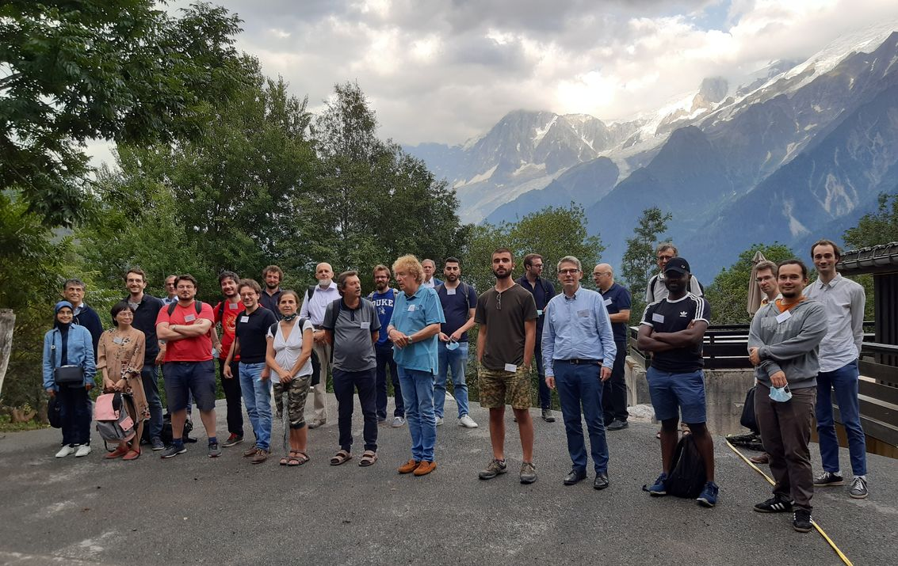
Online participants: Elena Celledoni, Manuel de León, Steve Huntsman, Frank Nielsen, Susanne Still, Koichi Tojo, Hiroaki Yoshimura
Joint Structures and Common Foundations of Statistical Physics, Information Geometry and Inference for Learning (SPIGL July 27-31th 2020, Les Houches, France)

