Slide 1
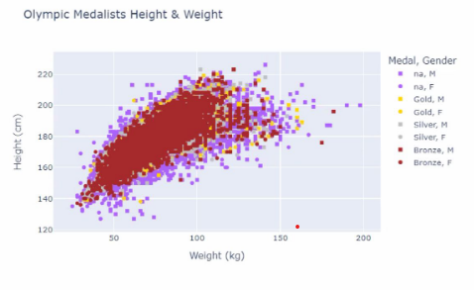
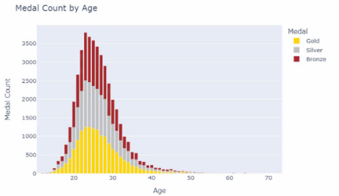
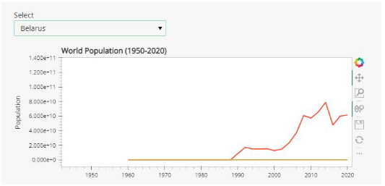
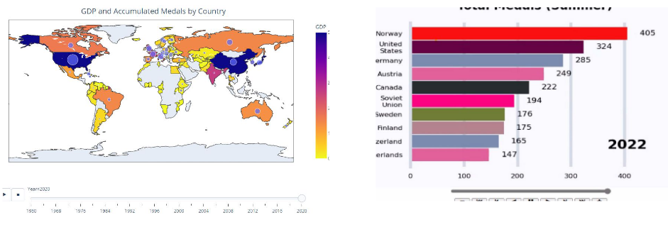
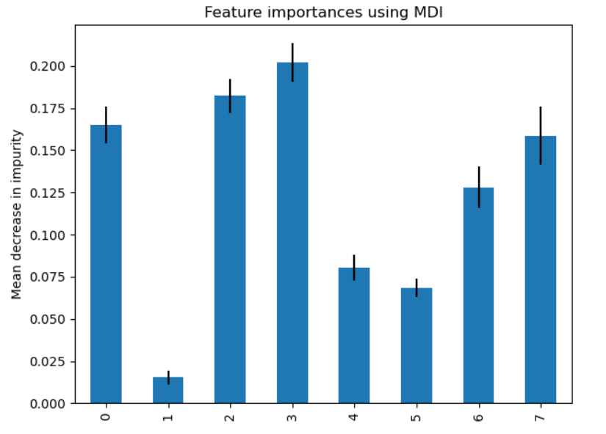
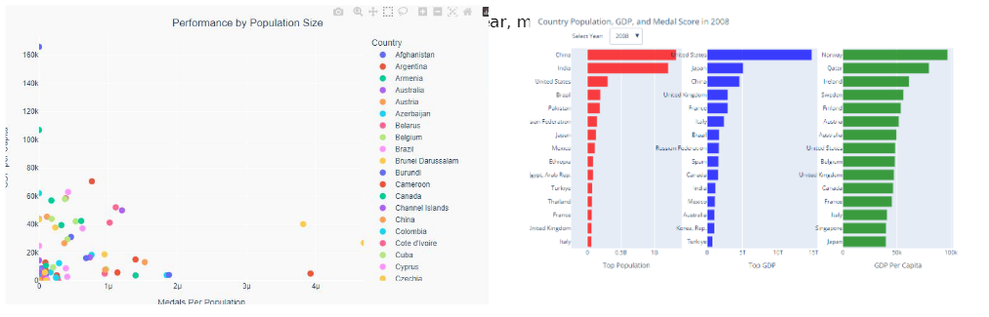
Olympic Medaling Dashboard – Storyboard
Visualizations
Interactive Components
DRAFT
Project description and objective
Data Introduction
Question1 – Using Charts to Answer
Question 2&3 – Using Machine Learning to Answer
Q2 - Visualizations & Metrics TBD
Accuracy
Precision
Recall
F1 score
Feature Importance
Q3 - Visualizations & Metrics
Output TBD
Interactive Components

