Slide 1
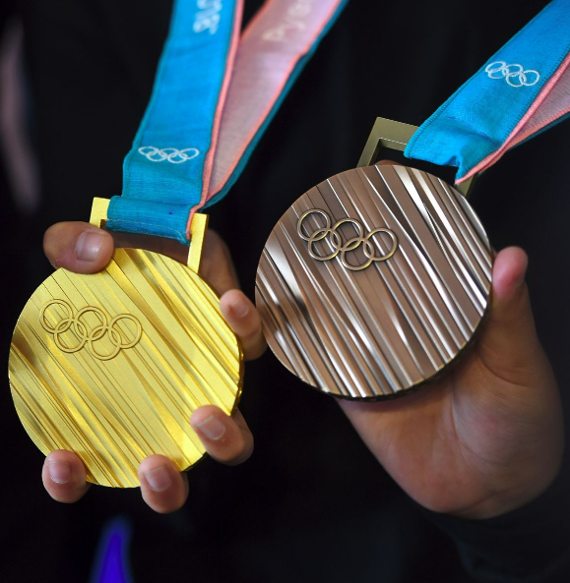
Olympic Medaling
DATA ANALYTICS
MARCH 2023

Slide 2




Meet the Team
William Ferry
Data Analyst
Laura Lewis
Project Manager
Frank Passalacqua
Data Scientist
Melinda Sheehy
Data Engineer

Slide 3
Topic Overview: Olympic Medaling
14000+ Athletes
200+ Countries
Modern games dating back to 1896
Data Visualizations
Medal Predictions
Answers!!

Slide 4
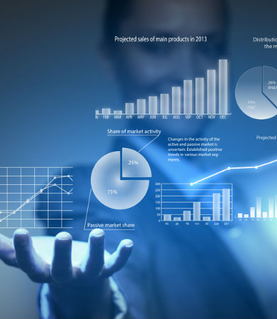








Tools
The team has performed an analysis on Olympic Medaling data utilizing many tools and languages including:
Computing Environment:
Jupyter Notebook
Programming Libraries:
Pandas
Scikit-learn (Random Forest)
Plotly
Dashboards:
Panel
Tableau
Repository:
Github
This Photo by Unknown Author is licensed under CC BY-SA-NC

Slide 5



Data Introduction
The analysis will be based on numerous sources which have been used to collect the following information:
OLYMPIC GAME DATA
Year
Season
Country
Sport
Medals
COUNTRY STATS
GDP
Population
Medals
ATHLETE BIOS
Gender
Height
Weight
Age
Sport
Medals

Slide 6
Questions to Answer
Goal - Create a one-stop shop of data & analytics that will assist in answering the following three questions:
1
Is there a correlation between a country’s GDP, population, and medal count?
2
Can a model predict, based on an athlete’s physical attributes and team(country), whether they will place a medal?
3
Can the model determine if a hypothetical athlete would win?

Slide 7
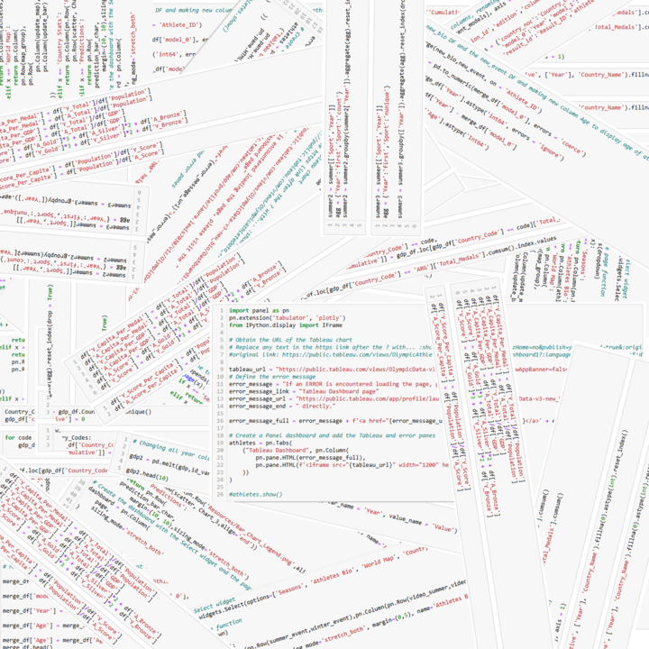
Data Exploration
Database
Cleanse
Summarize the data via an ERD
Modeling
Build example visualizations
Cleanse the data (merging tables, melting columns, concatenation, etc.)
Test scripts and code
Determine data source(s)
Build database

Slide 8
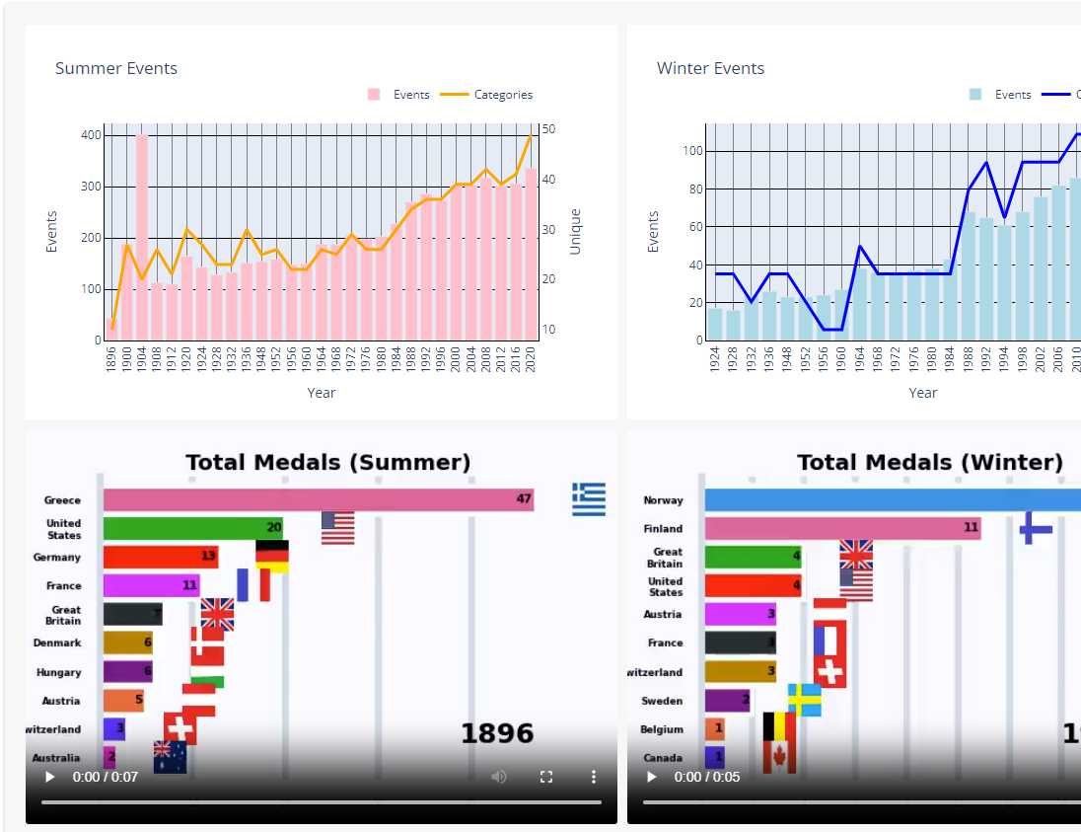
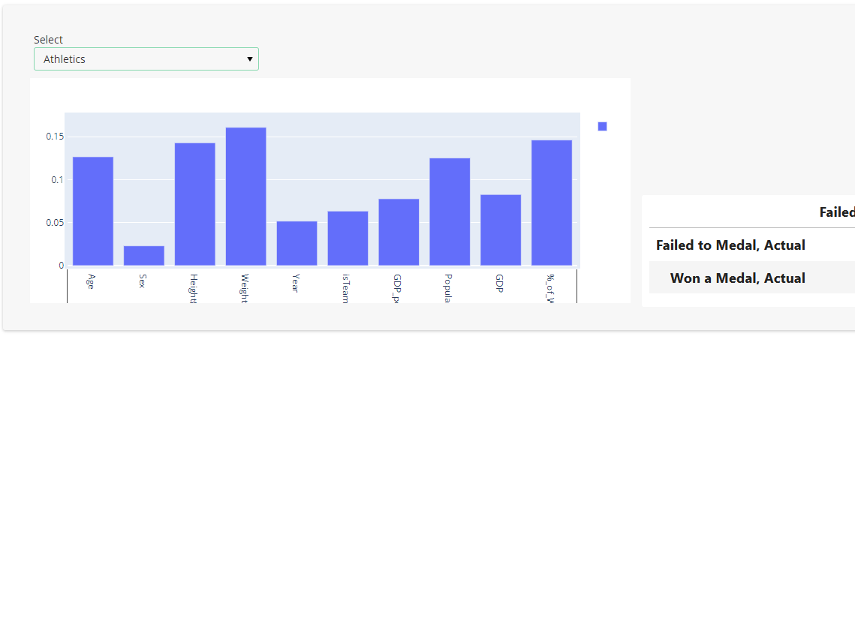
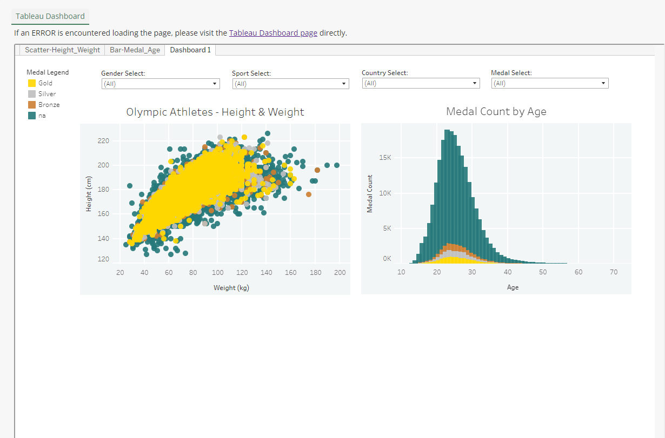
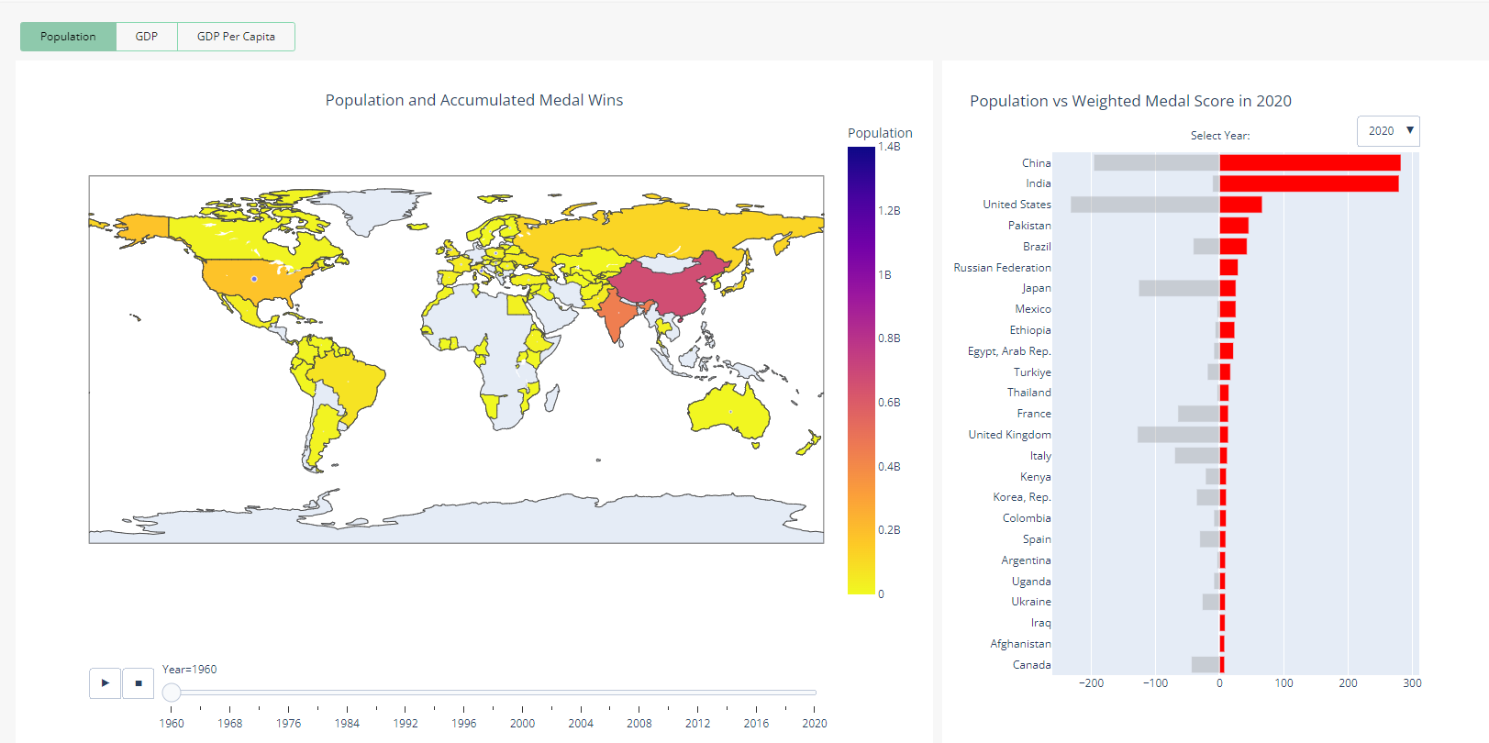
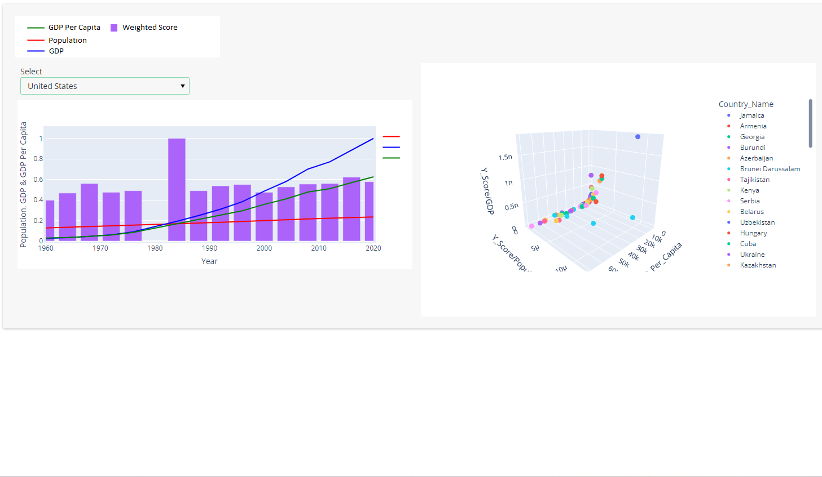
Dashboard - Live Demo
Dashboard - Demo
Seasons tab: provides a count of Summer & Winter events by year, along with a medal tie lapse demo
Athlete bio: includes athlete weight, height, age and medaling stats
World map: choropleth map of population, GDP and GDP per capita
Country Stats: minmak graph with country stats and 3D scatter plot displaying country performance
Predictions: Collection of bar graphs depictinghow the feature importance differs for each sport
Seasons tab: provides a count of Summer & Winter events by year, along with a medal tie lapse demo
Athlete bio: tableau dashboard includes athlete weight, height, age and medaling stats
World map: choropleth map of population, GDP and GDP per capita
Country Stats: minmax graph with country stats and 3D scatter plot displaying country performance
Predictions: collection of bar graphs depicting how the feature importance differs for each sport
DASHBOARD VIDEO DEMO

Slide 9
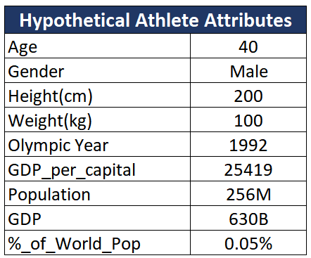




Random Forest Prediction
Question - Can the model predict if a hypothetical athlete would win a medal?
Diving
Figure Skating
Tennis
Sailing

Slide 10

Did we succeed?
1
Is there a correlation between a country’s GDP, population, and medal count?
2
Can a model predict, based on an athlete’s physical attributes and team(country), whether they will place a medal?
3
Can the model determine if a hypothetical athlete would win?

Slide 11
Final thoughts
What worked well?
Developing test models
Levaraging each other's expertise
Future enhancements:
Improved comprehension of dashboard tools and library compatibility
Utilization of Github branches and merging

Slide 12
The End. Any questions?

