Slide 1
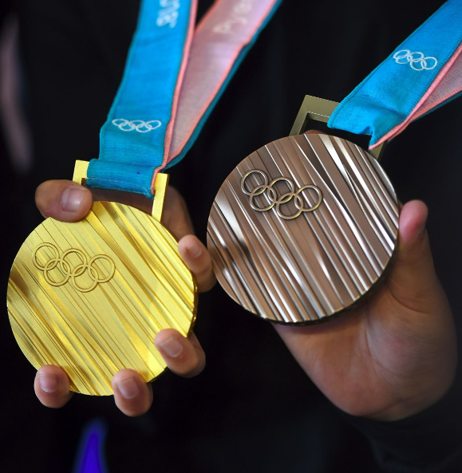
Olympic Medaling
DATA ANALYTICS
MARCH 2023

Slide 2




Meet the Team
William Ferry
BIO
Laura Lewis
Finance Manager seeking to expand data analytic skills with the hopes of obtaining a hybrid Finance/Data Reporting role.
Frank Passalacqua
BIO
Melinda Sheehy
BIO

Slide 3
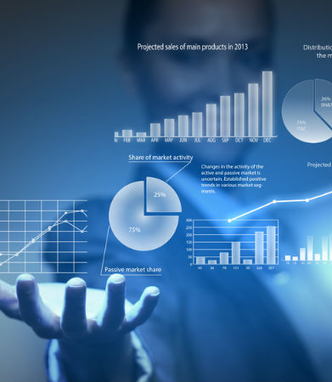




Overview
The team has performed an analysis on Olympic Medaling data utilizing many tools and languages including:
Jupiter Notebook
Pandas
Random Forest
Panel
Other??
With a goal of achieving:
Data Visualization
Medal Predictions
Answers
This Photo by Unknown Author is licensed under CC BY-SA-NC

Slide 4



Data Introduction
The analysis will be based on numerous sources which have been used to collect the following information:
OLYMPIC GAME DATA
Year
Season
Country
Sport
Medalists
COUNTRY STATS
GDP
Population
ATHLETE BIOS
Gender
Height
Weight
Age
Sport
Medalist

Slide 5
Questions to Answer
The goal of the analysis is to answer the following three questions:
1
Is there a correlation between a country’s economic factors (GDP), demographics (population) and medal count?
2
Can a model predict, based on an athlete’s physical attributes and team(country), whether they will place a medal?
3
Can a model determine if a hypothetical athlete would win?

Slide 6

Dashboard
INSERT SCREENSHOT OF DASHBOARD & HYPERLINKS

Slide 7

Machine Learning Results – q2
INSERT SCREENSHOT OF RESULTS

Slide 8

Machine Learning Results – q3
INSERT SCREENSHOT OF RESULTS

Slide 9

Closing Statements
INSERT SUMMARY STATEMENTS

Slide 10


