Slide 1
stonehenge
cross-platform desktop applications
written in pure C#

Slide 2
History of User Interface Techniques
1992 - MFC (Microsoft Foundation Classes)
C++
Modified Model-View-Controller-Architecture
2002 - WinForms
Comming with .NET Framework
Code Behind
2006 - WPF
Comming with .NET 3.0
MVVM (Model-View-ViewModel)
Notes:
Graphical Windows Uis only

Slide 3
Other UI Techniques
Qt
GTK
SVG

Slide 4
Web UI Techniques
HTML5
SVG

Slide 5
Other Projects
XAML
Avalonia - http://avaloniaui.net/
OmniGUI - https://github.com/OmniGUI/OmniGUI
HTML
Electron - https://electronjs.org/
Electron.NET - https://github.com/ElectronNET/Electron.NET
Blazor - https://dotnet.microsoft.com/apps/aspnet/web-apps/client

Slide 6
Design Goals
Minimal dependencies
No JavaScript tooling (Node) required
No JavaScript usage for standard problems

Slide 7
Electron.NET
Tooling
dotnet tool install ElectronNET.CLI -g
node.js v8.6.0
npm install electron-builder –global

Slide 8
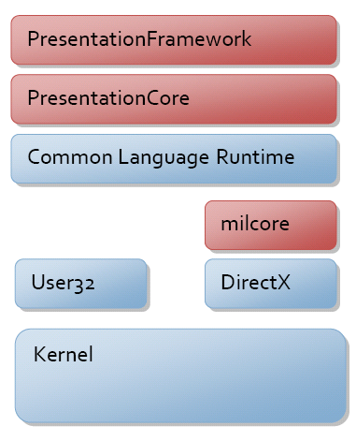
WPF
Source: Microsoft, 8.6.2019, https://docs.microsoft.com/en-us/dotnet/framework/wpf/advanced/wpf-architecture
Notes:
Presentation Framework
Depends on CLR
Depends on User32 == Windows

Slide 9
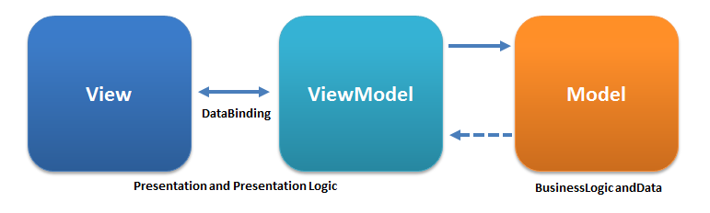
MVVM
XAML
C#
C#
Source: Wikipedia, 8.6.2019, https://de.wikipedia.org/wiki/Model_View_ViewModel

Slide 10
Bring it together

Slide 11
Vus.js

