Slide 1
stonehenge
cross-platform desktop applications
written in pure C#
Frank Pfattheicher - .NET User Group Karlsruhe 24.10.2019

Slide 2
History of Desktop User Interface Techniques
1992 - MFC (Microsoft Foundation Classes)
C++
Modified Model-View-Controller-Architecture
2002 - WinForms
Comming with .NET Framework
Code Behind
2006 - WPF
Comming with .NET 3.0
MVVM (Model-View-ViewModel)
Notes:
Graphical Uis Windows only
Ask audience:
MFC / WinForms / WPF / Other

Slide 3
Other UI Techniques
Desktop
Qt
GTK
Web
HTML5
SVG
Mobile
Xamarin-Forms
Cordova PhoneGap
Notes:
Qt & GTK => Linux

Slide 4

Other Projects
XAML
Avalonia - http://avaloniaui.net/
OmniGUI - https://github.com/OmniGUI/OmniGUI
Uno Platform - https://platform.uno/
HTML
Electron - https://electronjs.org/
Electron.NET - https://github.com/ElectronNET/Electron.NET
Blazor - https://dotnet.microsoft.com/apps/aspnet/web-apps/client
Notes:
XAML Derivates
WPF – Silverlight – Windows Phone – Other Projects
Electron.NET is a wrapper around a "normal" Electron application with an embedded ASP.NET Core application.
Via our Electron.NET IPC bridge we can invoke Electron APIs from .NET.

Slide 5
Electron.NET
Tooling
dotnet tool install ElectronNET.CLI -g
node.js v8.6.0
npm install electron-builder –global

Slide 6
stonehenge Design Goals
All platforms supporting .NET Core
Minimal dependencies
No JavaScript tooling (Node) required
No GRUNT, NPM, …
No JavaScript usage for standard problems

Slide 7
Design Tradeoffs
Server-side state
Chatty
No IE11 support
(due to missing async/await support)
Notes:
Server-side Blazor also is chatty – using websockets
Websockets are bidirectional – hiding chattyness
IE11 – maybe there is a polyfill – who cares

Slide 8
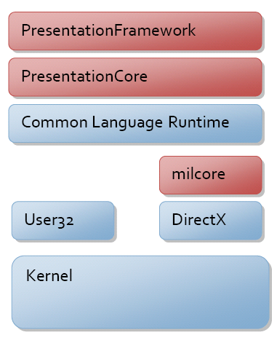
WPF
Source: Microsoft, 08.06.2019, https://docs.microsoft.com/en-us/dotnet/framework/wpf/advanced/wpf-architecture
Notes:
Presentation Framework
Depends on CLR
Depends on User32 == Windows

Slide 9
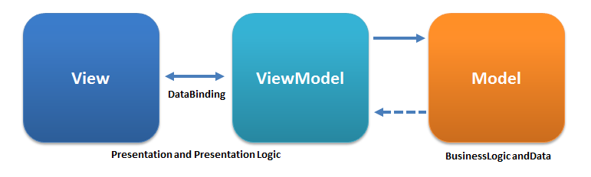
WPF - MVVM
XAML
C#
C#
PresentationFramework
.NET Core
Source: Wikipedia, 08.06.2019, https://de.wikipedia.org/wiki/Model_View_ViewModel
Notes:
// Navigate to URI using the Navigate method
this.Navigate(new Uri("HomePage.xaml", UriKind.Relative));

Slide 10
Move to HTML
Sandbox
No Changes here !
HTML
?
C#
C#
Browser
.NET Core

Slide 11
Binding using client JS
stonehenge3
HTML
generated JS
HTTP
C#
C#
Browser
.NET Core
Notes:
Client Side Solution: Use a common used framework – Vue.js
Older versions using Aurelia and Knockout

Slide 12
Client - Vus.js, Bootstrap & Fontawesome
Vue.js (2.6)
Used as client framework
Client code is automatically generated from ViewModels
Provides bindings and event handling
Supports components
Router support via vue-router
Bootstrap 4
Simple layout
Fontawesome 5
Supports symbols

Slide 13
Theory Practice

Slide 14
Getting Started
Console.WriteLine(@"Sample starting");
Create Project
File - New Project - Visual C# - .NET Core - Console App (.NET Core)
Choose .NET Core 2.x … 3.0 as target framework
Add reference to stonehenge3 Nuget package
Notes:
.NET 4.7 also supported, but not recommented

Slide 15
Getting Started
Console.WriteLine(@"Sample starting");
Add Code to Main
var vue = new VueResourceProvider(); var provider = StonehengeResourceLoader.CreateDefaultLoader(vue);
var options = new StonehengeHostOptions { Title = "Demo", StartPage = "start" };
var host = new KestrelHost(provider, options);
host.Start("localhost", 32000);
Console.ReadLine();
Notes:
We have to decide what client (JavaScript) framework to use. This description uses Vue.js. The server deploys embedded resources to the client. So we need to create a resource provider. Immediately adding the Vue provider enables delivering automaatically generated Vue code.
Now we define application title and a start page name and some other as hosting options.
Next we have to decide what hosting environment to use. This description uses [Kestrel], the .NET Core default stack (https://docs.microsoft.com/de-de/aspnet/core/fundamentals/servers/kestrel).
Finally we have to start the server giving a listening address and a TCP port.
- Use * for all IP-adresses (i.e. public)
- Use zero for auto-select free port

Slide 16
Getting Started
public string ComputerName => Environment.MachineName;
Add content
Create a html file named start.html within the app solution folder
<div> <p>Hello Client from computer {{ComputerName}}!</p> </div>
Mark start.html as EmbeddedRessource
Add corresponding server side ViewModel
Create class StartVm in ViewModels solution folder.
public class StartVm : ActiveViewModel { public string ComputerName => Environment.MachineName;
}
Notes:
ViewModels solution folder is a „best practice“ only
Deriving from ActiveViewModel is optional

Slide 17
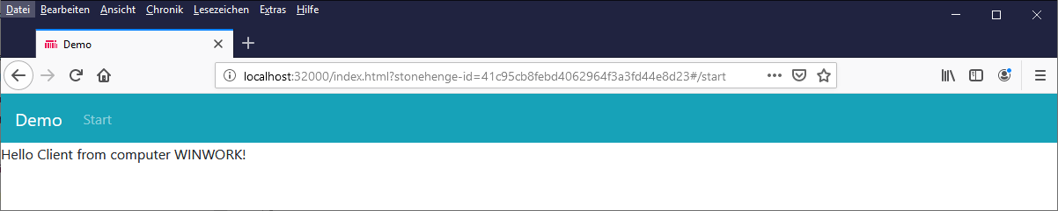
Go!

Slide 18
Hosting Options
Console.WriteLine(@"Sample starting");
Create Host Window
var wnd = new HostWindow(host); wnd.Open();
Selects installed Browser
(Chrome, Firefox, others)
Start Browser in Kiosk Mode
(no address line and toolbars)
Navigates to App content

Slide 19
How does it work 1/3?
Startup
Search all html files in /app folder => this are the pages
Parse html for Title comment <!—Title:PageTitle:PageSortIndex-->
Parse html for ViewModel comment <!—ViewModel:ViewModelClassName--> Default ViewModel class name is UpperCamelCase of filename + „Vm“ Example: start.html => StartVm
Parse html for CustomElement comment <!—CustomElement:ListOfProperies--> This is a component view with the given properties to bind data to
Build list of routes for vue-router
Register vue-components in application

Slide 20
How does it work 2/3?
Delivering index.html
Search all css files in /styles and /themes folders Insert them at the placeholder of index.html <!—stonehengeUserStylesheets-->
Search all js files in /scripts folder Insert them at the placeholder of index.html <!—stonehengeUserScripts->
Create app.js including information collected at startup
Title
Routes

Slide 21
How does it work 3/3?
Delivering Page
Deliver page.html
Create corresponding Vue component client script page.js
Check for existing page_user.js If found, add content at the end of generated page.js
Serialize ViewModel data as JSON and send this data on request GET /ViewModel/ViewModelClassName
Notes:
_user.js ist für JavaScript Controls notwendig

Slide 22
Vue Bindings
Content
<p>Message: "{{ MessageText }}"</p>
Raw HTML
<div>{{{ RawHtml }}}</div>
Attributes
<div v-bind:class=“ClassName"></div> <a v-bind:href=“TargetUrl"> ... </a>
Conditional
<h1 v-if="awesome">Vue is awesome!</h1>
Lists
<ul id="example-1"> <li v-for="item in Items"> {{ item.message }} </li> </ul>
Source: Vue.js, 26.06.2019, https://v1.vuejs.org/guide/syntax.html
Notes:
{{ number + 1 }}
{{ ok ? 'YES' : 'NO‘ }}
{{ MessageText.split('').reverse().join('') }}
<!-- full syntax -->
<a v-bind:href="url"> ... </a>
<!-- shorthand -->
<a :href="url"> ... </a>
v-else

Slide 23
Vue Advanced Bindings
Input
<input v-model="message1" placeholder="edit me"> <textarea v-model="message2" placeholder="add multiple lines"></textarea>
Checkbox
<input type="checkbox" id="checkbox" v-model="checked"> <label for="checkbox">{{ checked }}</label>
Radio
<input type="radio" id="one" value="One" v-model="picked"> <label for="one">One</label> <br> <input type="radio" id="two" value="Two" v-model="picked"> <label for="two">Two</label> <br> <span>Picked: {{ picked }}</span>
Select
<select v-model="selected"> <option>A</option> <option>B</option> </select>
<span>Selected: {{ selected }}</span>
Source: Vue.js, 26.06.2019, https://v1.vuejs.org/guide/syntax.html
Notes:
By default, v-model syncs the input with the data after each input event. You can add the lazy modifier to instead sync after change events:
<!-- synced after "change" instead of "input" -->
<input v-model.lazy="msg" >

Slide 24
Vue Event Bindings
Click
<button v-on:click=“AddOne()">Add 1</button>
Keyboard
<input v-on:keyup.page-down=“OnPageDown()">
Source: Vue.js, 26.06.2019, https://v1.vuejs.org/guide/syntax.html
Notes:
<!-- full syntax -->
<a v-on:click="doSomething"> ... </a>
<!-- shorthand -->
<a @click="doSomething"> ... </a>

Slide 25
Style Options
Index.html could be replaced
Basic bootstrap style is incliuded with stonehenge
Notes:
Contains basic bootstrap menu

Slide 26
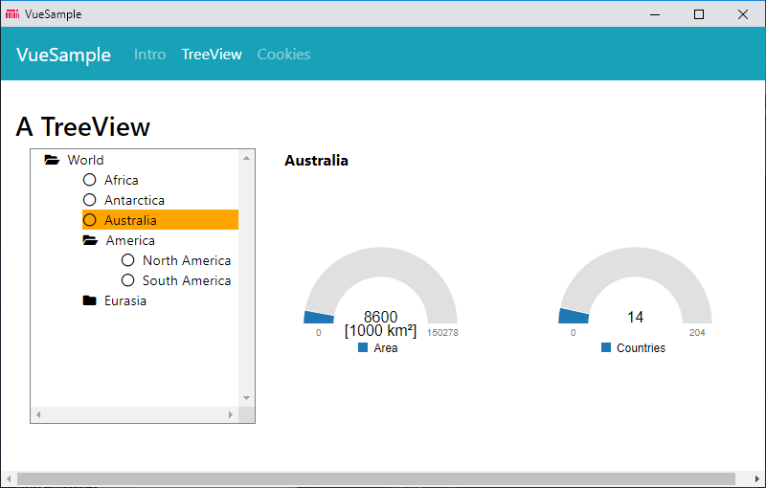
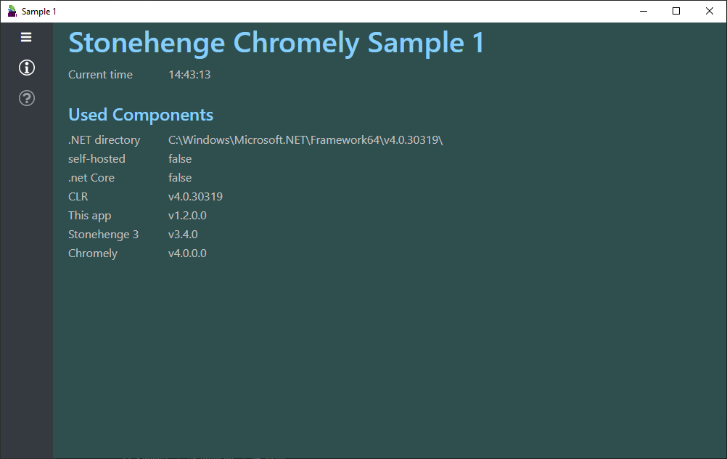
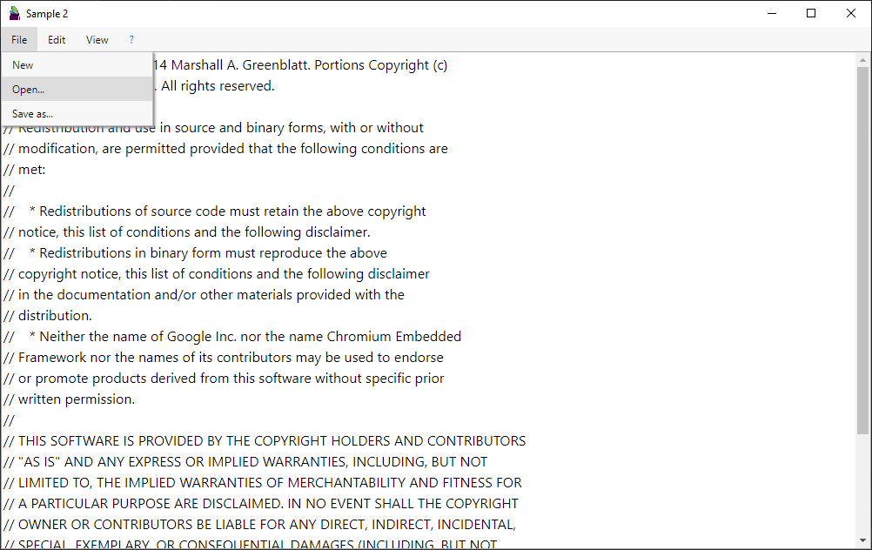
Client UI Choices
General change in UI is done by
customizing index.html
Default
Bootstrap SPA menu
VsCode Style
Alternate menu style
Classic Desktop
Classic Menu support using CSS
Notes:
Provided by index.html

Slide 27
Still a Browser required
Default Support
Automatic browser detection
Start in kiosk mode
Missing Functionality
System Dialogs (File Open/Save, MessageBox)
Notes:
Provided by index.html

Slide 28
Pause
Questions?

Slide 29
Chromely
cross-platform desktop applications
written in pure C#
Frank Pfattheicher - .NET User Group Karlsruhe 24.10.2019

Slide 30
Browser replaced by CEF
Uses Chromium Embedded Framework (CEF) A simple framework for embedding Chromium-based browsers in other applications.
Lightweight alternative to Electron.NET, Electron for .NET Core
Based on Xilium.CefGlue, CefSharp implementations of embedded Chromium (CEF) without WinForms or WPF
Uses Windows and Linux native GUI API as "thin" chromium hosts
Source: Chromium Embedded Framework, 26.06.2019, https://bitbucket.org/chromiumembedded/cef
Source: chromelyapps, 26.06.2019, https://github.com/chromelyapps/Chromely
Notes:
Provided by index.html

Slide 31
Supported Platforms
Platform | CefGlue.Winapi | CefGlue.Gtk | CefSharp.Winapi
Windows⁽¹⁾ 32-bit | net461, netstandard2.0 | net461, netstandard2.0 | net461
Windows⁽¹⁾ 64-bit | net461, netstandard2.0 | --- | ---
Linux⁽²⁾ 32-bit | --- | netstandard2.0 | ---
Linux⁽²⁾ 64-bit | --- | netstandard2.0 | ---
MacOSX⁽³⁾ 64-bit | --- | --- | ---
Linux ARM⁽⁴⁾ | --- | netstandard2.0 | ---
⁽¹⁾ Windows 7, Service Pack 1 and newer ⁽²⁾ Ubuntu 16.04 and newer (Mono currently not working, window resizing not working) ⁽³⁾ Work in progress... ⁽⁴⁾ i.e. Raspberry Pi 3+ (manual download of CEF builds for ARM available on http://chromely.org/cefbuilds/index.html)
For more info/documentation, please check Chromely wiki.
Source: chromelyapps, 24.10.2019, https://github.com/chromelyapps/Chromely
Notes:
Nobody available to push MacOS support ☹

Slide 32
Simple to Use
Add Nuget Packages
Chromely.Core
Chromely.CefGlue
Chromely.CefGlue.Winapi
Chromely.CefGlue.Gtk
Add some Hosting Code…
Notes:
Currently no Meta-Package available…

Slide 33
Simple to Use
class Program
{
static void Main(string[] args) {
var startUrl = "https://google.com";
var config = ChromelyConfiguration .Create()
.WithHostMode(WindowState.Normal)
.WithHostTitle("chromely")
.WithHostIconFile("chromely.ico")
.WithAppArgs(args)
.WithHostBounds(1000, 600)
.WithStartUrl(startUrl);
using var window = ChromelyWindow.Create(config); window.Run(args);
}
Source: chromelyapps, 26.06.2019, https://github.com/chromelyapps/Chromely

Slide 34
Bringing it togeter
class Program { static void Main(string[] args) { // stonehenge Backend var provider = StonehengeResourceLoader .CreateDefaultLoader(new VueResourceProvider()); var options = new StonehengeHostOptions { Title = "Demo", StartPage = "start", }; var host = new KestrelHost(provider, options);
if (!host.Start("localhost", 32000)) { Console.WriteLine(@"Failed to start server on: " + server.BaseUrl); Environment.Exit(1); }
// Chromely Frontend var config = ChromelyConfiguration .Create() .WithHostMode(WindowState.Normal) .WithHostTitle("chromely") .WithHostIconFile("chromely.ico") .WithAppArgs(args) .WithHostBounds(1000, 600) .WithStartUrl(host.BaseUrl);
using var window = ChromelyWindow.Create(config); window.Run(args); }

Slide 35
Known Problems
Debugging
.NET Core 2.x does not build an EXE by default – publish required
No debugging possible
GTK Window Handling (Linux)
window resizing does not work
tooltips at wrong position
Notes:
Currently no Meta-Package available…

Slide 36
Missing for Desktop Applications
System Dialogs
MessageBox
FileOpen
FileSave
SelectFolder
Notes:
Direct access to system resources not a problem due to server side netcore code only.

Slide 37
UI Components
HTML5 provides simple controls only
label
input
select / option / optgroup
textarea
button
datalist (drop-down list of the pre-defined options as they input data)
Often this is not enough…
Notes:
Reusable parts of UI and behaviour

Slide 38
UI Components (Vue)
Vue requires to register a component with
Tag-name
List of properties (data)
Template (HTML presentation)
Notes:
Stonehenge does this for you

Slide 39
Vue Components - View
Occupancy
Define a View as „tree-view.html“, define rootnodes as parameter
<!--CustomElement:rootnodes--> <div> <ul style="…" > <tree-node v-for="child of rootnodes" :node="child" :key="child.Id„
@select="$emit('select', $event)"
@toggle="$emit('toggle', $event)" </ul> </div>
The file name is used as custom HTML5 tag, so you can now use tree-view as a element.
The filename defines the HTML tag-name
The CustomElement comment is the hint for stonehenge to create a Vue component.
Names following the colon are the names of variables the component should expose.
(comma sepearated list)
Notes:
Vue does NOT BUBBLE events up the DOM tree

Slide 40
Vue Components - View
Define a second View as „tree-node.html“, define node as parameter
<!--CustomElement:node--> <div> <li v-if="node.IsVisible" > <div :class="node.Class" > <span v-if="node.HasChildren" :class="node.Icon" style="cursor: pointer;" @click="$emit('toggle', node.Id)"></span> <span v-else class="far fa-circle" @click="$emit('toggle', node.Id)"></span> <span style="cursor: pointer;" @click="$emit('select', node.Id)">&nbsp;{{node.Name}}</span> </div> <ul style="list-style-type: none;"> <tree-node v-for="child of node.Children" :node="child" :key="child.Id" @select="$emit('select', $event)" @toggle="$emit('toggle', $event)"/> </ul> </li> </div>

Slide 41
Vue Components – Model
Define the ViewModel as „TreeNode.cs“
public class TreeNode { public string Id { get; } public string Name { get; }
public List<TreeNode> Children { get; set; }
public bool IsVisible => _parent?.IsExpanded ?? true;
public bool IsExpanded { get; set; } public bool IsSelected { get; set; } public bool HasChildren => Children.Count > 0; public string Icon => IsExpanded ? "fa fa-folder-open" : "fa fa-folder"; public string Class => IsSelected ? "tree-selected" : "";
private readonly TreeNode _parent; public TreeNode(TreeNode parentNode, string name) { Id = Guid.NewGuid().ToString("N"); Name = name; Children = new List<TreeNode>(); _parent = parentNode; } public IEnumerable<TreeNode> AllNodes() { yield return this; foreach (var node in Children.SelectMany(child => child.AllNodes())) { yield return node; } } public TreeNode FindNodeById(string id) { return AllNodes().FirstOrDefault(node => node.Id == id); } }

Slide 42
Vue Components - Usage
In the View simply use the „tree-view“ tag and bind rootnodes.
<div> <h3>A TreeView</h3> <tree-view v-bind:rootnodes="RootNodes" v-on:select="TreeSelect($event)" v-on:toggle="TreeToggle($event)"/> </div>
In the ViewModel provide RootNodes and handle select and toggle.
public List<TreeNode> RootNodes => new List<TreeNode>();
[ActionMethod] public void TreeToggle(string nodeId) { var node = RootNodes[0].FindNodeById(nodeId); if (node == null) return; node.IsExpanded = !node.IsExpanded; } [ActionMethod] public void TreeSelect(string nodeId) { … }
Notes:
Vue.js „bubbelt“ Events nicht….

Slide 43
Done.
Questions?

