Slide 1
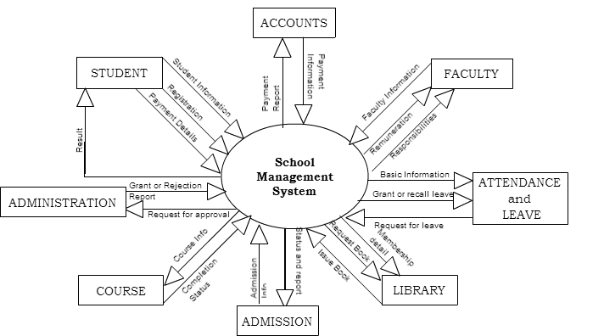

Slide 2
Registration
STUDENT
Attendance Info
Attendance Info
FACULTY
D6 FACULTY INFO
ADMIN/STUFF
Faculty Info
ATTENDANCE /
LEAVE MANAGEMENT
7
FACULTY MANAGEMENT
2
Authentication
D7 ADMIN/STUFF INFO
Attendance Details
Grant or Reject
Admin info
Leave info
SCHOOL MANAGEMENT
1
Receipt
Attendance Details
Admission info
D3 ATTENDANCE INFO
ADMISSION SYSTEM
3
Payment Status
D2 STUDENT INFO
D2 STUDENT INFO
Get admission
Payment details
Balance Sheet
D1 COURSE INFO
Student Record
Course status
Payment info
ACCOUNT MANAGEMENT
6
LIBRARIAN
Course status
COURSE MANAGEMENT
4
Schedules/Result
STUDENT
ACCOUNT
Invoice
Book/Student Details
Course info
Faculty Availability
D4 ACCOUNT INFO
Issue Library Card
Request for book
LIBRARY MANAGEMENT
5
COURSE
STUDENT
D2 STUDENT INFO
Issue Book or Reject Request
Check Validity
D5 BOOK DETAILS
Book Details/Availability

Slide 3
Class Details
D9 Class Details
Assignment Manager
4.2
Class Assignment Details
Schedules Details
Class Maintenance
4.1
STUDENT
Class Details
Assignment Details
Study Material
4.3
Study Material
Assignment Details
FACULTY
Approval
Course Maintenance
4.4
D8 Study Material
Course Details
Study Material

Slide 4
D10 Leave Details
Leave Details
Update Pending Leave
7.2
Leave request details
Request for Approval
Leave Request
7.1
Apply for Leave
ADMIN
FACULTY
Leave Details
Faculty Details
Grant Leave
2.3
Grant or Reject
Update status
D6 Faculty Info

Slide 5
Check for Completeness
3.2
STUDENT
Clarification
Application
Prepare for Decision
3.3
Application
Enquiry
Receive Application
3.1
Application
Reply to Enquiry
3.4
D11 Received Application
Update status
Application’s Status Analysis
3.5
Prepared Approval
3.7
STUDENT
Approved Application
3.6
Application Approval
Application Analyzed
D12 Seat Details
D13 Approved Application

Slide 6
Request for Approval
Check Funds
6.2
Funds details
Approval
ADMIN
Classify Expenditure
6.3
STUDENT
Payment
D14 Account Type
D4 Account Info
Funding
6.1
Account Details
D15 Allocated Budget
Set up Budget
6.5
Provide Summaries
6.4
Spending Summaries
ADMIN
Budget Allocation

Slide 7
Approval Request
Set up Budget
6.3.1
Update Type Account
6.3.2
Classified Request
D17 Type Account
D16 Departmental Account
Update Request
Update Departmental Record
6.3.4
Sum Total
6.3.3
Request total
Recorded Request

