Slide 1
Software Foundations of Security and Privacy (15-316, spring 2017) Lecture 6: Inline Reference Monitors
Jean Yang
jyang2@andrew.cmu.edu
With material from Vitaly Shmatikov and Ulfar Urlingsson

Slide 2
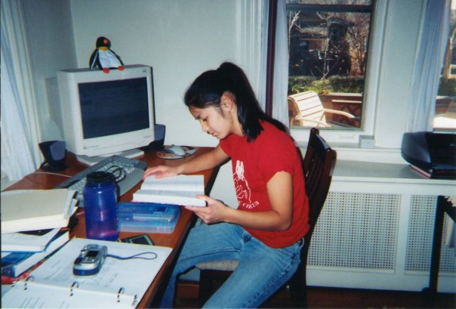
A tale of monitoring…

Slide 3
How this relates to our class
Desired safety property: Jean never goes on AOL Instant Messenger.
Enforcement mechanism: Mom checks Internet Explorer cookies. (This is an audit-based security mechanism!)
What Mom would like: a mechanism for preventing Jean from going on AIM before it happens.

Slide 4
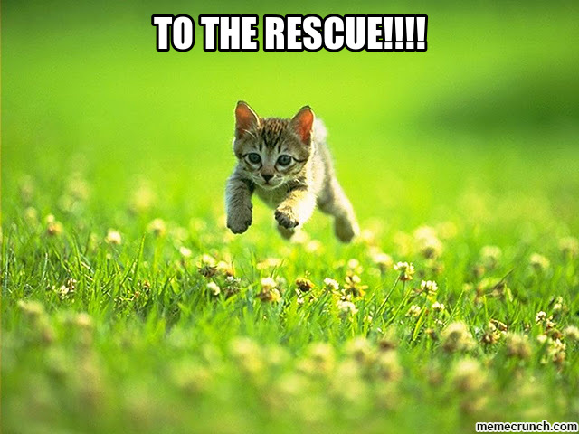
Solution: reference monitors!

Slide 5

Leftovers from Lecture 5

Slide 6
Mechanism integrity
To correctly enforce a policy, we must assume:
Input symbols correspond to actual execution.
Transitions correspond to automaton’s true transition function.
If target corrects mechanism, it can violate these assumptions.
Address with two strategies:
Isolation: target must be unable to write to internal representation of automaton.
Complete mediation: make sure all aspects of execution that might generate input symbols are covered by implementation.

Slide 7
Proving correct enforcement
Goal: Show that when S executes under enforcement of SA P:
S terminates when its execution violates P
S continues to execute otherwise
This requires a proof that the implementation satisfies:
Complete mediation.
Target control.
Isolation.
Later, we will see how different implementation strategies lead to different kinds of proof!

Slide 8
More pragmatics
Two mechanisms are needed to implement SA:
Input read: Determines that an input symbol has been produced by the target and forwards that symbol to the automaton simulation.
Transition: Determines whether the automaton can make a transition on a given input symbol, and if so, executes that transition by updating automaton state effectively.
These implementations affect correctness and performance!

Slide 9
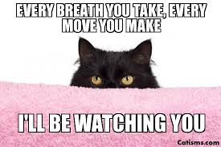
Part One: The Reference Monitor Framework

Slide 10
Recap: reference monitors
Slide source: Vitaly Shmatikov
Observes execution of the program/process
Possible abstraction levels: hardware, OS, network
Halts or contain execution if the program is about to violate the security policy
What’s a “security policy”?
Which system events are relevant to the policy?
Instructions, memory accesses, system calls, network packets…
Cannot be circumvented by the monitored process
Most enforcement mechanisms we will see are example of reference monitors

Slide 11
Reference monitor implementations
Slide source: Vitaly Shmatikov
Kernelized
Wrapper
Modified program
Program
RM
Program
Program
RM
RM
Kernel
Kernel
Kernel
Integrate reference monitor into program code during compilation or via binary rewriting
Policies can depend on application semantics
Enforcement doesn’t require context switches in the kernel

Slide 12
OS as a reference monitor
Slide source: Vitaly Shmatikov
Collection of running processes and files
Processes are associated with users
Files have access control lists (ACLs) saying which users can read/write/execute them
OS enforces a variety of safety policies
File accesses are checked against file’s ACL
Process cannot write into memory of another process
Some operations require superuser privileges
But may need to switch back and forth (e.g., setuid in Unix)
Enforce CPU sharing, disk quotas, etc.
Same policy for all processes of the same user

Slide 13
Validity checks
Slide source: Ulfar Erlingsson
Triggered by reference monitor on each event
Encode the security policy
Perform arbitrary computation to decide whether to allow event or halt
Can have side effects? (Not if EM!)
Can change program flow? (Not if EM!)
My work: how can we enforce safety properties if we want to have side effects and change the program flow?

Slide 14
Inline reference monitors
Slide source: Vitaly Shmatikov
Policy specified in some formal language
Policy deals with application-level concepts: access to system resources, network events, etc.
“No process should send to the network after reading a file”
“No process should open more than 3 windows”, …
Policy checks are integrated into the binary code, via binary rewriting or when compiling
Inserted checks should be uncircumventable

Slide 15
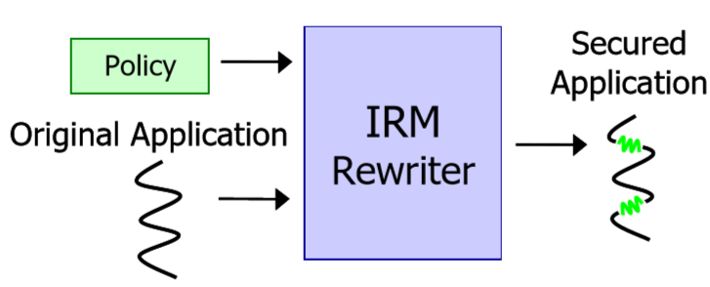
Implementing IRMs by program modification
[Erlingsson Schneider 99]
Slide source: Ulfar Erlingsson
Have access to program abstractions to capture all potential security-relevant events.
Rewriter works on machine language programs.

Slide 16
Challenges in implementing IRMs
[Erlingsson Schneider 99]
Slide source: Ulfar Erlingsson
How to capture all relevant events?
Prevent application from subverting reference monitor
Preserve application behavior

Slide 17
IRM enforcement advantages
Slide source: Ulfar Erlingsson
Can enforce policies on application abstractions (for instance MSWord macros and documents)
Each application can have a distinct policy
Enforcement overhead determined by policy
Mechanism customized to policy
Mechanism is simple and efficient

Slide 18
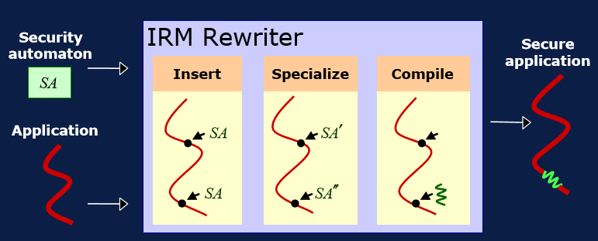
Efficient IRM enforcement
Slide source: Ulfar Erlingsson
Evaluate security automata policy at every point in the program
Simplify security automata by partial evaluation using static knowledge

Slide 19
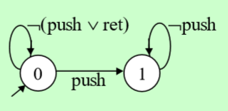
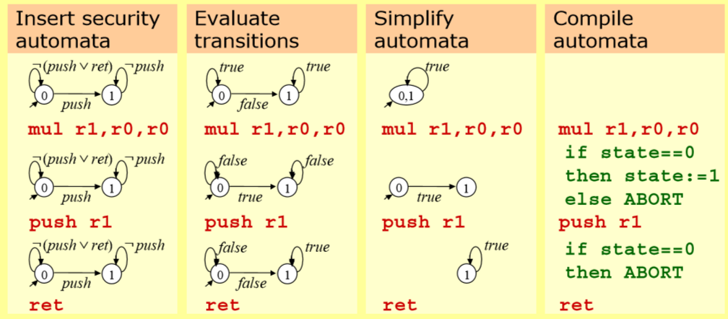
Example IRM rewriting
Slide source: Ulfar Erlingsson
Policy: push exactly once before returning

Slide 20

Part Two: From Policies to Reference Monitors

Slide 21
Enforceable security policies
Slide source: Vitaly Shmatikov
Reference monitors enforce safety policies [Schneider ‘98]
Execution of a process is a sequence of states
Safety policy is a predicate on a prefix of the sequence
Policy must depend only on the past of a particular execution; once it becomes false, it’s always false
Not policies that require knowledge of the future
“If this server accepts a SYN packet, it will eventually send a response”
Not policies that deal with all possible executions
“This program should never reveal a secret”

Slide 22
Some definitions
Access control. “Only my mom can see my Facebook posts.”
Information flow. “Only my mom can see any value derived from my Facebook posts.”
Integrity. “Only my mom is allowed to write on my Facebook wall.”
Liveness. “Facebook shows all my Facebook posts to my mom.”
Availability. “The Facebook site is never down for my Mom.”

Slide 23
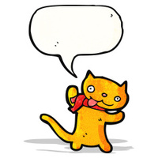
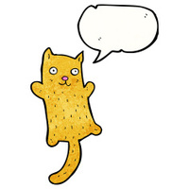






Which are safety properties?
Access control?
Info flow?
Integrity?
Bounded availability?
Liveness?
Availability?

Slide 24
Some different kinds of safety
Slide source: Vitaly Shmatikov
Memory safety: all memory accesses are “correct”
Respect array bounds, don’t stomp on another process’s memory, separation between code and data
Control-flow safety: all control transfers are envisioned by the original program
No arbitrary jumps, no calls to library routines that the original program did not call
… but wait until we see mimicry attacks
Type safety: all function calls and operations have arguments of correct type

Slide 25
Policy enforcement
Slide source: Vitaly Shmatikov
Checking before every instruction is an overkill
Check “No division by zero” only before DIV
There is a “semantic gap” between individual instructions and policy-level events
Applications use abstractions such as strings, types, files, function calls, etc.
Reference monitor synthesizes these abstractions

Slide 26
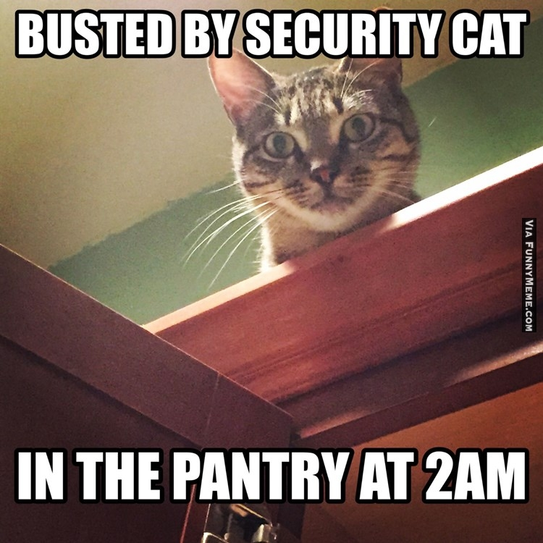
Part Three: Examples of Reference Monitors

Slide 27
CFI: control-flow integrity
[Abadi et al.]
Slide source: Vitaly Shmatikov
Main idea: pre-determine control flow graph (CFG) of an application
Static analysis of source code
Static binary analysis ← CFI
Execution profiling
Explicit specification of security policy
Execution must follow the pre-determined control flow graph

Slide 28
CFI: Binary Instrumentation
Slide source: Vitaly Shmatikov
Use binary rewriting to instrument code with runtime checks
Inserted checks ensure that the execution always stays within the statically determined CFG
Whenever an instruction transfers control, destination must be valid according to the CFG
Goal: prevent injection of arbitrary code and invalid control transfers (e.g., return-to-libc)
Secure even if the attacker has complete control over the thread’s address space

Slide 29
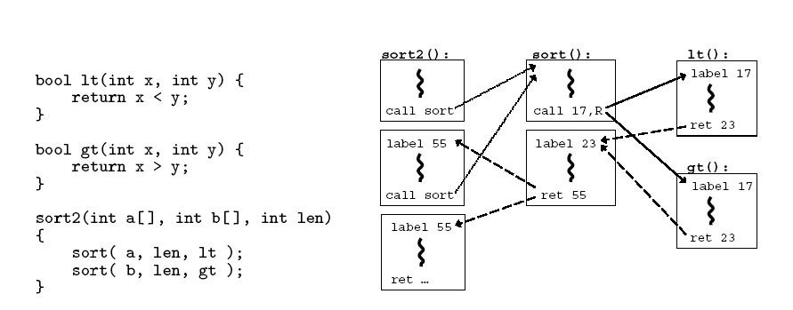
CFG Example
Slide source: Vitaly Shmatikov

Slide 30
CFI: Control Flow Enforcement
Slide source: Vitaly Shmatikov
For each control transfer, determine statically its possible destination(s)
Insert a unique bit pattern at every destination
Two destinations are equivalent if CFG contains edges to each from the same source
This is imprecise (why?)
Use same bit pattern for equivalent destinations
Insert binary code that at runtime will check whether the bit pattern of the target instruction matches the pattern of possible destinations

Slide 31
CFI: Example of Instrumentation
Slide source: Vitaly Shmatikov
Original code
Instrumented code
Abuse an x86 assembly instruction to
insert “12345678” tag into the binary
Jump to the destination only if
the tag is equal to “12345678”

Slide 32
CFI: Preventing Circumvention
Slide source: Vitaly Shmatikov
Unique IDs
Bit patterns chosen as destination IDs must not appear anywhere else in the code memory except ID checks
Non-writable code
Program should not modify code memory at runtime
What about run-time code generation and self-modification?
Non-executable data
Program should not execute data as if it were code
Enforcement: hardware support + prohibit system calls that change protection state + verification at load-time

Slide 33
CFI: Security Guarantees
Slide source: Vitaly Shmatikov
Effective against attacks based on illegitimate control-flow transfer
Stack-based buffer overflow, return-to-libc exploits, pointer subterfuge
Does not protect against attacks that do not violate the program’s original CFG
Incorrect arguments to system calls
Substitution of file names
Other data-only attacks

Slide 34
WIT: Write Integrity Testing
[Akritidis et al.]
Slide source: Vitaly Shmatikov
Combines static analysis …
For each memory write, compute the set of memory locations that may be the destination of the write
For each indirect control transfer, compute the set of addresses that may be the destination of the transfer
“Color table” assigns matching colors to instruction (write or jump) and all statically valid destinations
Is this sound? Complete?
… with dynamic enforcement
Code is instrumented with runtime checks to verify that destination of write or jump has the right color

Slide 35
WIT: Write Safety Analysis
Slide source: Vitaly Shmatikov
Start with off-the-shelf points-to analysis
Gives a conservative set of possible values for each ptr
A memory write instruction is “safe” if…
It has no explicit destination operand, or destination operand is a temporary, local or global variable
Such instructions either modify registers, or a constant number of bytes starting at a constant offset from the frame pointer or the data segment (example?)
… or writes through a pointer that is always in bounds
How do we know statically that a pointer is always in bounds?
Safe instructions require no runtime checks
Can also infer safe destinations (how?)

Slide 36
WIT: Runtime Checks
Slide source: Vitaly Shmatikov
Statically, assign a distinct color to each unsafe write instruction and all of its possible destinations
What if some destination can be written by two different instructions? Any security implications?
Add a runtime check that destination color matches the statically assigned color
What attack is this intended to prevent?
Same for indirect (computed) control transfers
Except for indirect jumps to library functions (done through pointers which are protected by write safety)
How is this different from CFI? Hint: think RET address

Slide 37
WIT: Additional Protections
Slide source: Vitaly Shmatikov
Change layout of stack frames to segregate safe and unsafe local variables
Surround unsafe objects by guards/canaries
What attack is this intended to prevent? How?
Wrappers for malloc()/calloc() and free()
malloc() assigns color to newly allocated memory
free() is complicated
Has the same (statically computed) color as the freed object
At runtime, treated as an unsafe write to this object
Reset color of object to 0 – what attack does this prevent?
Several other subtle details and checks – read the paper!

Slide 38
WIT: Handling Libraries
Slide source: Vitaly Shmatikov
Basic WIT doesn’t work for libraries (why?)
Instead, assign the same, standard color to all unsafe objects allocated by library functions and surround them by guards
Different from the colors of safe objects and guards
Prevents buffer overflows
What attack does this not prevent?
Wrappers for memory copying functions
For example, memcpy() and strcpy()
Receive color of the destination as an extra argument, check at runtime that it matches static color

Slide 39
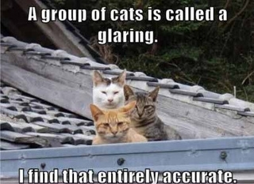
Part Four: A Group Exercise

Slide 40
Example from introduction
Desired safety property: Jean never goes on AOL Instant Messenger.
Enforcement mechanism: Operating system and browser enforce the policy.

Slide 41
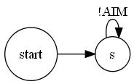
Security automata for example

Slide 42
Proving correct enforcement
Complete mediation.
Target control.
Isolation.

Slide 43
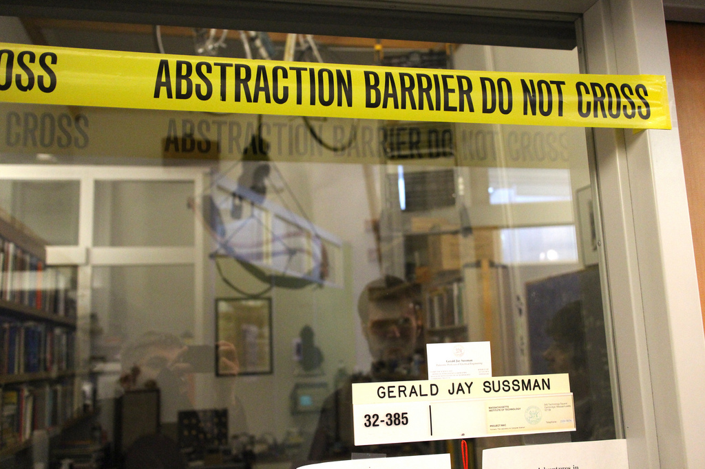
Discussion: levels of abstraction

Slide 44
Implementation plan?
Operating system?
Browser?
Other mechanisms of information release?

Slide 45
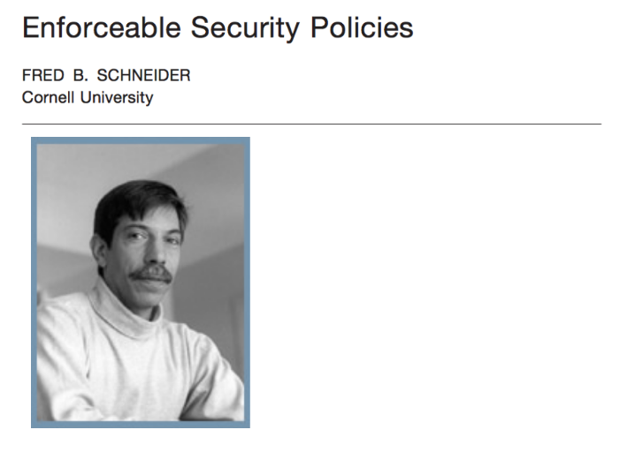
Further reading

Slide 46
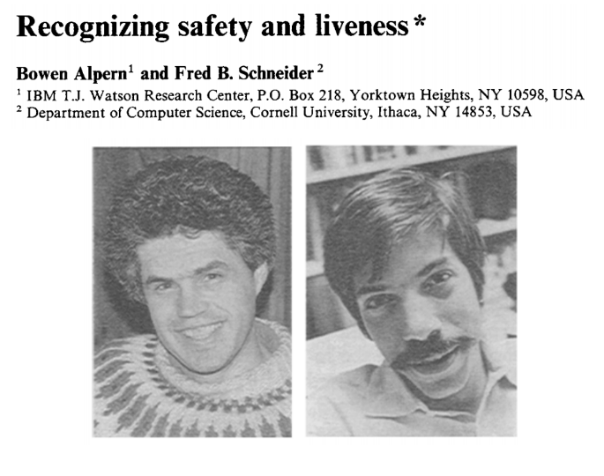
Further reading

