Slide 1
Software Foundations of Security and Privacy (15-316, spring 2017) Lecture 11: Information Flow (1)
Jean Yang
jyang2@andrew.cmu.edu

Slide 2

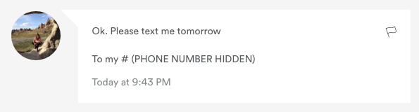
Goal: Keep Secrets Secret
Example courtesy of Chelsea Voss
Redacted by Airbnb
Airbnb has a policy of blocking phone numbers so communications happen through their application.
Notes:
The goal of software—or so we’d like—is to keep sensitive information private.
The website Airbnb, for turning your apartment into a temporary hotel, has added incentive to do this. As long as you don’t have the phone number of the person you’re contacting, you stay on their site.
A lot of the time, when you see a phone number, it will be redacted.
TRANSITION: This is the case when you view a message in its entirety, and also when you preview the message in your own email inbox.

Slide 3
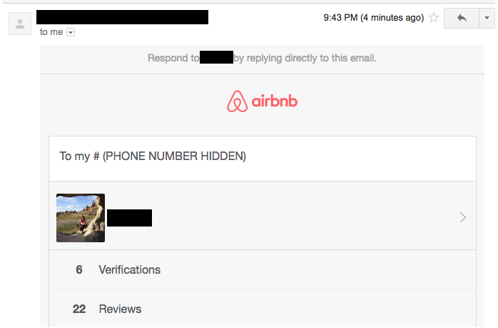
Redacting Phone Numbers…
Example courtesy of Chelsea Voss
Redacted by Airbnb
Phone number remains redacted in email view.
Notes:
This is the email that was sent to preview the message. Again, Airbnb redacted the number.
TRANSITION: The hard thing, however, is that the phone number can show up in so many places!

Slide 4
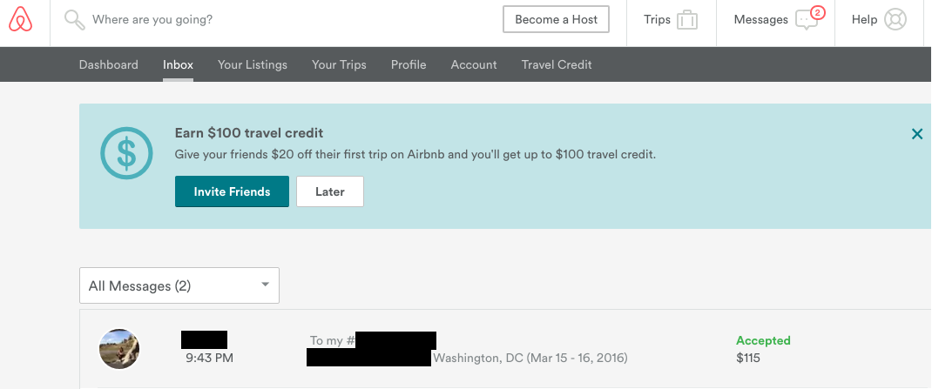
Missed a spot!
Example courtesy of Chelsea Voss
Actual phone number! Redacted by me and not Airbnb.
Phone number is visible in message preview.
Notes:
This is the screen for previewing messages.
Here, the number showed up directly!! (Though I redacted it.)
Airbnb tried very hard to prevent phone numbers from leaking, but it missed a spot.
TRANSITION: If we think about what goes into preventing leaks, this is not surprising.

Slide 5
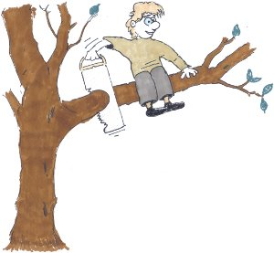
Main Takeaway
If companies can’t even protect information when their own financial interests are at stake, then we should be really afraid.

Slide 6

Alternative Takeaway
Companies don’t have the tools to prevent unauthorized information flows even when they are motivated to do so!

Slide 7
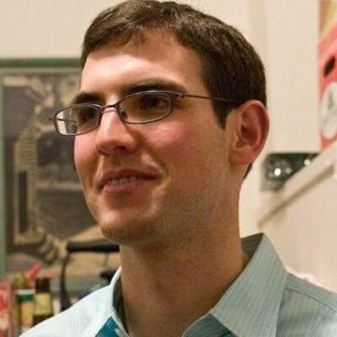
This Lecture: A Tribute to Max Krohn
Founded Thespark.com, OKCupid, and Keybase.
Built OKWS for OKCupid as a PhD student at MIT.
Continued using his research to make OKCupid’s backend better throughout his PhD.
@maxtaco on Twitter.

Slide 8

Part One: What’s Wrong with Access Control?

Slide 9
Problems with Access Control
Need to ensure the policy we are enforcing is the correct policy.
Need to ensure we are enforcing policy according to appropriate principles under appropriate conditions.
Who are we showing the sensitive information to?
What computations have we done with the sensitive data before showing it?

Slide 10
Limitations: Password Example
from: HotCRP
to: Eve
subject: Password Reminder
Dear Eve,
Alice’s password is [redacted].
<3, HotCRP

Slide 11
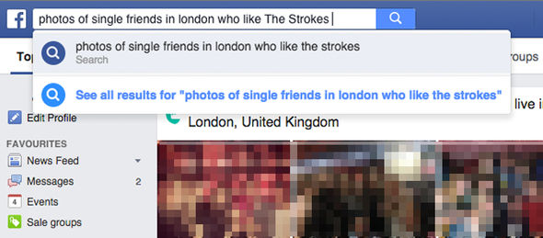
Limitations: Search Interface

Slide 12
Problem: Access Control Does Not Help Track Eventual Viewer
Ways viewer may be unpredictable:
Viewer determined by user input.
“Send mail to…”
Viewer computed from code.
Send to all users in a group.

Slide 13
Problem: Access Control Does Not Address Implicit Flows
int x := <secret>
if (x > 0) {
y := y+1;
}
Information flow from x to y!

Slide 14
Ways Implicit Flows May Arise
What are some examples where we could capture information flows indirectly?
Counting all users in a given location.
Showing someone’s photo in health record search results if some disease diagnosis is positive.

Slide 15
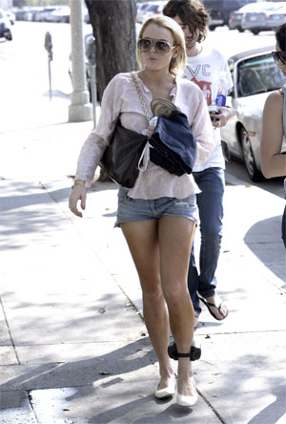
Goal: Track Sensitive Values
Want to allow program to compute over sensitive values more or less freely.
Want to prevent information from being released when there are unauthorized flows.
Lindsay Lohan with parole ankle bracelet.

Slide 16
Some Questions
What does access control give us?
With access control, what is trusted?
When isn’t access control enough?
What do we need to address the viewer problem and the problem of implicit flows?

Slide 17
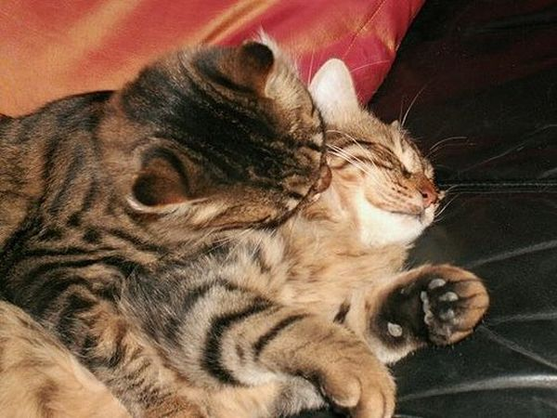

Part Two: Process Isolation with OKWS (Krohn 2004)

Slide 18
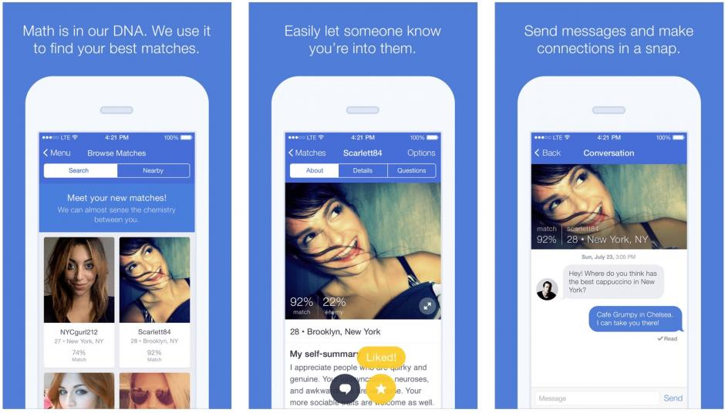
Real-World Motivation: Online Dating Involves Secrets

Slide 19
Solution Requirements
Needs to be able to run on Unix-based development server
Needs to support all of the desired features of a production web server
Needs to be fast enough to run OKCupid.com

Slide 20
Solution: Process Isolation
Run orthogonal services (for instance “search” and “inbox” in different processes.
This way, buffer overflow in “inbox” won’t affect “profile” or “search!”

Slide 21
Limitations
Building secure systems with Unix is challenging because tools such as setuid and chroot conflict with common web server features such as embedded Python/Perl interpreters
OKWS’s security promises remain weak: if Bob comprises “inbox,” can still read mail

Slide 22
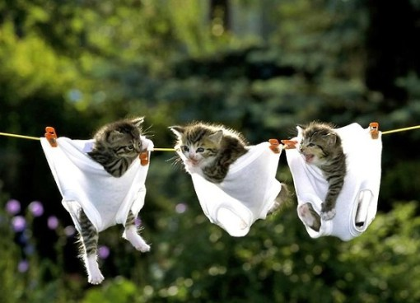
Part Three: Decentralized Information Flow Control with Flume (Krohn et al 2007)

Slide 23
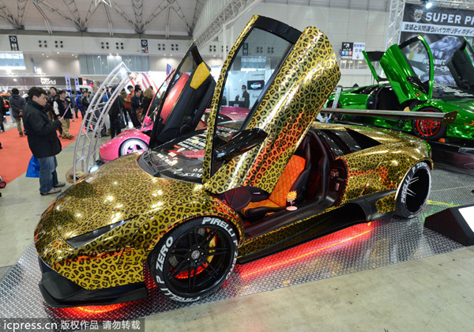
What If We Could Run On a Customized OS?

Slide 24
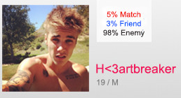

Decentralized Information Flow
Model for controlling information flow in systems with mutual distrust and decentralized authority. Sensitive data is labelled and can be declassified in a decentralized way.
Profile searches
Application
Label
Declassifier
“Likes”
Label

Slide 25
The Flume Operating System
Based on system call delegation. Bulit in user-space with a few small kernel patches on top of Linux and OpenBSD.
Regular OS
Flume OS
Web app
Web app
Flume ref. monitor
glibc
F. libc
Linux kernel
Linux kernel
“Likes”
“Likes”

Slide 26
Three Classes of Processes
Based on slide by Max Krohn
Flume-oblivious
Unconfined/mediators
Confined
Flume reference monitor
Flume reference monitor
Flume reference monitor
Process p
Process p
Process p
Linux kernel
Linux kernel
Linux kernel

Slide 27
Central Challenge
Accommodate process that use existing communication interfaces (for instance, socket and pipes) while specifying how and when they use their privileges.
Awkward to modify each call to read or write.
Conventional process interface full of channels that “leak” information, such as network sockets.

Slide 28
Solution: Labels + Endpoints
Label processes with what they are allowed to read and write.
Define how labels can be rewritten for declassification and endorsement.
Represent each communication resource (for instance sockets and files) as an endpoint that specifies what subset of its privileges should be used when communicating.

Slide 29
Two Types of Processes
Untrusted
Trusted
Do most of the computation.
Are constrained by, but possibly unaware of, DIFC controls.
Are aware of DIFC.
Set up privacy and integrity controls that constrain untrusted processes.
Have privilege to selectively violate classical information flow through declassification and endorsement.

Slide 30
Simple Label System
Goal: track which secrets a process has accessed.
Mechanism: each process gets a secrecy label summarizing the categories of data a process is assumed to have accessed.
{ “Likes” }
{ “Financial reports” }
{ “Likes” and “15-316 grades” }
Tag
Label

Slide 31
Some Nomenclature
Confidentiality: protecting sensitive reads.
When should a process be “authorized?”
Encryption provides end-to-end confidentiality, but it’s difficult to compute on encrypted data
Integrity: protecting sensitive writes.
Only authorized processes can write a file
Digital signatures provide end-to-end integrity, but cannot change signed data

Slide 32
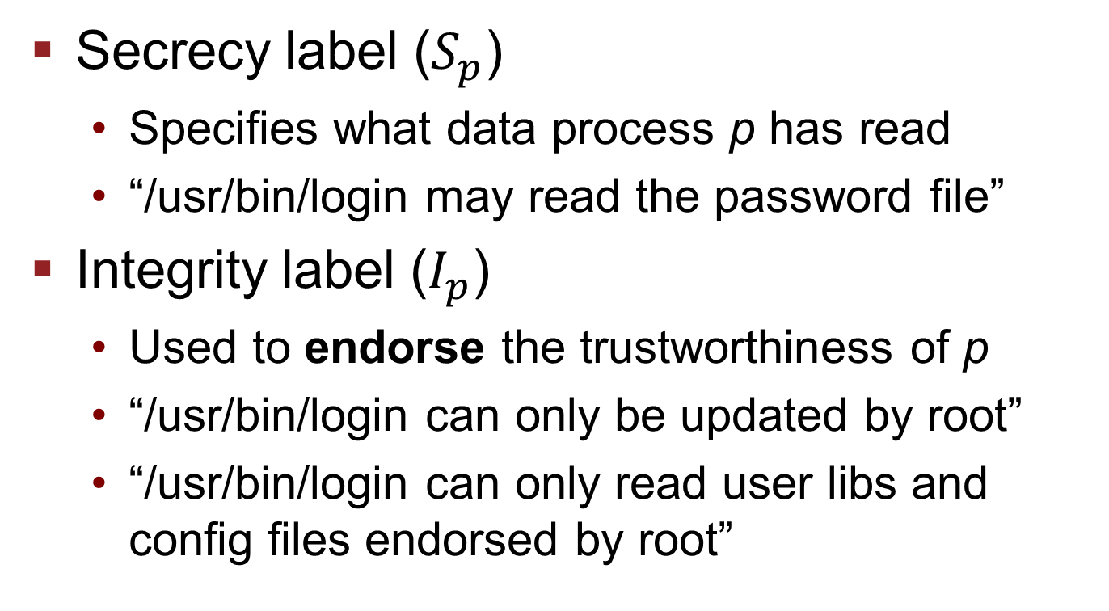
Confidentiality and Integrity
Secrecy label ($S_{p}$)
Specifies what data process p has read
“/usr/bin/login may read the password file”
Integrity label ($I_{p}$)
Used to endorse the trustworthiness of p
“/usr/bin/login can only be updated by root”
“/usr/bin/login can only read user libs and config files endorsed by root”

Slide 33
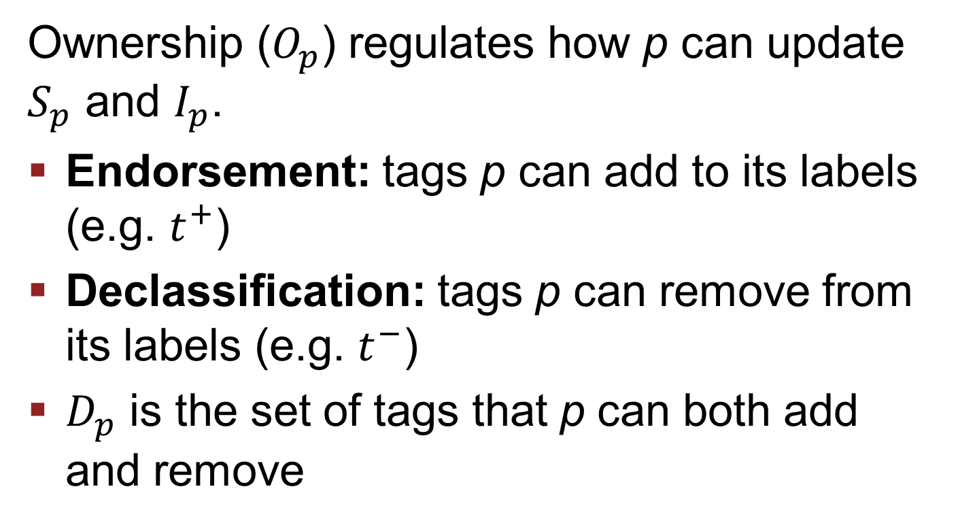
Privilege
Ownership ($O_{p}$) regulates how p can update $S_{p}$ and $I_{p}$.
Endorsement: tags p can add to its labels (e.g. $t^{+}$)
Declassification: tags p can remove from its labels (e.g. $t^{−}$)
$D_{p}$ is the set of tags that p can both add and remove

Slide 34
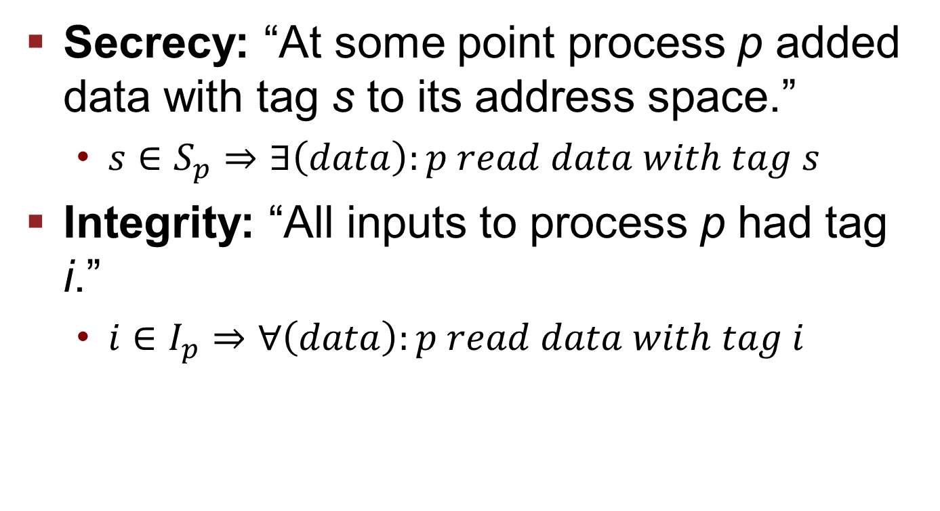
Secrecy and Integrity, More Formally
Secrecy: “At some point process p added data with tag s to its address space.”
$s∈S_{p}⇒∃\left(data\right):p read data with tag s$
Integrity: “All inputs to process p had tag i.”
$i∈I_{p}⇒∀\left(data\right):p read data with tag i$

Slide 35
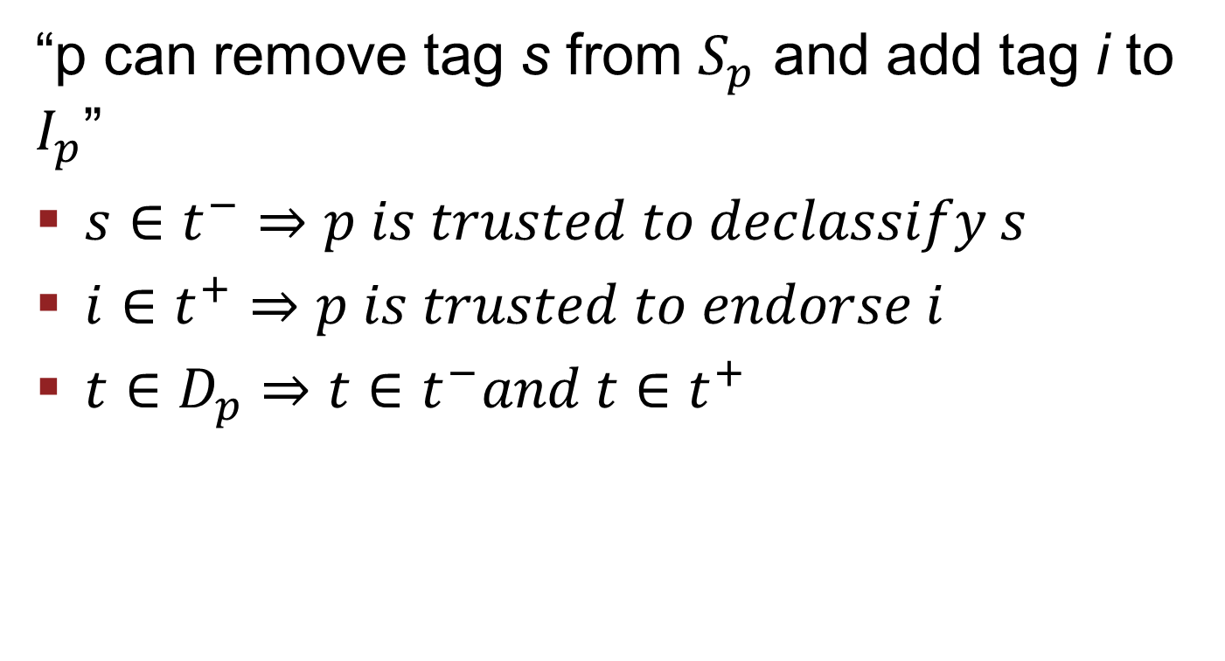
Privilege, More Formally
“p can remove tag s from $S_{p}$ and add tag i to $I_{p}$”
$s∈t^{−}⇒p is trusted to declassify s$
$i∈t^{+}⇒p is trusted to endorse i$
$t∈D_{p}⇒t∈t^{−}and t∈t^{+}$

Slide 36
Tags + Secrecy Labels
Based on slide by Max Krohn
Process p
change_label({Finance});
Secrets P has viewed
tag_t HR = create_tag();
change_label({});
Any process can add any tag to its label.
change_label({Finance,HR});
S_{p} = { Finance, HR }
S_{p} = { Finance }
S_{p} = {}
DIFC Rule: A process can create a new tag; gets ability to declassify it.
change_label({Finance});
D_{p} = {}
D_{p} = { HR }
Same as Step 1.
Tags P can add and remove from its label
DIFC: Declassification in action.
Finance
HR
Legal
Universe of Tags:
SecretProjects

Slide 37
Tags + Integrity Labels
Based on slide by Max Krohn
Process p
change_label({});
Endorsements of P
Any process can remove any tag from its label.
I_{p} = {Apple}
D_{p} = {}
Tags P can add and remove from its label
Finance
Legal
Universe of Tags:
Apple

Slide 38
Tags + Integrity Labels
Based on slide by Max Krohn
Process p
change_label({});
I_{p} = {}
D_{p} = {}
Finance
Legal
Universe of Tags:
Apple

Slide 39
Tags + Integrity Labels
Based on slide by Max Krohn
Process p
change_label({});
tag_t HR = create_tag();
change_label({Microsoft});
I_{p} = {}
D_{p} = {}
Finance
Legal
Universe of Tags:
Apple

Slide 40
Tags + Integrity Labels
Based on slide by Max Krohn
Process p
change_label({});
tag_t HR = create_tag();
I_{p} = {}
D_{p} = {}
Finance
Legal
Universe of Tags:
Apple

Slide 41
Tags + Integrity Labels
Based on slide by Max Krohn
Process p
change_label({});
tag_t HR = create_tag();
I_{p} = {}
DIFC Rule: A process can create a new tag; gets ability to endorse w/ it.
D_{p} = {HR}
Finance
HR
Legal
Universe of Tags:
Apple

Slide 42
Tags + Integrity Labels
Based on slide by Max Krohn
Process p
change_label({});
tag_t HR = create_tag();
change_label({HR});
I_{p} = {}
D_{p} = {HR}
Finance
HR
Legal
Universe of Tags:
Apple

Slide 43
Tags + Integrity Labels
Based on slide by Max Krohn
Process p
change_label({});
tag_t HR = create_tag();
change_label({HR});
I_{p} = {HR}
D_{p} = {HR}
DIFC: Endorsement in action.
Finance
HR
Legal
Universe of Tags:
Apple

Slide 44
Communication Rule
Based on slide by Max Krohn
P
Process p
Process q
S_{p} = { HR }
S_{q} = { HR, Finance }
p can send to q iff S_{p} ⊆ S_{q}

Slide 45
Flume Communication Rule
P
Based on slide by Max Krohn
?
?
Database (q)
MoinMoin (p)
MoinMoin (r)
S_{p} = { Alice }
S_{r} = { Bob }
S_{q} = {}
D_{q} = { Alice, Bob }
S_{q} = { Alice }
D_{q} = { Alice, Bob }
S_{p} ⊆ S_{q}
q changes to S_{q} = { Alice }
p sends to q
q changes back to S_{q}= {}

Slide 46
Flume Communication Rule
P
P
Based on slide by Max Krohn
Database (q)
MoinMoin (p)
MoinMoin (r)
S_{p} = { Alice }
S_{r} = { Bob }
S_{q} = {}
D_{q}= { Alice, Bob }
Senders get extra latitude
Receivers get extra latitude
p can send to q iff:
In IFC: S_{p} ⊆ S_{q}
In Flume: S_{p} – D_{p} ⊆ S_{q} ∪ D_{q}

Slide 47
The Unexpected Behavior Problem
Based on slide by Max Krohn
Process p
Process q
P
“Fire Alice, Bob, Charlie, Doug, Eddie, Frank, George, Hilda, Ilya…”
“I stopped reading”
“I crashed”
Exposing failure messages can leak information!

Slide 48
The Unexpected Behavior Problem
Based on slide by Max Krohn
Process p
Process q
stdout
stdin
S_{p} = {}
D_{p} = { HR }
S_{q} = { HR }
P
“Fire Alice, Bob, Charlie, Doug, Eddie, Frank, George, Hilda, Ilya…”
?
“SLOW DOWN!!”
“I crashed”
Slide by Max Krohn

Slide 49
Solution: Endpoint Abstraction
Based on slide by Max Krohn
Process p
Process q
e
f
S_{e} = { HR }
S_{f} = { HR }
S_{p} = {}
D_{p} = { HR }
S_{q} = { HR }
P
If S_{e} ⊆ S_{f} , then allow e to send to f
If S_{f} ⊆ S_{e} , then allow f to send to e
If S_{f} = S_{e} , then allow bidirectional flow
“Fire Alice, Bob, Charlie, Doug, Eddie, Frank, George, Hilda, Ilya…”
P
“SLOW DOWN!!”
“I crashed”

Slide 50
Benefits of Endpoints
Simplifies application programming. When a process attempts and fails to adjust labels on its endpoints, system can safely report errors.
Make many declassification and endorsement decisions explicit. Flume processes must explicitly mark file descriptors that serve as avenues for declassification/endorsement.

Slide 51
Endpoints Declassify Data
Based on slide by Max Krohn
Data enters process p with secrecy { HR }
Process p
But p keeps its label S_{p} = {}
e
S_{e} = { HR }
S_{p} = {}
D_{p} = { HR }
Thus p needs
HR ∈ D_{p}
Slide by Max Krohn

Slide 52
Endpoint Invariant
Based on slide by Max Krohn
Export inf.
For any tag t ∈ S_{p} and t ∉ S_{e}
Or any tag t ∈ S_{e} and t ∉ S_{p}
It must be that t ∈ D_{p}
Import inf.
Process p
e
S_{e} = { HR }
S_{p} = { Finance }
D_{p} = { Finance, HR}

Slide 53
Endpoints Labels Are Independent
Based on slide by Max Krohn
g
S_{g} = {}
Process p
Process q
e
f
S_{e} = { HR }
S_{f} = { HR }
S_{p} = {}
D_{p} = { HR }
S_{q} = { HR }

Slide 54
Evaluation
Based on slide by Max Krohn
Does Flume allow adoption of Unix software?
1,000 LOC launcher/declassifier
1,000 out of 100,000 LOC in MoinMoin changed
Python interpreter, Apache, unchanged
Does Flume solve security vulnerabilities?
Without our knowing, MoinMoin wiki case studies inherited two ACL bypass bugs from MoinMoin
Both are not exploitable in Flume’s MoinMoin
Does Flume perform reasonably?
Performs within a factor of 2 of the original on read and write benchmarks
Slide by Max Krohn

Slide 55
Limitations
Based on slide by Max Krohn
Bigger TCB than HiStar / Asbestos
Linux stack (Kernel + glibc + linker)
Reference monitor (~22 kLOC)
Covert channels via disk quotas
Confined processes like MoinMoin don’t get full POSIX API.
spawn() instead of fork() & exec()
flume_pipe() instead of pipe()
Slide by Max Krohn

Slide 56

Part Four: How Do We Have a Reference Monitor for IFC?

Slide 57
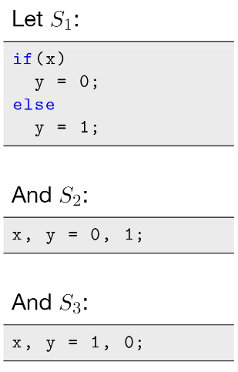
Recall: Information Flow Isn’t EM-Enforceable
Recall that we can only distinguish between these three programs if we can choose two values for x.
Information flow is a hyperproperty.
Information flow is a 2-safety property that is finitely refutable over pairs of traces.

Slide 58
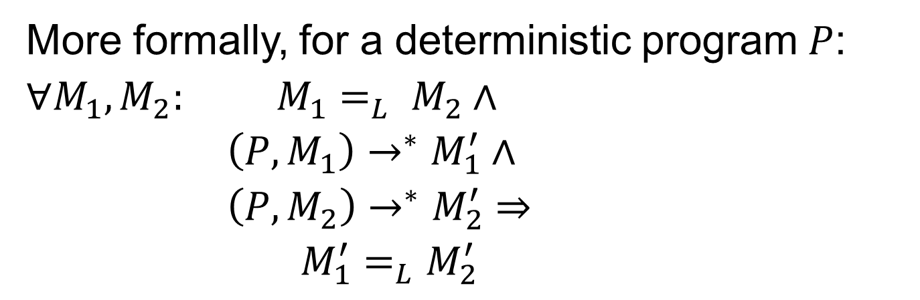
Desired Guarantee
Non-interference: observable program behavior should not depend on confidential data.
More formally, for a deterministic program $P$:
$∀M_{1},M_{2}:$ $M_{1}=_{L} M_{2}∧$
$\left(P, M_{1}\right)→^{∗}M_{1}^{′}∧$
$\left(P, M_{2}\right)→^{∗}M_{2}^{′}⇒$
$M_{1}^{′}=_{L}M_{2}^{′}$
Low-confidentiality projections of initial memory are equivalent.
Low-confidentiality projections of result memory are equivalent.

Slide 59
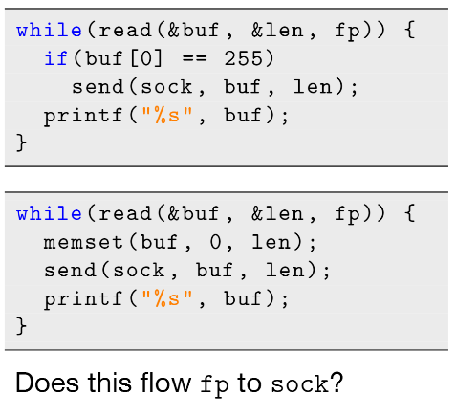
But Also Recall!
We discussed “no send after read” policy earlier.
Ideally want to prevent fp from flowing into sock.
But second program does not flow fp into sock! Check was conservative.

Slide 60
“Platonic” Information Flow is Fine-Grained!
Things that should be allowed under our definition of non-interference:
Sensitive value gets sent to process, but it doesn’t actually use it.
Sensitive value gets sent to process and it uses it, but doesn’t send it out across a specific endpoint.

Slide 61
So What Is Flume Doing?
Flume overapproximates programs that can leak information.
Flume tracks information flow at the process level, rather than at the granularity of individual reads/writes.
Question: What flows does Flume prevent, that may be otherwise allowed?

Slide 62
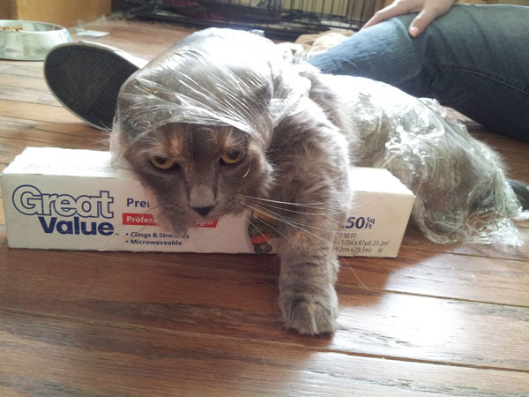
Part Five: Wrapping Up on Coarse-Grained IFC

Slide 63
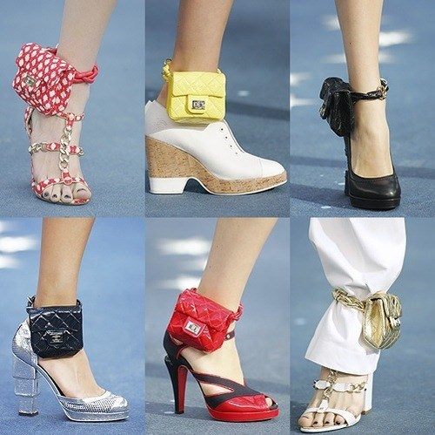
Information Flow Involves Tracking Across the Program
In a DIFC system, it is not only sensitive values that are tracked, but any value whose value depends on a sensitive value. Tracking becomes very fashionable!
Internet joke about how Lindsay Lohan tried to cover up her bracelet.

Slide 64
Granularity Matters
Precise information flow is not a safety property.
We can, however, overapproximate information flow using reference monitors.
There are tradeoffs between precision of tracking and programmer/runtime overhead!

Slide 65
Discussion Questions
How does access control fall short? (Why do we need information flow?)
What are the tradeoffs of the label abstraction? The endpoint abstraction?
What are the tradeoffs of using DFIC systems in general?
How do the techniques we learned about prevent the leaks we discussed?
Notes:
Label systems are complex
Unexpected program behavior
Cannot reuse existing code
Drivers
SMP support
Standard libraries

