Slide 1
Software Foundations of Security and Privacy (15-316, spring 2017) Lecture 6: Sandboxing and Software Fault Isolation
Jean Yang
jyang2@andrew.cmu.edu
With material from Brad Karp

Slide 2
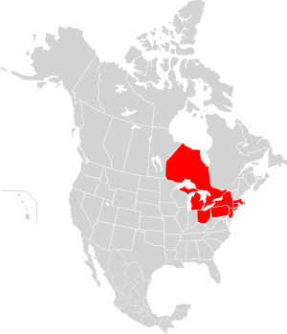
Northeast Blackout of 2003
Affected estimated 10 million people in Ontario and 45 million people in 8 US states.
Primary cause was software bug in alarm system at control room of FirstEnergy Co.
Operators were not aware of need to redistribute power, triggering race condition on control software.

Slide 3
Cascading Failure on the Grid
“Unprocessed events queued up after the alarm system failure and the primary server failed within 30 minutes. Then all applications (including the stalled alarm system) were automatically transferred to the backup server, which itself failed at 14:54. The server failures slowed the screen refresh rate of the operators' computer consoles from 1–3 seconds to 59 seconds per screen. The lack of alarms led operators to dismiss a call from American Electric Power about the tripping and reclosure of a 345 kV shared line in northeast Ohio. But by 15:42, after the control room itself lost power, control room operators informed technical support (who were already troubleshooting the issue) of the alarm system problem.”
- Technical Analysis of the August 14, 2003, Blackout

Slide 4

Part One: Sandboxing Software

Slide 5
Existential Threat: Untrusted Code
Material from Brad Karp
Goal: be able to run code from untrusted sources without invoking complete disaster.
Sources of untrusted programs: browser plugins (e.g. Flash plugin); software packages (e.g. binary kernel module for Linux).
Key risk: code from untrusted source will run in your application’s address space.

Slide 6
Risks of Running Untrusted Code
Material from Brad Karp
Overwrites trusted data or code
Reads private data from trusted code’s memory
Executes privileged instructions
Calls trusted functions with bad arguments
Jumps to middle of trusted functions
Contains vulnerabilities allowing others to do above

Slide 7

Running Lesson of the Course….
Using low-level languages like C is dangerous!

Slide 8
Ways to Mitigate Dangers of C
Using memory-safe languages
Bounds checking (reference monitor)
Verifying programs
Preventing bugs from spreading too far (sandboxing)
Today’s lecture!

Slide 9
Allowed Operations for Untrusted Code
Material from Brad Karp
Reads/writes own memory
Executes own code
Calls explicitly allowed functions in trusted code, at correct entry points

Slide 10
Solution: Sandboxing
Each application runs in its own process, with its own system resources.
There is a tight permissions framework that regulates which apps get access to data produced by other apps.
Usually restricts behaviors such as network access, inspecting the host system, and reading from input devices.

Slide 11
Example: Android
Material from John Mitchell
Isolation
Multi-user Linux operating system
Each application normally runs as different user
Communication between applications
May share same Linux user ID
Access files from each other
May share same Linux process and Dalvik VM (Java platform)
Communicate through application framework

Slide 12
Android Application Sandbox
Material from John Mitchell
Each application runs with its UID in its own Dalvik virtual machine
Provides CPU protection, memory protection
Authenticated communication protection using Unix domain sockets
Only ping, zygote (spawn another process) run as root
Applications announce permission requirement
Create a whitelist model – user grants access (all questions asked at compile time)
Inter-component communication reference monitor checks permissions

Slide 13
Example Android Permissions
Material from John Mitchell
“android.permission.INTERNET”
“android.permission.READ_EXTERNAL_STORAGE”
“android.permission.SEND_SMS”
“android.permission.BLUETOOTH”
Bad things happen when applications get more permissions than they are supposed to!

Slide 14
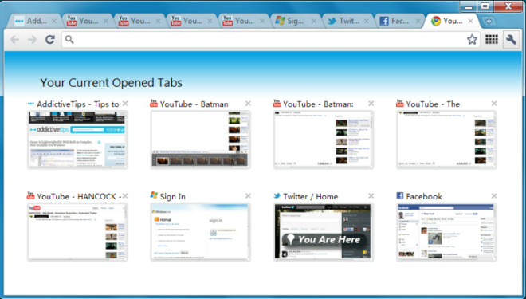
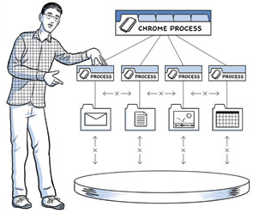
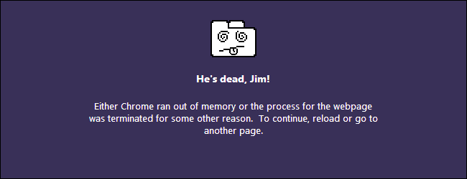
Example: Chrome
The Chrome browser is full of sandboxes! Processes, plugins, and more…

Slide 15
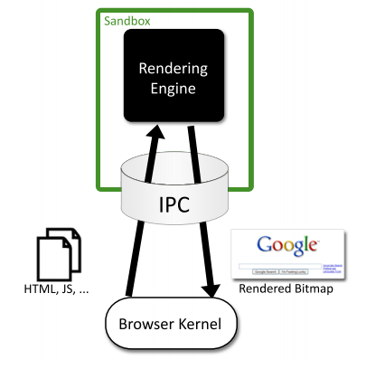
Chromium Security Model
Separate instance of rendering engine for each tab that displays content from the web.
Each plug-in runs in separate host process, outside both rendering engines and browser kernel.

Slide 16
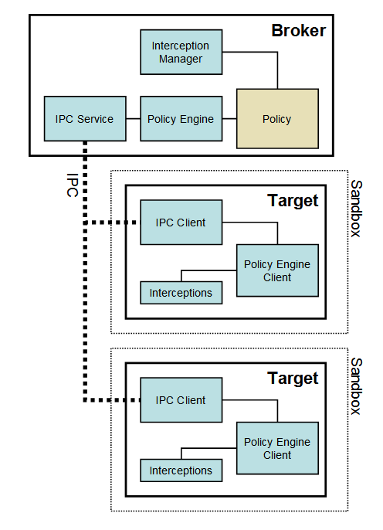
Chromium on Windows
Uses OS-provided security to contain code execution.
Principle of least privilege: sandbox works even if user cannot elevant to super-user.
Limits severity of bugs: cannot install persistent malware; cannot read and steal arbitrary files.

Slide 17
Chromium on Windows (2)
Broker Process Responsibilities
Target Process Architecture
Specify policy for each target process
Spawn target processes
Host sandbox policy engine service
Host sandbox interception manager
Host sandbox IPC service
Perform policy-allowed actions on behalf of target processes
All code to be sandboxed
Sandbox IPC client
Sandbox policy engine client
Sandbox interceptions

Slide 18
Problems with Extensions and Separate Processes
Material from Brad Karp
Not very transparent for programmer if application and extension are closely coupled
Performance hit: need context switches between processes
Trap to kernel, copy arguments, save and restore registers, flush processor’s TLB

Slide 19
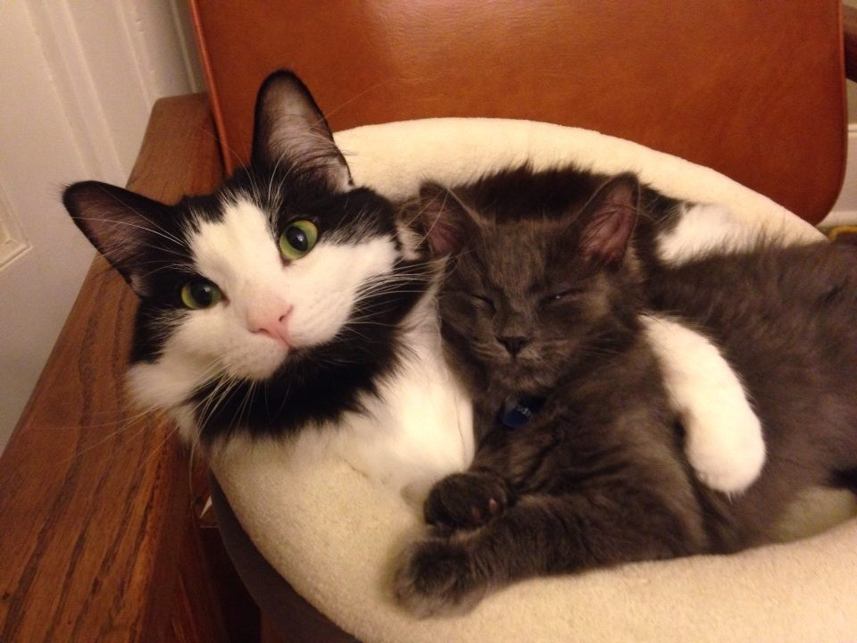
Part Two: Running Untrusted Code in the Same Process

Slide 20
Solution: Software Fault Isolation
Material from Brad Karp
Place extension’s code and data in sandbox:
Prevent extension’s code from writing to app’s memory outside sandbox
Prevent extension’s code from transferring control to app’s code outside sandbox
Main idea: add instructions between memory writes and jumps to inspect targets and constrain behavior

Slide 21
SFI Use Scenario
Material from Brad Karp
Developer runs sandboxer on unsafe extension code to produce safe, sandboxed version:
Adds instructions that sandbox unsafe instructions
Transformation by compiler or binary rewriter
Before running untrusted binary code, user runs verifier:
Checks that safe instructions don’t access memory outside extension code’s data
Checks that sandboxing instructions in place before all unsafe instructions

Slide 22
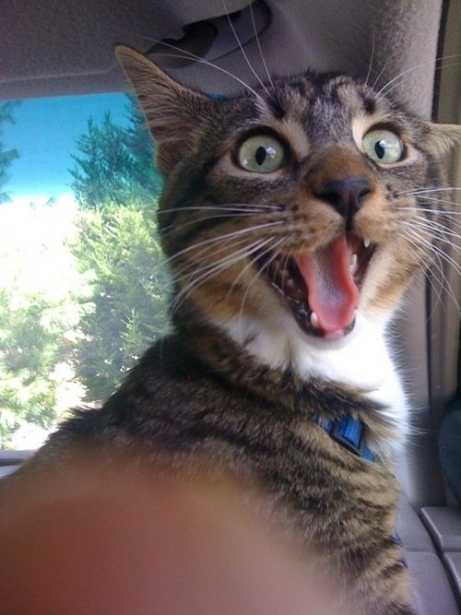
What Is Trusted?
Only the verifier!

Slide 23
Unit of Isolation: Fault Domain
Material from Brad Karp
SFI confines untrusted code within a fault domain, in same address space (process) as trusted code
Fault domain consists of:
Unique ID (for access control on syscalls)
Code segment: virtual address range with same unique high-order bits, used to hold code
Data segment: virtual address range with same unique high-order bits, used to hold data

Slide 24
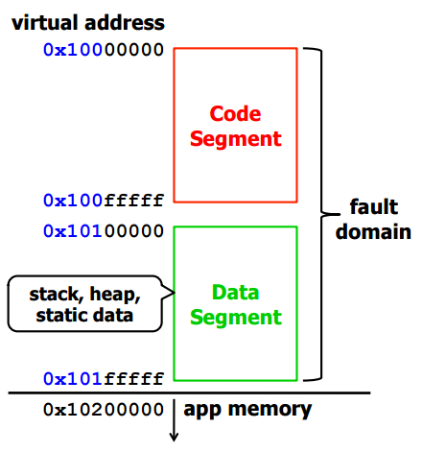
Fault Domain Example
Material from Brad Karp
Segment IDs are 12 bits long
Separate segments for code and data allow distinguishing addresses as falling in one or other

Slide 25
Sandboxing Memory
Material from Brad Karp
Untrusted code should only be able to:
Jump within its fault domain’s code segment
Write within its fault domain’s data segment
Sandboxer must ensure all jump, call, and memory store instructions comply.
Two types of memory address in instructions:
Direct: complete address is specified statically in instruction
Indirect: address computed from register’s value

Slide 26
Sandboxing Memory (2)
Material from Brad Karp
For directly addressed memory instructions, sandboxer should only emit:
Directly addressed jumps and calls whose targets fall in fault domain’s code segment
Directly addressed stores whose targets fall in fault domain’s data segment
Directly addressed jumps, calls, stores can be made safe statically

Slide 27
Indirectly Accessed Memory
Material from Brad Karp
Indirectly addressed jumps, calls, stores harder to sandbox—full address depends on register whose value is not known statically
e.g. STORE R0, R1
e.g. JR R3
These are unsafe instructions that must be made safe at runtime

Slide 28
Indirectly Accessed Memory (2)
Material from Brad Karp
Unsafe Instruction
Sandboxer output
STORE R0, R1
MOV Ra, R0
SHR Rb, Ra, Rc
CMP Rb, Rd
BNE fault
STORE Ra, R1
; copy R0 into Ra
; Rb = Ra >> Rc
; Rd holds data
; segment ID
; wrong data segment ID
; Do write
Ra, Rc, and Rd are dedicated registers that may not be used by extension code. Rd holds data segment ID.

Slide 29
Indirectly Accessed Memory (3)
Material from Brad Karp
Why does the rewritten code use STORE Ra, R1 and not STORE R0, R1? After all, R0 has passed the check!
But extension code may jump directly to STORE, bypassing check instructions!
Because Ra, Rc, Rd are dedicated, Ra will always contain a safe address inside the data segment.

Slide 30
Indirectly Accessed Memory (4)
Material from Brad Karp
Costs of first sandboxing scheme for indirectly addressed memory:
Adds 4 instructions before each indirect store
Uses 6 registers, 5 of which must be dedicated (never available to extensions)
Can we do better, and get away with fewer added instructions?
Yes, if we give up being able to identify which instruction access outside sandbox!

Slide 31
Faster Sandboxing of Indirect Addresses
Material from Brad Karp
Idea: instead of checking whether target address is in segment, force it to be in segment
Transform STORE R0, R1 into:
AND Ra, R0, Re ; clear segment ID bits in Ra
OR Ra, Ra, Rf ; set segment ID to correct value
STORE Ra, R1 ; do write to safe target address
Now segment ID bits in Ra will always be correct: can write anywhere in segment, but not outside it
Cost: 2 added instructions; 5 dedicated registers

Slide 32
Faster Sandboxing of Indirect Jumps and Calls
Material from Brad Karp
Transform JR R0 as follows:
AND Rg, R0, Re ; clear segment ID bits in Rg
OR Rg, Rg, Rh ; set segment ID
JR Rg ; do jump to safe target address
Note use of separate dedicated registers Rg for code target address, Rh for code segment ID
Return from function similar (to sandbox return address)

Slide 33
Optimization: Guard Zones
Material from Brad Karp
Some instructions use “register+offset” addressing: use register as base and offset for CPU to add to it
To sandbox such an instruction, SFI would need to do additional ADD to compute base+offset
Insight: offsets are of limited size, so if base correct, offset could stray no more than 64K outside that segment

Slide 34
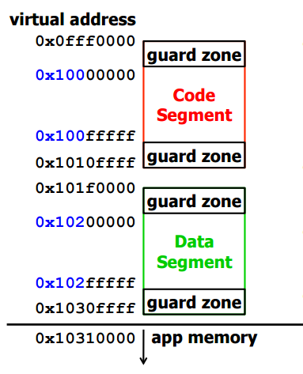
Guard Zones (2)
Material from Brad Karp
Surround each segment with 64K guard zone of unmapped pages.
Ignore offsets when sandboxing.
Accesses to guard zones cause traps!

Slide 35
Optimization: Stack Pointer
Material from Brad Karp
Insight: stack pointer is read far more often than it’s written—used as base address for many reg+offset instructions
SFI doesn’t sandbox uses of stack pointer as base address; instead sandboxes setting of stack pointer, so stack pointer always contains safe value
Reduces number of instructions that pay sandboxing overhead

Slide 36
Verifier
Material from Brad Karp
For instructions that use direct addressing, easy to check statically that segment IDs in addresses are correct
For those that use indirect addressing, verifier must ensure instruction preceded by full set of sandboxing instructions
Ensures no privileged instructions in code
Ensures PC-relative branches fall in code segment

Slide 37
SFI vs. Exploits
Material from Brad Karp
Exploit | SFI Protection
Stack-smashing (injecting code into stack buffer)
Return-to-libc
Format string vulnerabilities
Can’t execute own injected code—can’t jump to data segment
Can overwrite return address with one within fault-domain’s code segment—so can return-to-libc within extension
“”

Slide 38
But… SFI Limitations on x86
Material from Brad Karp
MIPS instructions fixed-length while x86 instructions are variable-length
Result: can jump into middle of x86 instruction!
Consider the binary for AND eax, 0x00CD, which is 25 CD 80 00 00. If adversary jumps to second byte, they execute CD 8, which traps to a system call on Linux!
Jump to mid-instruction on x86 may even jump out of fault domain into app code! :o
Also, x86 has very few registers, so cannot dedicate registers easily

Slide 39
SFI vs. Exploits: Lessons
Material from Brad Karp
SFI allows write (including buffer overrun, %n overwrite) to extension’s data
SFI allows jumps anywhere in extension’s code segment
…so attacker can exploit extension’s execution
…and on x86, can probably cause jump out of fault domain
SFI was not designed to prevent exploits, but rather to isolate untrusted extension!

Slide 40
SFI in the Wild: NaCl
Material from Brad Karp
Native Client (“NaCl”) is:
A sandbox for untrusted x86 native code
A browser-based framework designed to:
Allow browser-based applications to have the performance of native applications
Provide OS portability
Provide performance-oriented features such as threading, instruction set extensions, compiler intrinsics, and hand-coded assembly

Slide 41
SFI Summary
Material from Brad Karp
Confines writes and control transfers in extension’s data and code segments
Can support direct calls to allowed functions in trusted (app) code
Prevents execution of privileged instructions
Any write or control transfer within extensions memory is allowed
Requires dedicated registers

Slide 42
Summary: Motivations for SFI
Initial motivation was performance: can achieve memory protection at low cost.
Running programs without suitable protection in hardware.
Programs that support plug-ins.
Programs comprising many objects.

Slide 43
For Want of a Nail
For want of a nail the shoe was lost. For want of a shoe the horse was lost. For want of a horse the rider was lost. For want of a rider the message was lost. For want of a message the battle was lost. For want of a battle the kingdom was lost. And all for the want of a horseshoe nail.
Software Fault Isolation: When you lose a nail, you only lose your shoe.

Slide 44
Discussion Questions
When might you want to use software fault isolation, as to other kinds of reference monitoring?
What guarantees do we get from software fault isolation?
What guarantees don’t we get?
How can SFI still be useful if we can sandbox faster and faster?

