Slide 1
Software Foundations of Security and Privacy (15-316, spring 2017) Lecture 12: Information Flow (2)
Jean Yang
jyang2@andrew.cmu.edu

Slide 2
Last Class
Motivation for why we need more than access control.
Process-based decentralized information flow control.
How we can make reference monitors for information flow, even though it’s not a safety property.

Slide 3


Recall DIFC
Model for controlling information flow in systems with mutual distrust and decentralized authority. Sensitive data is labelled and can be declassified in a decentralized way.
Profile searches
Application
Label
Declassifier
“Likes”
Label

Slide 4
Problems with Dynamic DIFC
Non-trivial runtime overheads.
Required to be conservative, because can only make reference monitors for safety properties.
Conservative requires us to have all these trusted declassifications all over the place.

Slide 5


What We Want
Fine-grained information flow analysis that gives us non-interference.
As little run-time overhead as possible.
A way to get some static guarantees before we run our programs.
Information flow types give us all of this!

Slide 6

Part One: High-Level Introduction to Language-Level Information Flow Control

Slide 7
Information Flow in Java with Jif
[Myers]
Jif augments Java types with labels that are statically checked*.
int {Alice:Bob} x;
Object {L} o;
Subtyping with the ⊆ lattice order determines how differently-labeled values should be combined.
Type inference allows programmers to omit types.
* Over the years, there has been work to insert additional dynamic checks.

Slide 8
Hello Labels, My Old Friend
Slide from Vitaly Schmatikov.
Confidentiality constraints: who may read it?
{Alice: Bob, Eve} label means that Alice owns this data, and Bob and Eve are permitted to read it
{Alice: Charles; Bob: Charles} label means that Alice and Bob own this data but only Charles can read it
Integrity constraints: who may write it?
{Alice ? Bob} label means that Alice owns this data, and Bob is permitted to change it

Slide 9
Labels and Flow
int {Alice:Bob} x;
int {Alice:Bob, Charles} y;
x = y;
y = x;
// Okay, because policy on x is stronger
// Bad, because policy on y is weaker
Each owner can specify an independent policy.
Code running with owner authority can declassify data by adding more permissions.
When a value is read from a slot, it acquires the slot’s label.

Slide 10
What About Combining Values?
int {Alice:Bob} x;
int {Alice:Bob, Charles} y;
int {??} z;
z = x + y;
Q: What label does z need in order for this flow to be allowed?
A: {Alice: Bob}, the more restrictive label.

Slide 11
Label Lattice
Slide from Vitaly Schmatikov.
T
⊆ order
…
…
…
…
∪ join
{Alice:}
Labels higher in
the lattice are more restrictive
…
{Alice:Bob}
…
∪
…
{Alice:Bob,Charles}
{Alice: Bob,Eve}
…
{}

Slide 12
Challenge: Implicit Flows
[Zdancewic]
Slide from Vitaly Schmatikov.
{Alice:; Bob:}
int{Alice:} a;
int{Bob:} b;
...
{Alice:}
{Bob:}
PC label
{}
{}
{}∪{Alice:}={Alice:}
{}
if (a > 0) then {
b = 4;
}
This assignment leaks information contained in program counter (PC)

Slide 13
Challenge: Implicit Flows
[Zdancewic]
Slide from Vitaly Schmatikov.
{Alice:; Bob:}
int{Alice:} a;
int{Bob:} b;
...
{Alice:}
{Bob:}
PC label
{}
{}
{}∪{Alice:}={Alice:}
{}
if (a > 0) then {
b = 4;
}
To assign to variable with label X, must have PC ⊆ X

Slide 14
Challenge: Implicit Flows
[Zdancewic]
Slide from Vitaly Schmatikov.
{Alice:; Bob:}
int{Alice:} a;
int{Bob:} b;
...
{Alice:}
{Bob:}
PC label
{}
{}
{}∪{Alice:}={Alice:}
{}
if (a > 0) then {
f(4);
}
Effects inside function can leak information about program counter

Slide 15
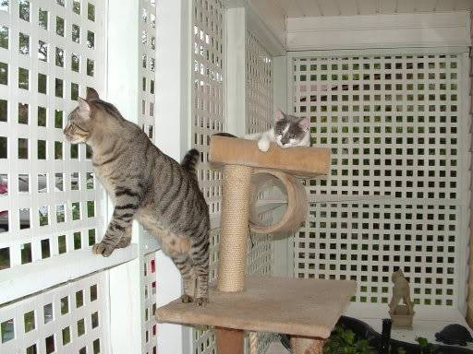
Part Two: Formalizing the Security Lattice

Slide 16
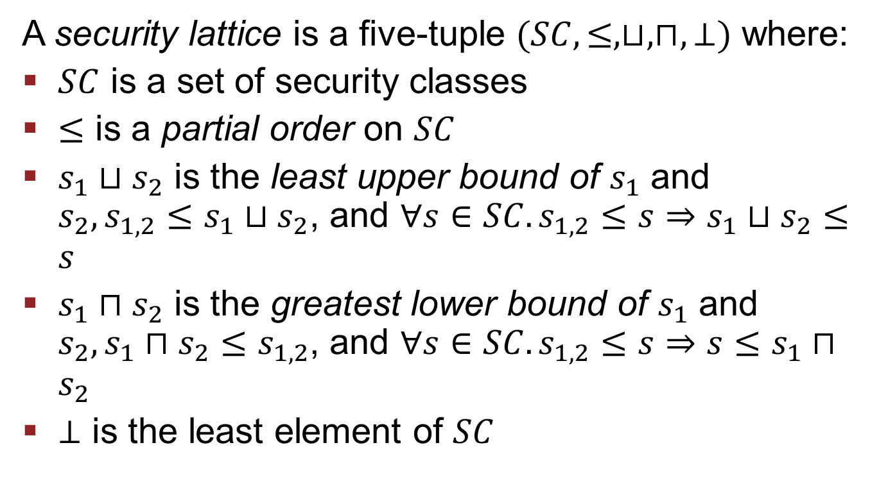
Security Lattice
Slide from Matt Fredrikson.
A security lattice is a five-tuple $(SC, ≤, ⊔, ⊓, ⊥)$ where:
$SC$ is a set of security classes
$≤$ is a partial order on $SC$
$s_{1}⊔s_{2}$ is the least upper bound of $s_{1}$ and $s_{2}, {s_{1,2}≤s}_{1}⊔s_{2}$, and ${∀s∈SC.s_{1,2}≤s⇒s}_{1}⊔s_{2}≤s$
$s_{1}⊓s_{2}$ is the greatest lower bound of $s_{1}$ and $s_{2}, s_{1}⊓s_{2}≤s_{1,2}$, and ${∀s∈SC.s_{1,2}≤s⇒s≤s}_{1}⊓s_{2}$
$⊥$ is the least element of $SC$

Slide 17

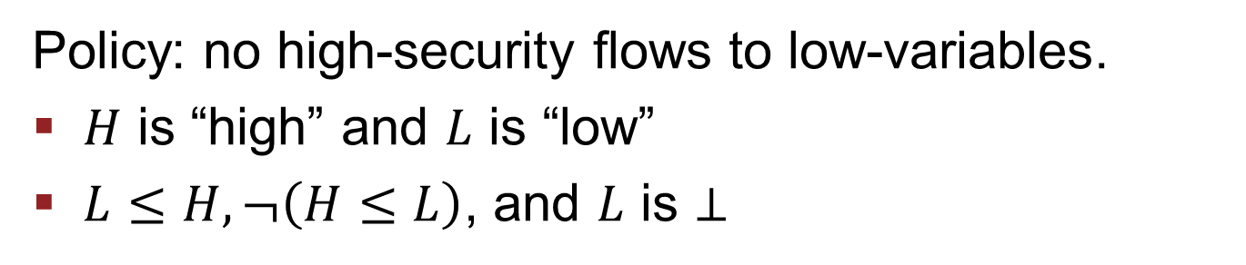

A Simple Lattice for Secrecy
Slide from Matt Fredrikson.
$$H$$
$$L$$
Policy: no high-security flows to low-variables.
$H$ is “high” and $L$ is “low”
$L≤H, ¬\left(H≤L\right)$, and $L$ is $⊥$
The partial order $≤$ means “can flow to.”

Slide 18

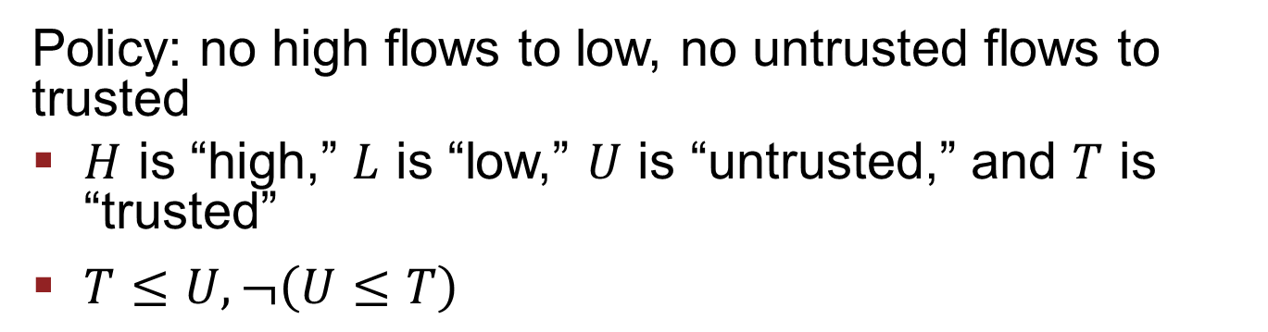



Secrecy and Integrity
Slide from Matt Fredrikson.
$$HU$$
$$LU$$
$$HT$$
$$LT$$
Policy: no high flows to low, no untrusted flows to trusted
$H$ is “high,” $L$ is “low,” $U$ is “untrusted,” and $T$ is “trusted”
$T≤U, ¬\left(U≤T\right)$

Slide 19
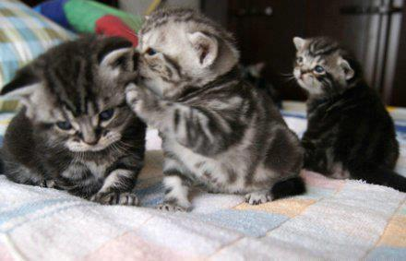
Part Three: A Type System for Information Flow

Slide 20
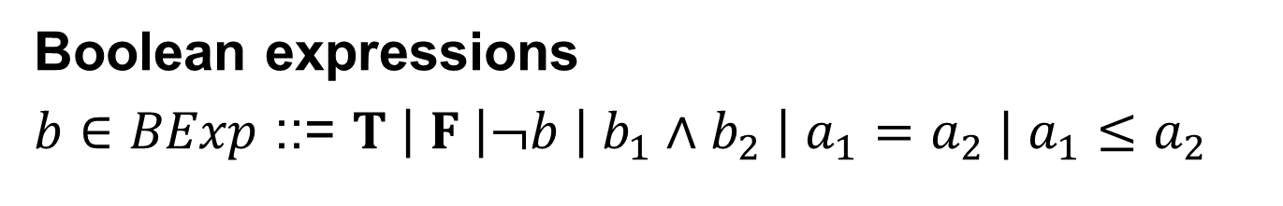
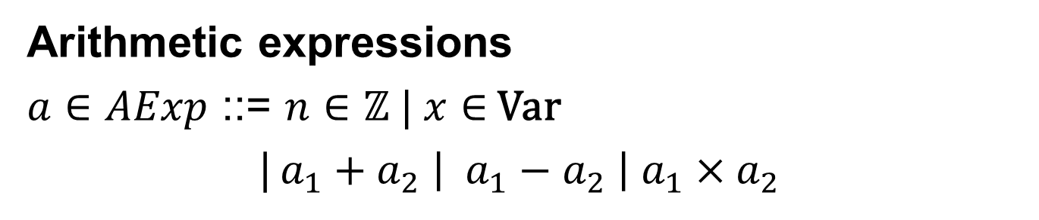
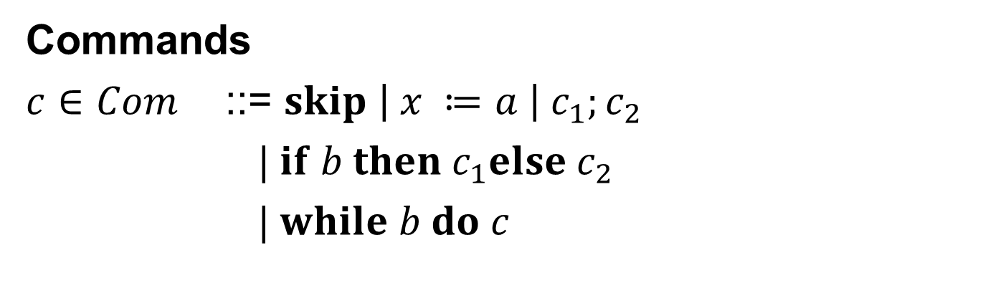
A Simple Imperative Language
Slide from Matt Fredrikson.
Arithmetic expressions
$a∈AExp$ ::= $n∈ℤ | x∈$ Var
|$a_{1}+a_{2} \left| a_{1}−a_{2} \right| a_{1}×a_{2}$
Boolean expressions
$b∈BExp$ ::= $T \left| F \right|¬b \left| b_{1}∧b_{2} \right| a_{1}=a_{2} | a_{1}≤a_{2}$
Commands
$c∈Com$ ::= $skip \left| x ≔a \right| c_{1};c_{2}$
$| if b then c_{1}else c_{2}$
$| while b do c$

Slide 21
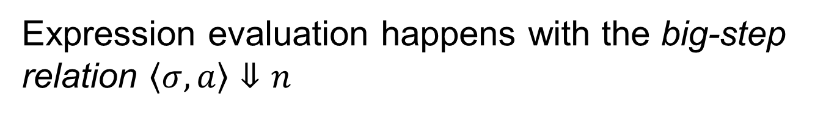



Expression Evaluation
Slide from Matt Fredrikson.
States are mappings $σ:Var↦ℤ$
Expression evaluation happens with the big-step relation $〈σ, a〉⇓n$
$$〈σ, n〉⇓n$$
$$〈σ, x〉⇓σ(x)$$
$〈σ, a_{1}〉⇓n_{1}$ $〈σ, a_{2}〉⇓n_{2}$ $n=n_{1}op n_{2}$
$$〈σ, a_{1}op a_{2}〉⇓n$$

Slide 22
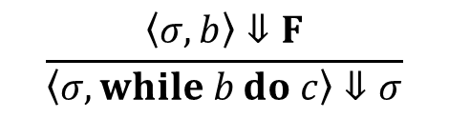
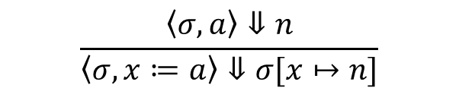
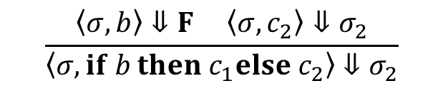
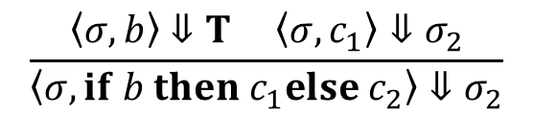
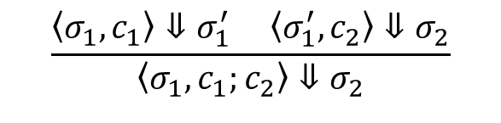
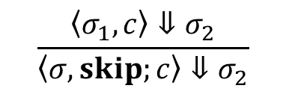
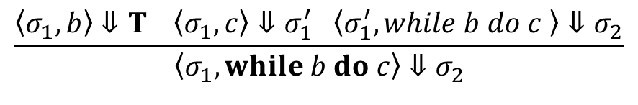
Command Evaluation
Slide from Matt Fredrikson.
Big-step relation $〈σ_{1},c〉⇓σ_{2}$
$$\frac{〈σ,a〉⇓n}{〈σ, x≔a〉⇓σ[x↦n]}$$
$$\frac{〈σ_{1},c〉⇓σ_{2}}{〈σ, skip;c〉⇓σ_{2}}$$
$$\frac{〈σ_{1},c_{1}〉⇓σ_{1}^{′} 〈σ_{1}^{′},c_{2}〉⇓σ_{2}}{〈σ_{1}, c_{1};c_{2}〉⇓σ_{2}}$$
$$\frac{〈σ, b〉⇓T 〈σ, c_{1}〉⇓σ_{2}}{〈σ, if b then c_{1}else c_{2}〉⇓σ_{2}}$$
$$\frac{〈σ, b〉⇓F 〈σ, c_{2}〉⇓σ_{2}}{〈σ, if b then c_{1}else c_{2}〉⇓σ_{2}}$$
$$\frac{〈σ, b〉⇓F}{〈σ, while b do c〉⇓σ}$$
$$\frac{〈σ_{1}, b〉⇓T 〈σ_{1},c〉⇓σ_{1}^{′} 〈σ_{1}^{′}, while b do c 〉⇓σ_{2}}{〈σ_{1}, while b do c〉⇓σ_{2}}$$

Slide 23
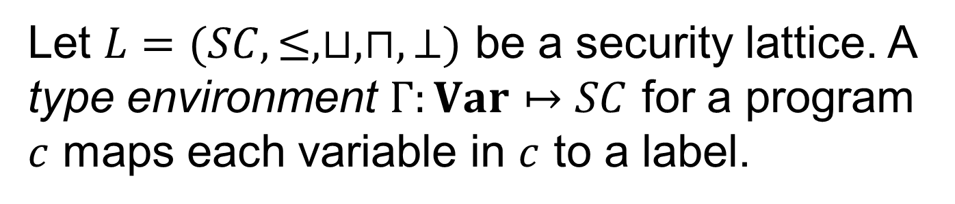

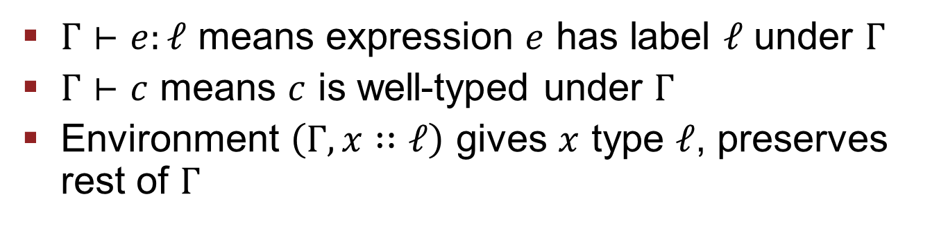

Type Environment $Γ$
Slide from Matt Fredrikson.
Let $L=(SC, ≤, ⊔, ⊓, ⊥)$ be a security lattice. A type environment $Γ:Var↦SC$ for a program $c$ maps each variable in $c$ to a label.
Additionally, $Γ$ contains an additional mapping for the program counter label $pc.$
$Γ⊢e:ℓ$ means expression $e$ has label $ℓ$ under $Γ$
$Γ⊢c$ means $c$ is well-typed under $Γ$
Environment $\left(Γ, x∷ℓ\right)$ gives $x$ type $ℓ$, preserves rest of $Γ$

Slide 24
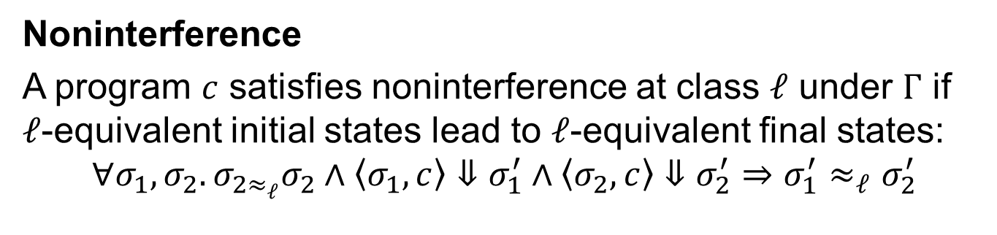
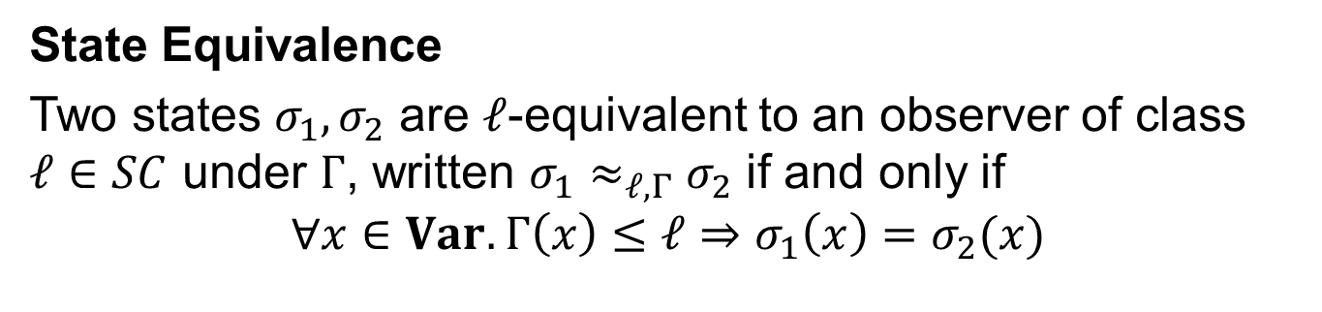

Goal: Noninterference
Slide from Matt Fredrikson.
Abbreviated as $σ_{1}≈_{ℓ}σ_{2}$
State Equivalence
Two states $σ_{1},σ_{2}$ are $ℓ$-equivalent to an observer of class $ℓ∈SC$ under $Γ$, written $σ_{1}≈_{ℓ,Γ}σ_{2}$ if and only if
$$∀x∈Var. Γ\left(x\right)≤ℓ⇒σ_{1}\left(x\right)=σ_{2}(x)$$
Noninterference
A program $c$ satisfies noninterference at class $ℓ$ under $Γ$ if $ℓ$-equivalent initial states lead to $ℓ$-equivalent final states:
$$∀σ_{1},σ_{2}.σ_{2≈_{ℓ}}σ_{2}∧〈σ_{1},c〉⇓σ_{1}^{′}∧〈σ_{2},c〉⇓σ_{2}^{′}⇒σ_{1}^{′}≈_{ℓ}σ_{2}^{′}$$
Initial states are state equivalent
Final states are state equivalent

Slide 25
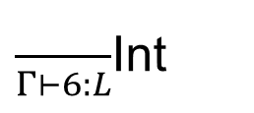


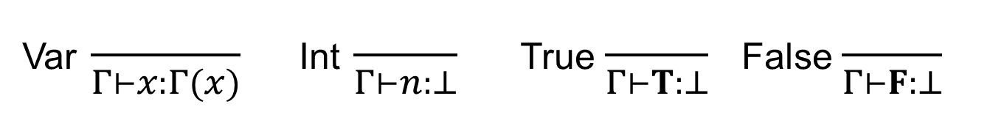
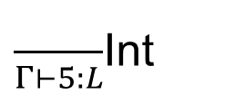




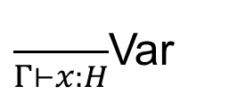
Typing Rules: Expressions
Slide from Matt Fredrikson.
Var $\frac{}{Γ⊢x:Γ(x)}$ Int $\frac{}{Γ⊢n:⊥}$ True $\frac{}{Γ⊢T:⊥}$ False $\frac{}{Γ⊢F:⊥}$
Bin $\frac{Γ⊢a_{1}:ℓ_{1} Γ⊢a_{2}:ℓ_{2}}{Γ⊢a_{1}op a_{2}:ℓ_{1}⊔ℓ_{2}}$
Example
$$5≤6+x, Γ=x∷H$$
$\frac{}{Γ⊢6:L}$Int
$\frac{}{Γ⊢x:H}$Var
$\frac{}{Γ⊢5:L}$Int
$\frac{ }{Γ⊢6+x:}$Bin
$$H$$
Bin
$Γ⊢5≤6+x:$
$$H$$

Slide 26
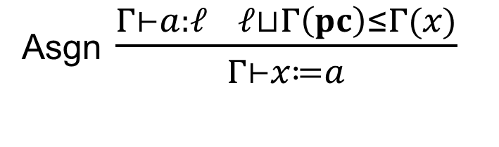
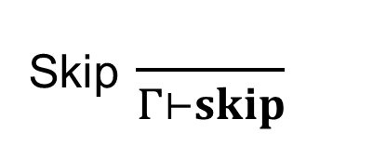
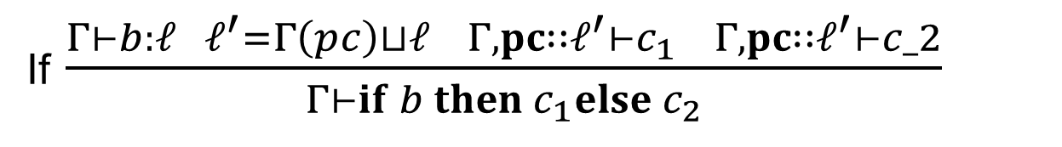
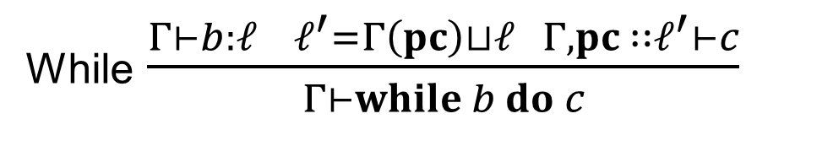
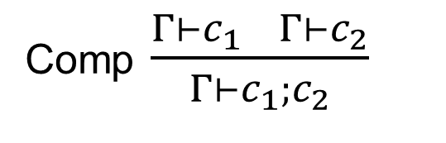
Typing Rules: Commands
Slide from Matt Fredrikson.
Skip $\frac{}{Γ⊢skip}$
Asgn $\frac{Γ⊢a:ℓ ℓ⊔Γ\left(pc\right)≤Γ(x)}{Γ⊢x≔a}$
Comp $\frac{Γ⊢c_{1} Γ⊢c_{2}}{Γ⊢c_{1};c_{2}}$
While $\frac{Γ⊢b:ℓ ℓ^{′}=Γ\left(pc\right)⊔ℓ Γ,pc ∷ℓ^{′}⊢c}{Γ⊢while b do c}$
If $\frac{Γ⊢b:ℓ ℓ^{′}=Γ\left(pc\right)⊔ℓ Γ, pc∷ℓ^{′}⊢c_{1} Γ,pc∷ℓ^{′}⊢c_2}{Γ⊢if b then c_{1}else c_{2}}$

Slide 27



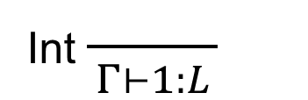

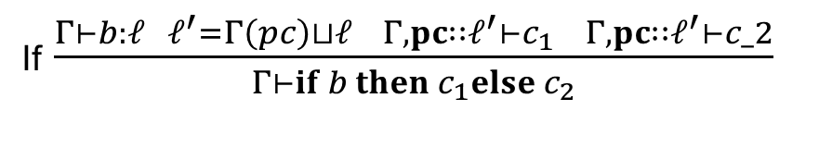
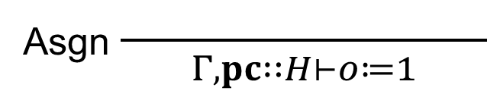
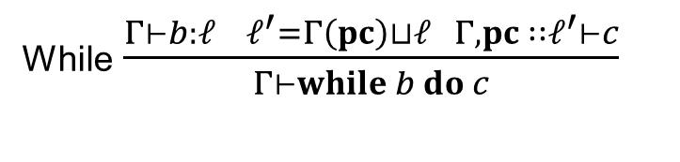

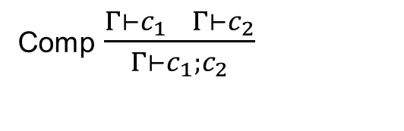
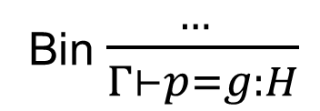
Command Typing Example
Slide from Matt Fredrikson.
$$Γ=p∷H, g∷L, o∷L, pc∷L$$
Int $\frac{ }{Γ⊢1:L}$
$$L⊔H≤Γ(o)$$
Bin $\frac{ … }{Γ⊢p=g:H}$
Asgn $\frac{ }{Γ,pc∷H⊢o≔1}$
$$H=Γ\left(pc\right)⊔H$$
If $\frac{ }{Γ⊢if p=g then o≔1 else o≔2}$
Command Typing Rules
Skip $\frac{}{Γ⊢skip}$
Asgn $\frac{Γ⊢a:ℓ ℓ⊔Γ\left(pc\right)≤Γ(x)}{Γ⊢x≔a}$
Comp $\frac{Γ⊢c_{1} Γ⊢c_{2}}{Γ⊢c_{1};c_{2}}$
While $\frac{Γ⊢b:ℓ ℓ^{′}=Γ\left(pc\right)⊔ℓ Γ,pc ∷ℓ^{′}⊢c}{Γ⊢while b do c}$
If $\frac{Γ⊢b:ℓ ℓ^{′}=Γ\left(pc\right)⊔ℓ Γ, pc∷ℓ^{′}⊢c_{1} Γ,pc∷ℓ^{′}⊢c_2}{Γ⊢if b then c_{1}else c_{2}}$

Slide 28


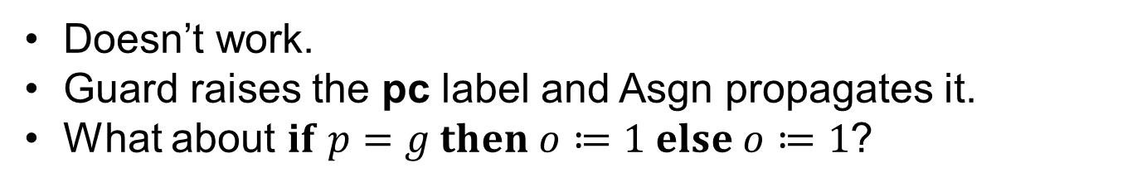
Command Typing Example
Slide from Matt Fredrikson.
$$Γ=p∷H, g∷L, o∷L, pc∷L$$
Int $\frac{ }{Γ⊢1:L}$
$$L⊔H≤Γ(o)$$
Bin $\frac{ … }{Γ⊢p=g:H}$
Asgn $\frac{ }{Γ,pc∷H⊢o≔1}$
$$H=Γ\left(pc\right)⊔H$$
If $\frac{ }{Γ⊢if p=g then o≔1 else o≔2}$
Doesn’t work.
Guard raises the pc label and Asgn propagates it.
What about $if p=g then o≔1 else o≔1$?

Slide 29
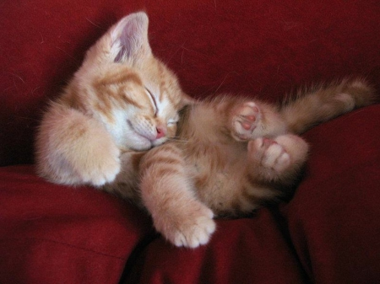
Part Three: Proving Soundness

Slide 30
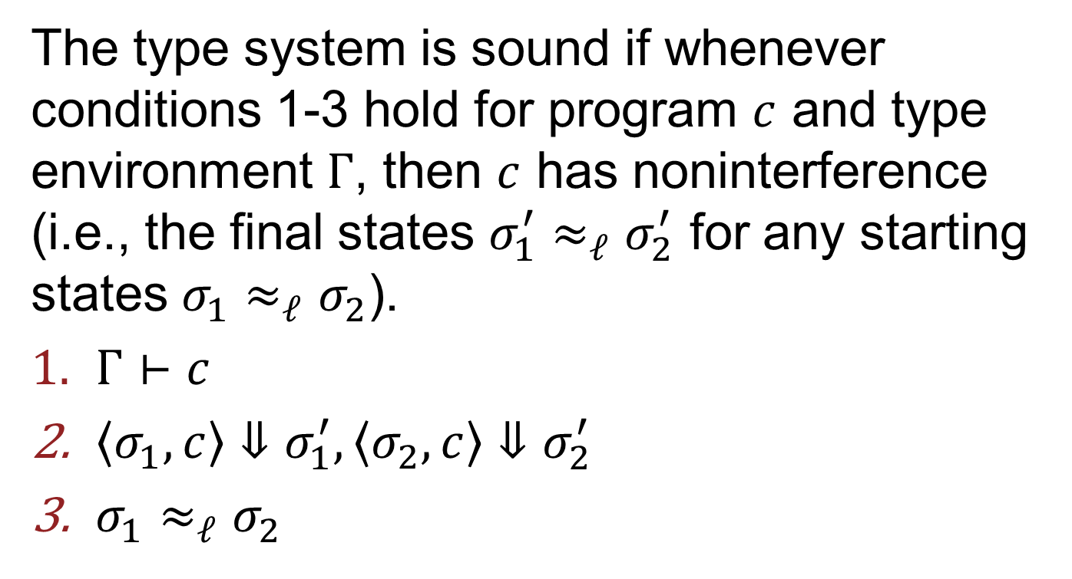
Soundness
[Volpano, Smith, Irvine ‘96]
Slide from Matt Fredrikson.
The type system is sound if whenever conditions 1-3 hold for program $c$ and type environment $Γ$, then $c$ has noninterference (i.e., the final states $σ_{1}^{′}≈_{ℓ}σ_{2}^{′}$ for any starting states $σ_{1}≈_{ℓ}σ_{2}$).
$Γ⊢c$
$〈σ_{1},c〉⇓σ_{1}^{′}, 〈σ_{2},c〉⇓σ_{2}^{′}$
$σ_{1}≈_{ℓ}σ_{2}$

Slide 31
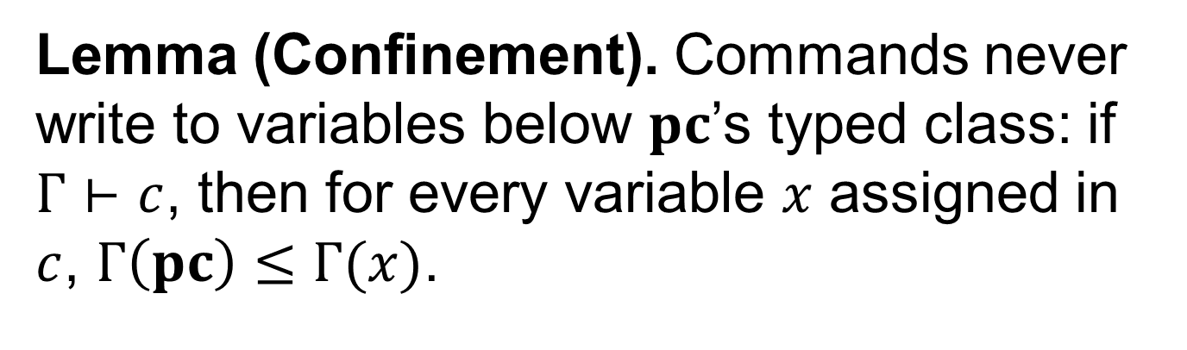
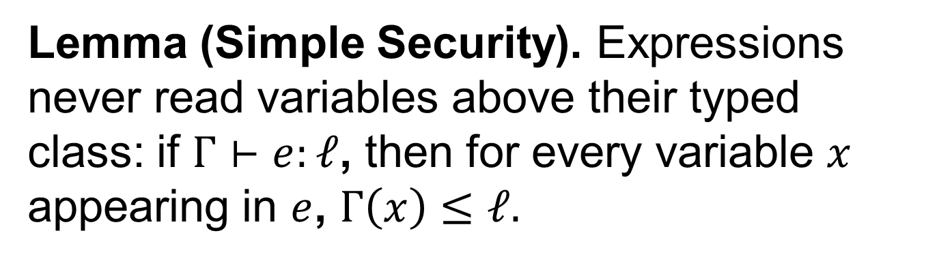
Two Key Lemmas
Slide from Matt Fredrikson.
Lemma (Simple Security). Expressions never read variables above their typed class: if $Γ⊢e:ℓ$, then for every variable $x$ appearing in $e$, $Γ\left(x\right)≤ℓ.$
Lemma (Confinement). Commands never write to variables below $pc$’s typed class: if $Γ⊢c$, then for every variable $x$ assigned in $c$, $Γ\left(pc\right)≤Γ(x)$.

Slide 32
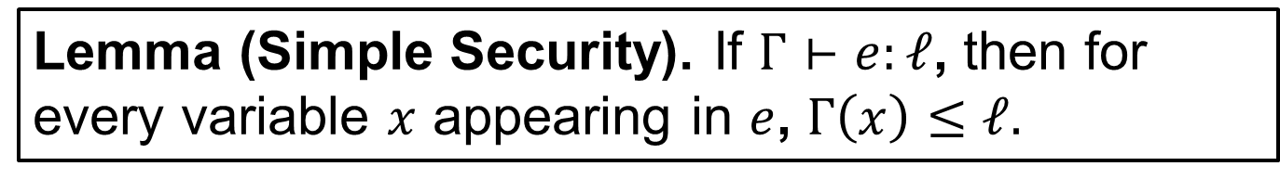
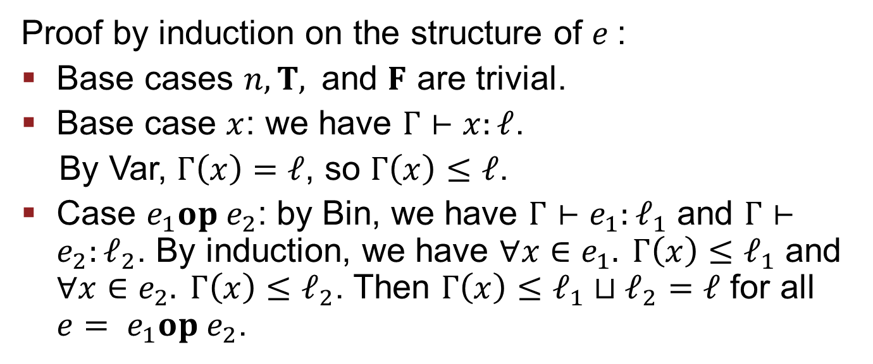
Proof: Simple Security
Slide from Matt Fredrikson.
Lemma (Simple Security). If $Γ⊢e:ℓ$, then for every variable $x$ appearing in $e$, $Γ\left(x\right)≤ℓ.$
Proof by induction on the structure of $e$:
Base cases $n,T, \text{and} F$ are trivial.
Base case $x$: we have $Γ⊢x:ℓ$.
By Var, $Γ\left(x\right)=ℓ$, so $Γ\left(x\right)≤ℓ$.
Case $e_{1}op e_{2}$: by Bin, we have $Γ⊢e_{1}:ℓ_{1}$ and $Γ⊢e_{2}:ℓ_{2}$. By induction, we have $∀x∈e_{1}. Γ\left(x\right)≤ℓ_{1}$ and $∀x∈e_{2}. Γ\left(x\right)≤ℓ_{2}$. Then $Γ\left(x\right)≤ℓ_{1}⊔ℓ_{2}=ℓ$ for all ${e= e}_{1}op e_{2}$.
□

Slide 33
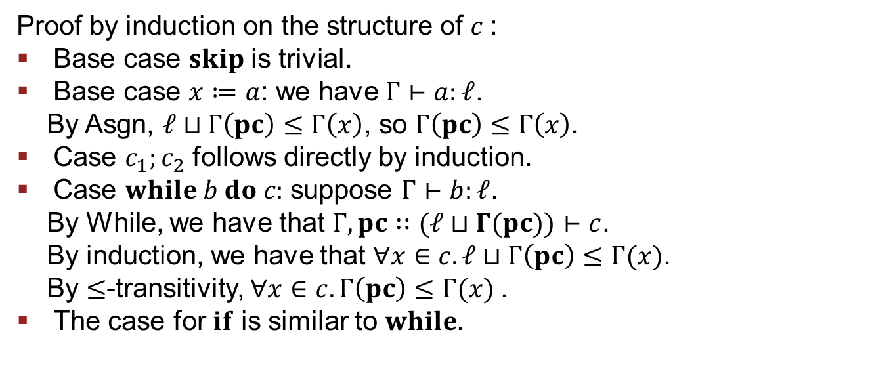
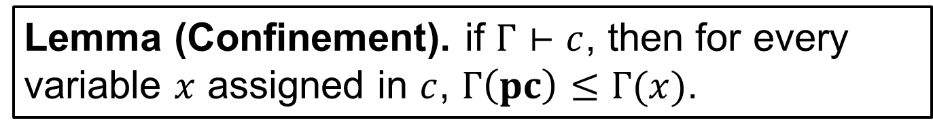
Proof: Confinement
Slide from Matt Fredrikson.
Lemma (Confinement). if $Γ⊢c$, then for every variable $x$ assigned in $c$, $Γ\left(pc\right)≤Γ(x)$.
Proof by induction on the structure of $c$:
Base case $skip$ is trivial.
Base case $x≔a$: we have $Γ⊢a:ℓ$.
By Asgn, $ℓ⊔Γ\left(pc\right)≤Γ\left(x\right)$, so $Γ\left(pc\right)≤Γ\left(x\right)$.
Case $c_{1};c_{2}$ follows directly by induction.
Case $while b do c:$ suppose $Γ⊢b:ℓ$.
By While, we have that $Γ, pc∷(ℓ⊔Γ(pc))⊢c$.
By induction, we have that $∀x∈c. ℓ⊔Γ\left(pc\right)≤Γ(x)$.
By $≤$-transitivity, $∀x∈c. Γ\left(pc\right)≤Γ(x)$.
The case for $if$ is similar to $while$.
□

Slide 34
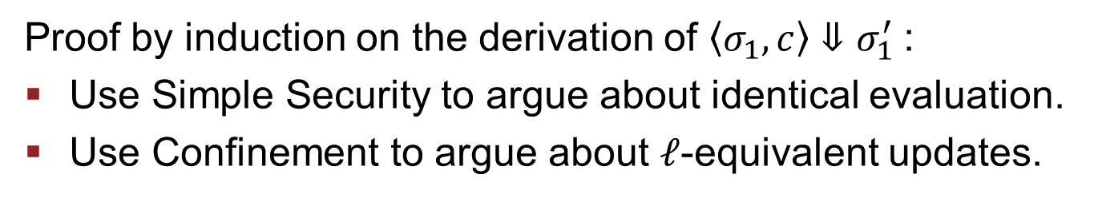
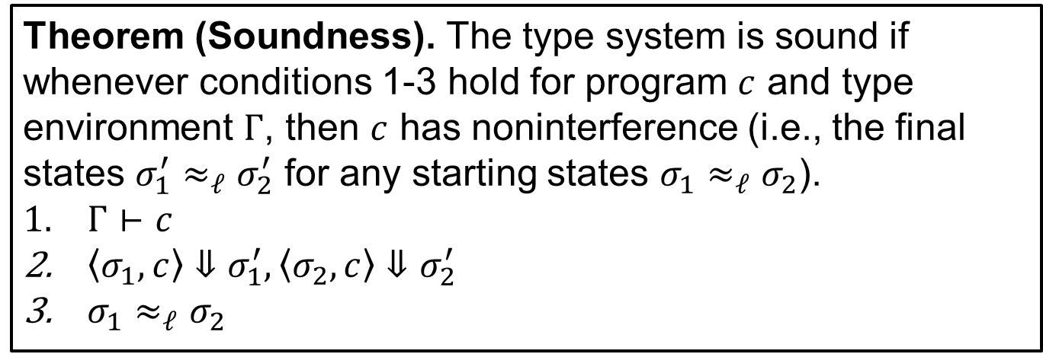
Proof Sketch: Soundness
Slide from Matt Fredrikson.
Theorem (Soundness). The type system is sound if whenever conditions 1-3 hold for program $c$ and type environment $Γ$, then $c$ has noninterference (i.e., the final states $σ_{1}^{′}≈_{ℓ}σ_{2}^{′}$ for any starting states $σ_{1}≈_{ℓ}σ_{2}$).
$Γ⊢c$
$〈σ_{1},c〉⇓σ_{1}^{′}, 〈σ_{2},c〉⇓σ_{2}^{′}$
$σ_{1}≈_{ℓ}σ_{2}$
Proof by induction on the derivation of $〈σ_{1}, c〉⇓σ_{1}^{′}$:
Use Simple Security to argue about identical evaluation.
Use Confinement to argue about $ℓ$-equivalent updates.

Slide 35
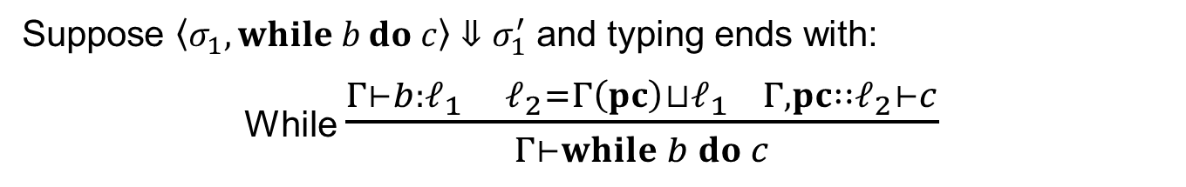
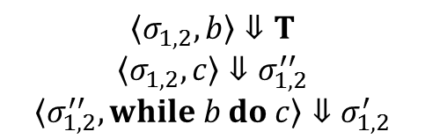




Example: $while$
Theorem (Soundness). Want following conditions:
$Γ⊢c$
$〈σ_{1},c〉⇓σ_{1}^{′}, 〈σ_{2},c〉⇓σ_{2}^{′}$
$σ_{1}≈_{ℓ}σ_{2}$
Suppose $〈σ_{1}, while b do c〉⇓σ_{1}^{′}$ and typing ends with:
While $\frac{Γ⊢b:ℓ_{1} ℓ_{2}=Γ\left(pc\right)⊔ℓ_{1} Γ,pc∷ℓ_{2}⊢c}{Γ⊢while b do c}$
$$〈σ_{1,2}, b〉⇓T$$
$$〈σ_{1,2}, c〉⇓σ_{1,2}^{′′}$$
$$〈σ_{1,2}^{′′}, while b do c〉⇓σ_{1,2}^{′}$$
Case $l_{2}≤ℓ$ (condition can flow into low memory):
By Simple Security, ${Γ\left(x\right)≤l}_{2}≤ℓ$ for all $x$ in $b$.
By (3), $σ_{1}\left(x\right)=σ_{2}(x)$ for all $x$ in $b$, so $〈σ_{1}, b〉⇓v$ and $〈σ_{2}, b〉⇓v$
If $v=F$, then $σ_{1}=σ_{1}^{′}$ and $σ_{2}=σ_{2}^{′}$. Invoke (3).
If $v=T$,
$$\frac{}{〈σ_{1,2}, while b do c〉⇓σ_{1,2}^{′}}$$
then $σ_{1}^{′′}≈_{ℓ}σ_{2}^{′′}$ by induction. Then $σ_{1}^{′}≈_{ℓ}σ_{2}^{′}$ also by induction.

Slide 36

Example: $while$
Theorem (Soundness). Want following conditions:
$Γ⊢c$
$〈σ_{1},c〉⇓σ_{1}^{′}, 〈σ_{2},c〉⇓σ_{2}^{′}$
$σ_{1}≈_{ℓ}σ_{2}$
Suppose $〈σ_{1}, while b do c〉⇓σ_{1}^{′}$ and typing ends with:
While $\frac{Γ⊢b:ℓ_{1} ℓ_{2}=Γ\left(pc\right)⊔ℓ_{1} Γ,pc∷ℓ_{2}⊢c}{Γ⊢while b do c}$
Case $l_{2}>ℓ$ (condition cannot flow into low memory):
By Confinement, $ℓ_{1}≤Γ(x)$ for all $x$ assigned in $c$.
For $x$ assigned in $c,$ $¬(Γ\left(x\right)≤ℓ)$.
For every $x$ in $c$ where $Γ\left(x\right)≤ℓ$, $σ_{1,2}(x)=σ_{1,2}^{′}(x)$.
By (3), we have $σ_{1}≈_{ℓ}σ_{2}^{′}$.
□

Slide 37
Discussion Questions
What kinds of guarantees can language-based information flow provide?
What are the tradeoffs of static information flow analysis?
This work came before the Flume work. Why did people become interested in coarser-grained information flow?

