Slide 1
PART B / OFF-MARKET
Estimate sale price before the list price is known
A reproducible model, selected before the final six-month backtest
01 FEATURES
02 MODEL
03 HONEST CHECK
Size and room counts
Type, style and synthetic location
Lot size and missingness
Listing-date calendar features
Fixed remarks / condition flags
Histogram gradient boosting
Learn log(price) → exponentiate
Compare RF, gradient boosting and CatBoost
Tune Oct–Nov 2025 only
Freeze before Dec–May
Refit using earlier sales each month
No list price / post-sale / AVM inputs
Sale-month protocol; not per-home listing-time
SSU Data Dash 2026 | Synthetic data | Hidden-test prices unavailable
Notes:
Explain the problem, allowed features, log-price model, and separation of tuning from final validation. max_iter=350; learning_rate=0.07; max_leaf_nodes=31; l2_regularization=10.0; remarks features=on; log-price target; random seed 42.

Slide 2
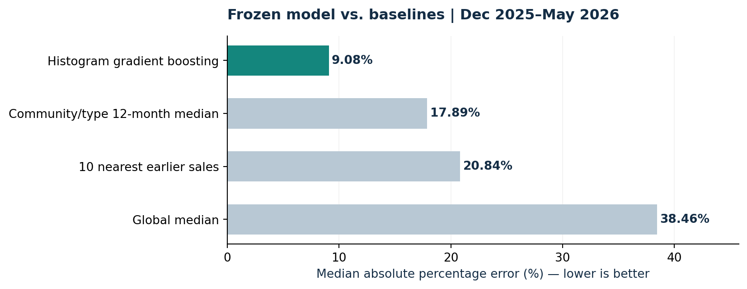
PART B / OFF-MARKET
Measured error on future held-out months
December 2025–May 2026 | 10,069 held-out homes | selected configuration unchanged
9.08%
Median absolute % error
11.60% MAPE
17.89% baseline MdAPE
83.8% within 20% of sale price
Validation ≠ hidden-test accuracy. Synthetic data and future market shifts limit generalization.
SSU Data Dash 2026 | Synthetic data | Hidden-test prices unavailable
Notes:
Histogram gradient boosting achieved 9.08% MdAPE and 11.60% MAPE over 10,069 held-out sales. This is 49.2% lower MdAPE than the rolling community/type baseline (17.89%). The $2m+ group had 14.68% MdAPE across 719 homes, with -9.57% median signed error. The data is synthetic; results do not establish real-world appraisal accuracy. Six months do not capture every future market regime. Expensive or unusual homes may have larger errors. The June–September 2026 test prices are hidden, so test accuracy is unknown. Do not describe the validation score as a hidden-test score.

