Slide 1
Green Campus Simulator – A carbon reducing game
REN Yixiao, YANG Xikun

Slide 2

Problem Existed

Slide 3

Problem 1. Students’ lack of awareness
Recent studies show that many students are disconnected from the consequences of climate change due to insufficient exposure to its direct impacts (Smith, 2024).

Slide 4
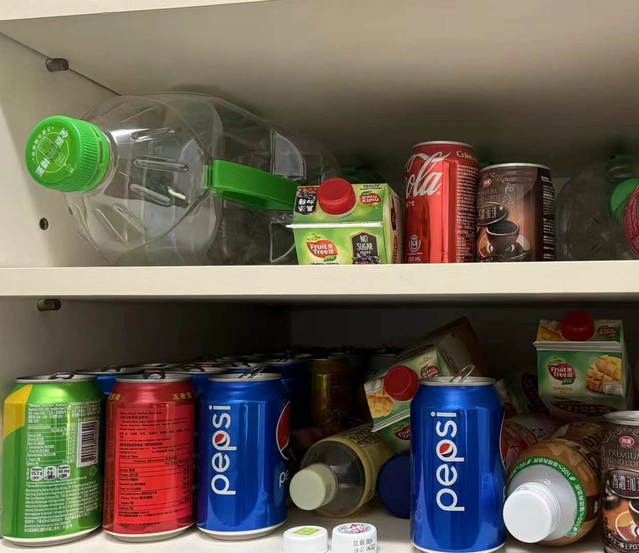
Problem 2. Limitations of the GreenCoin system
The initiative of Green Coin
The Limitations:
Lack of interaction- reducing the user's sense of usability and experience.
Single collection method- reducing the audience base.

Slide 5

Our solution： An interesting strategy game

Slide 6

Analysis
Problem
Low appeal of the GreenCoin system
Reason
Achievement: Lack of rewarding feeling
Engagement: No fun or engaging experiences
Competition: Absence of a leaderboard.

Slide 7

Game setting
Role: Head of Environmental Department
Objective: Minimize Carbon Emissions
Gameplay
3yrs office term
Monthly budget
Take combinations of carbon-reducing measures
Why interesting? How challenging?
Combining Strategies Effectively

Slide 8
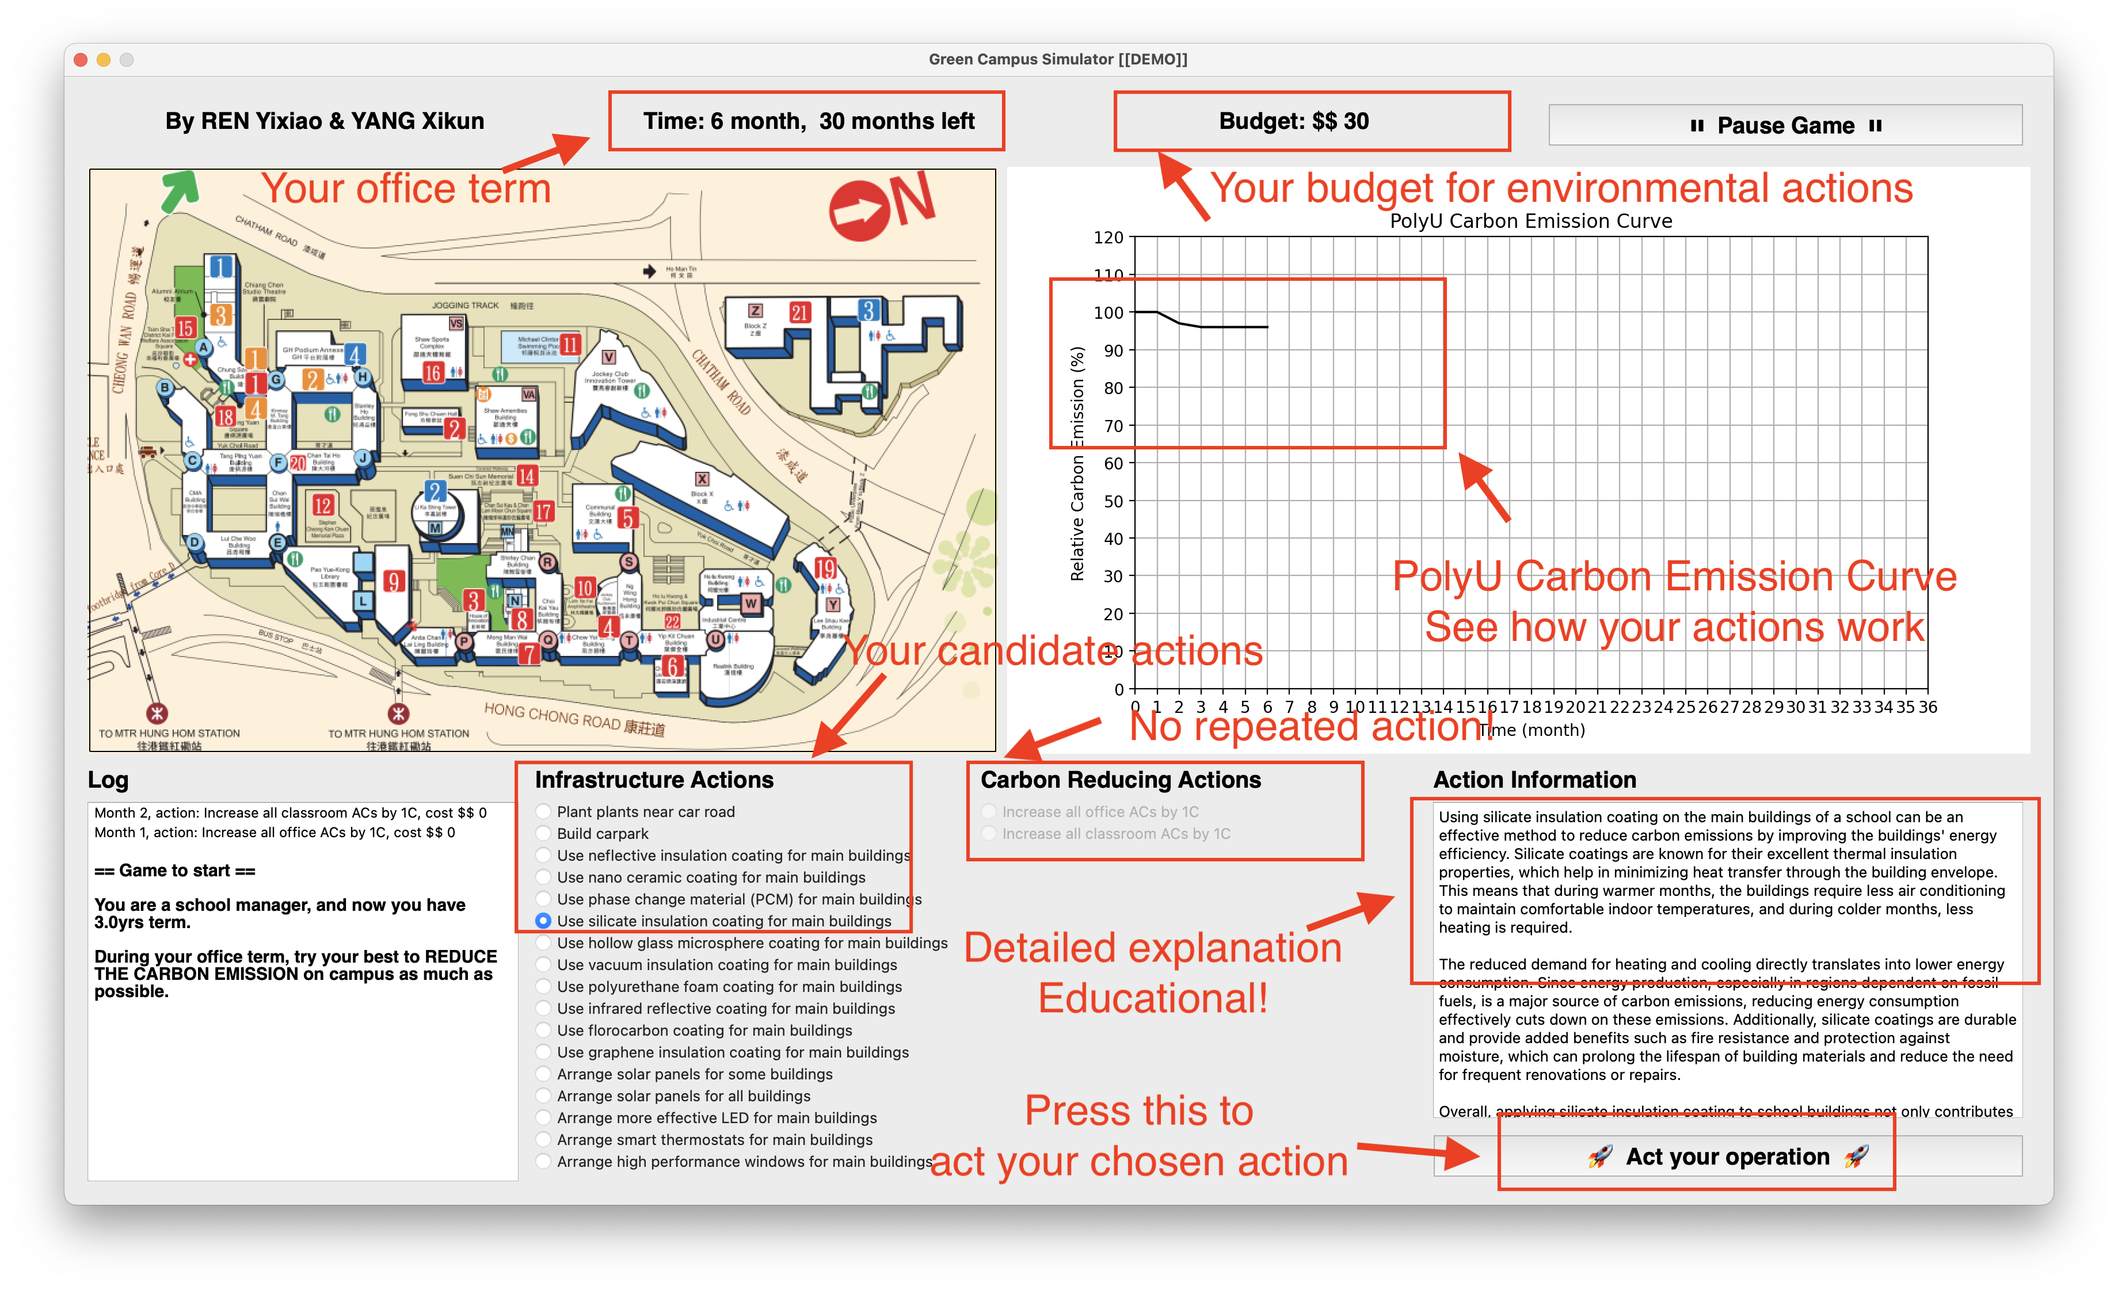

Slide 9
With the GreenCoin system
Leaderboards & rewards
Entry tickets
competition and incentive
Don’t forget real-life eco-friendly actions?!

Slide 10
We use data & professional analysis
Academic research
Campus data and calculations
Highly realistic
Real-life simulator
Detailed science materials
All people, any job, any age
Only gameplay?
Boost students’ understanding & awareness
Contribute to a
real green
campus

Slide 11
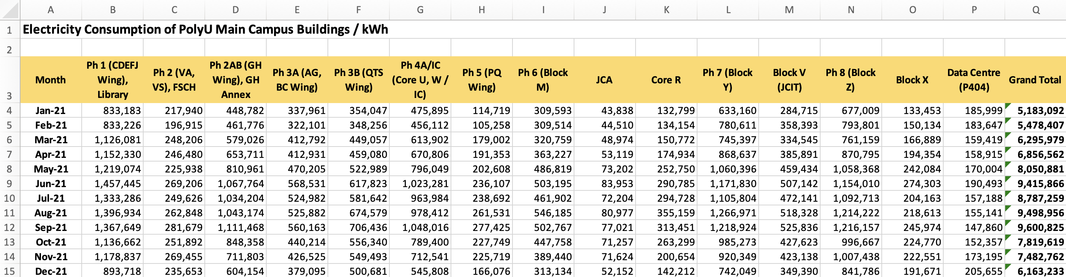
Example
Air-conditioned office buildings in subtropical Hong Kong use an average of 270 kWh/m2 per unit gross floor area, with heating, ventilation, and air conditioning being the major electricity end users. (Li et al., 2020)

Slide 12
Future Potential
Ren Yixiao & Yang Xikun

Slide 13
Strategic Promotion Platform
Platform Potential: The game work as a tool for promoting sustainability and increasing student engagement in environmental activities.

Slide 14
Increase Awareness and Participation in Environmental Activities
We plan to engage more students in school environmental activities through gaming.
Traditional email notifications often fail to catch sufficient attention.
The interactive and fun nature of the gaming platform will significantly boost student interest and participation in topics like sustainability and carbon emissions, thereby deepening their awareness and knowledge of environmental issues.

Slide 15
Establish an Inter-School Interaction Platform
Using this gaming platform, we communicate & collaborate with other schools that have similar green initiatives.
By sharing virtual environments and interactive games, schools can exchange green strategies and practices on a broader platform, which will further advance environmental education.

Slide 16

Serve the Green Finance Industry
We can use the gaming platform as a reference tool for green finance, allowing users to import different maps and set specific parameters to simulate and optimize green strategies in business environments.
This will provide a science and data-driven tool to help businesses understand and implement green finance strategies, optimizing their environmental responsibilities and economic benefits.

Slide 17
Neither the GreenCoins nor the game is our goal. A greener campus is.

Slide 18
Thanks for listening.

