Slide 1
Driver Analysis System
Yang Xikun, Yang Jinkun, Lau Kam-Ho, He Meisong, Li Yifeng

Slide 2
System Architecture
Data processing module (Spark)
Deployment backend module (AWS services)
Backend module (Python Flask)
Frontend module (HTML + CSS + JS)

Slide 3
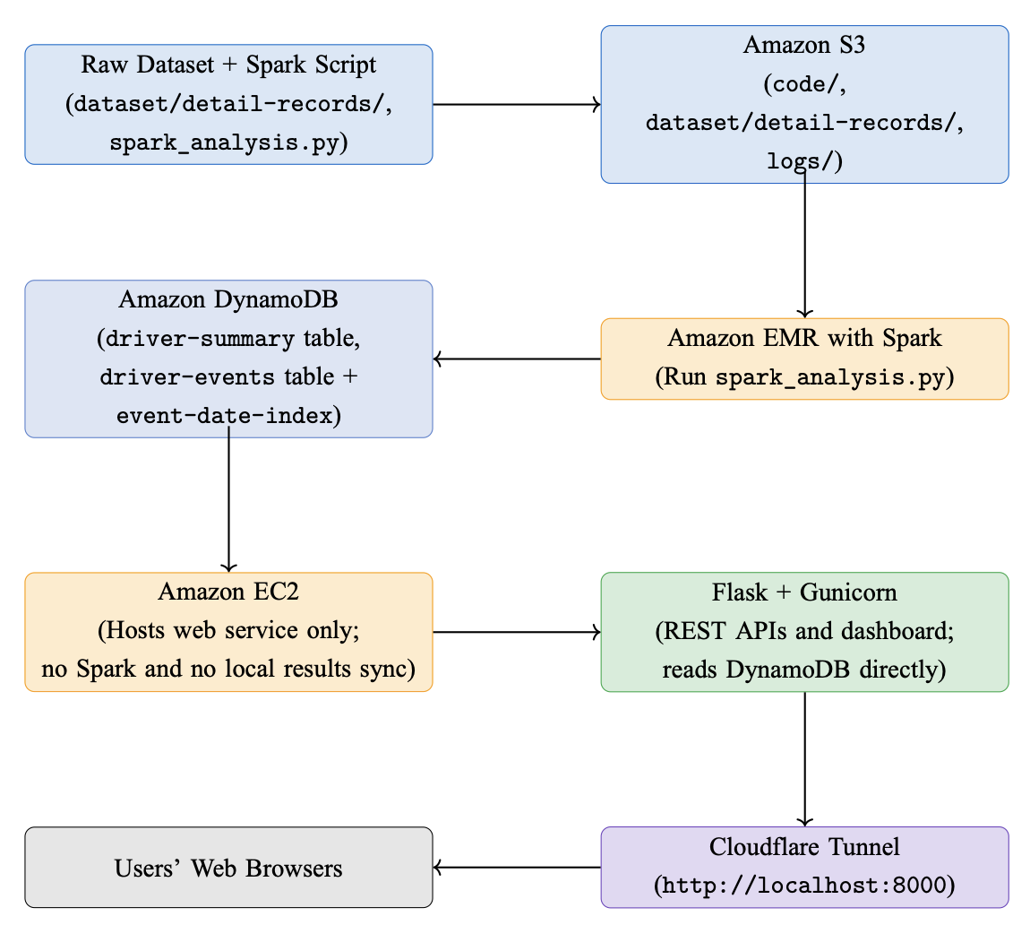

Slide 4
Data Processing Module (Spark)
Read dataset/detail-records/
Generate driver summary
Calculate a risk score
Generate event records (for user-customized time period filter)
Add DynamoDB keys
Write into DynamoDB database

Slide 5
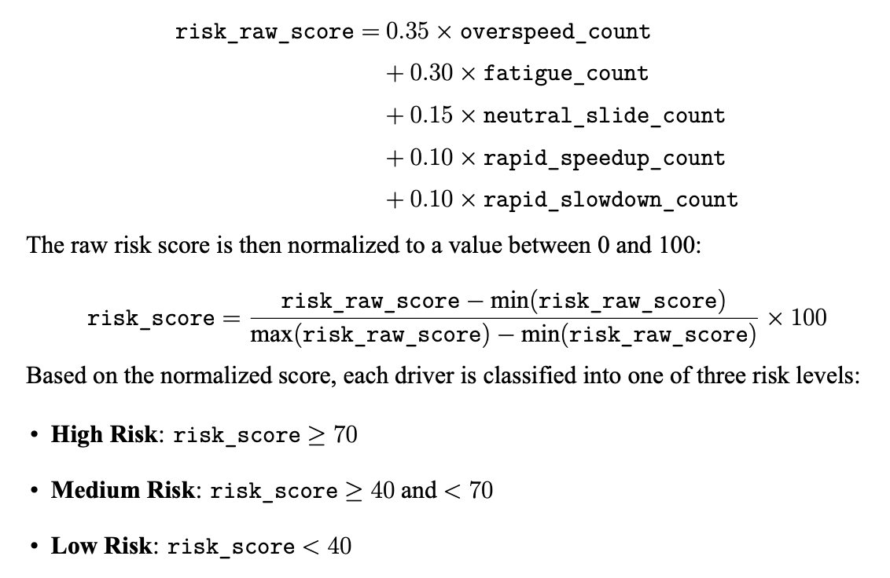

Slide 6
Backend module
GET /
GET /health
GET /ready
GET api/summary
GET api/summary?start=<>&end=<>
GET api/drivers
GET api/speed/<id>
GET api/speed/<id>?limit=<>&cursor=<next>

Slide 7
Frontend module
MacOS Aqua style
Driver behabior summary
Per-driver speed monitor
All drivers speed monitor
Please refer to our demo presentation.

Slide 8
Deployment: AWS Orchestration
Upload code and data from local to S3
→ run Spark jobs on EMR
→ store processed results in DynamoDB
→ run Flask/Gunicorn on EC2
→ expose to the public internet via Cloudflare Tunnel

Slide 9
Deployment: AWS Orchestration
S3: Stores Spark scripts, raw datasets, and EMR logs.
EMR: Runs spark/spark_analysis.py for data processing and analysis.
DynamoDB: Stores processed summaries and event-level details generated by Spark.
EC2: Runs only the Flask web application (no Spark jobs).
Gunicorn: Serves as the production WSGI server for Flask.
Cloudflare Tunnel: Exposes the EC2 local service (localhost:8000) to a public domain.

Slide 10
Deployment: Security Group
The security group only needs to allow SSH access for administrators, since public traffic goes through Cloudflare Tunnel and there is no need to open ports 80/443 directly.

Slide 11
Deployment: IAM Configuration
IAM: EMR instance profile = S3 read/log write + DynamoDB read/write; EC2 role = DynamoDB read only

Slide 12
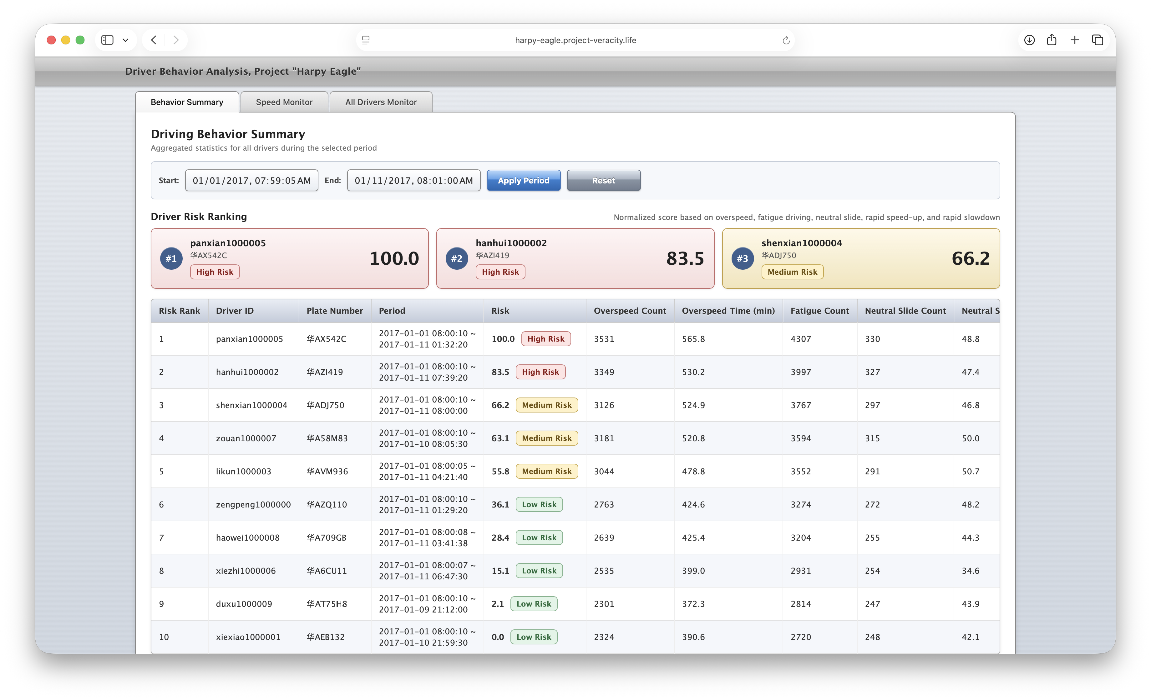
Demo
https://harpy-eagle.project-veracity.life

