Slide 1
Can we predict Supreme Court case outcomes?
Chris Nasrallah

Slide 2
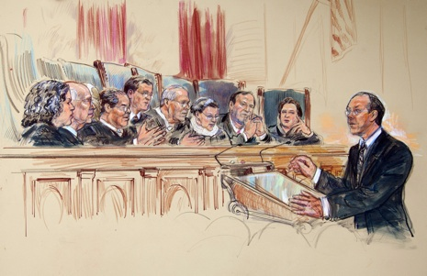

Slide 3
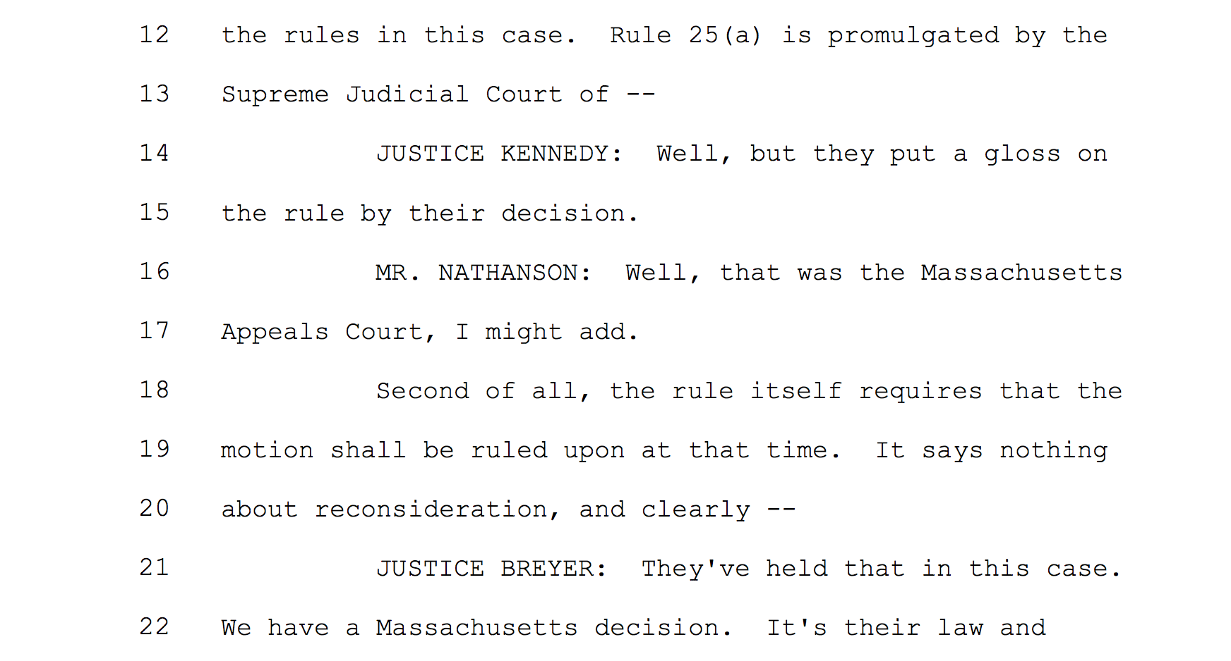
Which side is interrupted more?
P(Pet wins) | Petitioner | Tie | Respondent
Petitioner | 0.742 | 0.5 | 0.825
None | 0.569 | 0.7 | 0.760
Respondent | 0.353 | 0.714 | 0.5
Amicus Curae Support?
[2007-2013]

Slide 4
Analyses / Algorithms
Identify Key Performance Indicators
Petitioner vs. Respondent
Amicus Curae
Number of interruptions
Age, gender, or experience of lawyer?
Others?
NLP / Sentiment Analysis of Oral Arguments

