Slide 1
Can we predict Supreme Court case outcomes?
Chris Nasrallah

Slide 2
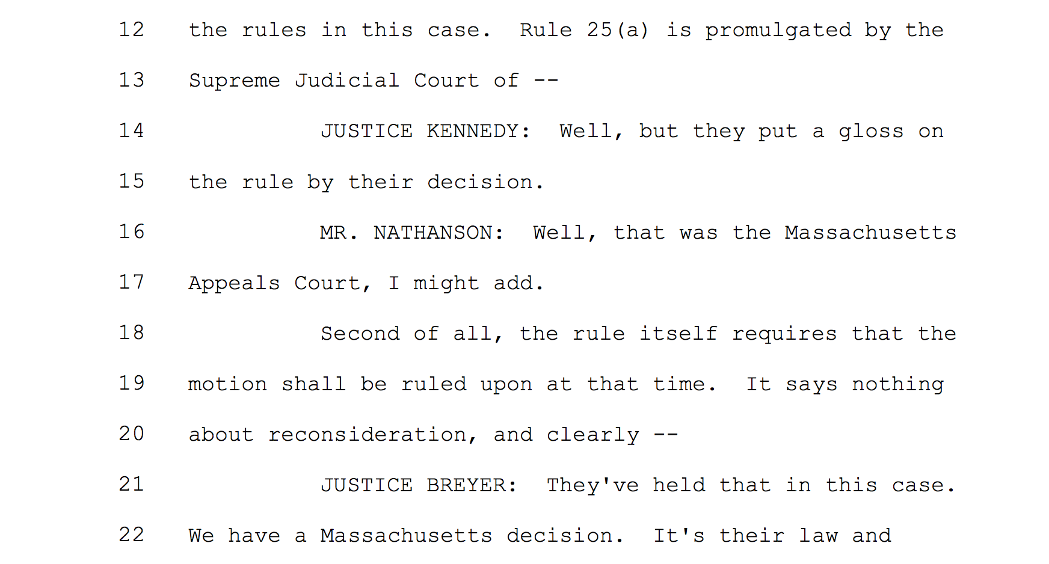
Which side is interrupted more?
P(Pet wins) | Petitioner | Respondent
Petitioner | 0.75 | 0.83
None | 0.60 | 0.75
Respondent | 0.28 | 0.51
Amicus Curae Support?
[2005-2013]

Slide 3
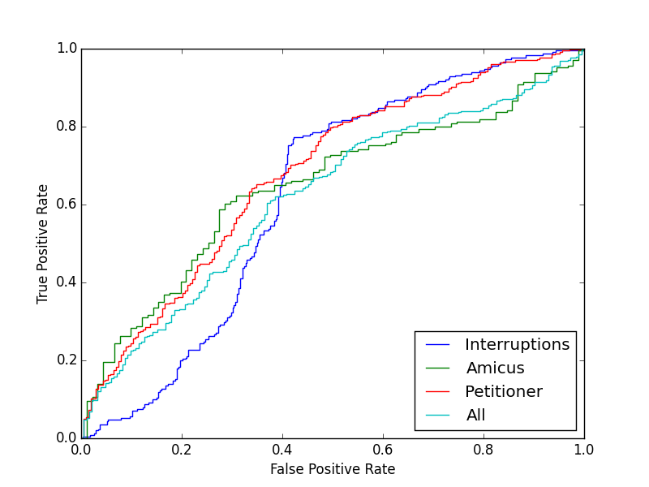

Slide 4
Analyses / Algorithms
NLP / Sentiment Analysis of Oral Arguments
Naïve Bayes binary classifier:
Labels:
‘positive’ == judge asking question votes in their favor
‘negative’ == judge asking question votes against
Features:
Petitioner, Amicus, Interruptions
Word presence – ‘Bag of words’ model
Training Set?
Cross-validation

Slide 5
