Slide 1
06.05.26
Cooperative Bachelor-Thesis:
Physiological and geodata-base analyses of methane reduction potential in ruminants
Author: Linus Benetz (xq97doq@studserv.uni-leipzig.de)
Supervisor: Dr. Flaiz, Prof. Molitor & Prof. Bastos
Faculty of physics and earth system sciences,
Intitute for earth system sciences and remote sensing,
Land-Atmosphere-Interaction
Faculty of life science,
Intitute for biochemistry,
Microbial Metabolic Biochemistry

Slide 2
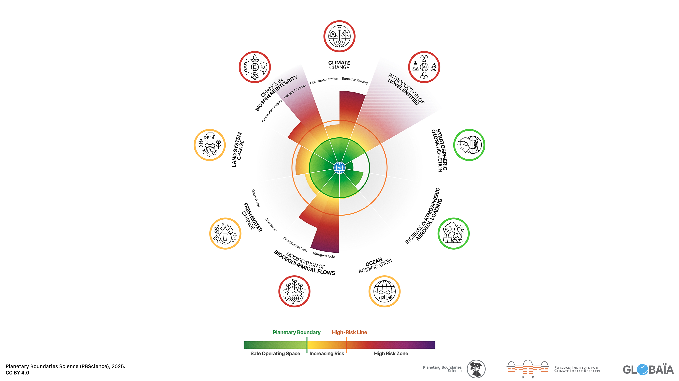
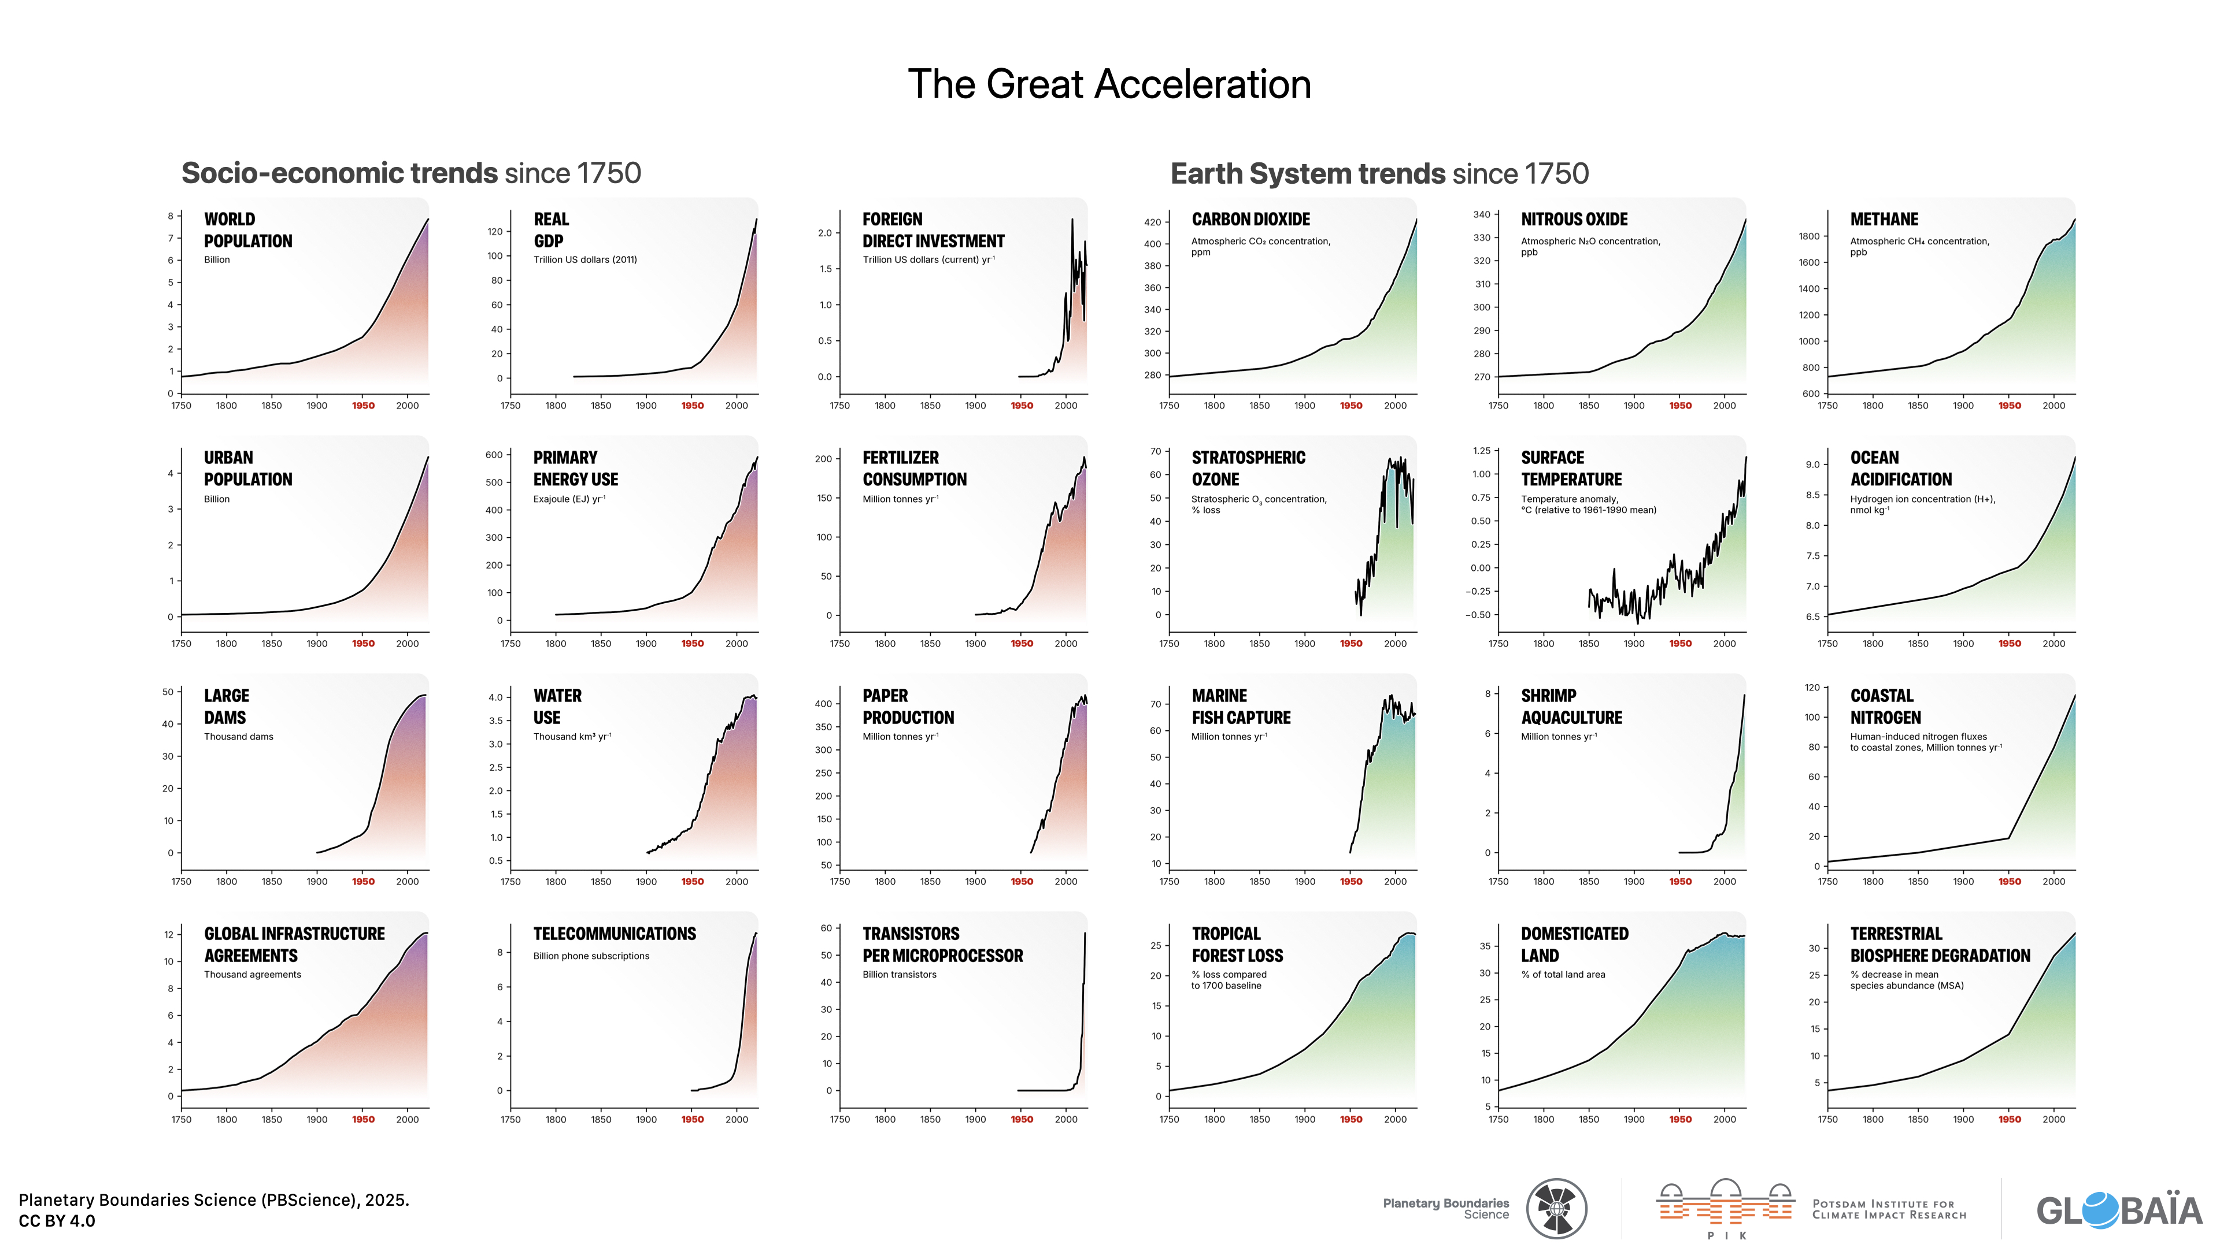
Planetary boundarys for human existence
Planetary Boundaries Science (PBScience), 2025.
2

Slide 3
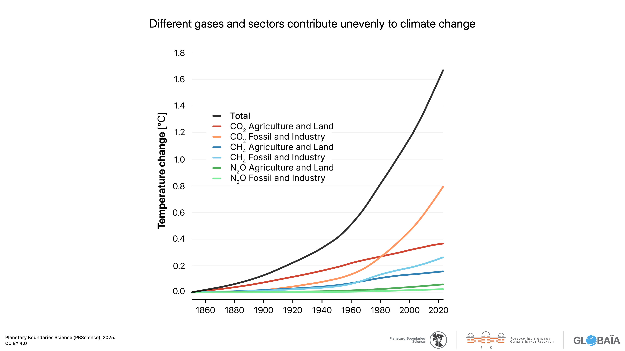
Greenhouse gases
CH4
lifetime | 9-15y
Impact on climat relativ to CO2 | 72 (20 y) 25 (100 y) 7.6 (500 y)
IPCC, 2005.; Umweltbundesamt, 2022.
Planetary Boundaries Science (PBScience), 2025.
3

Slide 4
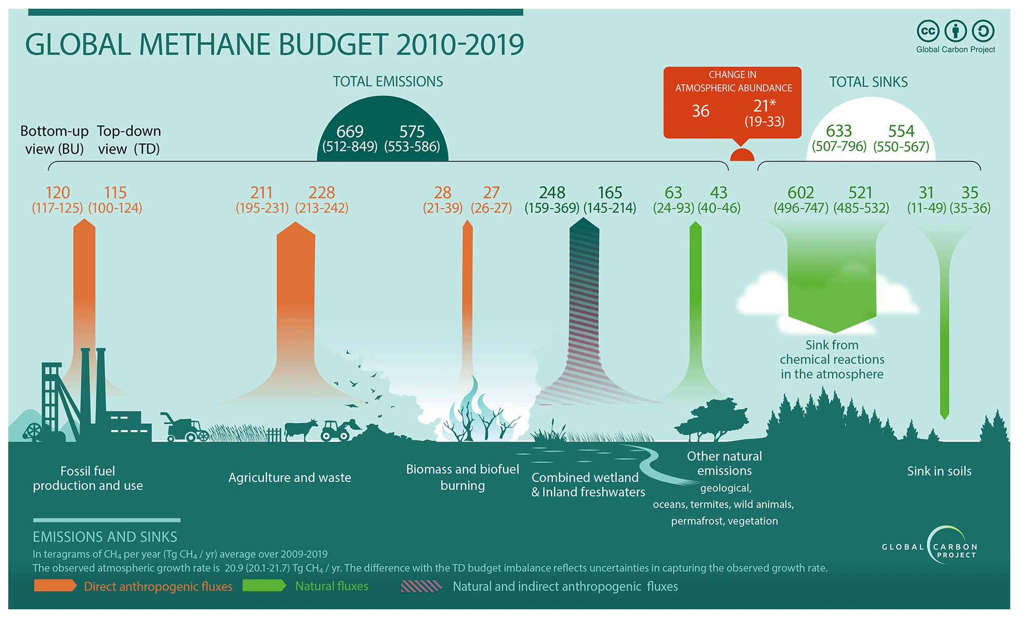
Methane emission sources
60% of anthropogenic methane from agriculture and waste
40% directly from agriculture (30% enteric fermentation)
Moss et al. (EDP Science), 2000.
Saunois et al. (ESSD), 2025.
4

Slide 5

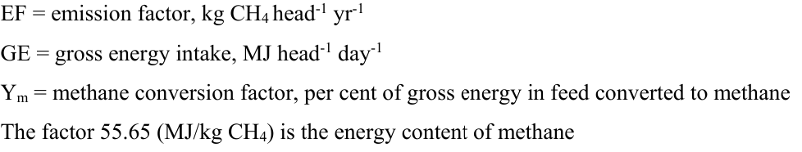

Geographical side – basic idea
IPCC Guidelines for National greenhouse gas Inventories (2006)
5

Slide 6
Geographical side – possible analyses
Max. potential decrease
Compare to other technics like antimethanogenic compounds
Decrease needed to stabilisize CH4 budget
Detect methane hot spots
Focus on a region
Saunois et al. (ESSD), 2025.
6

Slide 7
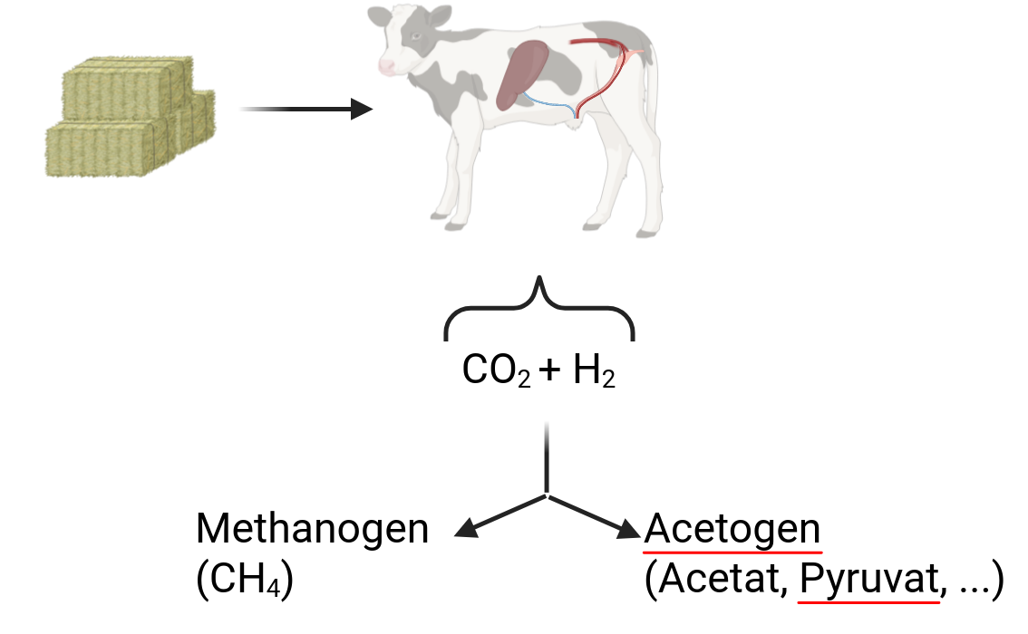
Enteric Fermentation Processes
Problem:
1. few metahnogens of rumen isolated
2. isolated methanogens little researched
Acetogen
(Acetat, pyruvat,...)
Moss et al. (EDP Science), 2000.; Lee et al., 2013.
7

Slide 8
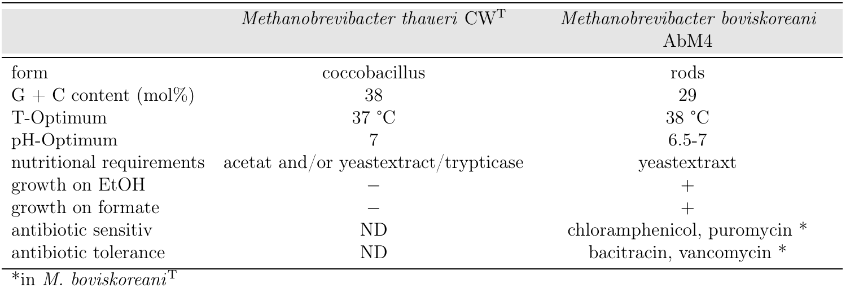
Wich Archaea do we use?
Lin & Miller, 2002.;
Lee et al., 2013.
8

Slide 9
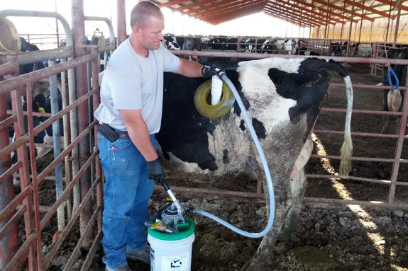
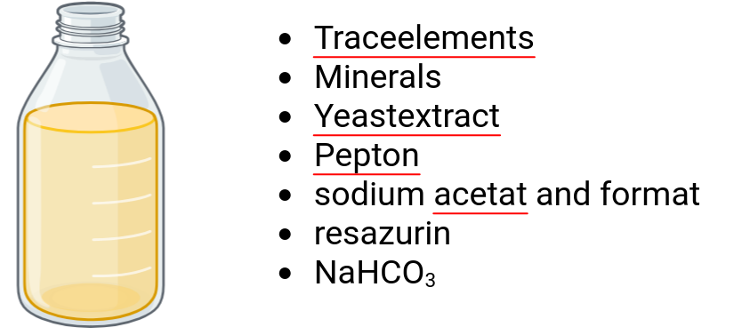
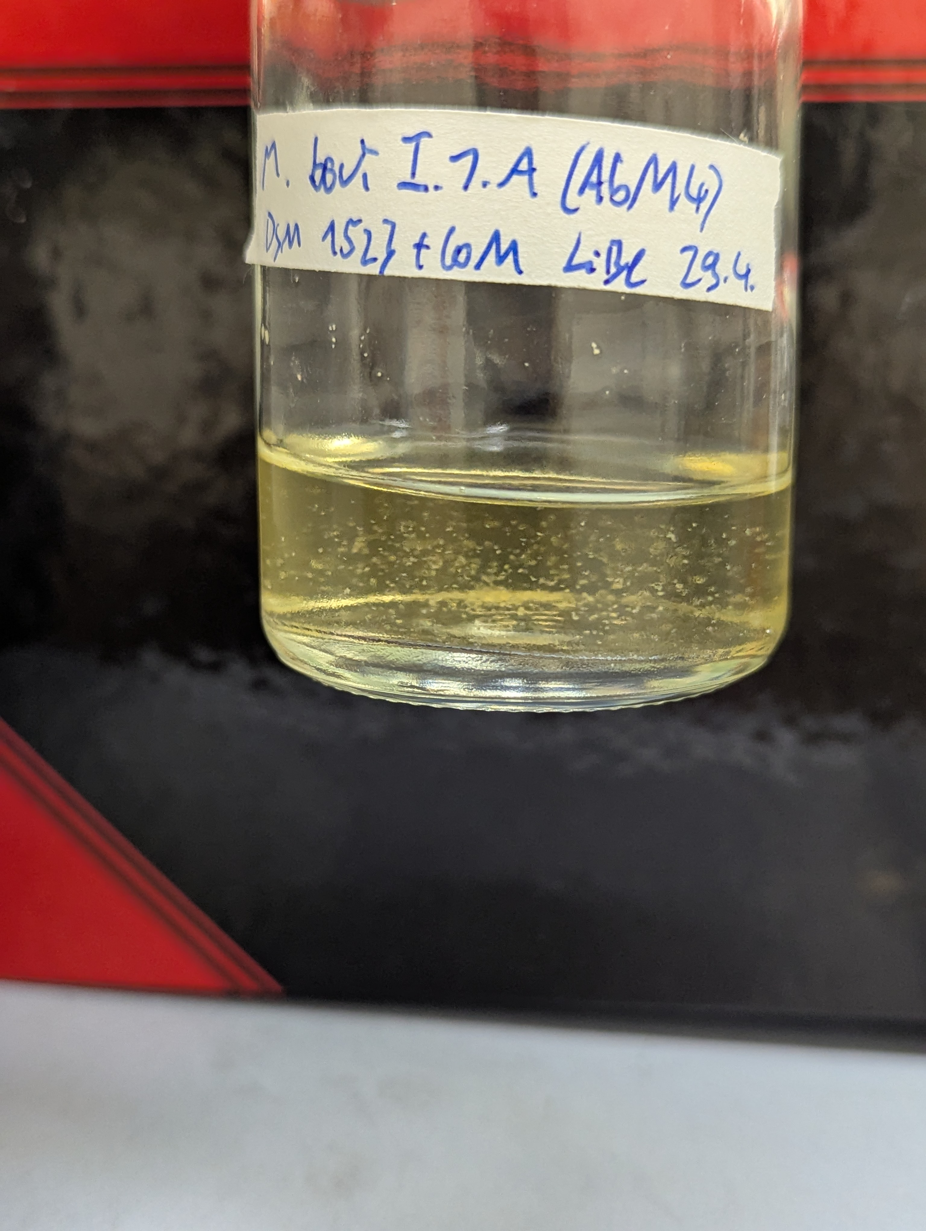
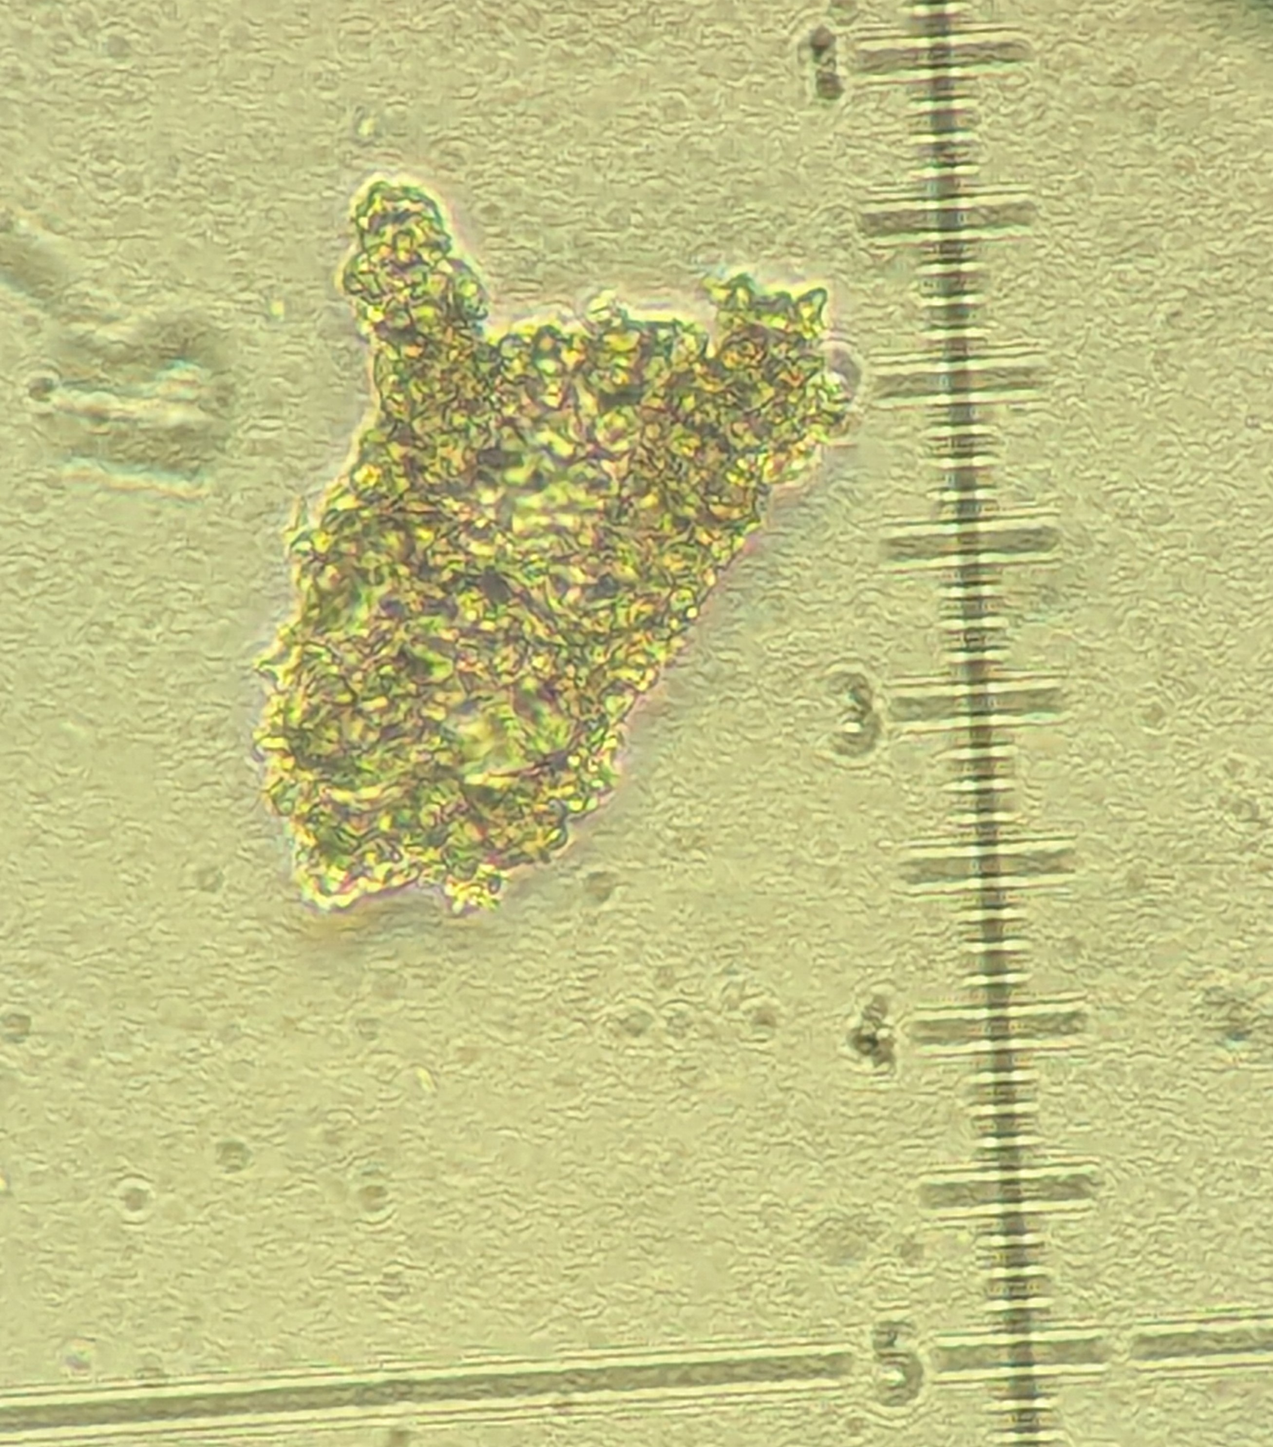
Diffrent Media
X
DSM 119RF
(Rumenfluid)
DSM 1523 + CoM
DSM 119 + CoM
Vitamin-SL10
Sludge fluid
Fatty acid mix
Wolins-Vitamin
M. thaueri lysed after few days
Precipitate of M. boviskoreani
400x magniification
9

Slide 10
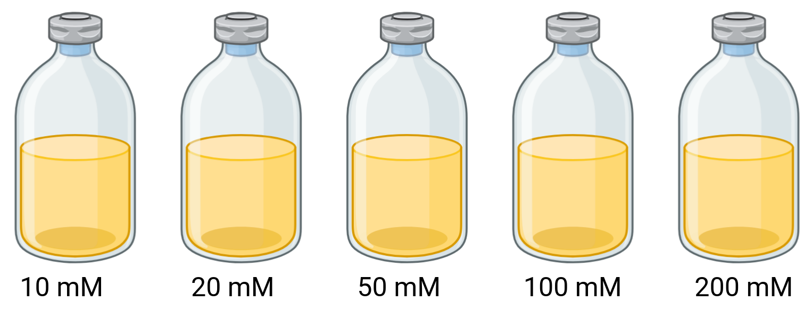
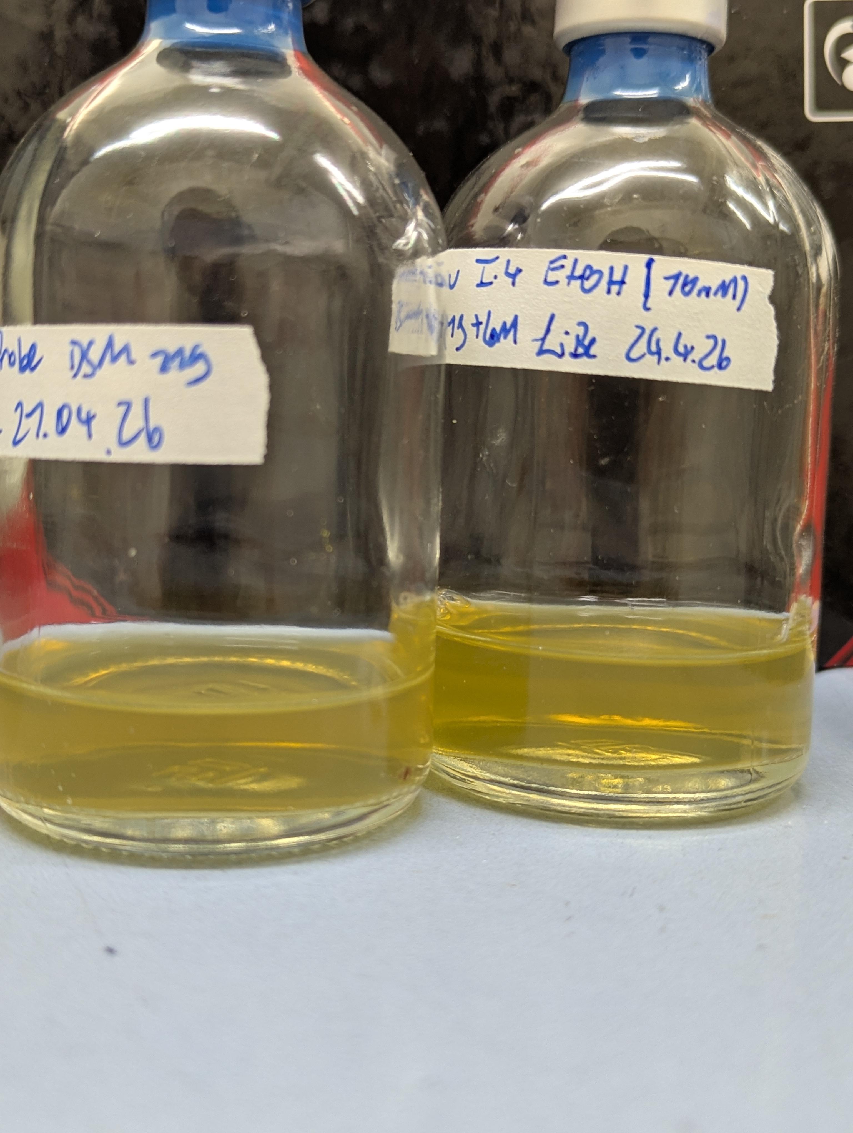
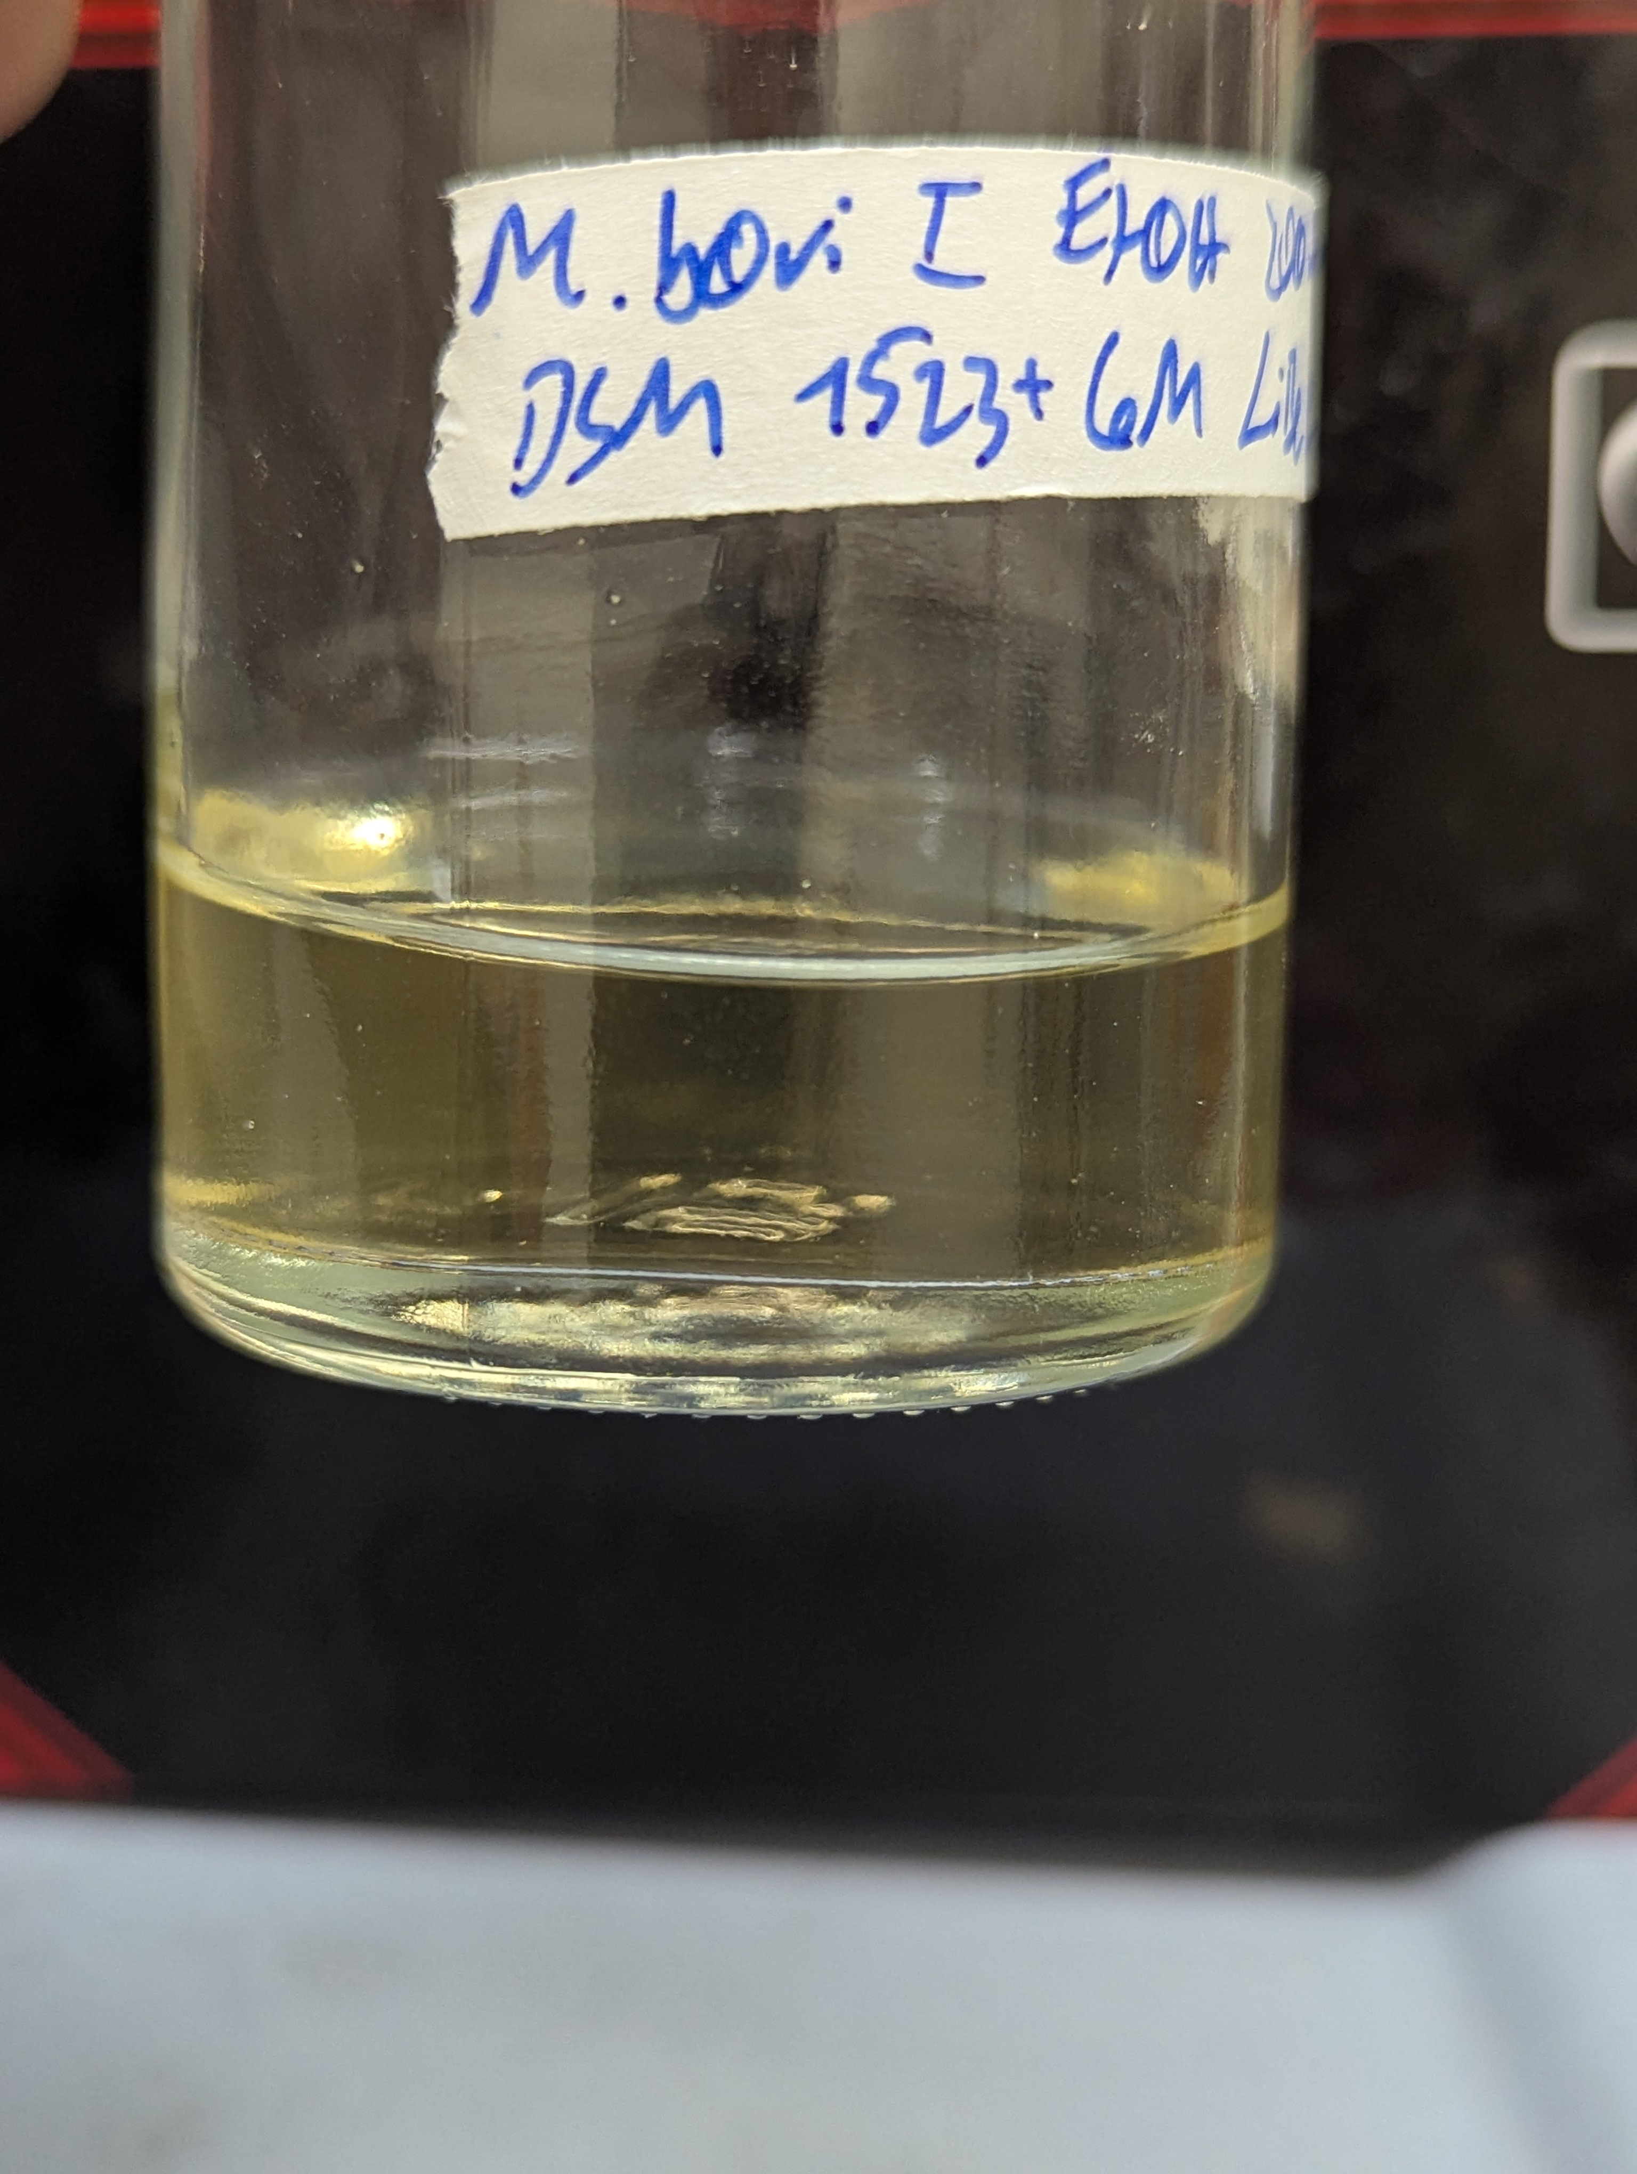
Diffrent substrates
EtOH
Formate
-> Li et al. 2023 M. boviskoreani JH1^{T} grows on 60 mM
M. thaueri
M. boviskoreani
10

Slide 11
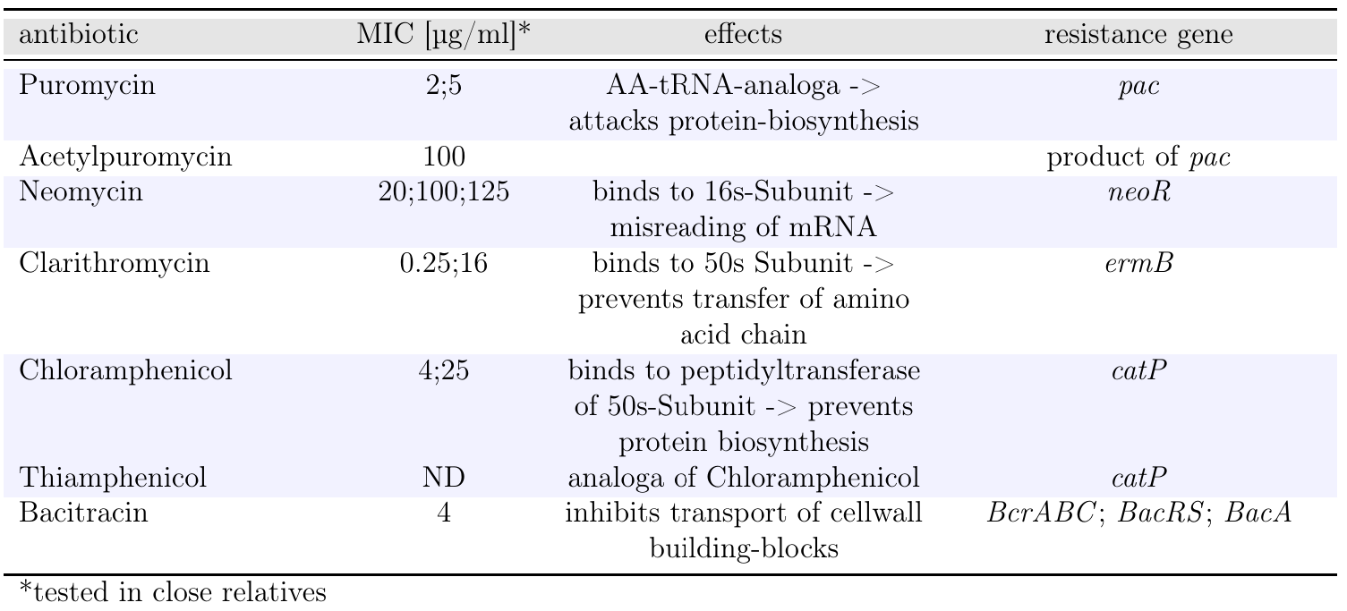
Antibiotica sensitivity
11

Slide 12
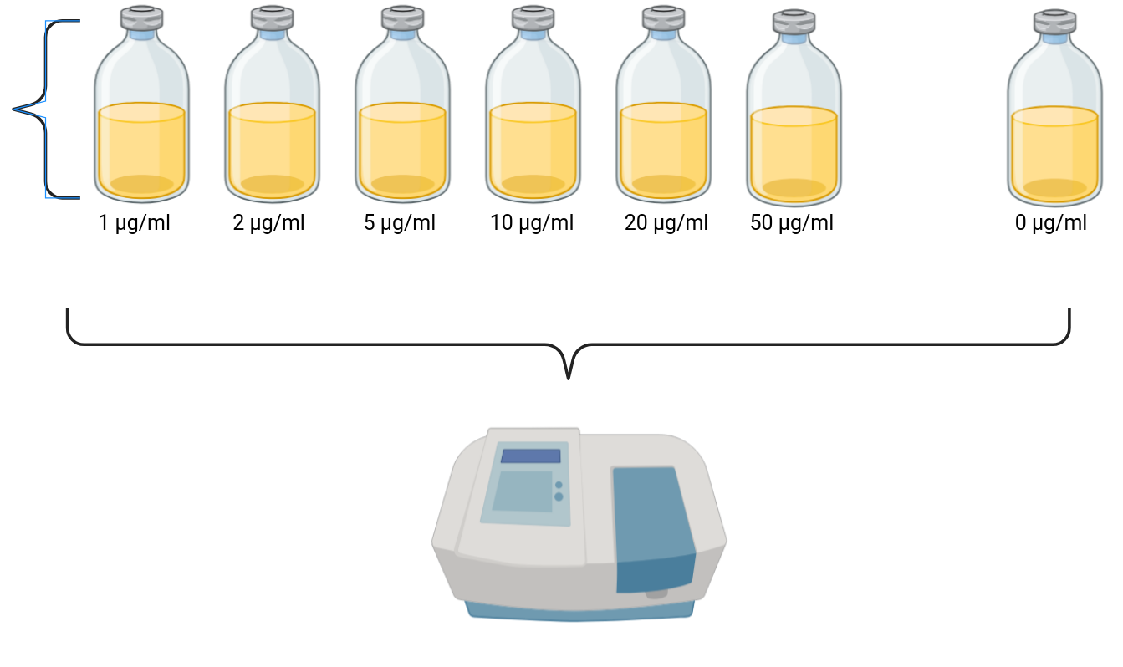
Experiment – puromycin
As triplicats:
+ control
20 ml Medium
+ 2 ml inoculum (10%)
12

Slide 13
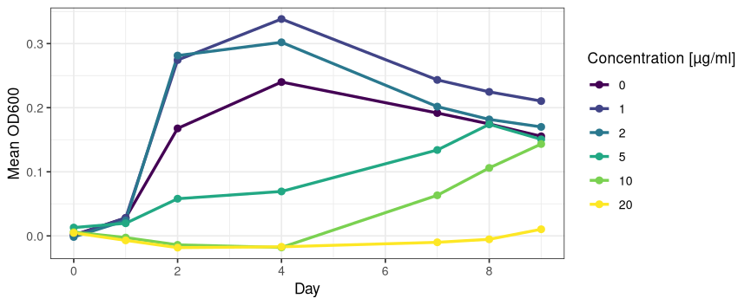
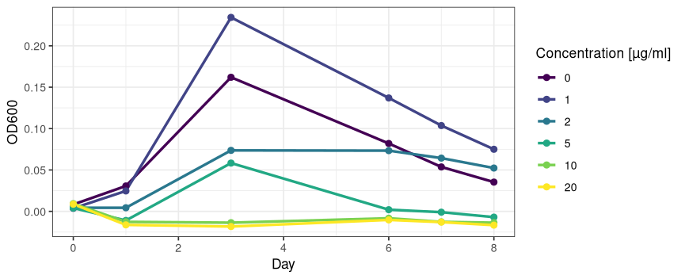
Data – puromycin
M. boviskoreani AbM4
M. thaueri CW

Slide 14
Summary
Work packages:
1. Geodata-analyses of entric
fermentation emission
2. Investigate growth parameters
3. Discover possible selection marker
4. Developing genetic engennering tools
-> Linus S.
13

Slide 15
Thanks for your attention :)
Do You have any questions, tips or notes?
14

Slide 16
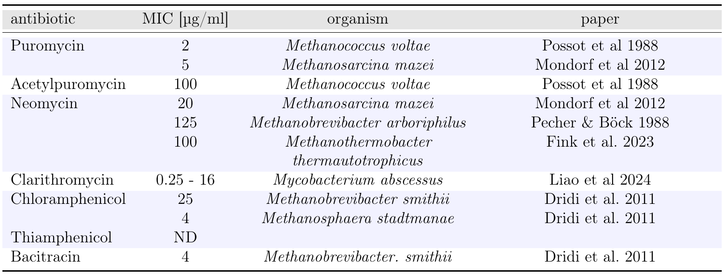
Antibiotica table with specific organism
15

