Slide 1
Data Visualization in Python

Slide 2
Contents
Basic of Data visualization
What Is Python Matplotlib?
What is Matplotlib used for?
Types Of Plots – Bar Graph – Histogram – Scatter Plot – Area Plot – Pie Chart

Slide 3
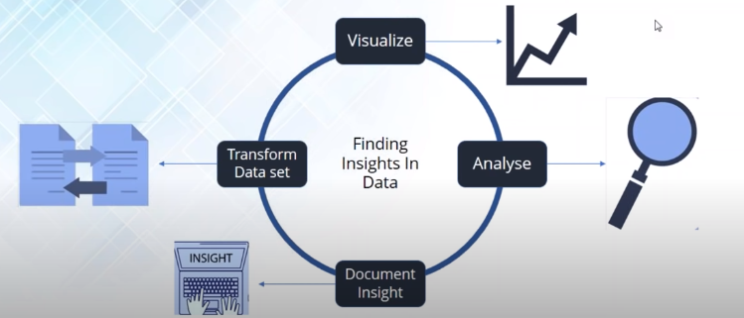
What is Data visualization
Data visualization is representation of data in Pictorial or graph form

Slide 4
What Is Python Matplotlib?
matplotlib.pyplot is a plotting library used for 2D graphics in python programming language.
It can be used in python scripts, shell, web application servers and other graphical user interface toolkits.

Slide 5
What is Matplotlib used for?
Matploitlib is a Python Library used for plotting, this python library provides and objected-oriented APIs for integrating plots into applications.

Slide 6
Is Matplotlib Included in Python?
Matplotlib is not a part of the Standard Libraries which is installed by default when Python,
there are several toolkits which are available that extend python matplotlib functionality.
Some of them are separate downloads, others can be shipped with the matplotlib source code but have external dependencies.
Basemap: It is a map plotting toolkit with various map projections, coastlines and political boundaries.
Cartopy: It is a mapping library featuring object-oriented map projection definitions, and arbitrary point, line, polygon and image transformation capabilities.
Excel tools: Matplotlib provides utilities for exchanging data with Microsoft Excel.
Mplot3d: It is used for 3-D plots.
Natgrid: It is an interface to the natgrid library for irregular gridding of the spaced data.

Slide 7
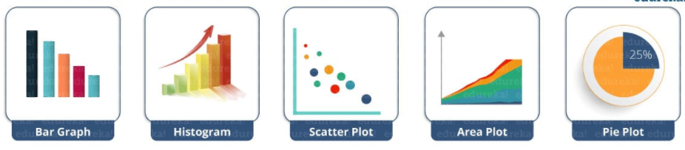
Python Matplotlib : Types of Plots
There are various plots which can be created using python matplotlib. Some of them are listed below:

Slide 8
Program 1
Basic codes in python matplotlib in order to generate a simple graph.
from matplotlib import pyplot as plt
#Plotting to our canvas
plt.plot([1,2,3],[4,5,1])
#Showing what we plotted
plt.show()

Slide 9
Program 2
How can we add title, labels to our graph created by python matplotlib library to bring in more meaning to it.
Consider the below example:
from matplotlib import pyplot as plt
x = [5,2,7]
y = [2,16,4]
plt.plot(x,y)
plt.title('Info')
plt.ylabel('Y axis')
plt.xlabel('X axis')
plt.show()

Slide 10
Change the style of Plot
If you want to change the width or color of a particular line or want to have some grid lines, there you need styling
First, you need to import the style package from python matplotlib library and then use styling functions

Slide 11
Program 3
from matplotlib import pyplot as plt
from matplotlib import style
style.use('ggplot')
x = [5,8,10]
y = [12,16,6]
x2 = [6,9,11]
y2 = [6,15,7]
plt.plot(x,y,'g',label='line one', linewidth=5)
plt.plot(x2,y2,'c',label='line two',linewidth=5)
plt.title('Epic Info')
plt.ylabel('Y axis')
plt.xlabel('X axis')
plt.legend()
plt.grid(True,color='k')
plt.show()

Slide 12
Python Matplotlib: Bar Graph
A bar graph uses bars to compare data among different categories.
Bar Graph is well suited when you want to measure the changes over a period of time.
It can be represented horizontally or vertically.
longer the bar, greater is the value

Slide 13
Program 4.
from matplotlib import pyplot as plt
plt.bar([0.25,1.25,2.25,3.25,4.25],[50,40,70,80,20],
label="BMW",width=.5)
plt.bar([.75,1.75,2.75,3.75,4.75],[80,20,20,50,60],
label="Audi", color='r',width=.5)
plt.legend()
plt.xlabel('Days')
plt.ylabel('Distance (kms)')
plt.title('Information')
plt.show()

Slide 14
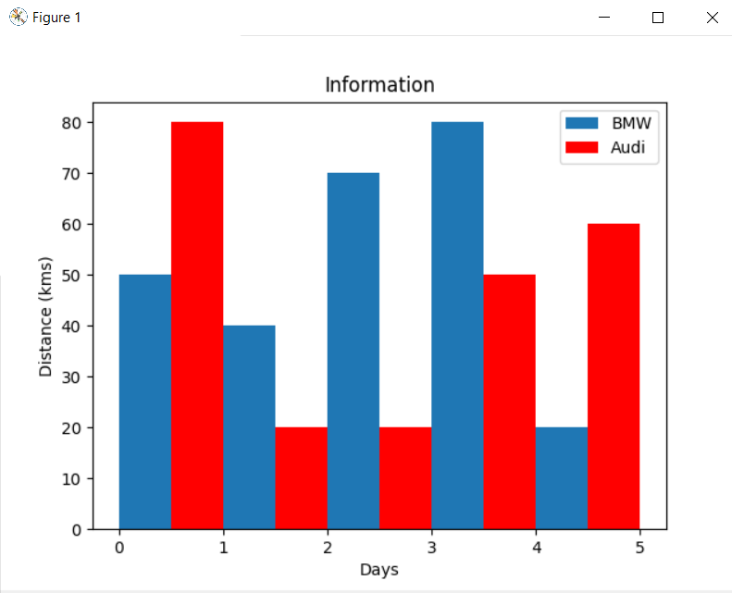
Output of program 3

Slide 15
Python Matplotlib – Histogram
Histograms are used to show a distribution whereas a bar chart is used to compare different entities
Histograms are useful when you have arrays or a very long list

Slide 16
Python Matplotlib – Histogram
Let’s consider an example to plot the age of population with respect to bin.
Now, bin refers to the range of values that are divided into series of intervals.
Bins are usually created of the same size.
We will create the bins in the interval of 10 which means the first bin contains elements from 0 to 9, then 10 to 19 and so on.

Slide 17
Program 5
import matplotlib.pyplot as plt
population_age = [22,55,62,45,21,22,34,42,42,4,2,102,95,85,55,110,120,70,65,55,111,115,80,75,65,54,44,43,42,48]
bins = [0,10,20,30,40,50,60,70,80,90,100]
plt.hist(population_age, bins, histtype='bar', rwidth=0.8)
plt.xlabel('age groups')
plt.ylabel('Number of people')
plt.title('Histogram')
plt.show()

Slide 18
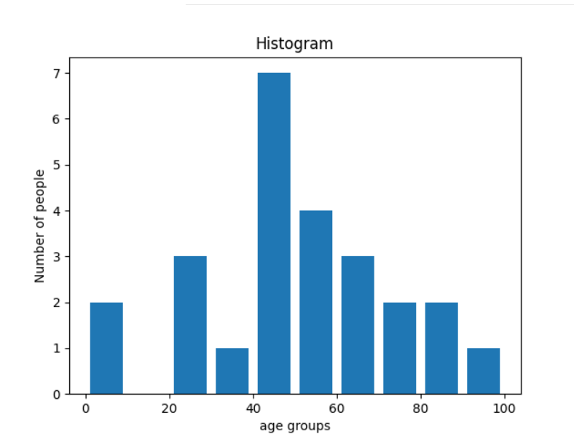
Output of Program 5

Slide 19
Python Matplotlib : Scatter Plot
Scatter plots is used in order to compare variables.
How much one variable is affected by another variable to build a relation out of it
The data is displayed as a collection of points, each having the value of one variable which determines the position on the horizontal axis and the value of other variable determines the position on the vertical axis.

Slide 20
Program 6
import matplotlib.pyplot as plt
x = [1,1.5,2,2.5,3,3.5,3.6]
y = [7.5,8,8.5,9,9.5,10,10.5]
x1=[8,8.5,9,9.5,10,10.5,11]
y1=[3,3.5,3.7,4,4.5,5,5.2]
plt.scatter(x,y, label='high income low saving',color='r')
plt.scatter(x1,y1,label='low income high savings',color='b')
plt.xlabel('saving*100')
plt.ylabel('income*1000')
plt.title('Scatter Plot')
plt.legend()
plt.show()

Slide 21
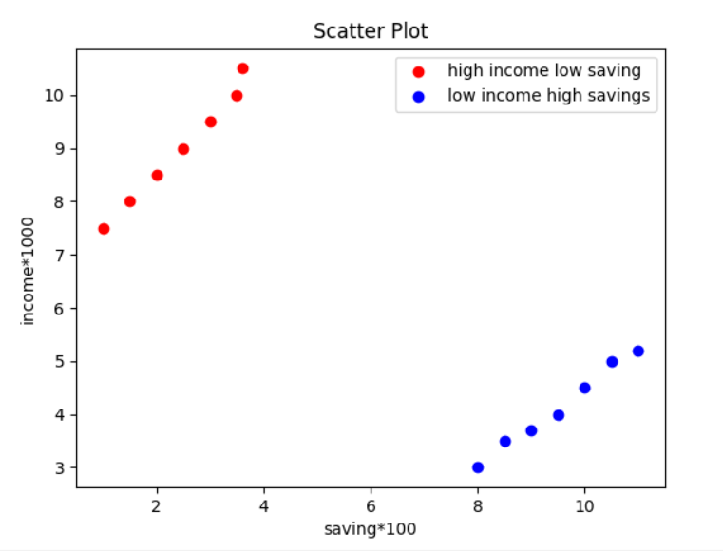
Output of program 6

Slide 22
Python Matplotlib : Area Plot
Area plots are pretty much similar to the line plot.
They are also known as stack plots.
These plots can be used to track changes over time for two or more related groups that make up one whole category

Slide 23
Program 7
import matplotlib.pyplot as plt
days = [1,2,3,4,5]
sleeping =[7,8,6,11,7]
eating = [2,3,4,3,2]
working =[7,8,7,2,2]
playing = [8,5,7,8,13]
plt.plot([],[],color='m', label='Sleeping', linewidth=5)
plt.plot([],[],color='c', label='Eating', linewidth=5)
plt.plot([],[],color='r', label='Working', linewidth=5)
plt.plot([],[],color='k', label='Playing', linewidth=5)
plt.stackplot(days, sleeping,eating,working,playing, colors=['m','c','r','k'])
plt.xlabel('x')
plt.ylabel('y')
plt.title('Stack Plot')
plt.legend()
plt.show()

Slide 24
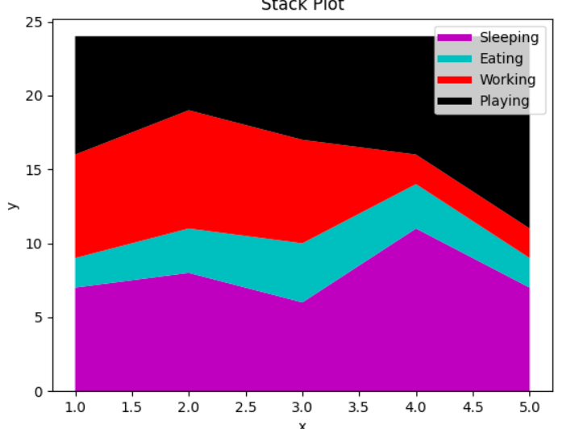
Output of Program 7

Slide 25
Python Matplotlib : Pie Chart
A pie chart refers to a circular graph which is broken down into segments i.e. slices of pie.
It is basically used to show the percentage or proportional data where each slice of pie represents a category.

Slide 26
Program 8
import matplotlib.pyplot as plt
days = [1,2,3,4,5]
sleeping =[7,8,6,11,7]
eating = [2,3,4,3,2]
working =[7,8,7,2,2]
playing = [8,5,7,8,13]
slices = [7,2,2,13]
activities = ['sleeping','eating','working','playing']
cols = ['c','m','r','b']
plt.pie(slices,
labels=activities,
colors=cols,
startangle=90,
shadow= True,
explode=(0,0.1,0,0),
autopct='%1.1f%%')
plt.title('Pie Plot')
plt.show()

Slide 27
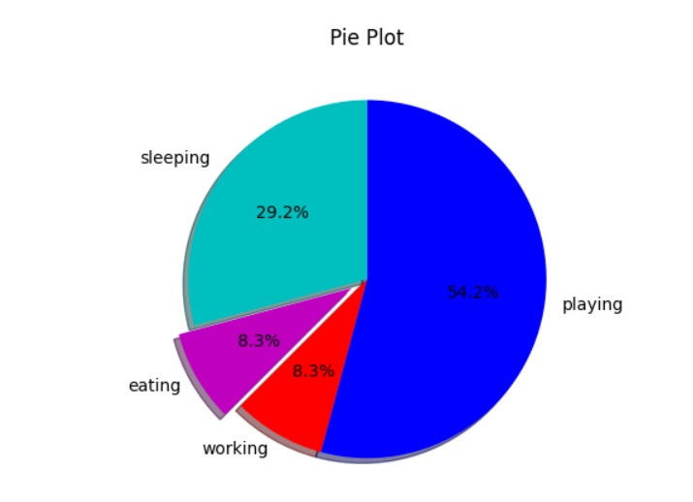
Output of Program 8

Slide 28
Python Matplotlib : Working With Multiple Plots
we have discussed about multiple types of plots in python matplotlib such as bar plot, scatter plot, pie plot, area plot etc.
Now, we will plot multiple plots in single program.
For this, we have to import numpy module

Slide 29
Program 9
import numpy as np
import matplotlib.pyplot as plt
def f(t):
return np.exp(-t) * np.cos(2*np.pi*t)
t1 = np.arange(0.0, 5.0, 0.1)
t2 = np.arange(0.0, 5.0, 0.02)
plt.subplot(221)
plt.plot(t1, f(t1), 'bo', t2, f(t2))
plt.subplot(222)
plt.plot(t2, np.cos(2*np.pi*t2))
plt.show()

Slide 30
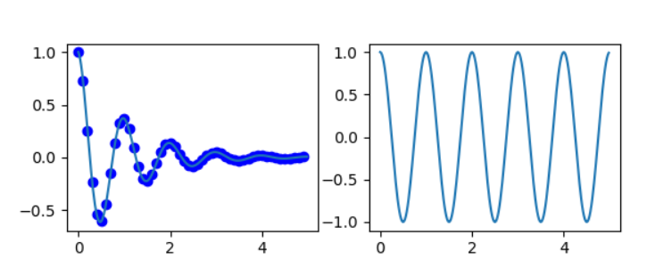
Output of Program 9

Slide 31
Python Matplotlib : Box Plot
.
A Box Plot is also known as Whisker plot is created to display the summary of the set of data values having properties like minimum, first quartile, median, third quartile and maximum
In the box plot, a box is created from the first quartile to the third quartile, a verticle line is also there which goes through the box at the median. Here x-axis denotes the data to be plotted while the y-axis shows the frequency distribution.
The matplotlib.pyplot module of matplotlib library provides boxplot() function with the help of which we can create box plots

Slide 32
Program 10
import matplotlib.pyplot as plt
import numpy as np
# Creating dataset
np.random.seed(10)
data = np.random.normal(100, 20, 200)
fig = plt.figure(figsize =(10, 7))
# Creating plot
plt.boxplot(data)
# show plot
plt.show()

Slide 33
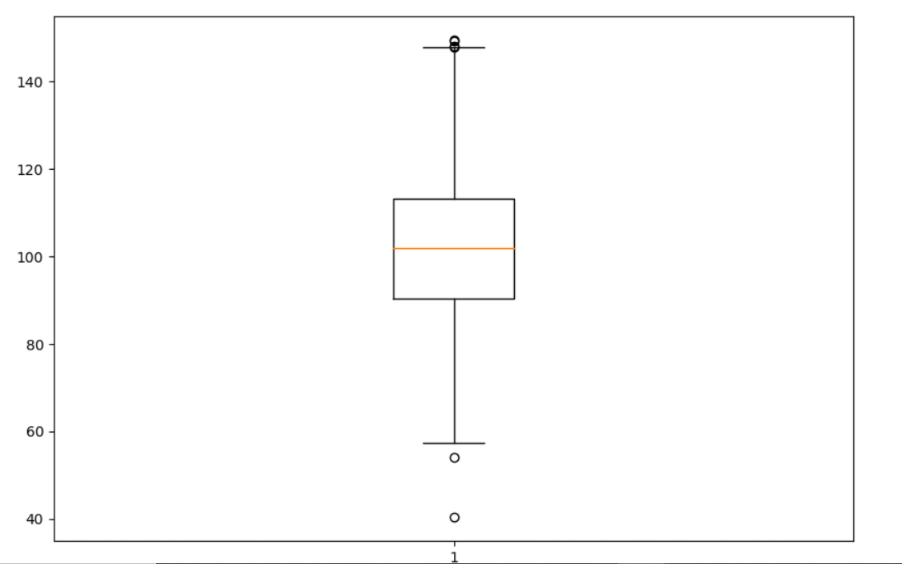
Output of Program 10

Slide 34
Python Matplotlib : Heatmap
A 2-D Heatmap is a data visualization tool that helps to represent the magnitude of the phenomenon in form of colors
Program 11
# Program to plot 2-D Heat map
# using matplotlib.pyplot.imshow() method
import numpy as np
import matplotlib.pyplot as plt
data = np.random.random(( 12 , 12 ))
plt.imshow( data , cmap = 'autumn' , interpolation = 'nearest' )
plt.title( "2-D Heat Map" )
plt.show()

Slide 35
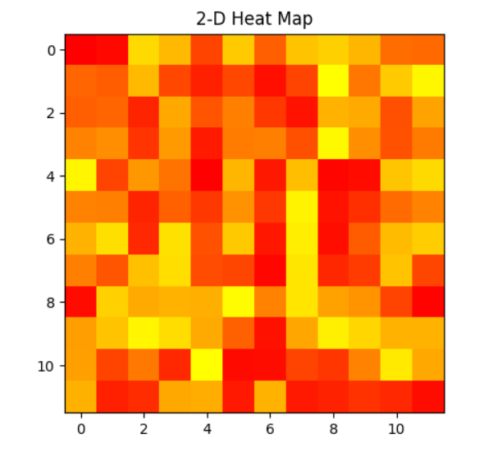
Output of program 11

