Slide 1


SECURITY BENCHMARK
CodeMender best practices
43 runs across Python, Node.js & Java (Benchmark)
Google Cloud · CodeMender v0.14.0
Notes:
Welcome to the CodeMender v0.14.0 security benchmark briefing, grounded in 43 controlled runs across Python (ref-codemender-test), Node.js (juice-shop), and Java (mall).

Slide 2





EVALUATION METRICS
Four discoveries redefine CodeMender deployment
100%
118
90
9.0x
Python GT recall
Peak Node.js bugs
Peak Java bugs
Deep mode uplift
11/11 vulns, 0% FP (Benchmark)
19 Crit, 58 High (Benchmark)
8 Crit, 36 High (Benchmark)
10 to 90 Java bugs (Benchmark)
100% ground-truth recall
4.9x–9.0x deep mode lift
No literal filenames in -c
On Python ref-codemender-test, c3_hybrid_max hits 11/11 recall with 0% false positives.
Concurrent --deep workers jump findings from 24 to 118 (Node.js) and 10 to 90 (Java).
Avoid literal file.ext in --deep -c prompts so Tier 0 pruning never drops your codebase.
Golden evaluation metrics rule: Pair --deep mode with semantic c3_hybrid_max context and expanded config.yaml.
2 / 12
Notes:
Our 43-run evaluation metrics uncovered 100% (11/11) Python ground-truth recall with 0% FP, 118 Node.js findings (4.92x lift), and 90 Java findings (9.0x lift).

Slide 3



TIMEOUT BOTTLENECK
Avoid turn exhaustion & literal filename traps
ANTI-PATTERN: LITERAL FILE TRAP
BEST PRACTICE: SEMANTIC --DEEP
Turn limits & literal -c trap
Semantic context + 16 workers
• Quick mode caps out at 16⁠–⁠24 JS and 10⁠–⁠13 Java findings
• Writing literal requirements.txt in --deep -c yields 0 bugs (py_13)
• Default config.yaml ignores *.xml, *.yml, and *.pug files
• Use semantic manifest descriptions in -c (0 literal file.ext)
• Reaches 100% (11/11) Python GT recall in 76.3s (py_12)
• Unlocks 118 Node.js bugs (4.9x) and 90 Java bugs (9.0x)
Why literal filenames break --deep: Regex scoping + Tier 0 lockfile pruning drops app.py (0% vs 100% recall).
3 / 12
Notes:
Passing literal filenames like requirements.txt in --deep -c caused 0 findings in 0.5s (py_13) due to regex file scoping plus Tier 0 pruning. Semantic descriptions restored 100% recall.

Slide 4



TAINT PIPELINE
Enabling --deep unlocks multi-file taint tracking
Stage 1 — Route & entry enumeration (PROJECT_FILE_INDEX.md)
Maps Python WSGI rules, Express routes, and Spring @RequestMapping controllers.
Stage 2 — Cross-file taint pipeline (16 parallel workers)
Follows tainted parameters through auth filters, services, and MyBatis XML mappers.
Cross-file sink verification
Stage 3 — Sink & safe wrapper check (0% false positives)
Traces untrusted HTTP inputs across Python, TypeScript, and Java files to sinks.
Verifies SQL/NoSQL parameterization and safe_join confinement without false alarms.
4 / 12
Notes:
The --deep taint pipeline operates in three stages: route enumeration, inter-procedural taint propagation across 16 workers, and sink verification with 0% false positives on safe_join.

Slide 5



REASONING ENGINE
Tri-language model comparison across 43 runs
Model & Mode
Target ecosystem
Bugs
Crit / High
Recall / CWE
Sec
3.8 Flash (Quick c3)
Python WSGI (2f)
13
4 / 6
100% (11/11)
231
4 Argon (--deep c3)
Python WSGI (2f)
11
4 / 4
100% (11/11)
76
4 Argon (Quick c0)
Python WSGI (2f)
10
3 / 5
90.9% (10/11)
307
3.5 Flash (Quick c3)
Python WSGI (2f)
12
3 / 5
100% (11/11)
203
3.8 Flash (--deep c3)
Node.js bench (16f)
118
19 / 58
35 CWEs
224
3.8 Flash (--deep c3)
Node.js high (35f)
116
20 / 49
31 CWEs
536
4 Argon (--deep c3)
Java bench (20f)
90
8 / 36
29 CWEs
327
3.8 Flash (--deep c3)
Java bench (20f)
80
7 / 32
29 CWEs
253
Frontier reasoning depth
Gemini 3.8 Flash leads Node.js (118 bugs); 4 Argon leads Java (90 bugs) and zero-shot Python (90.9%).
Tri-language highlight: 100% (11/11) Python GT recall in 76s, 118 Node.js bugs, and 90 Java bugs.
5 / 12
Notes:
Across 43 runs, Gemini 3.8 Flash and 4 Argon both achieve 100% (11/11) Python Ground Truth recall, 118 Node.js bugs, and 90 Java bugs.

Slide 6



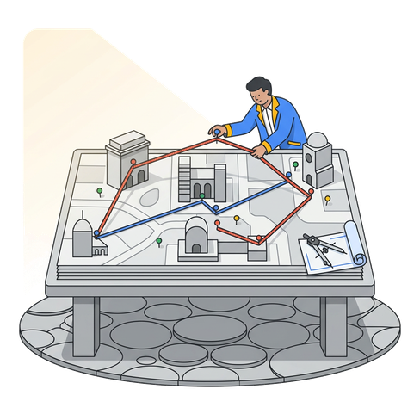

CONTEXT BLUEPRINT
Hybrid -c context unlocks 100% Python GT recall
Zero context baseline
SCA dependency manifest
SAST framework topology
Hybrid max context brief
72.7% Py / 24 JS / 10 Java
100% Py / 25 JS / 13 Java
90.9% Py / 35 JS / 29 Java
100% Py / 118 JS / 90 Java
No -c flag; misses Werkzeug CVEs, Debugger PIN RCE, and Cookie flags.
Supplies semantic manifest versions (Werkzeug 2.2.0, jsonwebtoken, MyBatis).
Maps WSGI handlers, Express routes, Spring controllers, and XML mappers.
Combines semantic SCA versions, SAST sinks, and safe_join control checks.
Context blueprint rule: Use semantic manifest descriptions (zero literal file.ext) to preserve 100% recall in --deep.
6 / 12
Notes:
Moving from c0_none to c3_hybrid_max lifts Python Ground Truth recall from 72.7% (8/11) to 100% (11/11, even on 3.5-flash), Node.js to 118 bugs, and Java to 90 bugs.

Slide 7

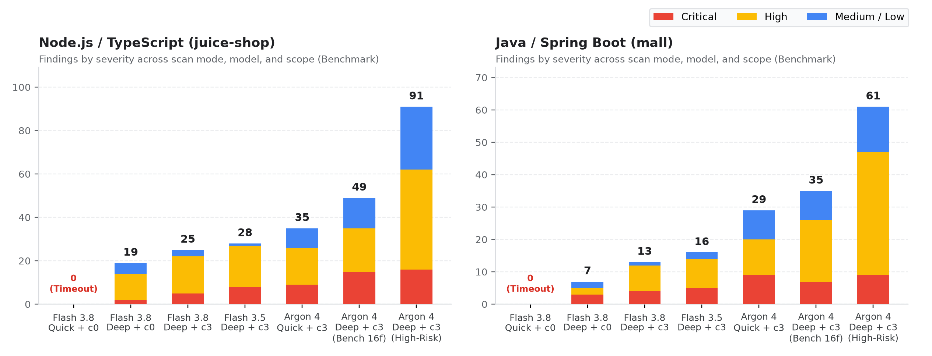


ABLATION GROWTH
Model, mode & context compound
Compounding security gains
Ablation growth across 43 runs: --deep gives 4.9x⁠–⁠9.0x lift while c3_hybrid_max hits 11/11 Python GT recall.
Zero false-positive control
Across all 13 Python runs, 0 runs falsely flagged the safe_join (/files/secure-download) negative control.
43-run takeaway: Combining --deep + c3_hybrid_max hits 100% Python GT recall, 118 JS & 90 Java bugs.
7 / 12
Notes:
This stacked bar chart summarizes our 43-run ablation growth across Python, Node.js, and Java, showing 100% precision (0% FP on safe_join) alongside 4.9x–9.0x discovery lift.

Slide 8




DIRECTORY SCOPING
Match scan mode to repository scale
Microservice scope (1⁠–⁠5 files)
Curated service (15⁠–⁠50 files)
Full core monolith
Python WSGI · 1–3 min
Node.js / Java · 3–6 min
120–300+ files · 10–15 min
Use Quick + c3_hybrid_max or Argon --deep for 100% (11/11) GT recall & full SCA.
Optimal directory scoping with PROJECT_FILE_INDEX.md (118 JS / 90 Java bugs).
Exclude generated ORM POJOs (mall-mbg) and frontend specs to avoid dilution.
Scope profile
Files scanned
Recommended mode & model
Peak findings / Recall
Wall time
Primary CI/CD use case
Python WSGI micro
2 files
Quick or Argon --deep + c3
13 bugs (100% 11/11 GT)
76s–231s
Microservice & PR gate
Node.js bench scope
16 files
3.8 Flash (--deep w=16 t=8)
118 bugs (19 Crit / 58 High)
223.7s
Service-level security gate
Java bench scope
20 files
4 Argon (--deep w=16 t=8)
90 bugs (8 Crit / 36 High)
326.8s
Multi-module release gate
High-risk scale-out
35–48 files
3.8 Flash (--deep w=16 t=8)
116 JS / 59 Java bugs
536s–672s
Nightly full-surface audit
8 / 12
Notes:
Match scan mode to repository size: Quick + c3_hybrid_max or Argon --deep on 1-5 file Python microservices (100% recall), and 16-worker --deep on medium/large Node.js and Java repos.

Slide 9

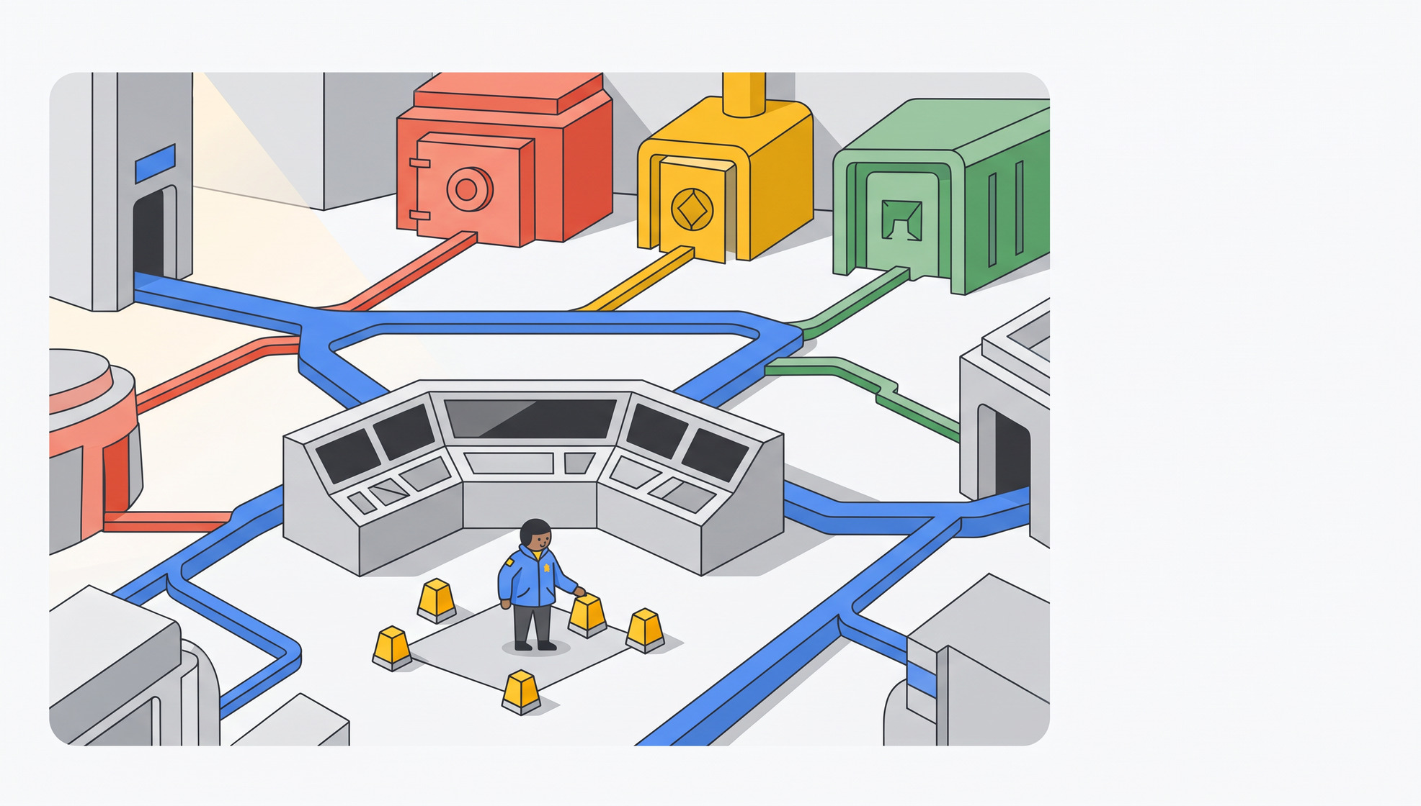

TYPESCRIPT ROUTES
Express best practices capture 118 findings
Vulnerability class (CWE)
Bugs
Representative files & sinks discovered (Benchmark)
CWE⁠-⁠94 / 1336 Code & SSTI RCE
14
views/promotionVideo.pug (Pug SSTI), b2bOrder.ts (vm)
CWE-89 SQL Injection
8
routes/search.ts, login.ts (Sequelize raw interpolation)
CWE-943 NoSQL Injection
9
routes/showProductReviews.ts, trackOrder.ts (MarsDB)
CWE⁠-⁠918 Server-Side Request Forgery
5
routes/profileImageUrlUpload.ts (unvalidated HTTP fetch)
CWE⁠-⁠22 / 611 Path Traversal & XXE
12
routes/fileUpload.ts (unzipper Zip Slip & libxmljs XXE)
CWE⁠-⁠347 / 327 JWT & Crypto Flaws
15
lib/insecurity.ts (RS256->HS256 confusion, MD5, keys)
Express route tainting
CWE⁠-⁠639 / 862 Broken Access Control
21
routes/basket.ts (IDOR), dataErasure.ts, updateProductReviews
Target typescript routes/.ts, lib/insecurity.ts, and views/.pug while excluding UI bundles.
CWE⁠-⁠79 / 601 XSS & Open Redirect
16
routes/redirect.ts, userProfile.ts (reflected XSS)
9 / 12
Notes:
On OWASP Juice Shop typescript routes, Gemini 3.8 Flash with --deep and c3_hybrid_max identified 118 vulnerabilities across 35 unique CWEs in 223.7 seconds.

Slide 10




MYBATIS MAPPERS
Spring Boot & MyBatis rules uncover 90 findings
MyBatis XML SQL injection
Missing endpoint authorization
Config secrets & OSS uploads
Add .xml to config.yaml and scan resources/dao/*.xml to catch ${} SQLi in OmsOrderDao.xml (8 Critical).
Pair portal controllers with SecurityConfig to expose unauthenticated admin routes and order IDOR (36 High).
Add .yml to config.yaml to audit JWT secrets in application.yml, MinioController XSS, and Alipay callbacks.
Java golden scope rule: Exclude mall-mbg POJOs, add .xml/.yml to config.yaml, and generate PROJECT_FILE_INDEX.md.
10 / 12
Notes:
On the macrozheng/mall Spring Boot codebase, combining Java controllers, Spring YAML configs, and MyBatis XML mappers yielded 90 findings across 29 CWEs.

Slide 11

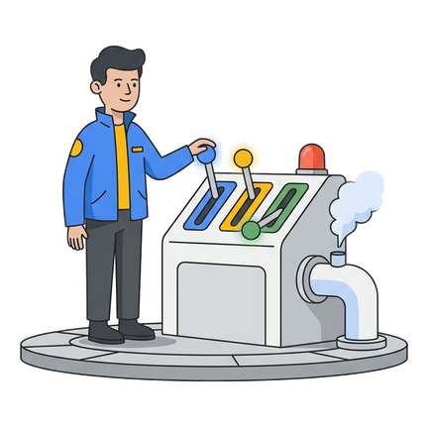

PIPELINE AUTOMATION
Standardize PR gates and nightly deep audits
Production CLI profile (pipeline.py wrapper)
Automated CI/CD security gate
Pipeline automation: keep --enable-bash off for 1.87x faster parallel worker completion.
1. Configure CM_HOME/config.yaml & PROJECT_FILE_INDEX.md
include: [.py, .txt, .js, .ts, .java, .json, .xml, .yml, .pug, .hbs]
2. Build semantic hybrid context (-c with 0 literal file.ext)
export CM_CTX="Read file index; correlate manifest CVEs + SAST sinks."
SQLite & JSON reporting
Export cm report -f json and state.db findings to block PR merges on Critical/High CWEs.
3. Execute parallel deep scan (native tools, no --enable-bash)
cm -y --sandbox=false find . --deep --deep-workers 16 --deep-max-turns 8 -c "$CM_CTX"
11 / 12
Notes:
Use this copy-paste pipeline automation template in CI/CD to configure config.yaml extensions, inject a semantic hybrid -c brief, and invoke cm find --deep.

Slide 12

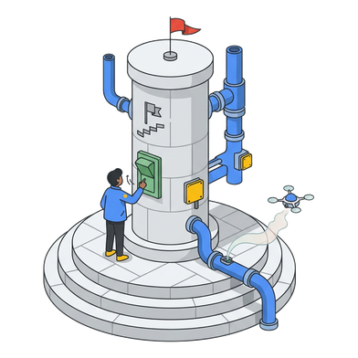


ROLLOUT ROADMAP
Five rules unlock peak recall across 3 stacks
Match mode to repo scale
Zero literal filenames in -c
Extend config.yaml & index
Use Quick+c3 on 1⁠–⁠5 file microservices (100% Py GT) and --deep on 10⁠–⁠300+ file repos.
Use semantic manifest descriptions in --deep -c so Tier 0 pruning never drops code.
Add .xml, .yml, .json, .pug, .txt to config.yaml and generate PROJECT_FILE_INDEX.md.
Rollout dimension
Anti-pattern to avoid
Recommended golden standard
Verified 43-run impact
Prompt syntax (-c)
Literal file.ext in --deep -c (py_13: 0%)
Semantic manifest description + versions
0% -> 100% (11/11) Python GT
Analysis mode
Quick mode on large multi-file repos
--deep --deep-workers 16 --deep-max-turns 8
4.92x JS (118) & 9.0x Java (90)
Config & extensions
Default config.yaml (misses XML/YAML)
Add .xml, .yml, .json, .pug + FILE_INDEX
Unlocks MyBatis SQLi & SSTI
Precision control
Unbounded noisy prompts
c3_hybrid_max + safe wrapper verification
100% recall with 0% FP (safe_join)
12 / 12
Notes:
Follow these five golden rules verified across 43 runs in Python, Node.js, and Java to achieve 100% Ground Truth recall with 0% false positives.

