Slide 1



Final-Year Projects 2026-27
Changhong ZHAO (趙常宏)
Associate Professor
chzhao@ie.cuhk.edu.hk
Office: SHB 806

Slide 2
Logistics management
Social networks
Information, communication
… …
Networked systems
Transportation
Water, heat, fuel, …
Power systems

Slide 3

Motivation: more energy, less emission
Renewable generation
(generation)
Electrification
(on land)

Slide 4
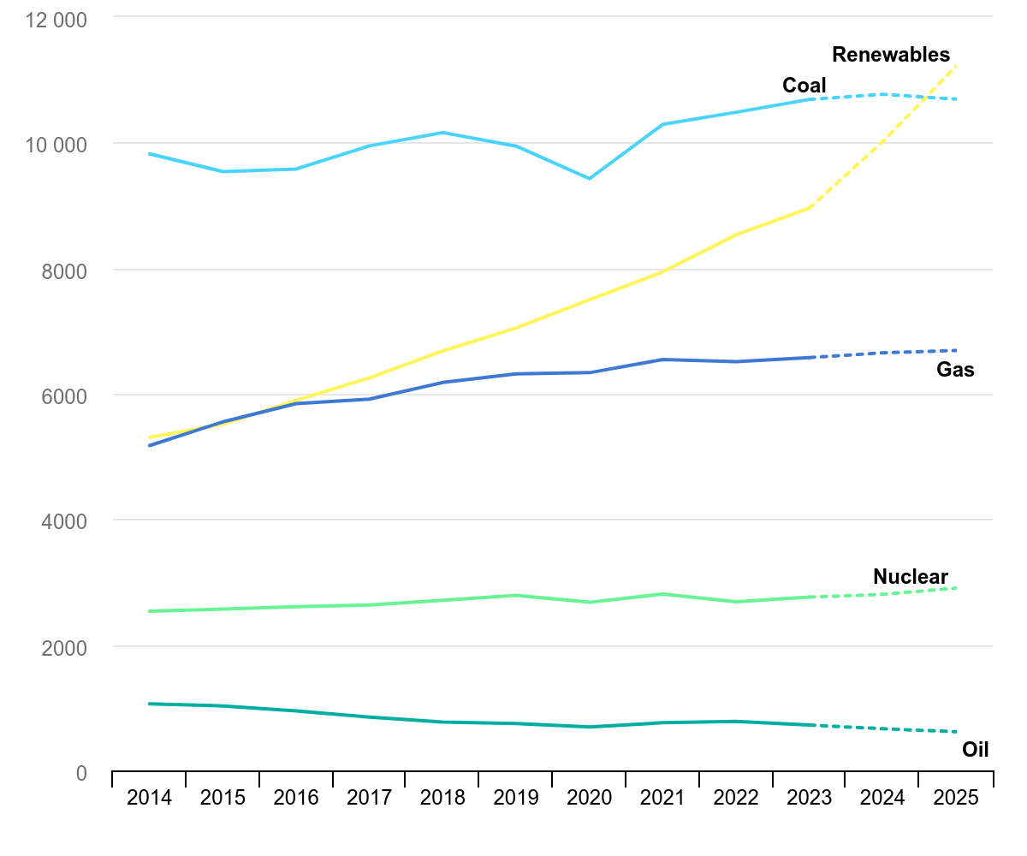
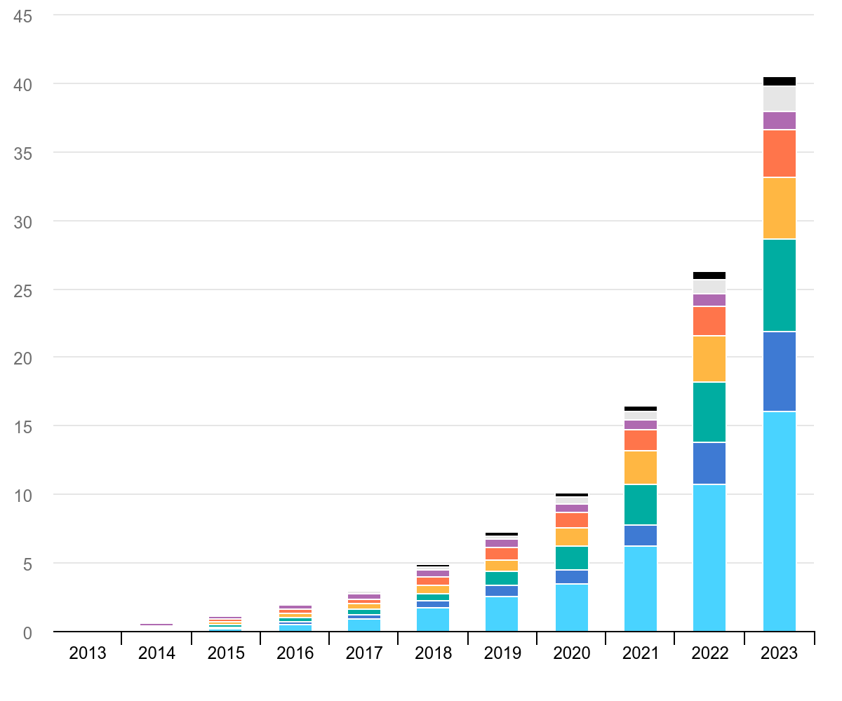
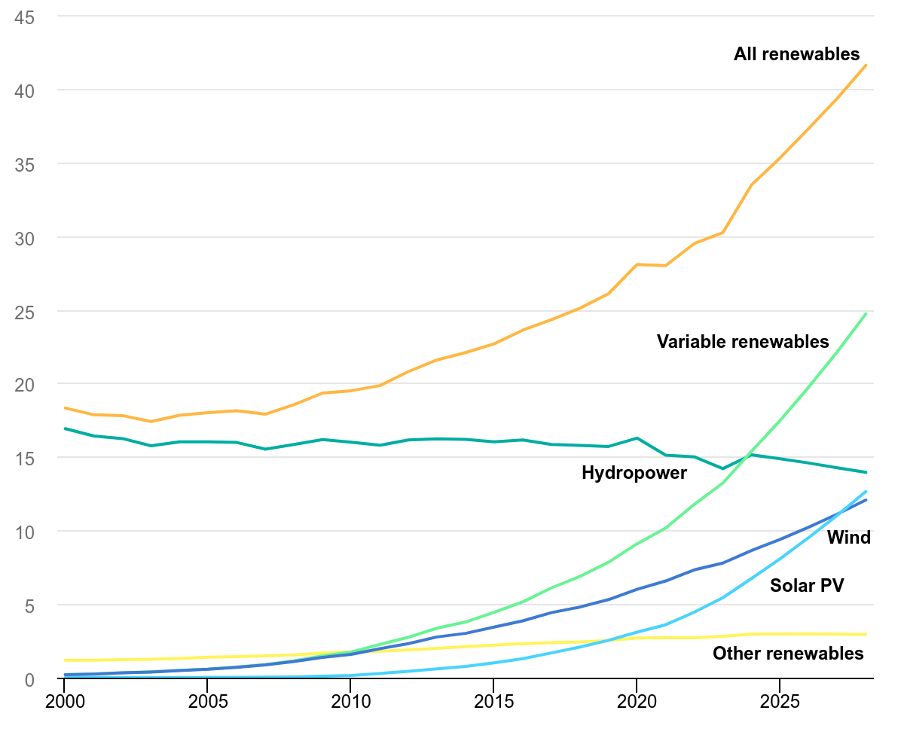
Trends in power systems
(TWh)
Global electricity generation by source
Renewables
Coal
Gas
Nuclear
Oil
Global electric car stock
(millions)
Other PHEV
Other BEV
US PHEV
US BEV
Europe PHEV
Europe BEV
China PHEV
China BEV
(%)
Share of renewable generation by technology
All renewables: 42%
Variable renewables (wind, solar PV): 25%
Hydropower: 14%
Other renewables (e.g., biomass): 3%
All figures in this page are from iea.org

Slide 5
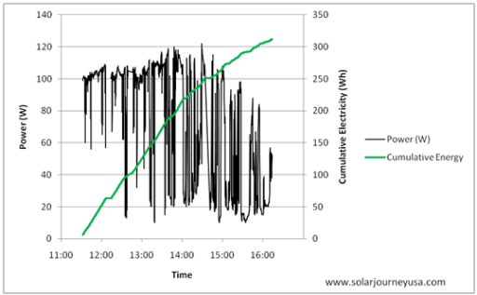

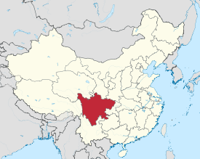
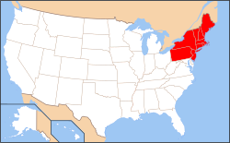
Solar power: big potential, big risk
Solar PV output
Voltage (V)
252
240
228
One-month voltages
University of Hawaii

Slide 6
CHZ1: Power network topology optimization (1~2 students)
Solve optimal topology and power flow (OTPF) problem:
Jointly optimize on/offs of power lines and generations, loads, power flows, for reliable, efficient operation with high renewables
Develop an OTPF solution algorithm with improved computation efficiency and solution quality
Proposed method lowers power loss than Method 3
Our recent method (left) based on
successive optimization improves
voltage stability over time (right).
Tasks:
(4998) Broadly study existing OTPF models and solution algorithms in the literature.
(4998/4999) Develop computer (e.g., MATLAB) simulation of power network testcases to benchmark and compare different algorithms.
(4999) Develop a novel algorithm and demonstrate its performance on your simulation platform.

Slide 7
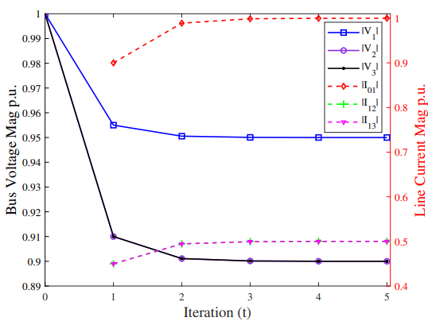
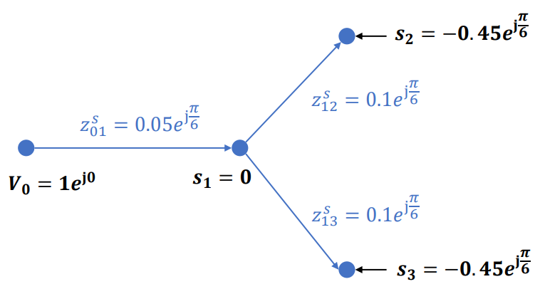
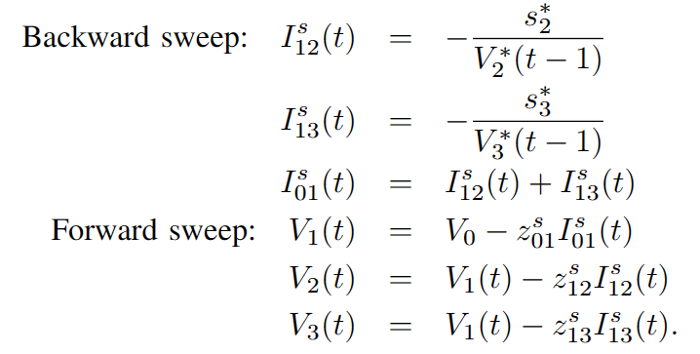
CHZ2: Improving AC power flow solution (1~2 students)
Solve the fundamental AC power flow problem​:
Given some variables in nonlinear AC power flow equations, solve for other variables
Common methods:​ Newton-Raphson; Backward-Forward Sweep (BFS)
A simple case of power flow problem and its BFS algorithm (left), which converges to the desired solution (right).
Tasks:
(4998) Broadly study existing power flow algorithms and their convergence analyses in the literature.
(4998/4999) Develop computer (e.g., MATLAB) simulation of power network testcases to benchmark and compare different algorithms.
(4999) Improve the convergence rate of the existing BFS algorithm and demonstrate the improvement on your simulation platform.

Slide 8
CHZ3: Self-proposed topic (1~2 students)
Any topic that applies mathematics to solve a practical engineering problem.
Preference for control and dynamical systems, stochastic processes, optimization, machine learning, game theory, and networked systems.
Please email me: chzhao@ie.cuhk.edu.hk a half-page project proposal for discussion and approval of your topic.

