Slide 1

Monarch
A ‘Reddit’ clone

Slide 2
Application Concept

Slide 3
"Monarch" is a social platform drawing inspiration from Reddit and other similar message boards. It utilizes numerous associated tables within an SQL database to achieve parent-child data relationships. Users can submit posts to the forum, view current posts by category or author, as well as vote and comment on other users' posts. Posts can be "liked" or "disliked" by other users, forming the basis of the monarch ranking system.

Slide 4
Technologies Used:

Slide 5
MySQL - constructing the database
Node.js and Express Web Server with Body-Parser
Sequelize.js - building the tables and required associations an ORM to establish queries and other functions used throughout the app
Handlebars - handling the web structure of user posts and comments
jQuery - dynamically manipulating elements of the UI
API routes for accepting user CRUD requests
A Model-View-Controller (MVC) structure for our directory
Materialize for styling (new Tech for us)

Slide 6
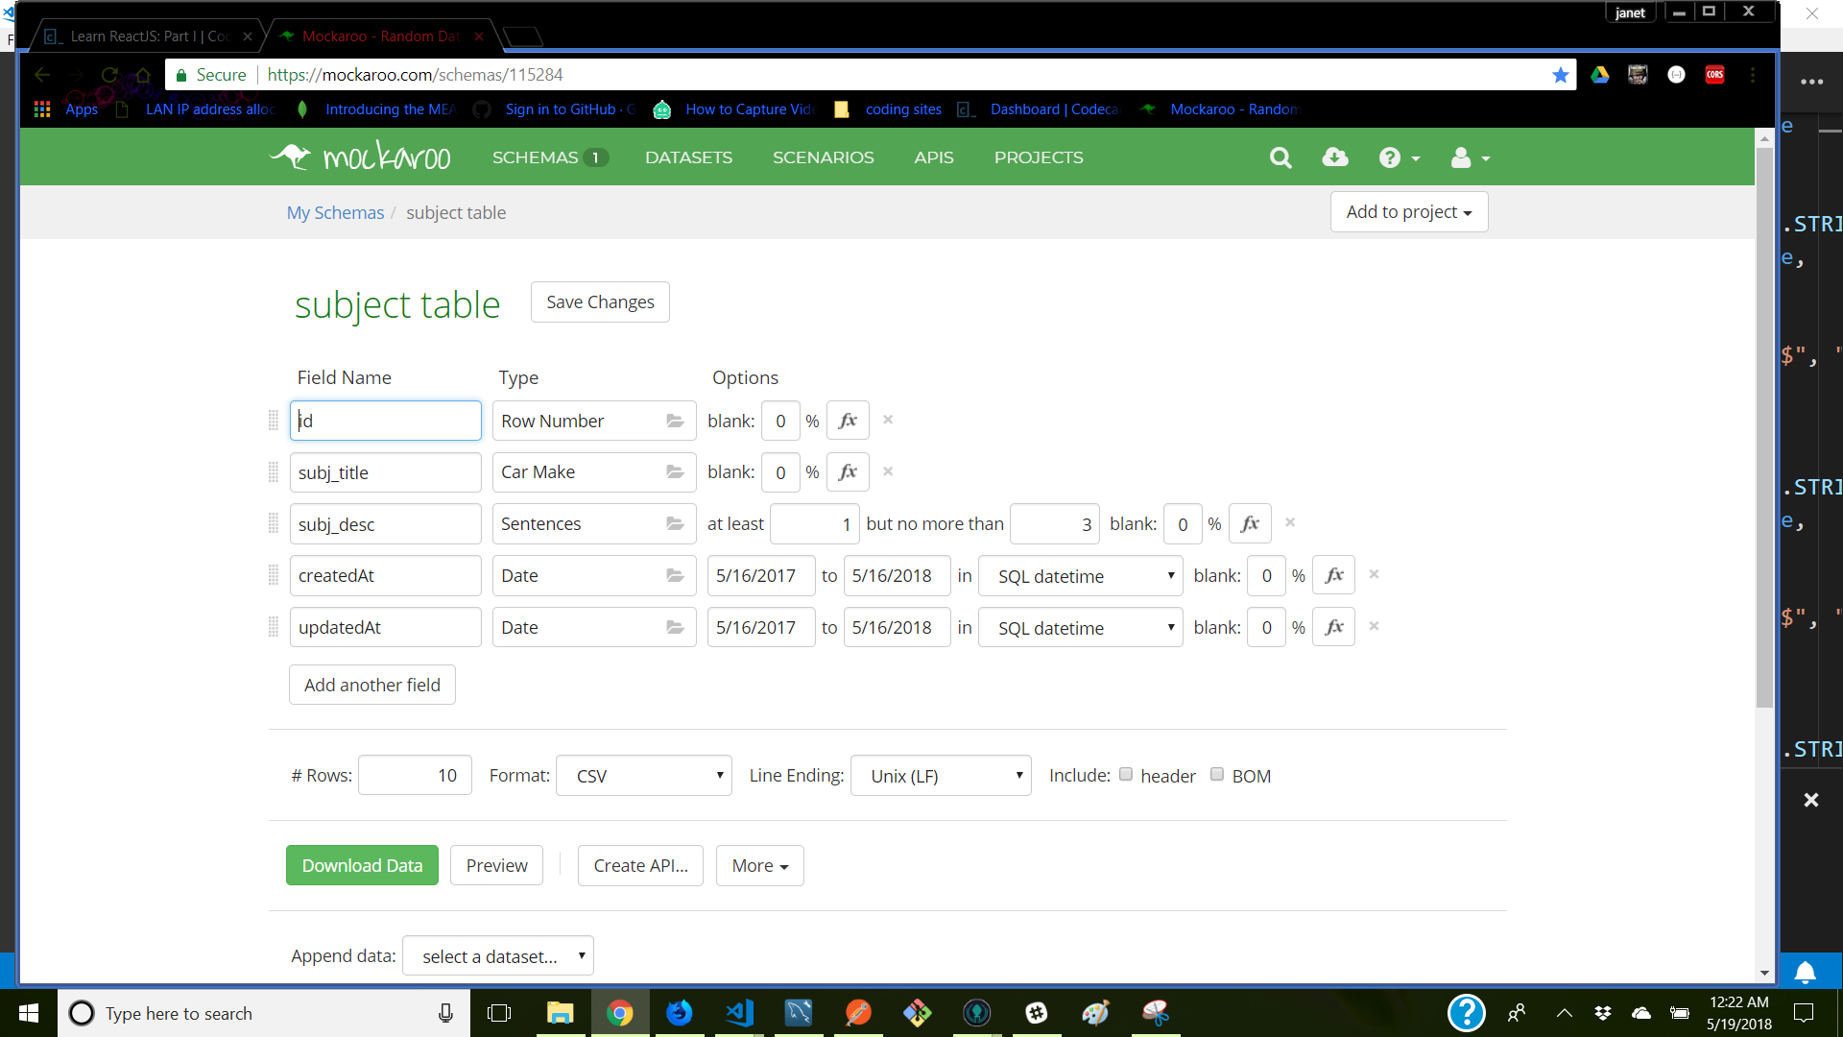
Mockaroo to populate our database

Slide 7
Design Process

Slide 8
Brainstorming always starts with a random topic which this time was butterfly.
Through much deliberation, we finally landed on trying to replicate reddit which with their upvote system led us to getting the most likes on a post would make you King of that subject.
King led to Monarchy which led to Monarch as our idea (be sure to know this tied into the butterfly).
WE HAD NO IDEA HOW INVOLVED THIS WAS GOING TO BE!

Slide 9
Demonstration
Monarch

Slide 10

Directions for future plans and uses

Slide 11
The End…………Questions ??????

