Slide 1
Collections
1.Introductions
2.List
3.Set
4.Map
5.Questions and Codes

Slide 2
1.Introdutions
Collection:
1. List : LinkedList, ArrayList,Vector
2. Set
3.Map: Hashtable, HashMap, WeakHashMap
Collection接口 Collection是最基本的集合接口，一个Collection代表一组Object，即 Collection的元素（Elements)

Slide 3
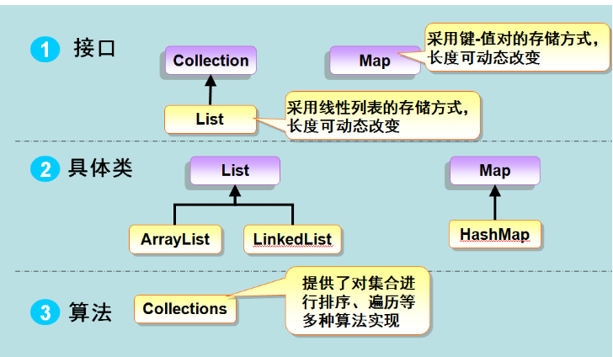
集合框架体系

Slide 4
2. List
List子接口:有序，可以有重复元素。
eg. List list = new ArrayList() or List list = new LinkedList();
// list.add(“abd”);
list 自带方法：
void add(int index, Object element)
boolean addAll(int index, Collection collection)
Object get(int index)
int indexOf(Object element)
int lastIndexOf(Object element)
Object remove(int index)
Object set(int index, Object element)

Slide 5
3. Set
Set子接口:无序，不允许重复
eg. Set set = new HashSet();
Set<String> set = new HashSet<String>();
Iterator<String> it = set.iterator();
while (it.hasNext()) {
String str = it.next(); System.out.println(str);
}
注：set.add(“test”)等方法类似于List

Slide 6
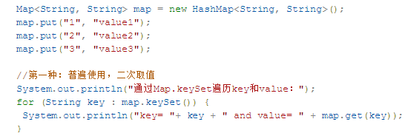
4.Map
Map 接口不是 Collection 接口的继承,而是从自己的用于维护键-值关联的接口层次结构(key- value)
eg. Map map =new HashMap();
map.put(“key”,”test”);
map.get(“key”);
内置方法：
Object get(Object key)
boolean containsKey(Object key)
boolean containsValue(Object value)
int size()
boolean isEmpty()

Slide 7
5.Questions and Codes
1.List
package com.pactera.java.set;
import java.util.HashSet;
import java.util.Iterator;
import java.util.Set;
public class SetTest {
public static void main(String[] args) {
News news = new News(1,"招聘","peter");
News test = new News(2,"考试","Jack");
Set newsSet = new HashSet();
newsSet.add(news);
newsSet.add(test);
System.out.println("新闻总数："+ newsSet.size());
System.out.println("是否包含："+ newsSet.contains(test));
}
}

Slide 8
2.Set
package com.pactera.java.set;
import java.util.HashSet;
import java.util.Iterator;
import java.util.Set;
public class SetTest {
public static void main(String[] args) {
News news = new News(1,"招聘","peter");
News test = new News(2,"考试","Jack");
Set newsSet = new HashSet();
newsSet.add(news);
newsSet.add(test);
System.out.println("新闻总数："+ newsSet.size());
System.out.println("是否包含："+ newsSet.contains(test));
}
}

Slide 9
3.Map
News news = new News(1,"招聘","peter");
News test = new News(2,"考试","Jack");
Set newsSet = new HashSet();
newsSet.add(news);
newsSet.add(test);
System.out.println("新闻总数："+ newsSet.size());
System.out.println("是否包含："+ newsSet.contains(test));

