Slide 1
Climate Change Tracker
Web503 Advanced Full stack Web development
Prof. Rich Loke
Fupin Yao

Slide 2
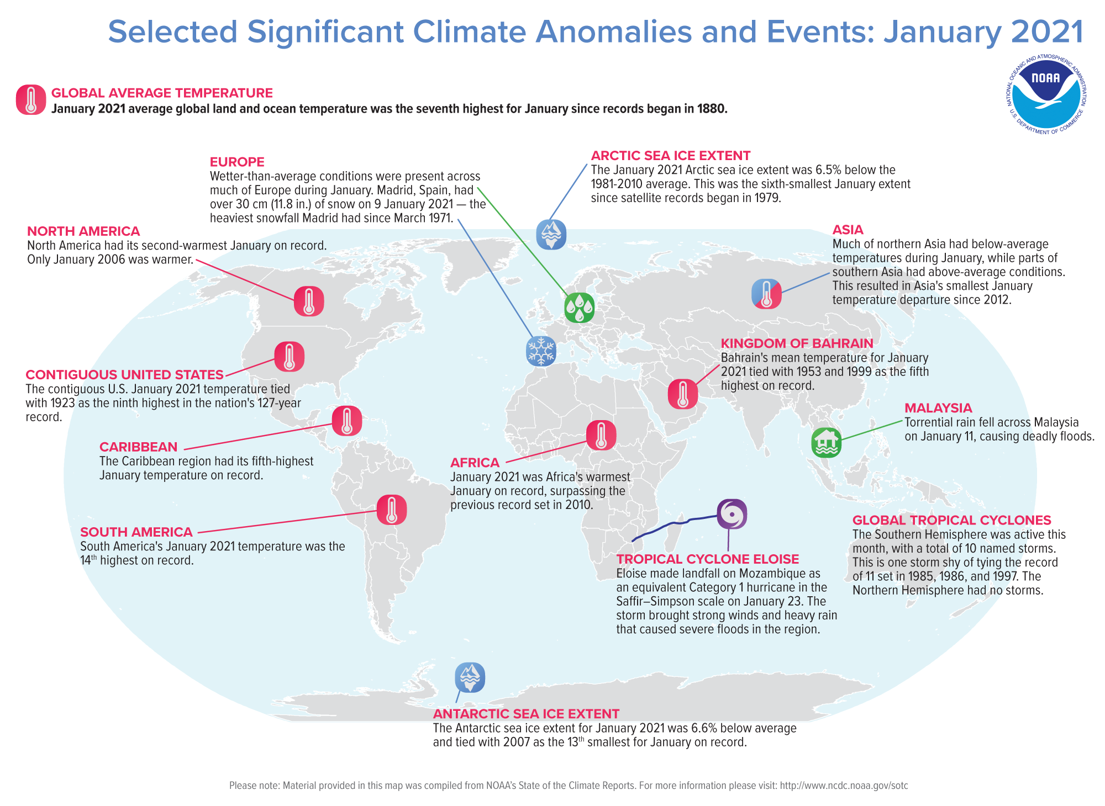
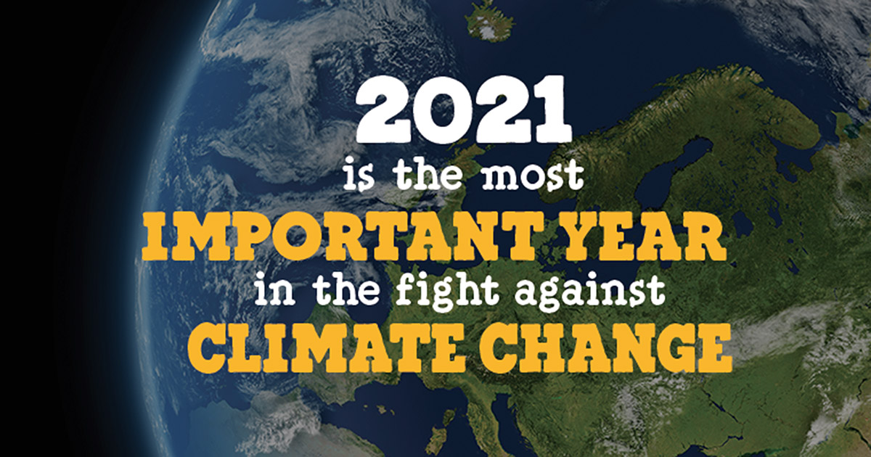
Introduction
We have seen dramatic climate events this year. It’s time to act!

Slide 3
Objectives
We hope everyone can report abnormal climate events and see climate reports

Slide 4
Target audience
Everyone who is interested in climate change.

Slide 5
Key Features
Report abnormal climate events
Names, description, time, address, emergency levels
See climate reports
Summary of events globally or in the selected city
Events nearby when inputting a zip code

Slide 6
Technology Requirements
React, Mongodb, Facebook OAuth login, MongoDB, JSON/Ajax, SSL
Third-party APIs: http://www.zipcodeapi.com/

Slide 7
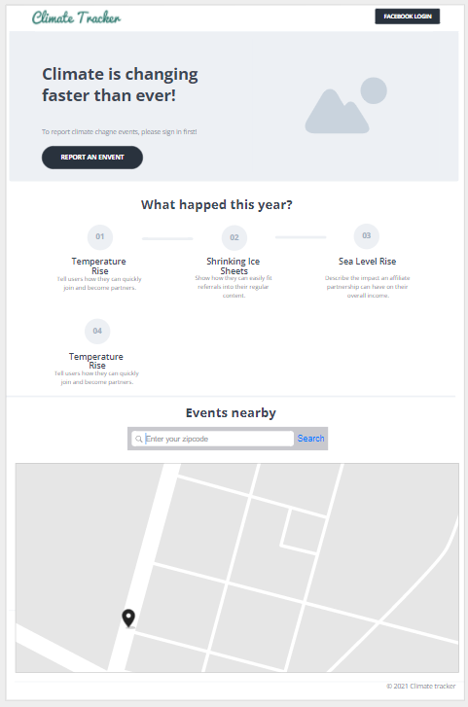
Wireframes
https://app.moqups.com/uNDbOwmynd/view/page/ac51565f3

Slide 8
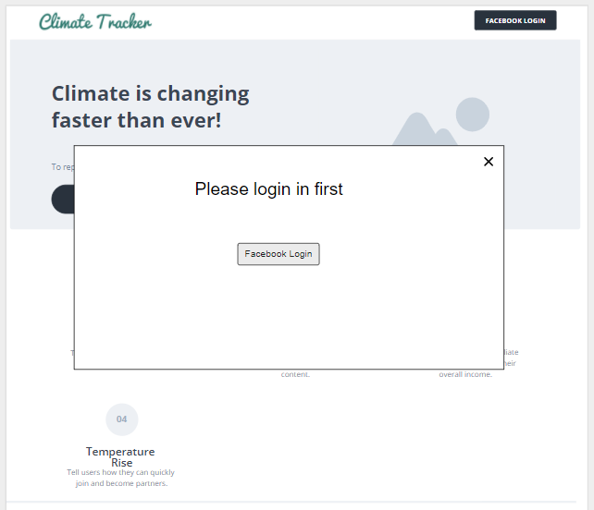
Wireframes
https://app.moqups.com/uNDbOwmynd/view/page/ac51565f3

Slide 9
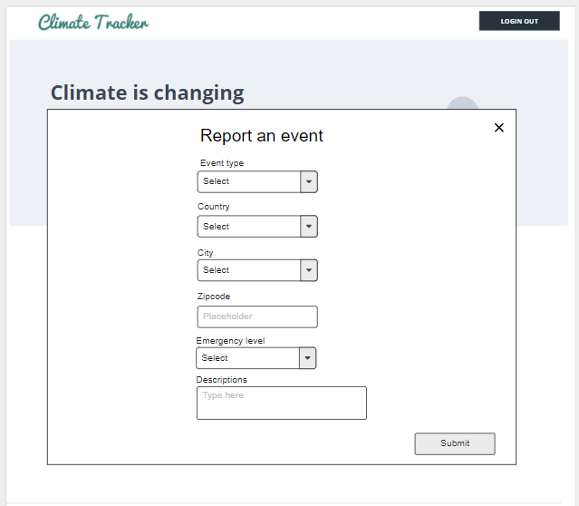
Wireframes
https://app.moqups.com/uNDbOwmynd/view/page/ac51565f3

Slide 10
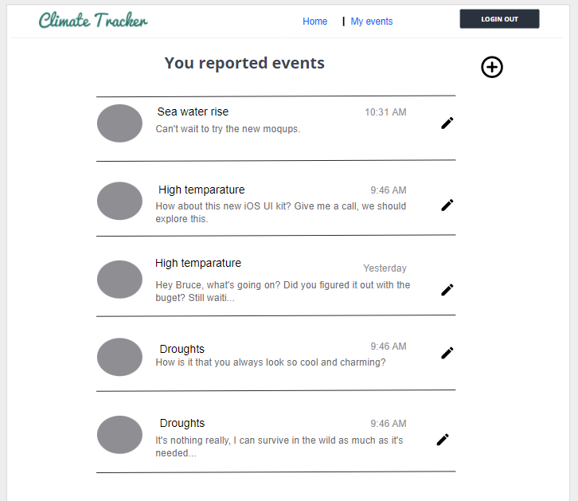
Wireframes
https://app.moqups.com/uNDbOwmynd/view/page/ac51565f3

