Slide 1
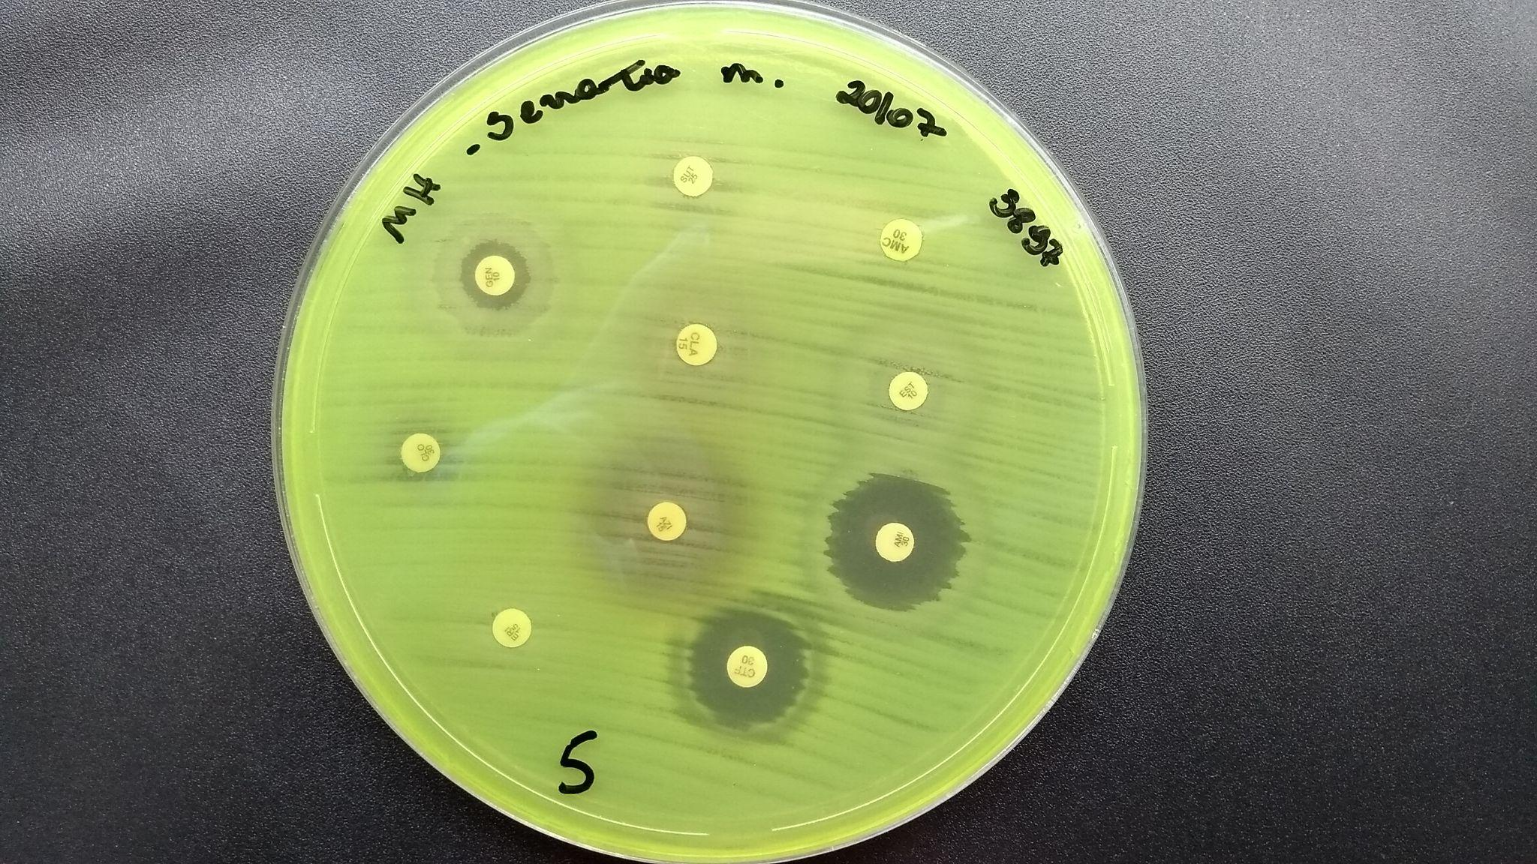
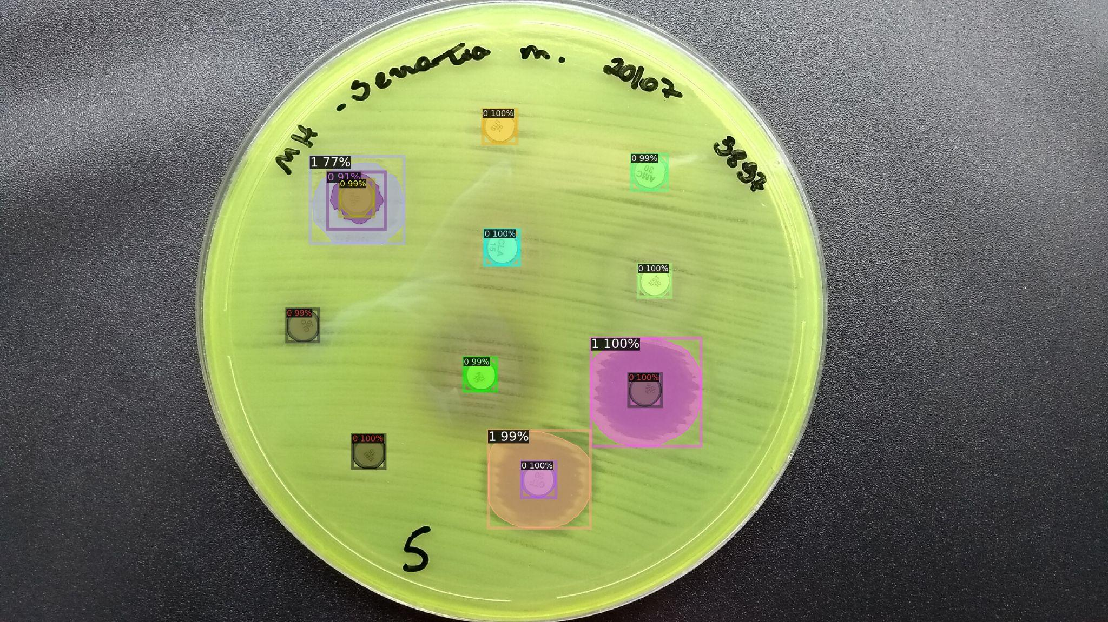
Business Use Case

Slide 2
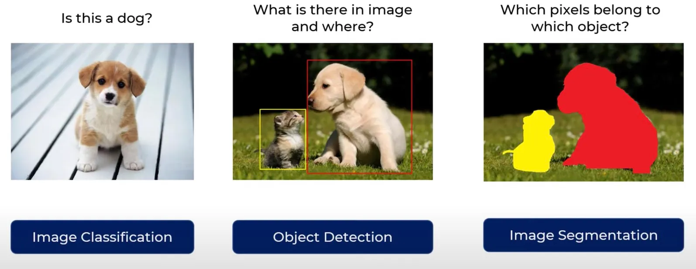
Classification,Detection and Segmentation

Slide 3
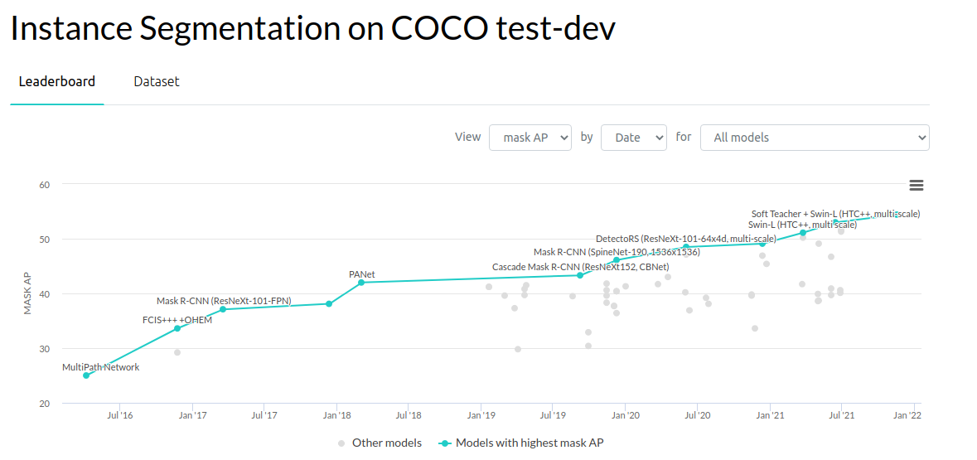
State of Art-Detection /Segmentation

Slide 4
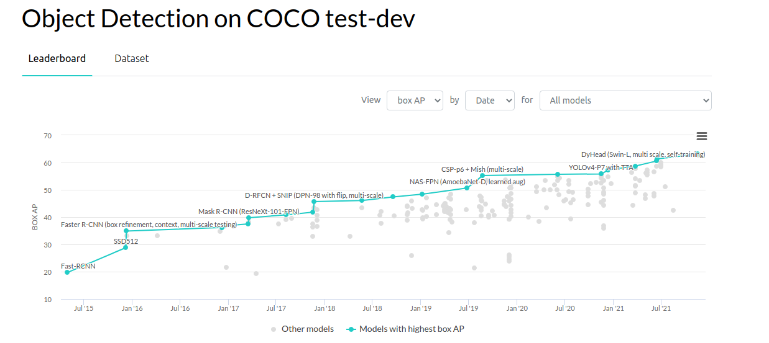

Slide 5
Detectron2
Few links to consider :
https://github.com/facebookresearch/detectron2
https://github.com/facebookresearch/maskrcnn-benchmark/
https://github.com/facebookresearch/Detectron/
How to install and official Docs:
https://detectron2.readthedocs.io/en/latest/

Slide 6
Detectron2 on Built-in Dataset
https://colab.research.google.com/drive/16jcaJoc6bCFAQ96jDe2HwtXj7BMD_-m5

Slide 7
Augmentation Techniques for Detectron2
https://detectron2.readthedocs.io/en/latest/tutorials/augmentation.html

