Slide 1
Secret-Key Encryption
Ing. Fabián Astudillo Salinas, PhD.
Diapositivas realizadas por: Wenliang (Kevin) Du, PhD

Slide 2
Introduction
Encryption is the process of encoding a message in such a way that only authorized parties can read the content of the original message
History of encryption dates back to 1900 BC
Two types of encryption
secret-key encryption : same key for encryption and decryption
pubic-key encryption : different keys for encryption and decryption
We focus on secret-key encryption in this chapter

Slide 3
Substitution Cipher
Encryption is done by replacing units of plaintext with ciphertext, according to a fixed system.
Units may be single letters, pairs of letters, triplets of letters, mixtures of the above, and so forth
Decryption simply performs the inverse substitution.
Two typical substitution ciphers:
monoalphabetic - fixed substitution over the entire message
Polyalphabetic - a number of substitutions at different positions in the message

Slide 4
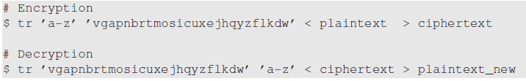
Monoalphabetic Substitution Cipher
Encryption and decryption

Slide 5
Breaking Monoalphabetic Substitution Cipher
Frequency analysis is the study of the frequency of letters or groups of letters in a ciphertext.
Common letters : T, A, E, I, O
Common 2-letter combinations (bigrams): TH, HE, IN, ER
Common 3-letter combinations (trigrams): THE, AND, and ING

Slide 6
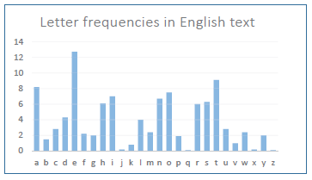
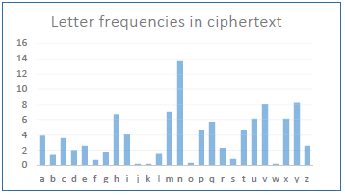
Breaking Monoalphabetic Substitution Cipher
Letter Frequency Analysis results:

Slide 7
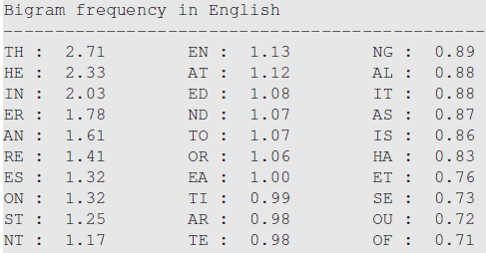
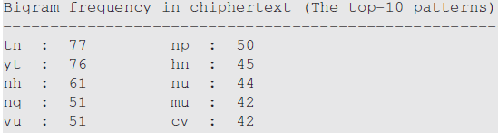
Breaking Monoalphabetic Substitution Cipher
Bigram Frequency Analysis results:

Slide 8
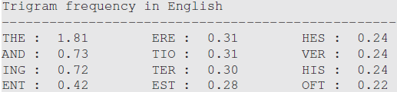
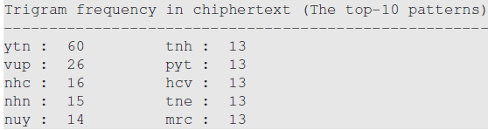
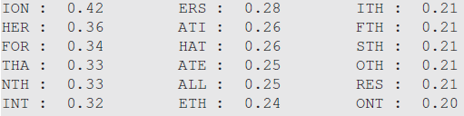
Breaking Monoalphabetic Substitution Cipher
Trigram Frequency analysis results:

Slide 9
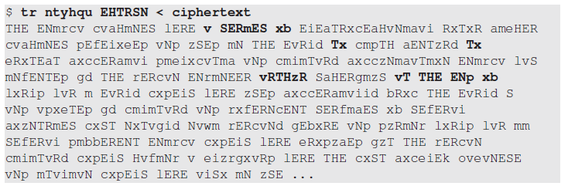
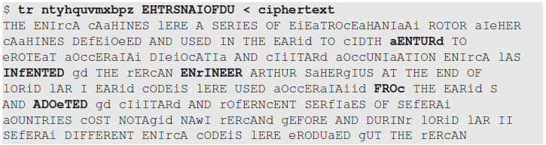
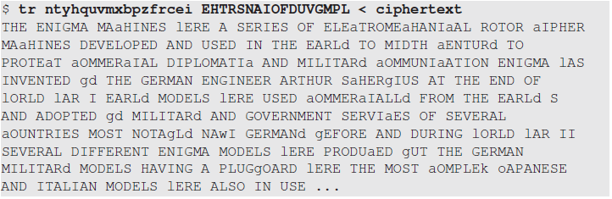
Breaking Monoalphabetic Substitution Cipher
Applying the partial mappings…

Slide 10
Data Encryption Standard (DES)
DES is a block cipher - can only encrypt a block of data
Block size for DES is 64 bits
DES uses 56-bit keys although a 64-bit key is fed into the algorithm
Theoretical attacks were identified. None was practical enough to cause major concerns.
Triple DES can solve DES’s key size problem

Slide 11
Advanced Encryption Standard (AES)
AES is a block cipher
128-bit block size.
Three different key sizes: 128, 192, and 256 bits

Slide 12
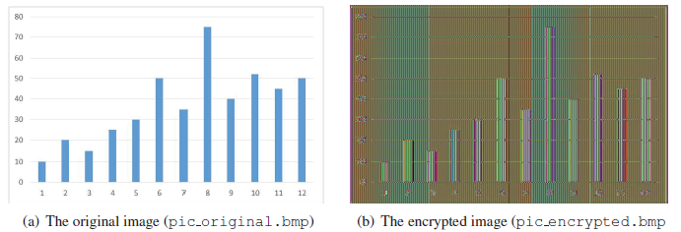
Encryption Modes

Slide 13
Encryption Modes
Encryption mode or mode of operation refers to the many ways to make the input of an encryption algorithm different.
Examples include:
Electronic Codebook (ECB)
Cipher Block Chaining (CBC)
Propagating CBC (PCBC)
Cipher Feedback (CFB)
Output Feedback (OFB)
Counter (CTR)

Slide 14
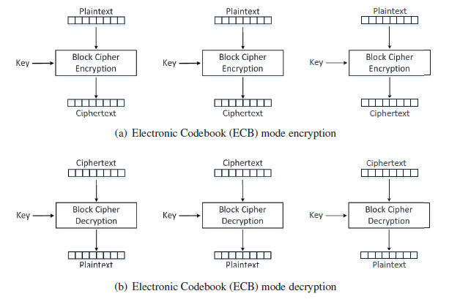
Electronic Codebook (ECB) Mode

Slide 15

Electronic Codebook (ECB) Mode
Using openssl enc command:
We use the 128-bit (key size) AES algorithm
The -aes-128-ecb option specifies ECB mode
The -e option indicates encryption
The -d option indicate decryption
The -K option is used to specify the encryption/decryption key

Slide 16
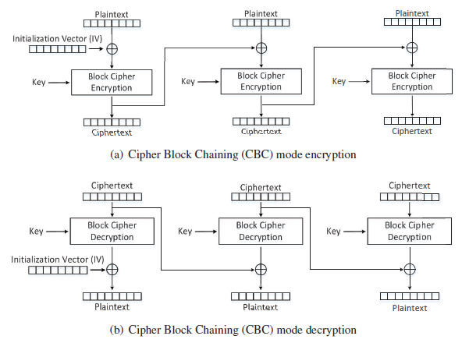
Cipher Block Chaining (CBC) Mode
The main purpose of IV is to ensure that even if two plaintexts are identical, their ciphertexts are still different, because different IVs will be used.
Decryption can be parallelized
Encryption cannot be parallelized

Slide 17
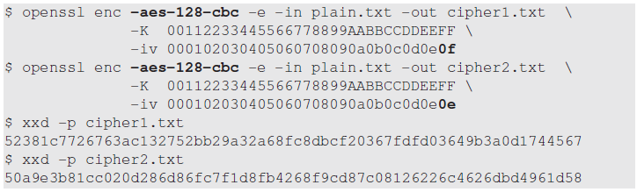
Cipher Block Chaining (CBC) Mode
Using openssl enc command to encrypt the same plaintext, same key, different IV:
We use the 128-bit (key size) AES algorithm
The -aes-128-cbc option specifies CBC mode
The -e option indicates encryption
The -iv option is used to specify the Initialization Vector (IV)

Slide 18
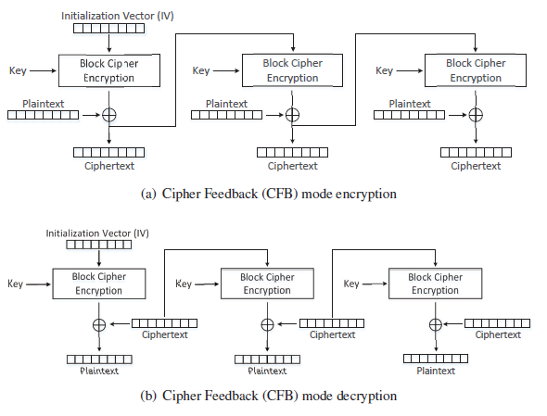
Cipher Feedback (CFB) Mode
A block cipher is turned into a stream cipher.
Ideal for encrypting real-time data.
Padding not required for the last block.
decryption using the CFB mode can be parallelized, while encryption can only be conducted sequentially

Slide 19
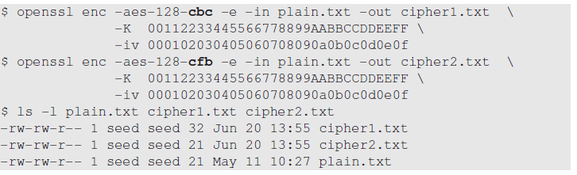
Comparing encryption with CBC and CFB
Plaintext size is 21 bytes
CBC mode: ciphertext is 32 bytes due padding
CFB mode: ciphertext size is same as plaintext size (21 bytes)

Slide 20
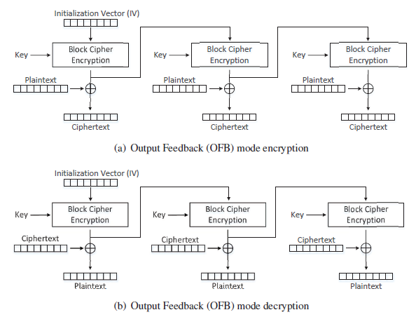
Output Feedback (OFB) Mode
Similar to CFB
Used as stream cipher
Does not need padding
Decryption can parallelized
Encryption in the OFB mode can be parallelized

Slide 21
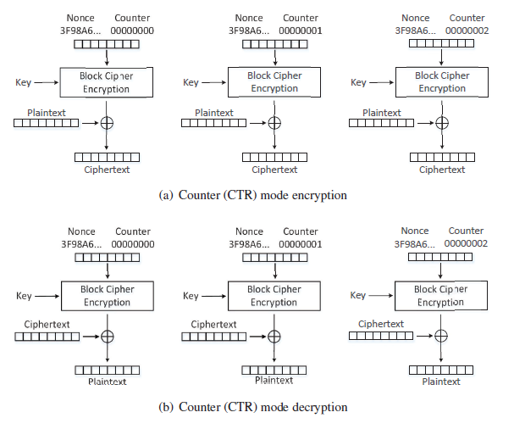
Counter (CTR) Mode
It basically uses a counter to generate the key streams
no key stream can be reused, hence the counter value for each block is prepended with a randomly generated value called nonce
This nonce serves the same role as the IV does to the other encryption modes.
both encryption and decryption can be parallelized
the key stream in the CTR mode can be calculated in parallel during the encryption

Slide 22
Modes for Authenticated Encryption
None of the Encryption modes discussed so far cannot be used to achieve message authentication
A number of modes of operation have been designed to combine message authentication and encryption.
Examples include
GCM (Galois/Counter Mode)
CCM (Counter with CBC-MAC)
OCB mode (Offset Codebook Mode)

Slide 23
Padding
Block cipher encryption modes divide plaintext into blocks and the size of each block should match the cipher’s block size.
No guarantee that the size of the last block matches the cipher’s block size.
Last block of the plaintext needs padding i.e. before encryption, extra data needs to be added to the last block of the plaintext, so its size equals to the cipher’s block size.
Padding schemes need to clearly mark where the padding starts, so decryption can remove the padded data.
Commonly used padding scheme is PKCS#5

Slide 24
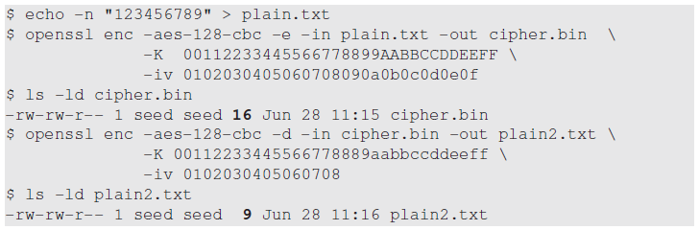
Padding Experiment
Plaintext size is 9 bytes.
Size of ciphertext (cipher.bin) becomes 16 bytes

Slide 25
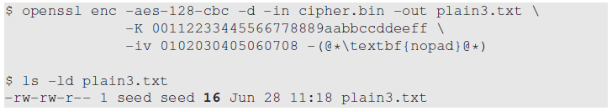

Padding Experiment
How does decryption software know where padding starts?
7 bytes of 0x07 are added as the padding data

Slide 26
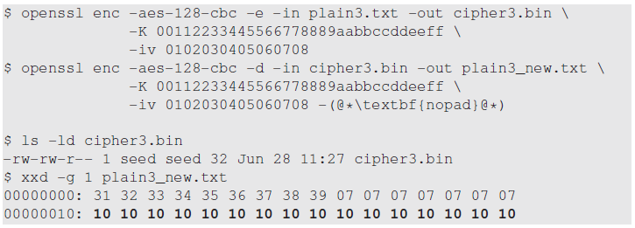
Padding Experiment – Special case
What if the size of the plaintext is already a multiple of the block size (so no padding is needed), and its last seven bytes are all 0x07
Size of plaintext (plain3.txt) is 16 bytes
Size of decryption output (plaint3_new.txt) is 32 bytes ( a full block is added as the padding).
Therefore, in PKCS#5, if the input length is already an exact multiple of the block size B, then B bytes of value B will be added as the padding.

Slide 27
Initial Vector and Common Mistakes
Initial vectors have the following requirements:
IV is supposed to be stored or transmitted in plaintext
IV should not repeat (uniqueness).
IV should not be predictable.

Slide 28
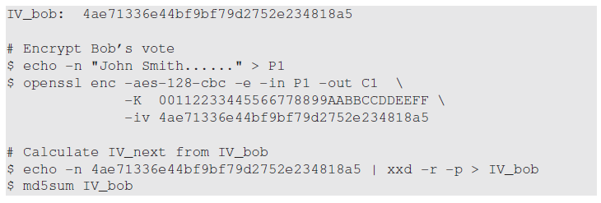

Experiment - IV should not be predictable
Eve calculates the next IV

Slide 29
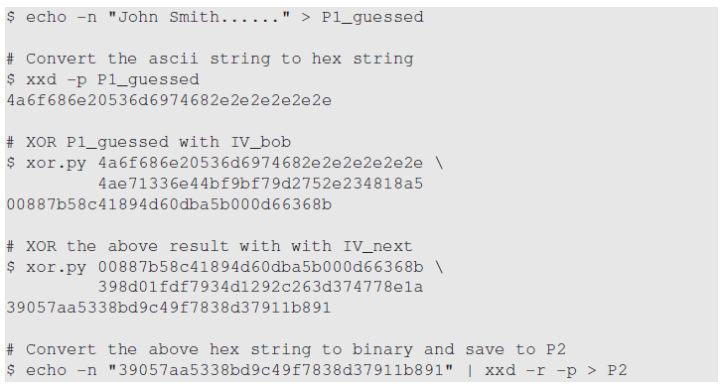
Experiment - IV should not be predictable
Eve guesses that Bob voted for John Smith, so she creates P1_guessed and XOR it with IV_bob and IV_next, and finally constructs the name for a write-in candidate.

Slide 30
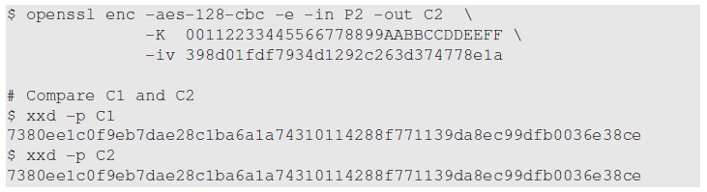
Experiment - IV should not be predictable
Eve gives her write-in candidate’s name (stored in P2) to the voting machine, which encrypts the name using IV_next as the IV. The result is stored in C2.
If C1 (Bob’s encrypted vote) == C2, then Eve knows for sure that Bob has voted for “John Smith”.

Slide 31
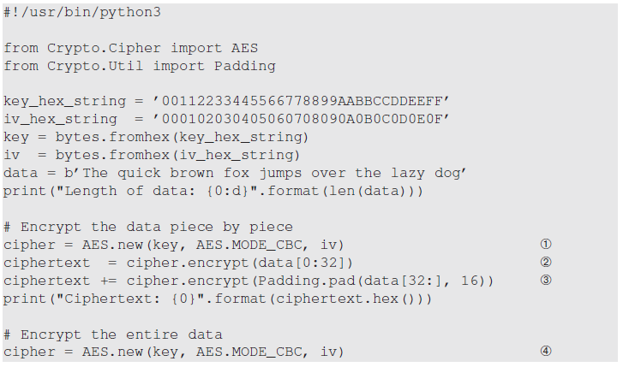
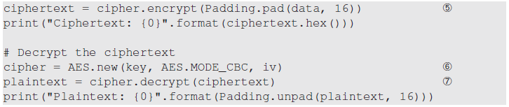
Programming using Cryptography APIs
We use PyCryptodome package’s APIs.
Line:
Initialize cipher
Encrypts first 32 bytes of data
Encrypts the rest of the data
Initialize cipher (start new chain)
Encrypt the entire data
Initialize cipher for decryption
Decrypt

Slide 32

Programming using Cryptography APIs
Modes that do not need padding include CFB, OFB, and CTR.
For these modes, the data fed into the encrypt() method can have an arbitrary length, and no padding is needed.
Example below shows OFB encryption

Slide 33
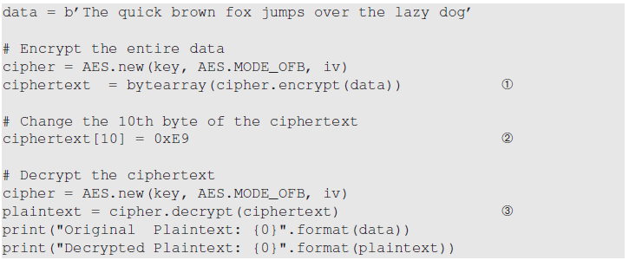
Attack on ciphertext’s integrity
Attacker makes changes to ciphertext (Line 2)
Result

Slide 34
Authenticated Encryption
To protect the integrity, the sender needs to generate a Message Authentication Code (MAC) from the ciphertext using a secret shared by the sender and the receiver.
The MAC and the ciphertext will be sent to the receiver, who will compute a MAC from the received ciphertext.
If the MAC is the same as the one received, the ciphertext is not modified.
Two operations are needed to achieve integrity of ciphertext: one for encrypting data and other for generating MAC.
Authenticated encryption combines these two separate operations into one encryption mode. E.g GCM, CCM, OCB

Slide 35
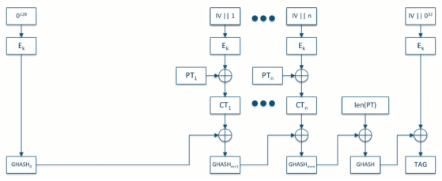
The GCM Mode

Slide 36
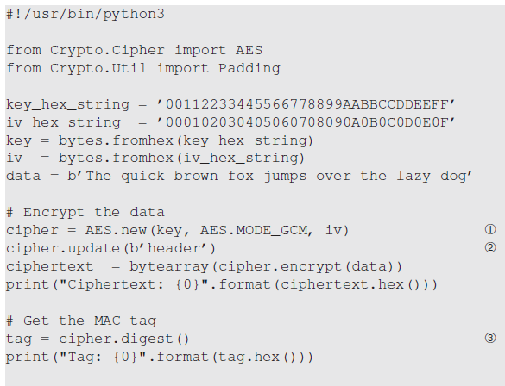
Programming using the GCM Mode
The unique part of the above code is the tag generation and verification.
In Line 3 , we use the digest() to get the authentication tag, which is generated from the ciphertext.

Slide 37
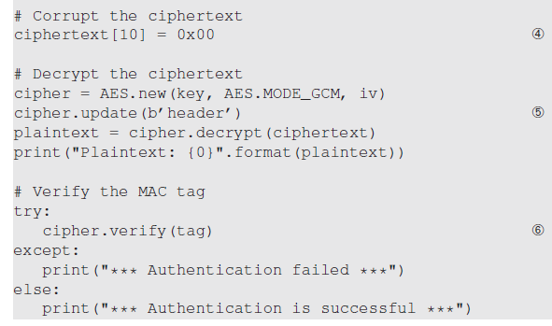
Programming using the GCM Mode
In Line 6 , after feeding the ciphertext to the cipher, we invoke verify() to verify
whether the tag is still valid.

Slide 38
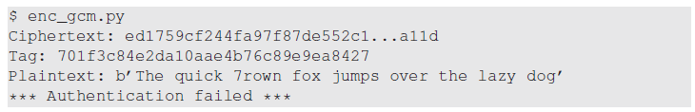
Experiment - GCM Mode
We modify the ciphertext by changing the 10th byte to (0x00)
Decrypt the modified ciphertext and verify tag

