Slide 1
VeriSol: Bringing Formal Verification to Solidity Smart Contract Developers
Shuvendu Lahiri
Microsoft Research, Redmond, WA
DevCon 2019 (October 8th, 2019)

Slide 2
VeriSol
A formal specification and verifier for Solidity Smart Contracts
A research project from Microsoft Research
Github
https://github.com/Microsoft/verisol
Contributors/collaborators
Shuo Chen, Ella Bounimova, Cody Born, Xinxing Liu (Microsoft)
Yuepeng Wang, Rong Pan, Isil Dillig, Jon Stephens, Kostas Ferles (UT Austin)
Diego Garbervetsky (Univ of Buenos Aires)
…

Slide 3
Motivation of VeriSol
Empower Smart Contract developers to specify and check properties of their business logic
Initial focus: Smart contracts in Azure Blockchain infrastructure and samples
Expose decades of advances in formal verification techniques developed within Microsoft Research (with open-source contributions)
Z3: state-of-the-art theorem prover (e.g. used by SMTChecker in Solidity comp)
Boogie: state-of-the-art intermediate verification language
Corral: state-of-the-art push-button Interprocedural verifier for Boogie
Houdini: lightweight (but predictable) conjunctive invariant inference
Push the envelope of specification and automation research for smart contracts
Avoids over-optimization
based on few examples

Slide 4
Built on proven formal verification capability in industry
Microsoft tools that leverage Boogie/Corral/Houdini+Z3-based verification
Windows Static Driver Verifier (SDV)
HAVOC
Reports of tools shipped/deployed in production for Windows/IE codebases (before VeriSol)
Towards Practical Reactive Security Audit Using Extended Static Checkers. Vanegue, Lahiri [S&P’13]
Powering the static driver verifier using corral. Lal, Qadeer [FSE‘14]
Angelic Verification: Precise Verification Modulo Unknowns. Das, Lahiri, Lal, Li [CAV‘15]

Slide 5
VeriSol in action

Slide 6
VeriSol installation
https://github.com/microsoft/verisol/blob/master/INSTALL.md
As a .NET Core global tool
Install .NET Core (version 2.2) for Windows/Linux/OSX
dotnet tool install --global VeriSol --version 0.1.1-alpha
Examples for today
https://github.com/microsoft/verisol/wiki/Experimental--options-in-VeriSol

Slide 7
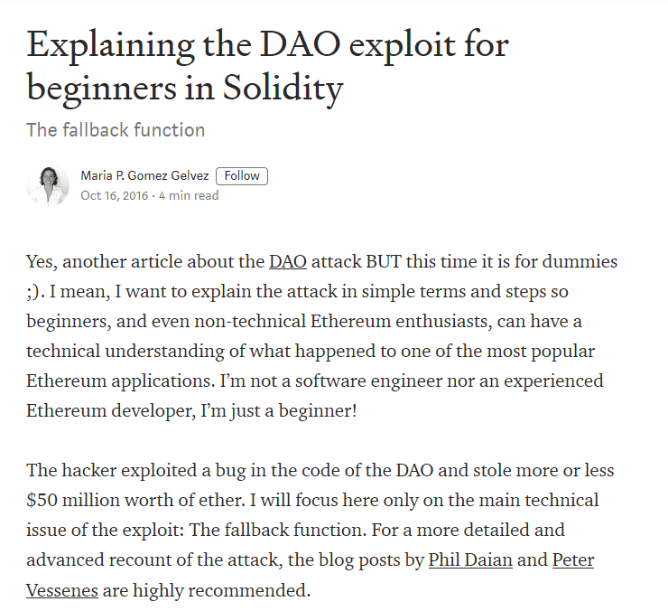
TheDAO

Slide 8
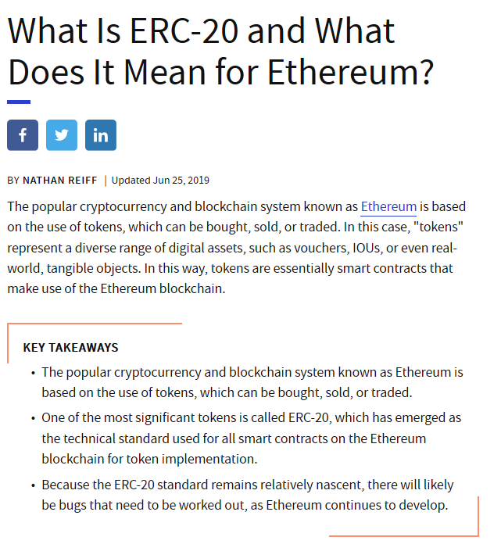
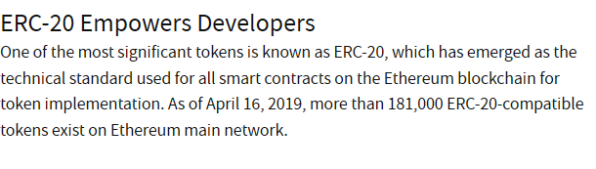
ERC20

Slide 9
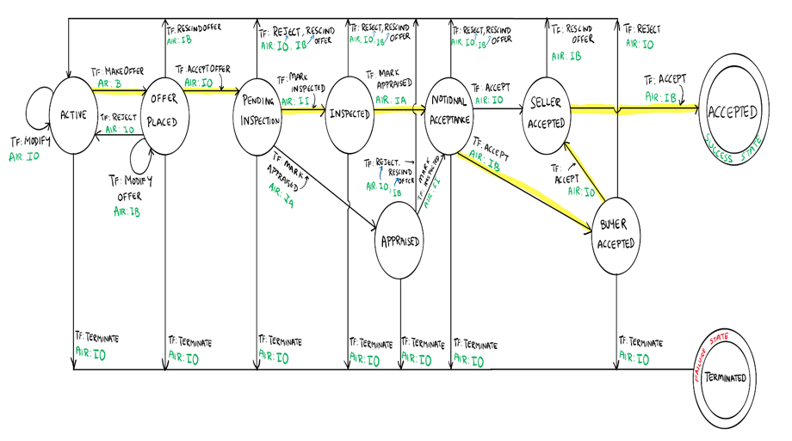

Checking Workflow policies in Azure Blockchain Workbench
function Accept() private
{ if (msg.sender == InstanceBuyer)
{ if (State == StateType.NotionalAcceptance)
{
State = StateType.BuyerAccepted;
}
else if (State == StateType.SellerAccepted)
{
State = StateType.Accepted;
}
}
else
{ if (State == StateType.NotionalAcceptance)
{
State = StateType.SellerAccepted;
}
else if (State == StateType.BuyerAccepted)
{
State = StateType.Accepted;
}
}
ContractUpdated('Accept');
}
Will catch many semantic mistakes during development!
JSON policy
state machine
Solidity implements state-machine policy?
After the discrepancy was fixed, the tool verified the absence of discrepancy for any sequence of transactions automatically
Solidity

Slide 10

VeriSol
Formal verification for Solidity
https://github.com/Microsoft/verisol
Based on a decade of investment that Microsoft Research made in formal verification
VeriSol
Z3
Boogie
Corral
Houdini
Fully verified (“Proof”)
Solidity To Boogie compiler
Verified up to K transactions
Solidity program with specifications
Code contracts
library
Violating trace
Decade of MSR
investment
Actively developed since
2019

Slide 11
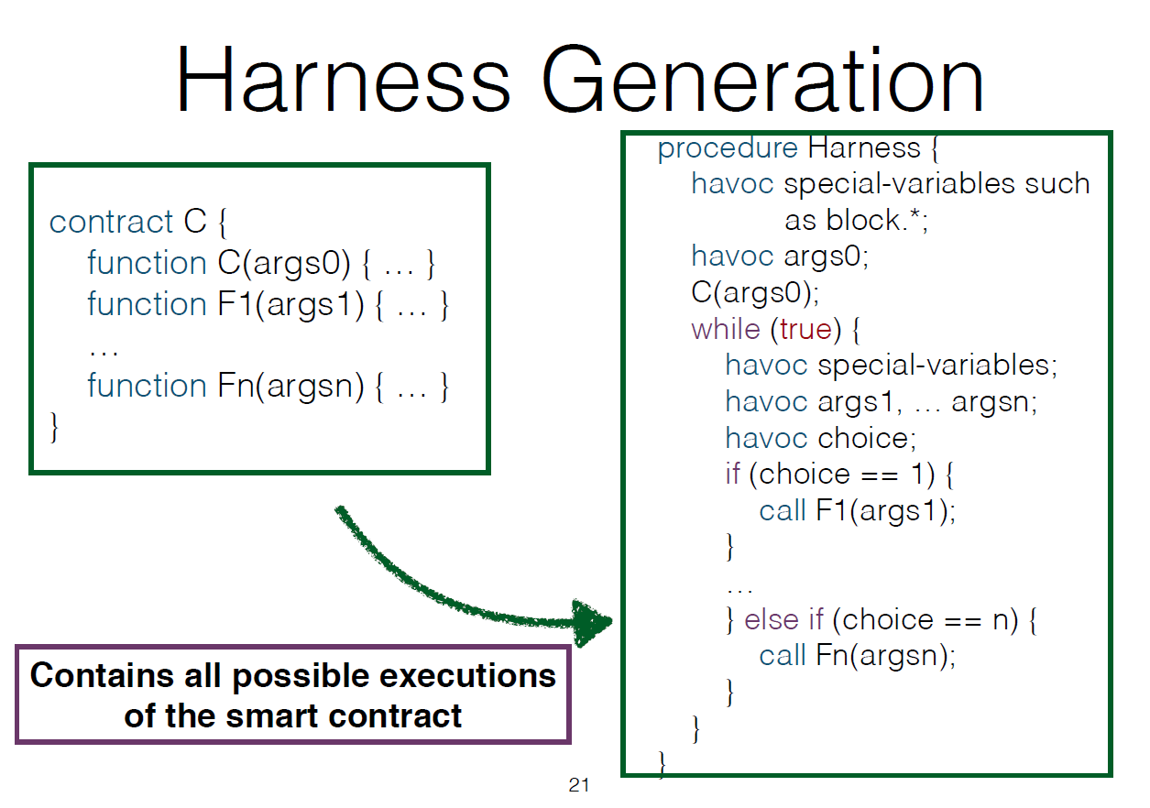
Formal verification
Fully verified (proof)
Verified up to K transactions
, msg.sender
Violating trace

Slide 12
VeriSol capabilities
A Solidity Code Contracts library to support specifications and proofs
Start with a known language
Scalable/push-button violations (and transaction-depth-bounded verification) using Corral
Highly automated proofs using Boogie
Simple but scalable conjunctive invariant inference using Houdini

Slide 13

Applications in Microsoft Azure Blockchain
Checking the workflow policies as specification on Solidity implementations for Azure Blockchain Workbench
Formalizing and checking critical “consortium governance” smart contracts for Ethereum on Azure and Azure Blockchain Service
https://www.microsoft.com/en-us/research/blog/researchers-work-to-secure-azure-blockchain-smart-contracts-with-formal-verification/
Notes:
Add the blog/press to VeriSol webpage

Slide 14
Formal verification of governance protocols
Consortium governance
Determines how members are added, removed, vote, …
Specified as smart contracts
Part of Ethereum on Azure and Azure Blockchain Service
Critical to Azure Blockchain
Bugs can be exploited to deadlock the blockchain network (e.g. # of admins is 0)
Bugs can result in members cheating (e.g. a removed member can cast vote)
Verification consists of 4 parts
Talking to developers to allow them to come up with specifications (and invariants)
Running a bounded verifiers up to a sufficient depth to catch bugs
Tool infers simple invariants
Researchers fill in missing “inductive invariants” to perform unbounded proof
Integrated into smart contract CI/build process
Subtle bugs found and fixed during development

Slide 15
Research prototype → community tool
VeriSol so far
Focused on specific applications within Azure Blockchain
Focus on Solidity subset most common in enterprise scenarios (e.g. non-payable, no inline assemblies, no low-level calls, ..)
VeriSol going forward
Enable the community to leverage power of formal verification for smart contract development
Useful for experimentation/prototyping
Serious usage within ecosystem for audit/verification of business logic

Slide 16
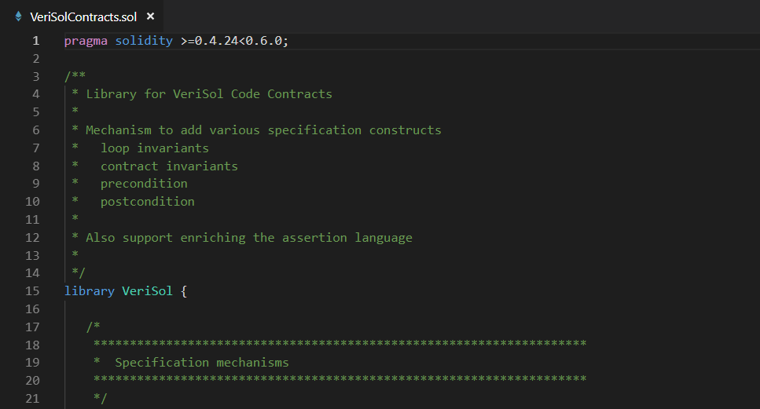
Specifications
A new code-contract library VeriSolContracts.sol
To express the inductive specification
Postconditions
Preconditions
Contract invariants
Loop invariants
Extend the expression language
Old, Sum, Quantifiers, …

Slide 17
Examples of inductive specifications
“bool-expr” is a side-effect-free expression (pure function calls coming)
Contract invariants
VeriSol.ContractInvariant(bool-expr)
bool-expr is an expression over state variables only
Preconditions
VeriSol.Requires(bool-expr)
Failures show up in callers
Postconditions
VeriSol.Ensures(bool-expr)
Allows covering all the different return paths
Loop invariant
VeriSol.Invariant(bool-expr)
bool-expr is an expression in scope at the loop head

Slide 18
Augmenting the assertion language
Allows user access to functions/predicates to write specifications concisely
VeriSol.Old(expr)
Refers to value of expr at entry to the function
VeriSol.SumMapping(mapping(address => uint) x)
Sum {x[a] | a is an address}
VeriSol.Forall(x, e(x)), VeriSol.Exists(x, e(x))
HACK: x is a fresh variable not used in the original program
e[x] holds true for all (respectively, at least one) x (can range over integers or addresses or strings)
VeriSol.Forall(x, !(0 <= x && x < arr.length) || arr[x] > 0)
The array arr only contains positive values
Under
development

Slide 19
Roadmap
Next ~3-6 months
Improved coverage of subset of Solidity that permits “high-level” reasoning
Several bug fixes
VSCode extension
Next ~6-12 months
Richer specifications (e.g. temporal logics, …), in conjunction with RV team
Improved invariant inference
Allow users to control templates for Houdini-based invariant inference (similar to HAVOC for C)
Pushing high-level proofs in source code through KEVM pipeline to get assurance at bytecode level

Slide 20
Questions? https://github.com/Microsoft/verisol

Slide 21
Backups

