Slide 1
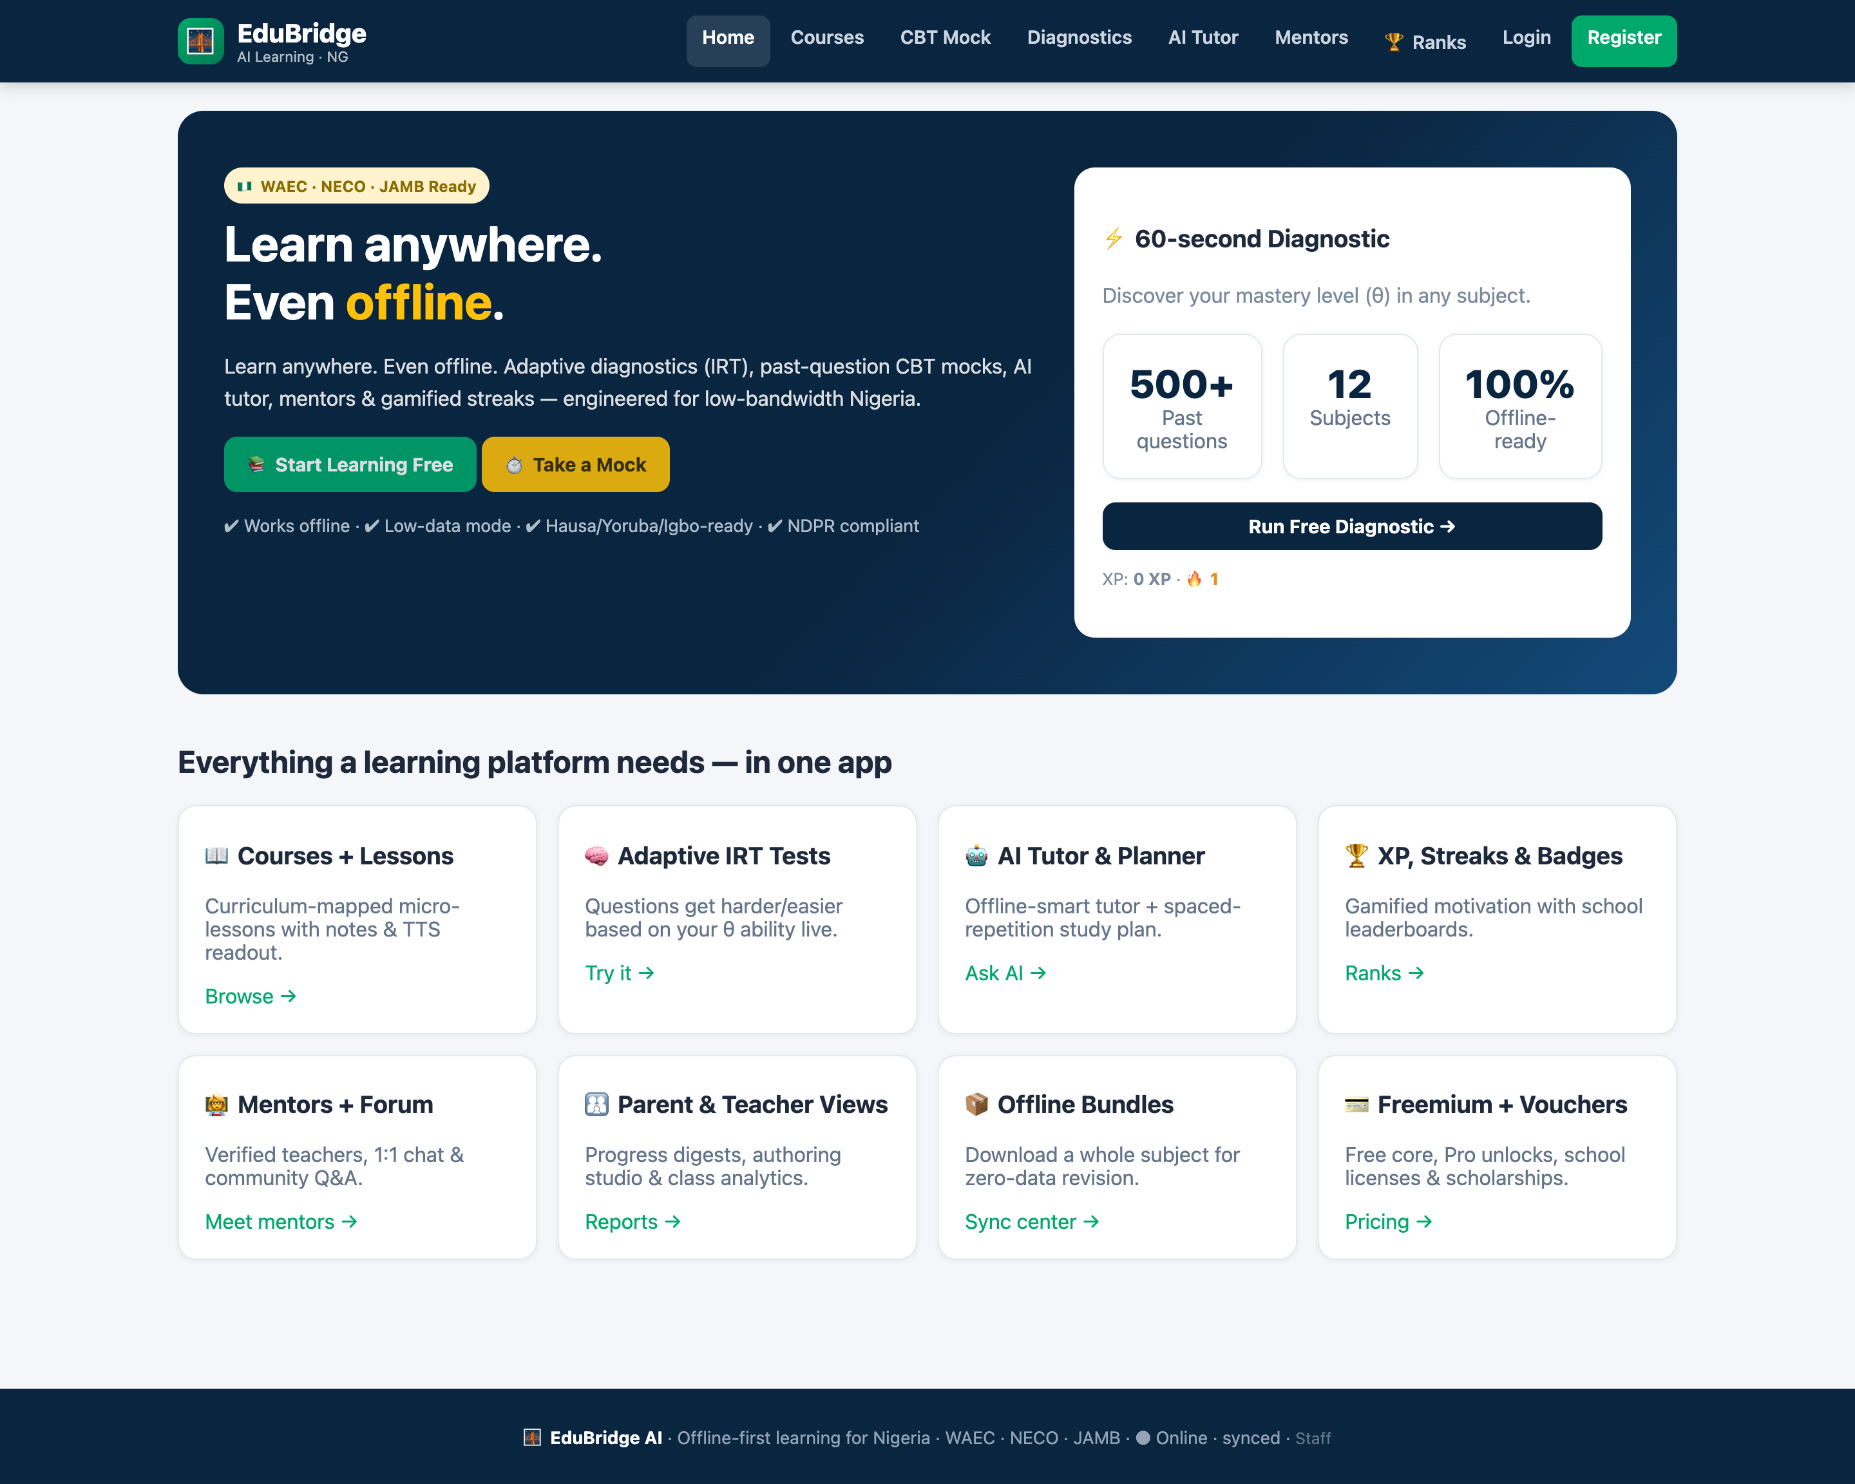
EDUBRIDGE AI · PRODUCT PITCH · 2026
Offline-first learning
for every Nigerian student
WAEC · NECO · JAMB aligned. Works on 2G, syncs when the network returns, and adapts to each learner's ability — with a free core that never locks a student out.
499
26
31
5
QUESTION BANK
SUBJECTS
TOPICS
LEVELS
Live product · EduBridge AI

Slide 2
THE PROBLEM
Nigeria's learners are online only on paper
Bandwidth cost, power intermittency and exam-prep quality make 'just put it online' fail.
📶
Data is expensive
⚡
Power is unreliable
A student streaming lessons burns more money than the phone costs. Preloaded data is limited and metered.
Lessons must survive a blackout mid-question and sync later, without losing a single attempt.
📚
One-size-fits-all prep
💸
Paywalls exclude
Past questions are dumped as PDFs. Nobody tells a learner which topic is actually costing them marks.
Paid-only study apps lock out the students who need them most. A scholarship pool should cover them.
EduBridge AI · Offline-first learning for Nigeria
02

Slide 3
THE SOLUTION
EduBridge AI — one PWA, three guarantees
Offline-first by architecture, adaptive by measurement, and free at the core.
①
Works offline, always
Service worker precache + IndexedDB + delta-sync queue. Every attempt, XP event and message queues locally and reconciles on reconnect.
②
Adapts to the learner
A real IRT engine estimates ability (theta) from every answer and drives mastery bars, weak-topic detection and a spaced-repetition study plan.
③
Free core, fair monetisation
Courses, CBT mocks and a daily AI tutor stay free. Paystack/Flutterwave, vouchers and a scholarship pool monetise schools without excluding pupils.
EduBridge AI · Offline-first learning for Nigeria
03

Slide 4
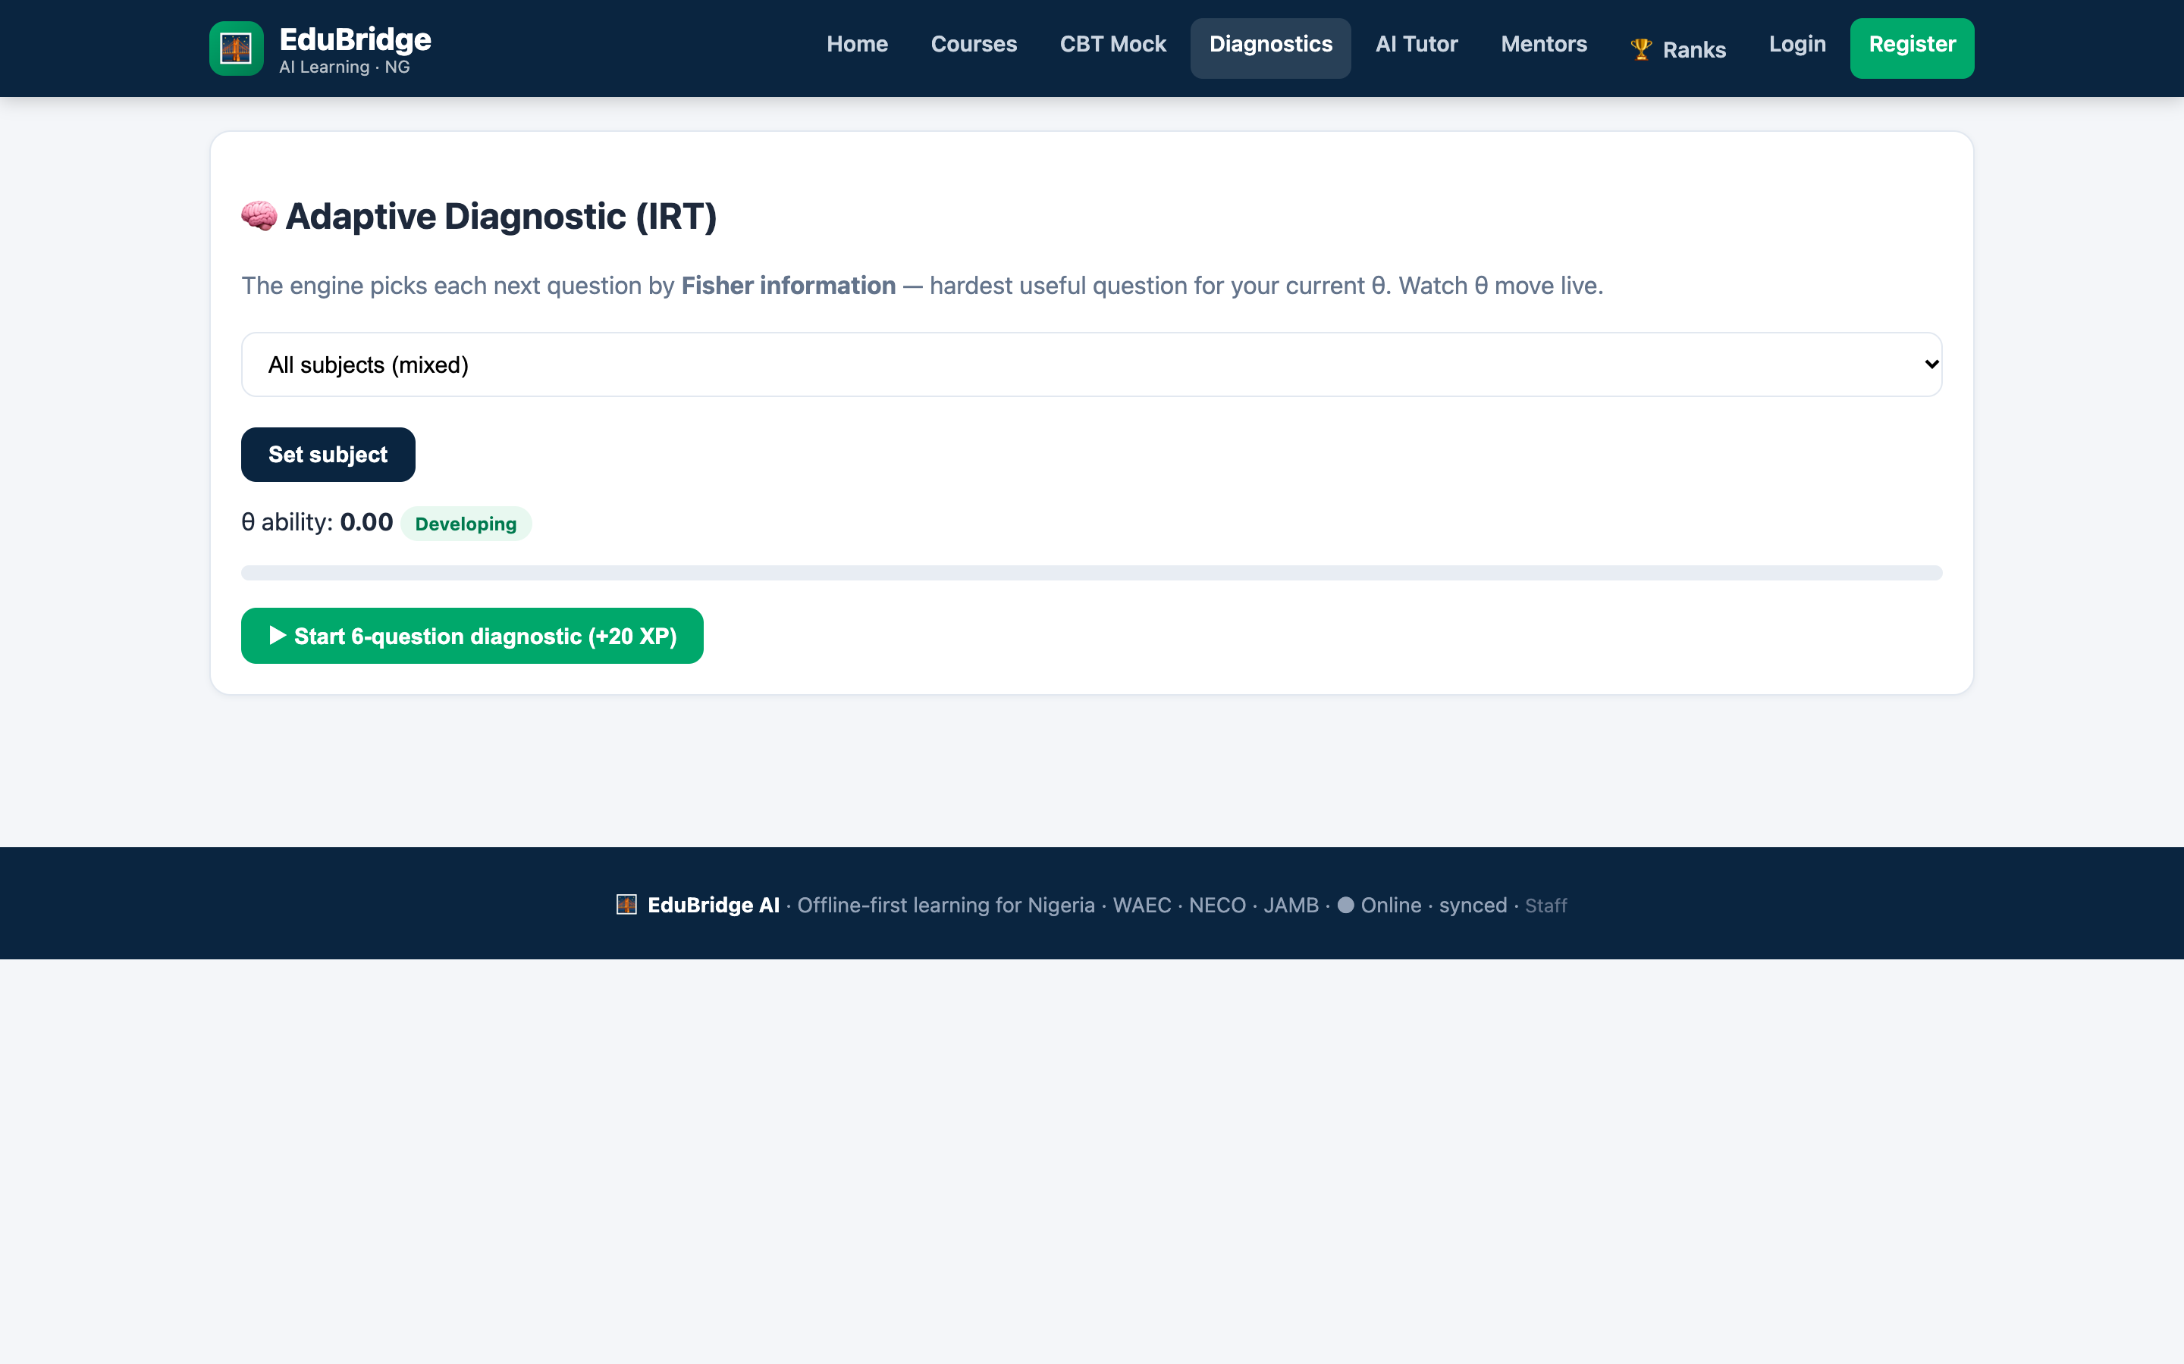
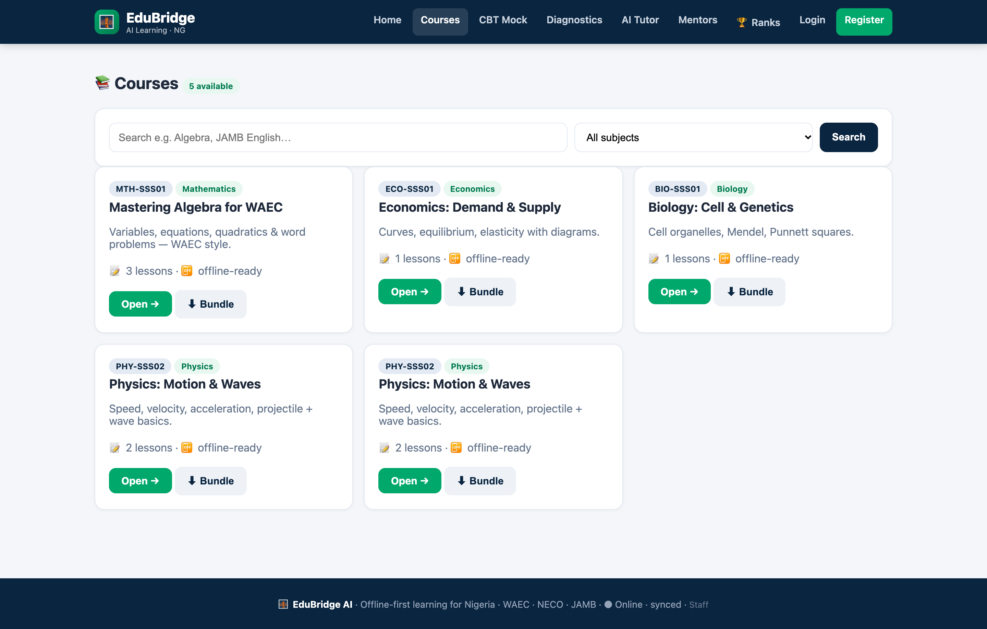
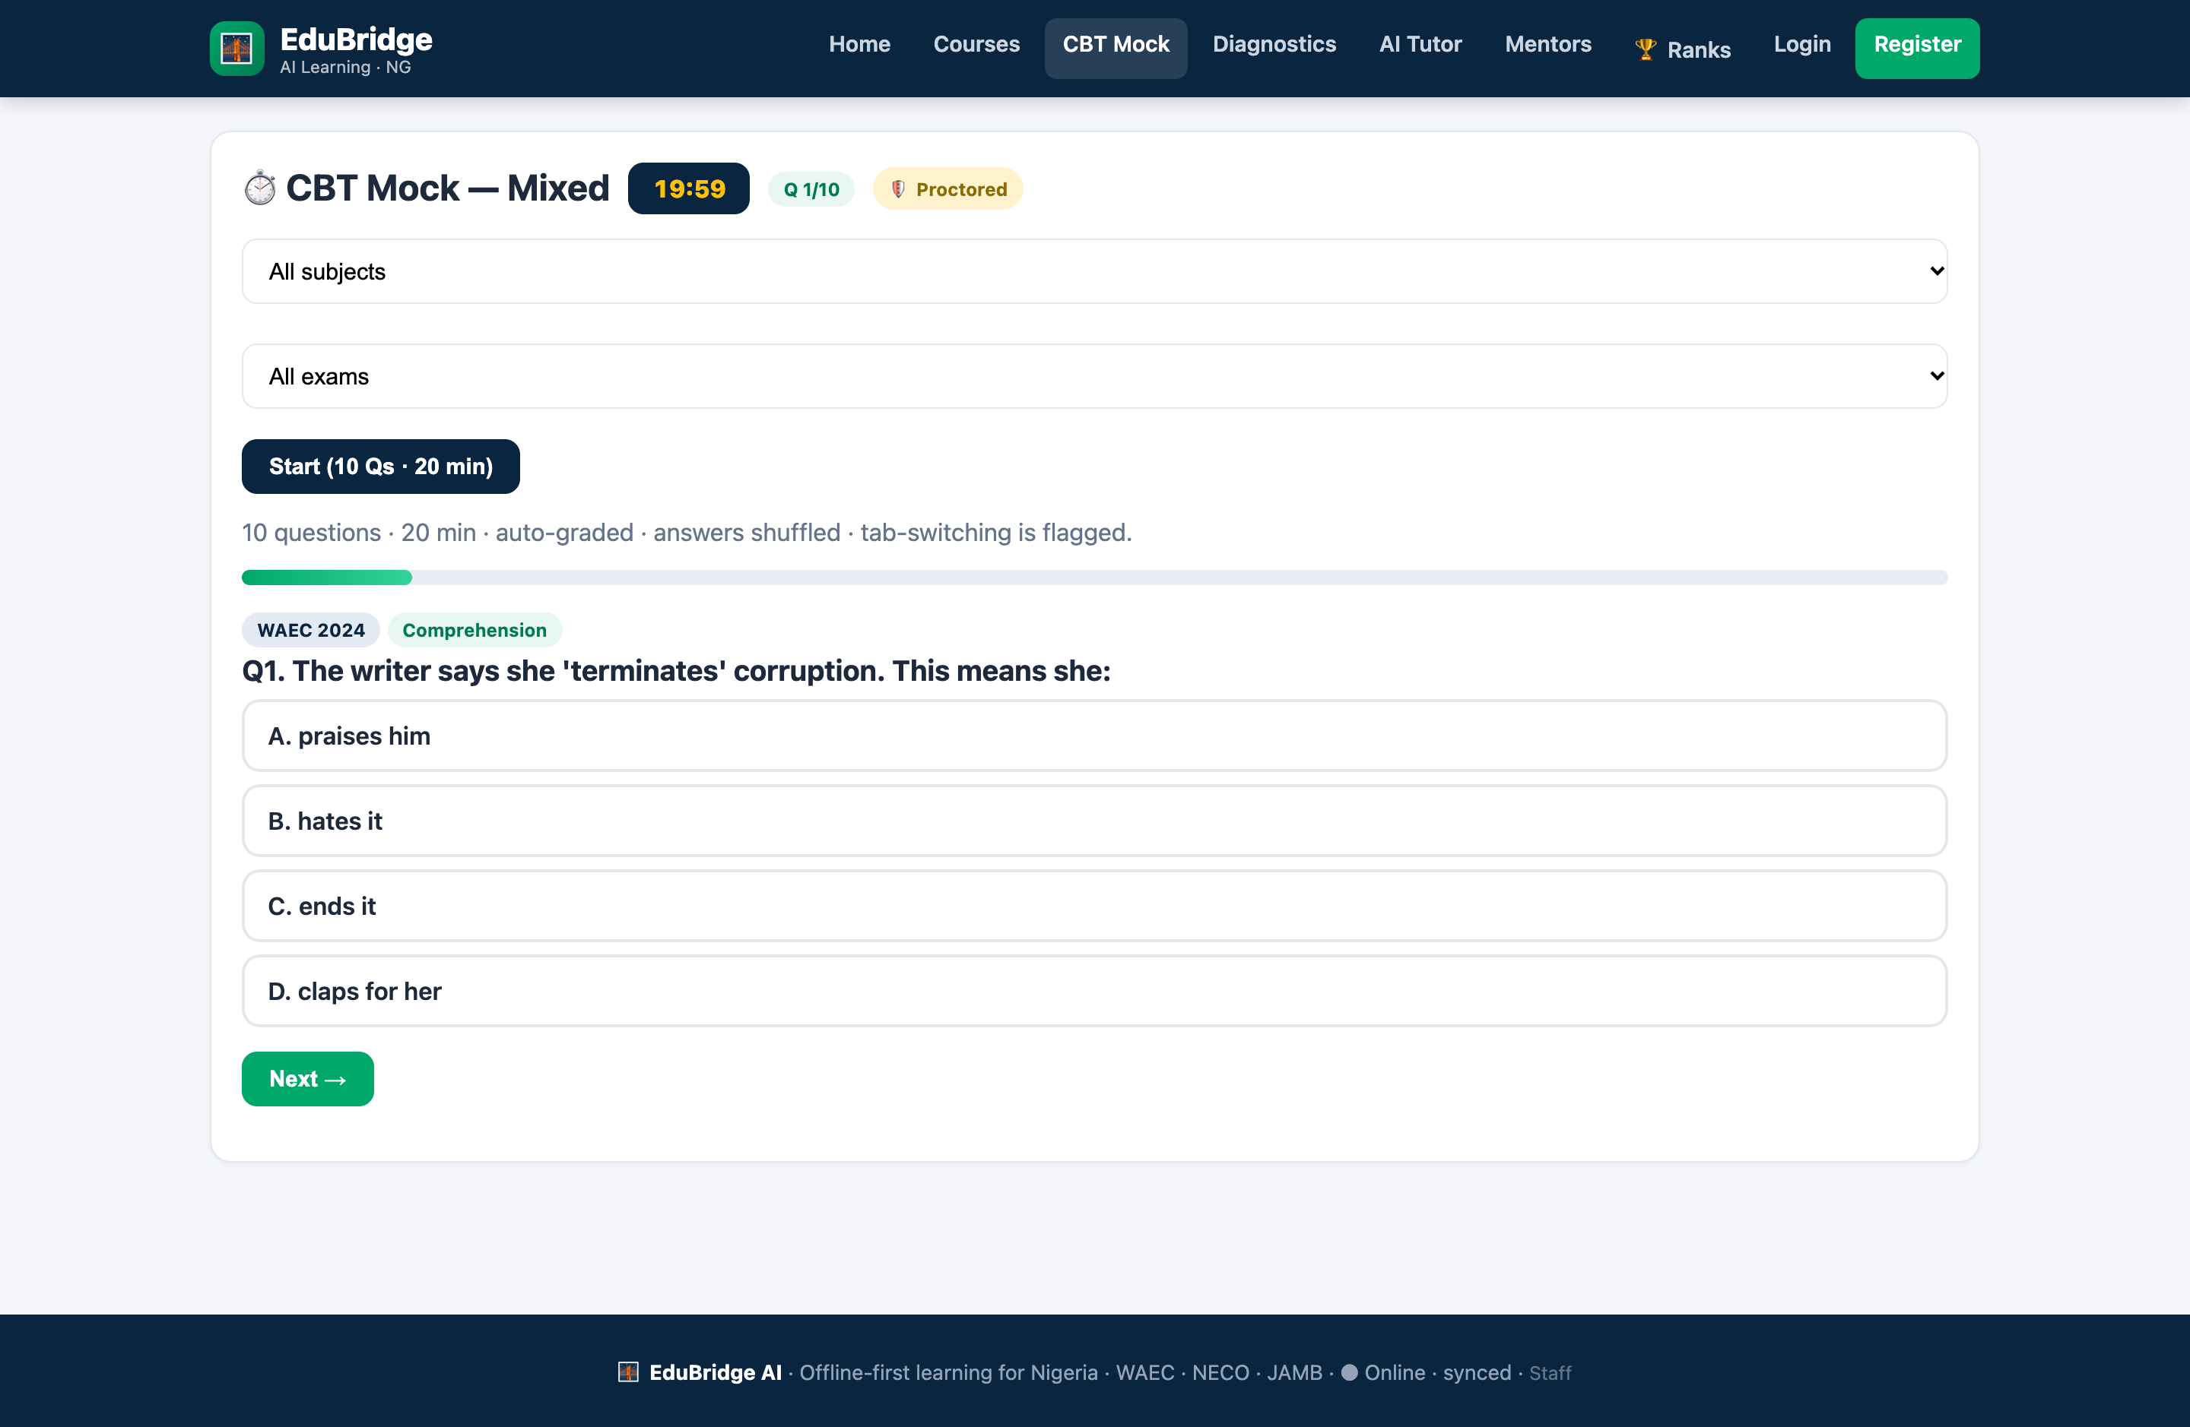
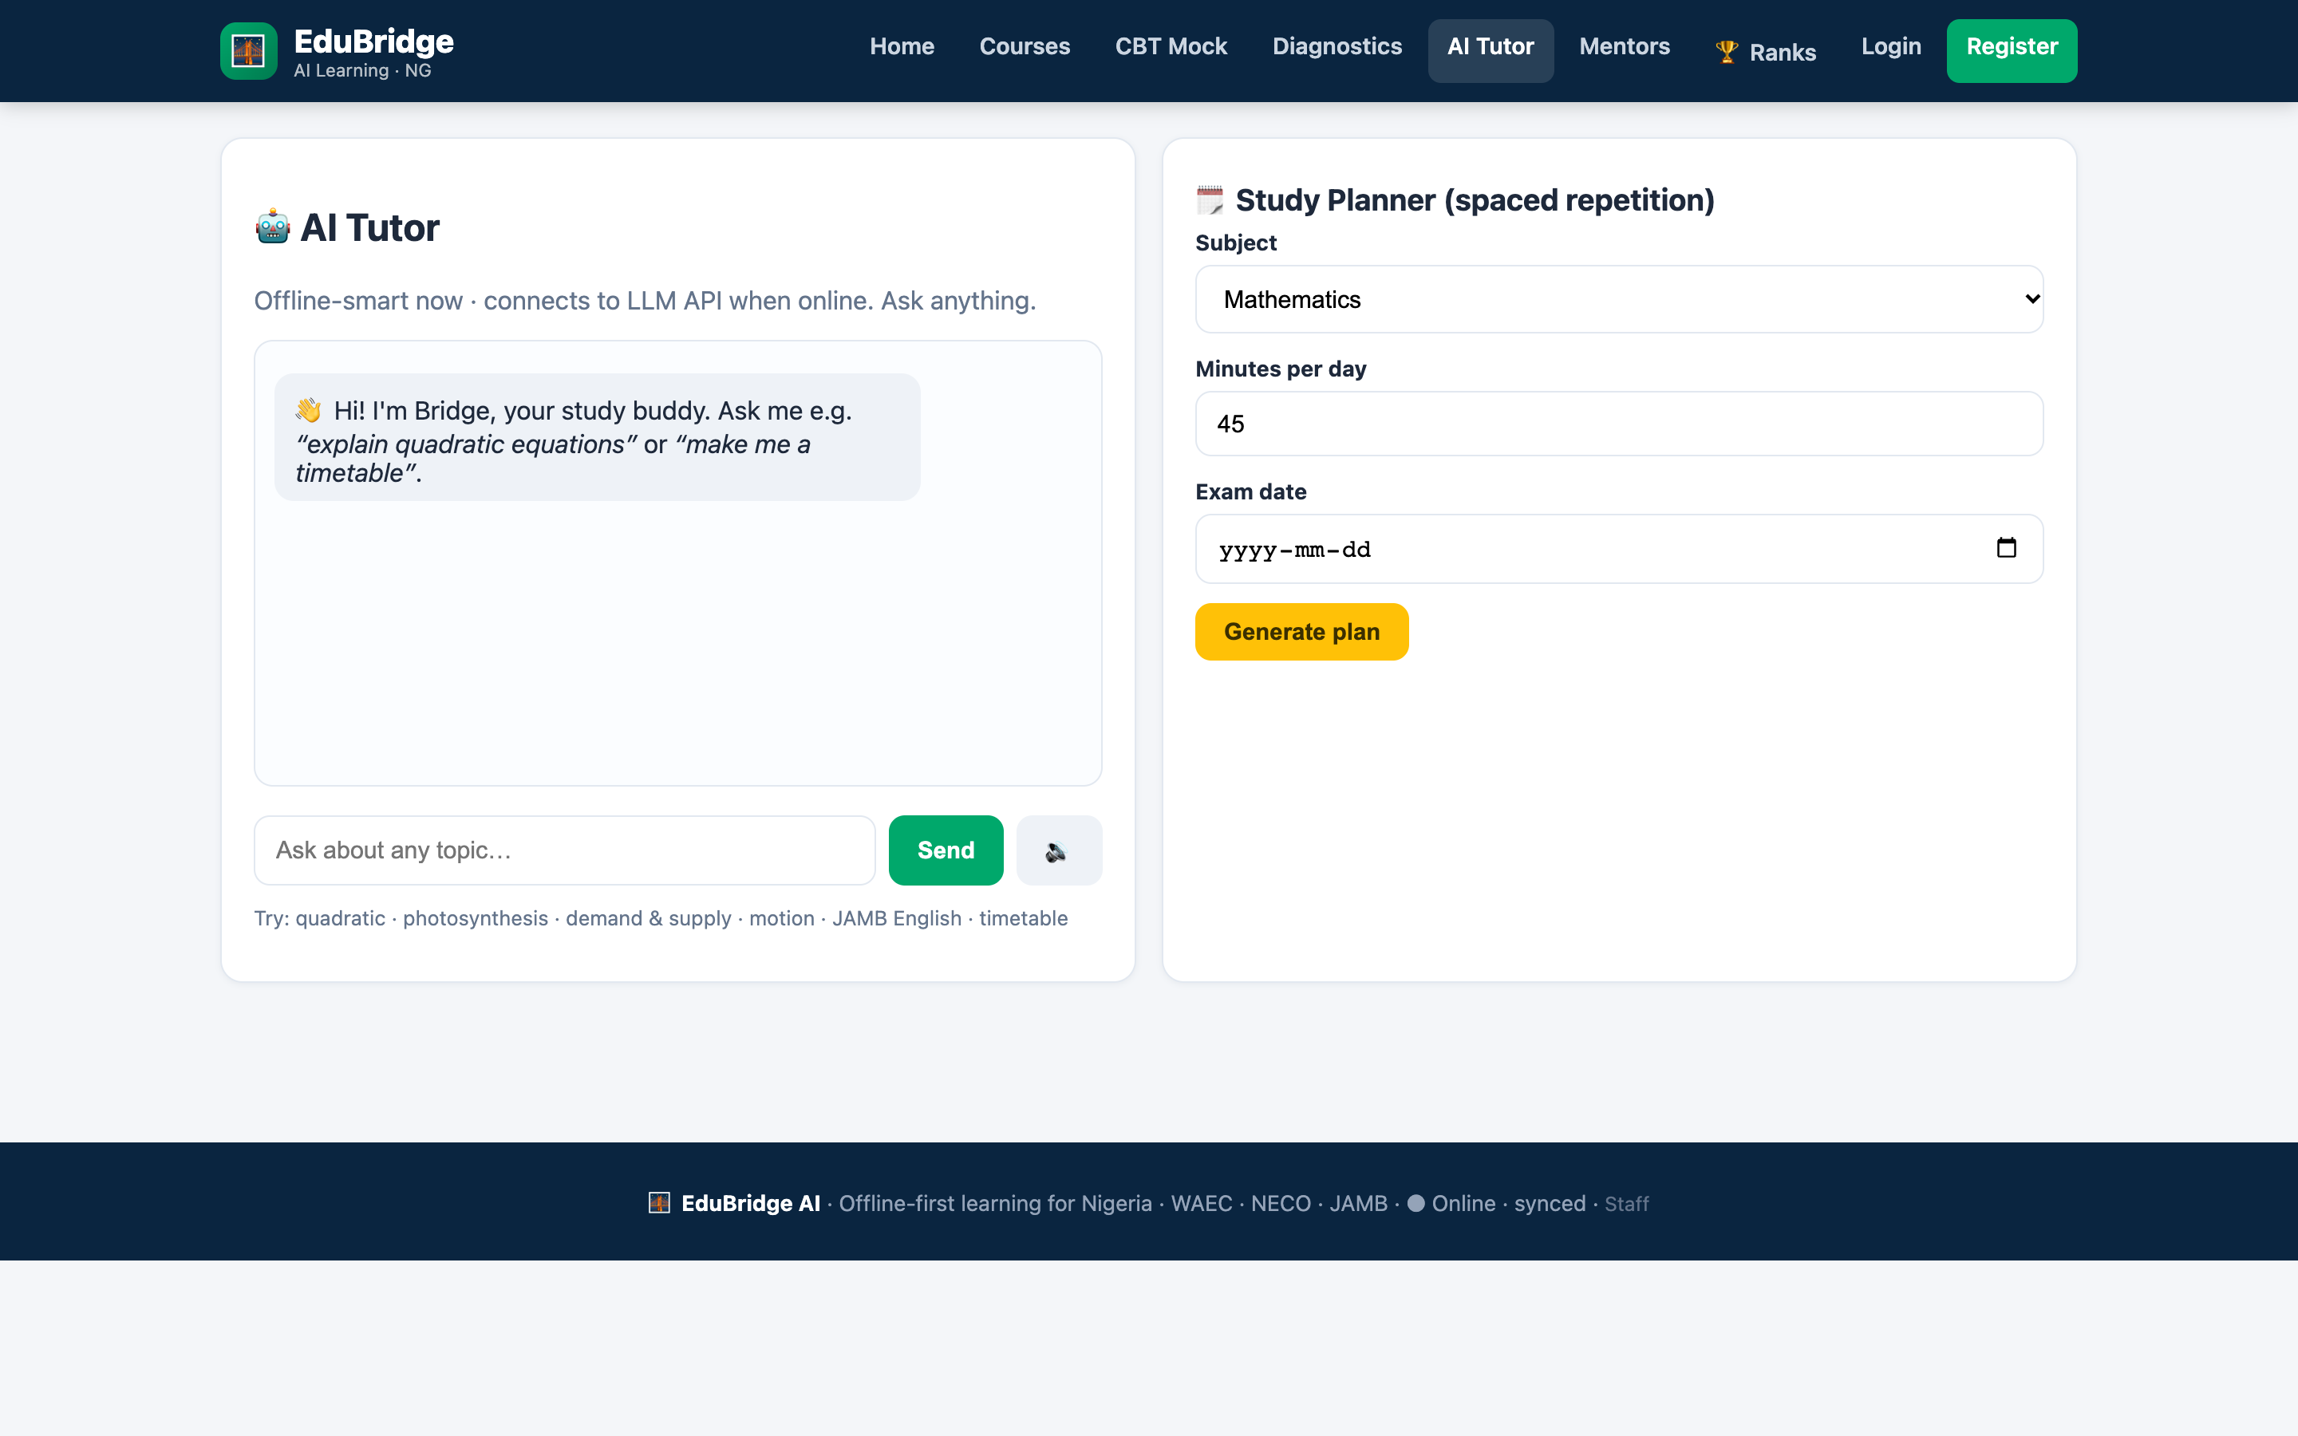
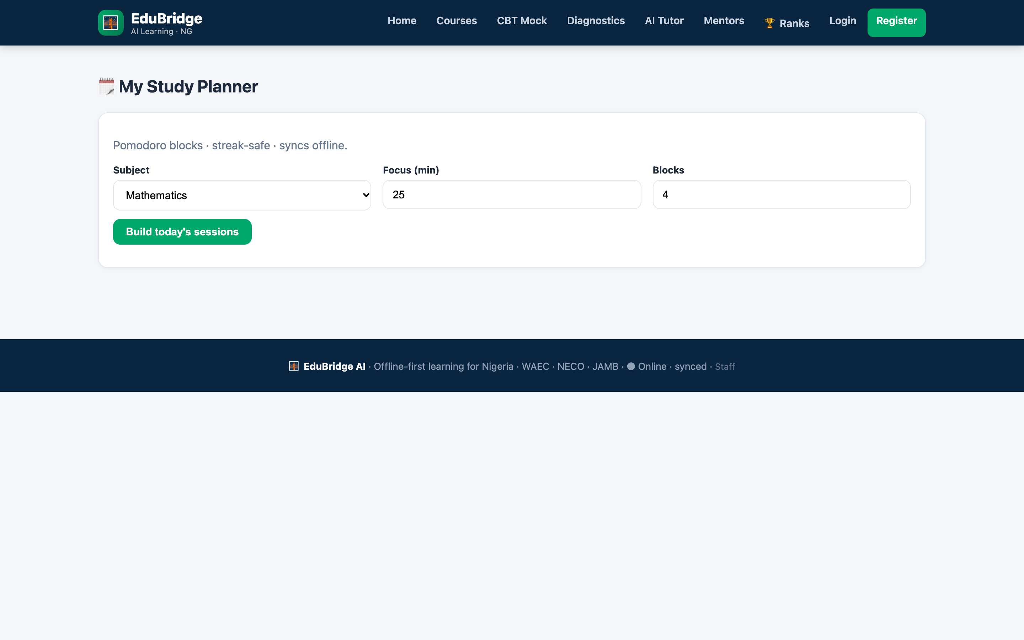
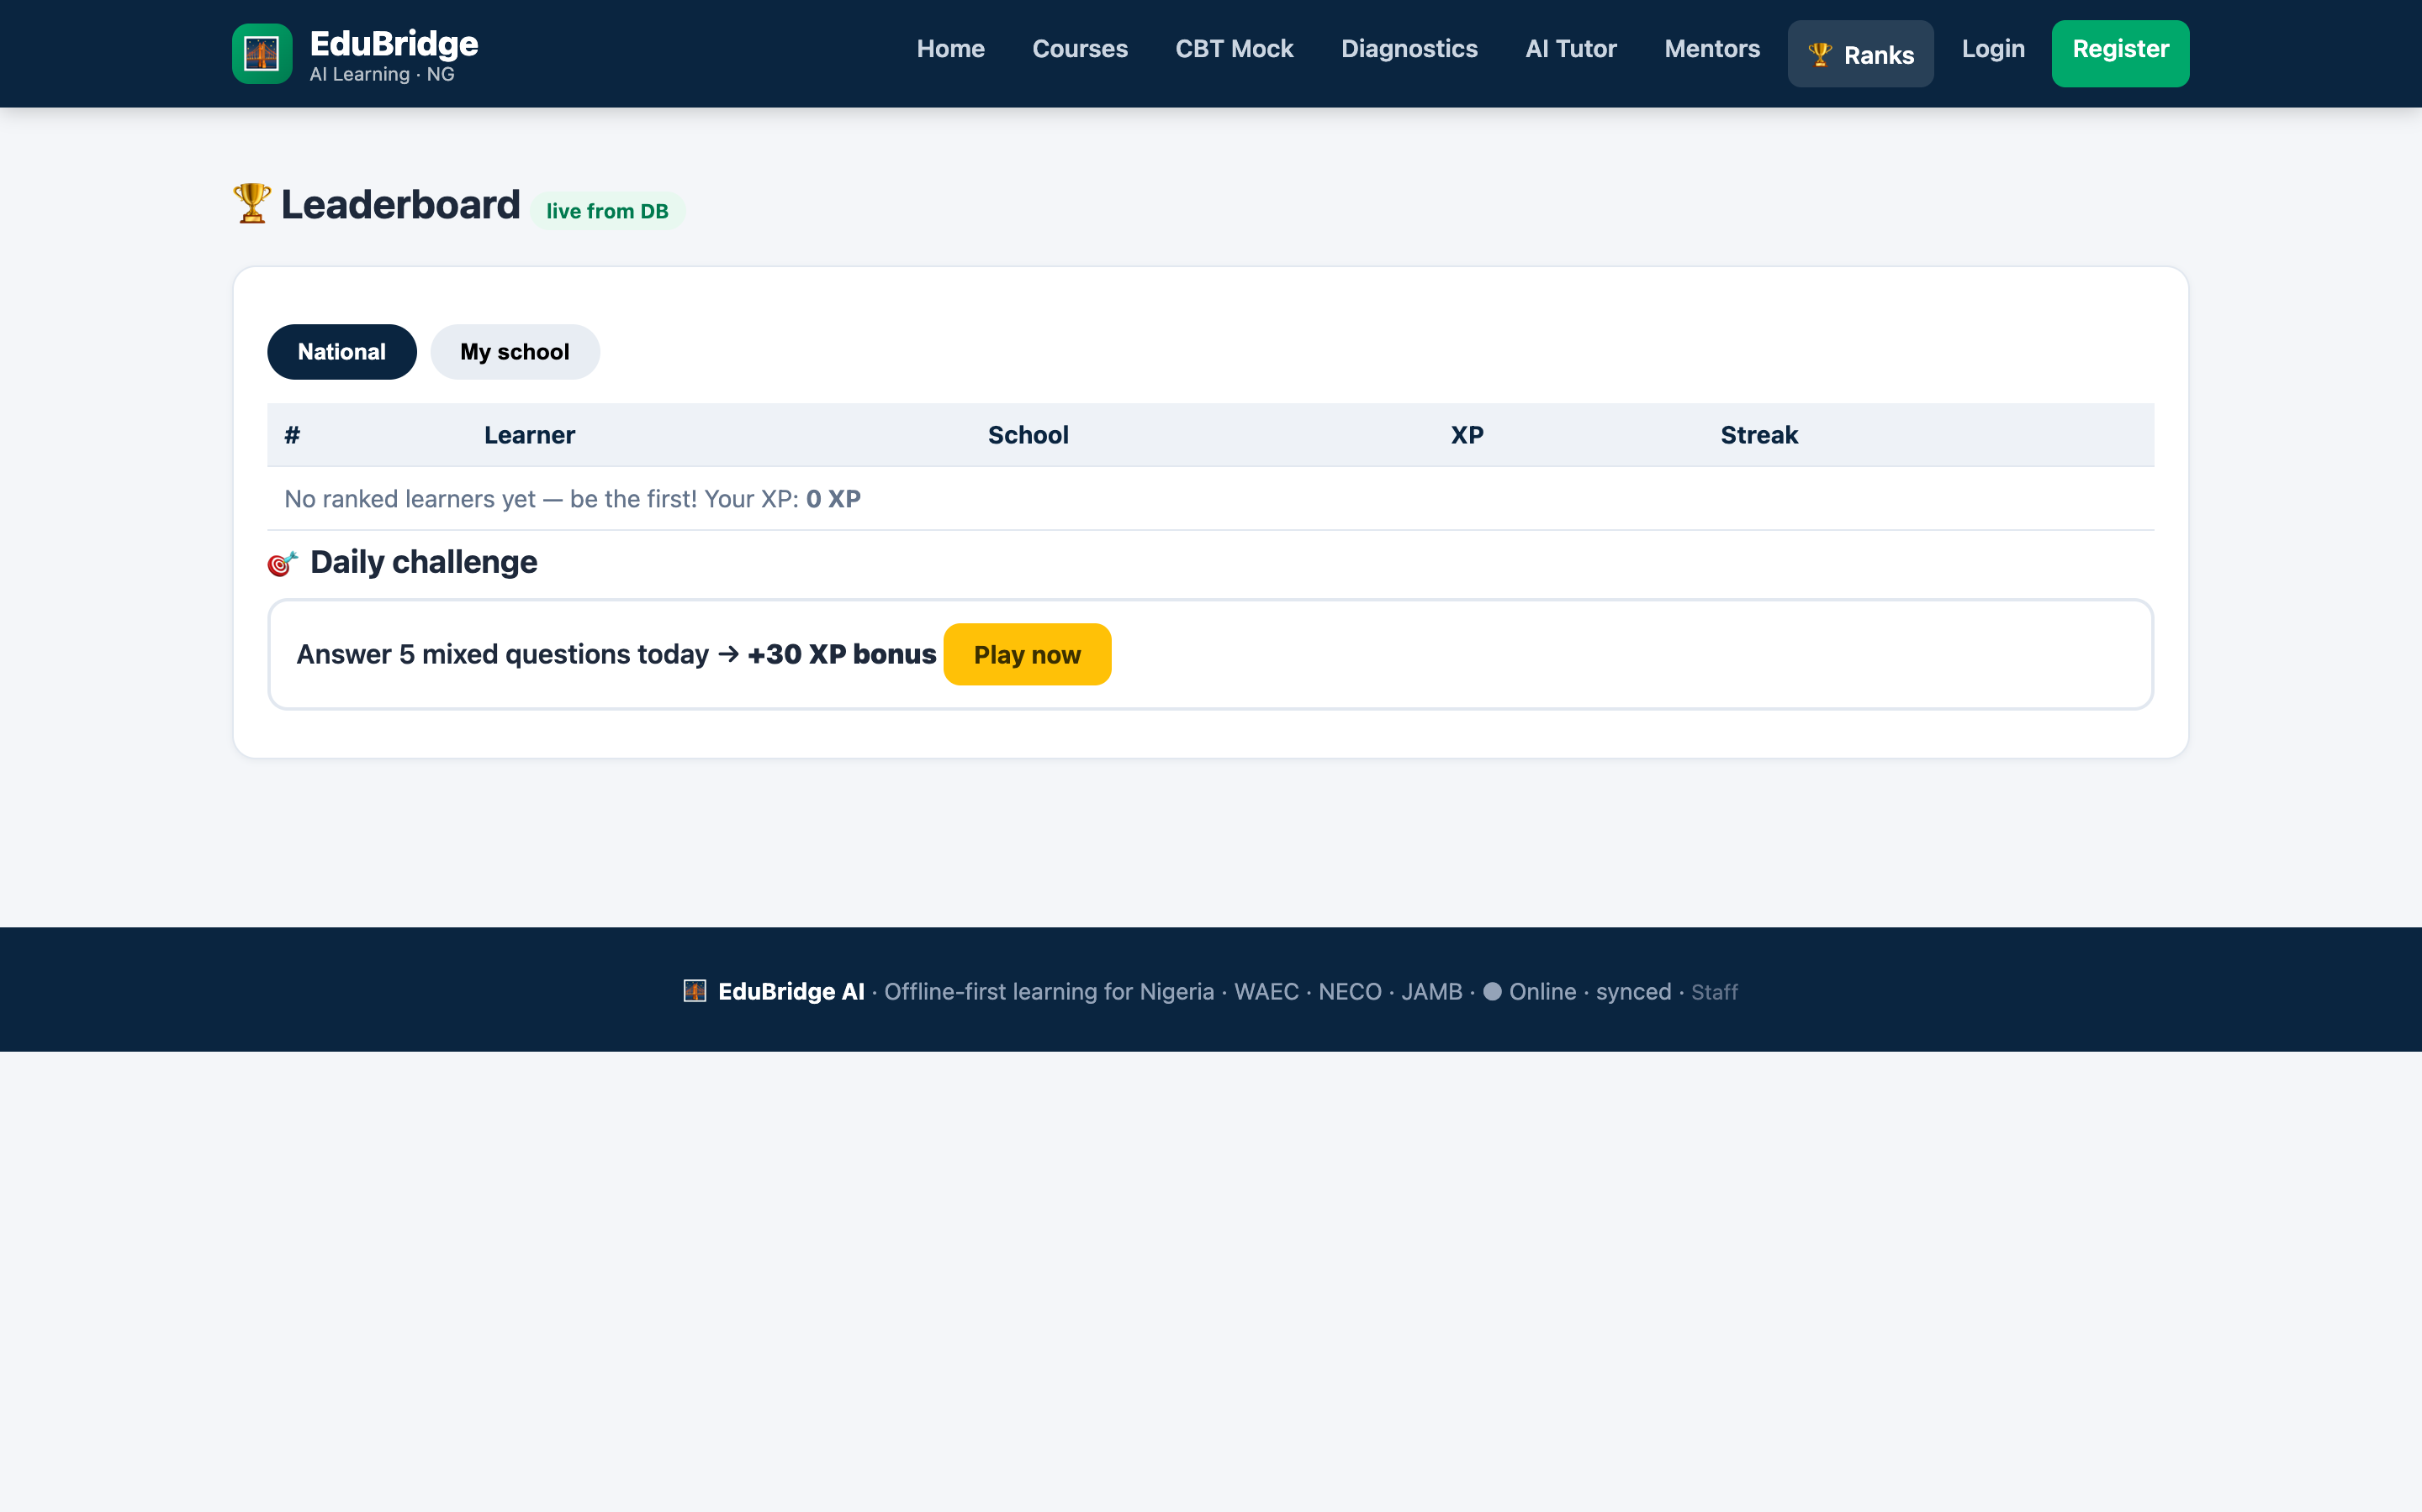
PRODUCT TOUR
One app, the full exam-prep loop
Diagnose → learn → practise → adapt → prove.
Adaptive diagnostics
Course catalogue
Timed CBT mock
IRT ability estimate + weak-topic detection
WAEC / NECO / JAMB mapped, offline bundles
Auto-grading, shuffle, timer, tab-blur flag
AI tutor
Study planner
Gamification
Offline rule-based answers, 60 msgs/day on Medium
Spaced repetition around each learner's gaps
XP, streaks, badges, ranks, daily challenge
EduBridge AI · Offline-first learning for Nigeria
04

Slide 5
ARCHITECTURE
Deploy on a school server today. Scale tomorrow.
Zero build step: PHP 8 + MySQL on Apache. No npm, no bundler, no lock-in.
CLIENT · PWA
12 SUBSYSTEMS
Vanilla SPA shell · IndexedDB (courses, quiz, queue) · Service worker precache · Offline bundles · Low-data mode · TTS · i18n (EN/HA/YO/IG/Pidgin)
▪ LMS Core
▪ Question Bank & CBT
▪ Adaptive IRT
▪ AI Tutor / Planner
▪ Gamification
▪ Live Class & Mentorship
▪ Community
▪ Authoring Studio
▪ Analytics (4 roles)
▪ Offline & Low-data
▪ Payments & Scholarships
▪ Safety & Compliance
API GATEWAY
TLS · rate limiting · router · session + JWT · RBAC (student / teacher / parent / school_admin / admin)
BACKEND SERVICES · PHP APIs
A Diagnostic & Sync · B IRT Assessment · C Mentorship & Chat · D AI Tutor & Planner · E Content & Live · F Engagement · G Payments & Enrollment · H Analytics & Safety
DATA
MySQL (users, courses, attempts, xp) · JSON seed bundles · IndexedDB mirror · Redis (later) · R2/S3 media · notification queue (mail / SMS / USSD)
EduBridge AI · Offline-first learning for Nigeria
05

Slide 6
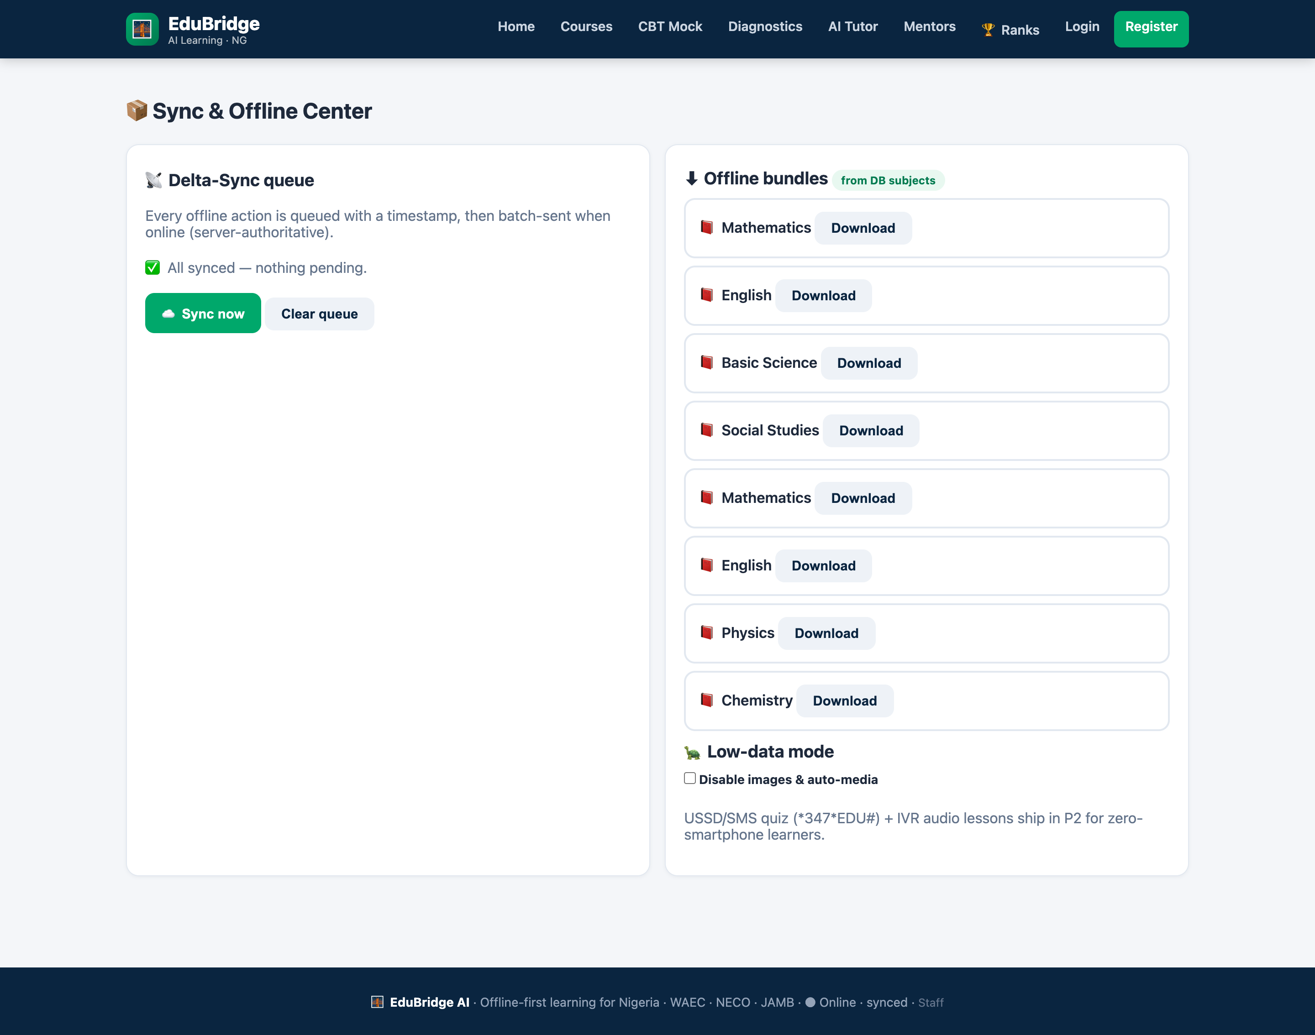
DIFFERENTIATOR
Offline-first is not a feature — it is the architecture
Most apps are online with an offline screen. EduBridge is offline with an online sync.
▪ Precache the shell Service worker keeps the app instant and available with zero network.
▪ Local-first writes Attempts, XP, messages and mentor chats land in IndexedDB immediately.
▪ Delta-sync queue Every mutation is queued with an op + payload and replayed on reconnect — idempotently.
▪ Low-data mode Learners choose a byte budget; bundles download once over WiFi and never again.
▪ Offline bundle downloader Courses, questions and media cached per subject for true 2G use.
EduBridge AI · Offline-first learning for Nigeria
06

Slide 7
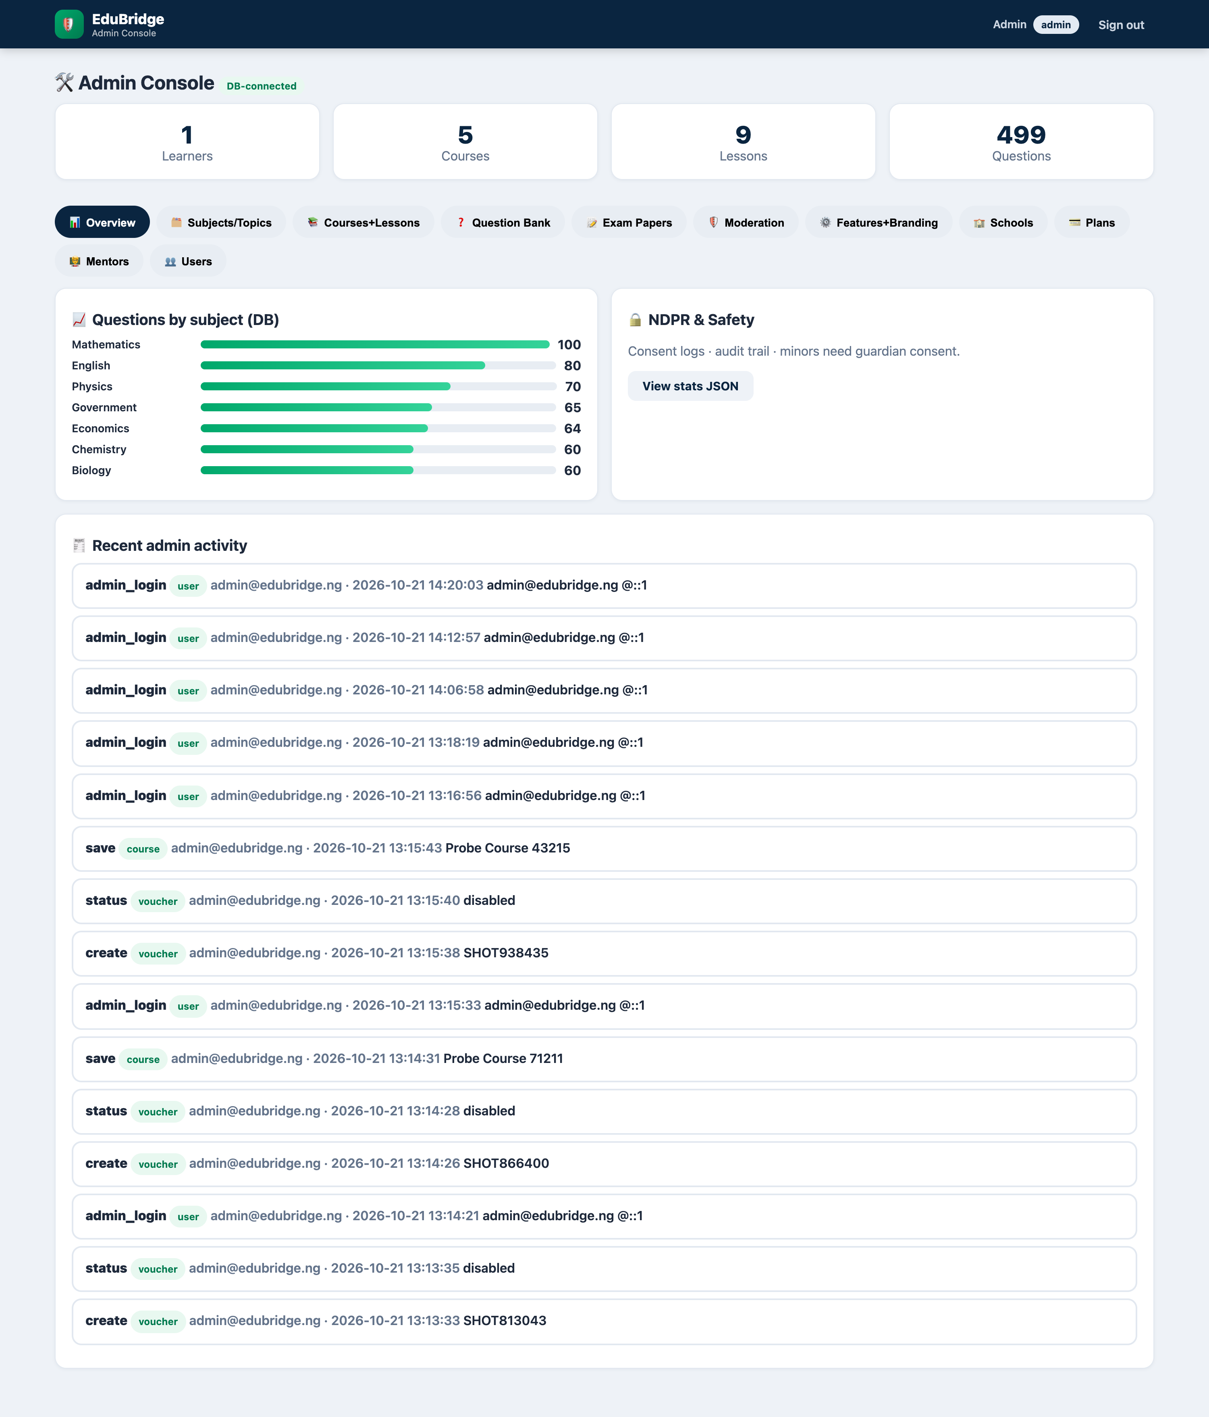
OPERATOR SIDE
A standalone staff console ships with the product
Content, moderation, commerce and people — with its own session namespace and audit trail.
Content
Subjects, topics, courses, lessons, question bank, exam papers, moderation queue
Commerce
Plans & pricing, vouchers, bulk enrolment, school licenses, payments
People
Users & roles, schools, mentors, guardians and parent links
Platform
Feature flags, branding, settings — and live audit logging of every action
Separate session namespace · bcrypt auth · brute-force lockout · every action audited
EduBridge AI · Offline-first learning for Nigeria
07

Slide 8
BUSINESS MODEL
Free core, monetised at the edges
The free tier is the growth engine; schools and power users fund the platform.
Free
Medium
MOST POPULAR
School
Pro
₦0
₦500
Custom
₦1,500
forever
per term
contact sales
per term
▪ Courses
▪ CBT mocks
▪ AI tutor (daily limit)
▪ Offline bundles
▪ Everything in Free
▪ 60 AI messages/day
▪ Study planner
▪ Forum
▪ Teacher studio
▪ Class analytics
▪ Bulk vouchers
▪ Scholarships
▪ Unlimited AI
▪ Adaptive plans
▪ Verified mentors
▪ Certificates
▪ Parent SMS · No ads
Payments: Paystack / Flutterwave + bank transfer + vouchers. No learner is locked out — the scholarship pool covers indigent students.
EduBridge AI · Offline-first learning for Nigeria
08

Slide 9
ROADMAP
Eight weeks to a two-school pilot
P0 is shipped. The next two pushes close the loop from 'good app' to 'institutional product'.
Wk 1–2
P0 polish + seed 500 real past questions
Harden the 499-question bank with authentic WAEC/NECO/JAMB items and tighten the IRT calibration.
Wk 3–4
Live classes + payments sandbox + i18n
WebRTC/Jitsi live classes with attendance, Paystack sandbox checkout, and a Hausa/Yoruba/Igbo/Pidgin toggle.
Wk 5–6
Authoring studio + deep analytics
Teacher course authoring with lesson drafts, plus per-role analytics dashboards and an at-risk churn predictor.
Wk 7–8
Pilot in 2 schools + hardening + NDPR audit
Supervised rollout, consent and data-protection audit, offline soak tests on real 2G, and certificate delivery.
EduBridge AI · Offline-first learning for Nigeria
09

Slide 10
THE ASK
Put every Nigerian learner's exam prep
in their pocket — for free, offline.
Pilot
Two schools, 8-week supervised rollout with offline soak testing on real 2G.
Content
Access to authentic WAEC/NECO/JAMB past papers to seed the bank past 500 items.
Partners
Payment rails (Paystack/Flutterwave) and SMS gateways for parent digests.
🌉 EduBridge AI · Learn anywhere. Even offline.
http://localhost/EduBridge/

