Slide 1
AXLERO SOLUTIONS
EVIDENCE
OmniBrain
ROUTING
Agentic Multi-Modal RAG Orchestrator
Advanced Data Science & ML Engineering
Project 1 | Real-World Applications
GUARDRAILS
Submitted by:
Laukik Suryavanshi
Rakhi Gahrwal
Nishant Saurav
Swapnil Kalita
Rudraksh Pandey
Project review presentation
Notes:
[Sources]
User-provided Axlero Solutions Project 1 brief; local OmniBrain project report.

Slide 2
THE CHALLENGE
Standard RAG breaks when research spans multiple data types
OmniBrain routes each question to the source that can answer it reliably.
Complex PDFs
Data silos
Hallucination risk
Financial reports mix narrative text, tables, charts, and embedded images. A single plain-text retrieval pass loses important context.
Historical prices and trading volume belong in structured data stores, not in a document-only vector search.
Weak retrieval can produce confident but unsupported answers unless the system can retry or refuse.
AXLERO SOLUTIONS | OMNIBRAIN
02
Notes:
[Sources]
User-provided Axlero Solutions Project 1 brief.

Slide 3
SYSTEM ARCHITECTURE
A supervisor coordinates specialist retrieval and reasoning paths
The architecture separates the user workspace, orchestration, data services, and output guardrails.
Document agent
Qdrant retrieval
LangGraph supervisor
Classifies intent and
maintains state
Researcher
+ PDF + question
Cited answer
or safe refusal
SQL agent
SQLite market data
Target multi-modal extension: VLM specialist for chart / image reasoning + CLIP-style image embeddings.
AXLERO SOLUTIONS | OMNIBRAIN
03
Notes:
[Sources]
User project brief; local repository files backend/app/agents/graph.py, routing.py, sql_agent.py, services/rag_service.py.

Slide 4
ROUTING AUDIT
The supervisor makes document and SQL choices explicit and testable
Deterministic pre-routing handles clear market-data questions before LLM supervision.
Document evidence request
Structured market-data request
“What does the revenue table
in this PDF show?”
“What was AAPL’s closing
price on 2025-01-10?”
Route: document_agent
Source: Qdrant vector retrieval
Output: cited document evidence
Route: sql_agent
Source: SQLite market_prices
Output: parameterized data lookup
AXLERO SOLUTIONS | OMNIBRAIN
04
Notes:
[Sources]
Local audit: docs/midproject_reasoning_audit.md; backend/tests/test_routing_audit.py.

Slide 5
STRUCTURED DATA PATH
The SQL agent proves safe, repeatable access to historical market data
The demonstration uses application-defined queries rather than accepting arbitrary SQL.
SQLite: market_prices
Why this is safer
ticker | trade_date | open | high | low | close | volume
•
Defined route
Only known market-data prompts reach the SQL agent.
AAPL | 2025-01-10 | … | 236.85 | …
MSFT | 2025-01-10 | … | volume
•
Parameterized
The application binds values; it does not execute free-form user SQL.
Seeded AAPL and MSFT examples make the audit reproducible.
•
Auditable
Tests verify routing decisions and expected database source.
AXLERO SOLUTIONS | OMNIBRAIN
05
Notes:
[Sources]
Local implementation: backend/app/services/market_data_service.py and backend/app/agents/sql_agent.py.

Slide 6
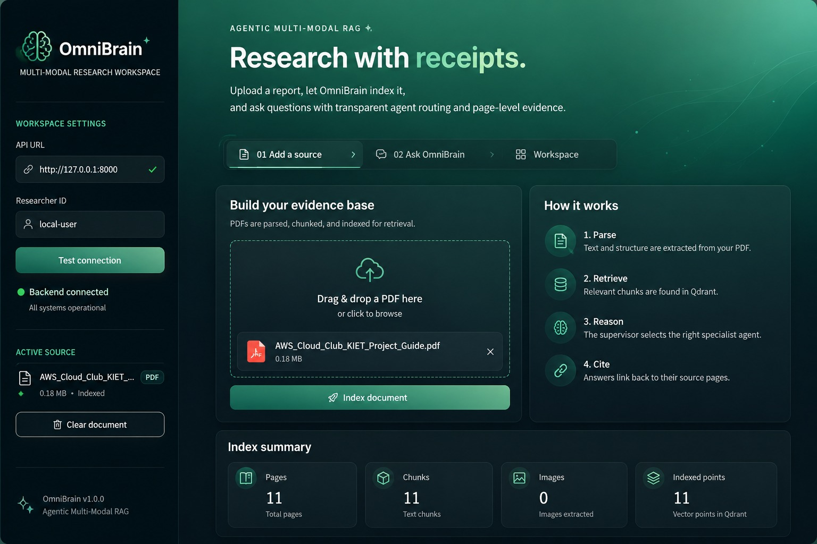
Frontend Design

Slide 7
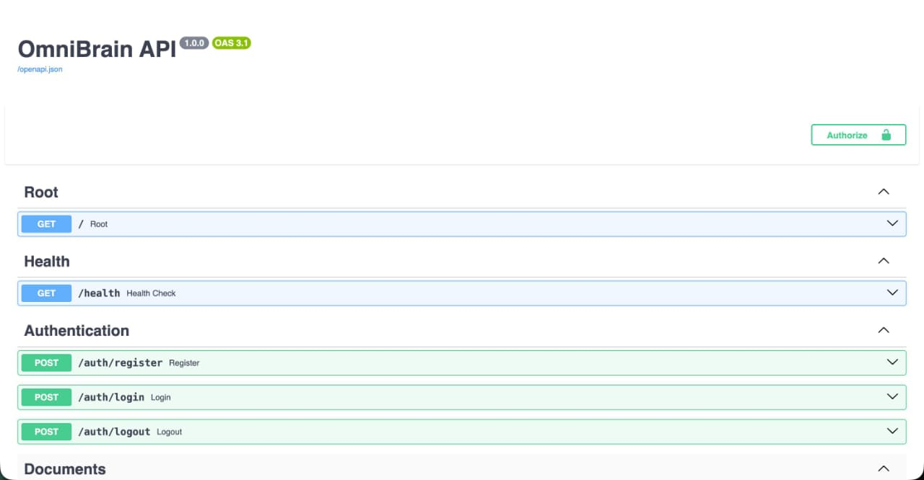
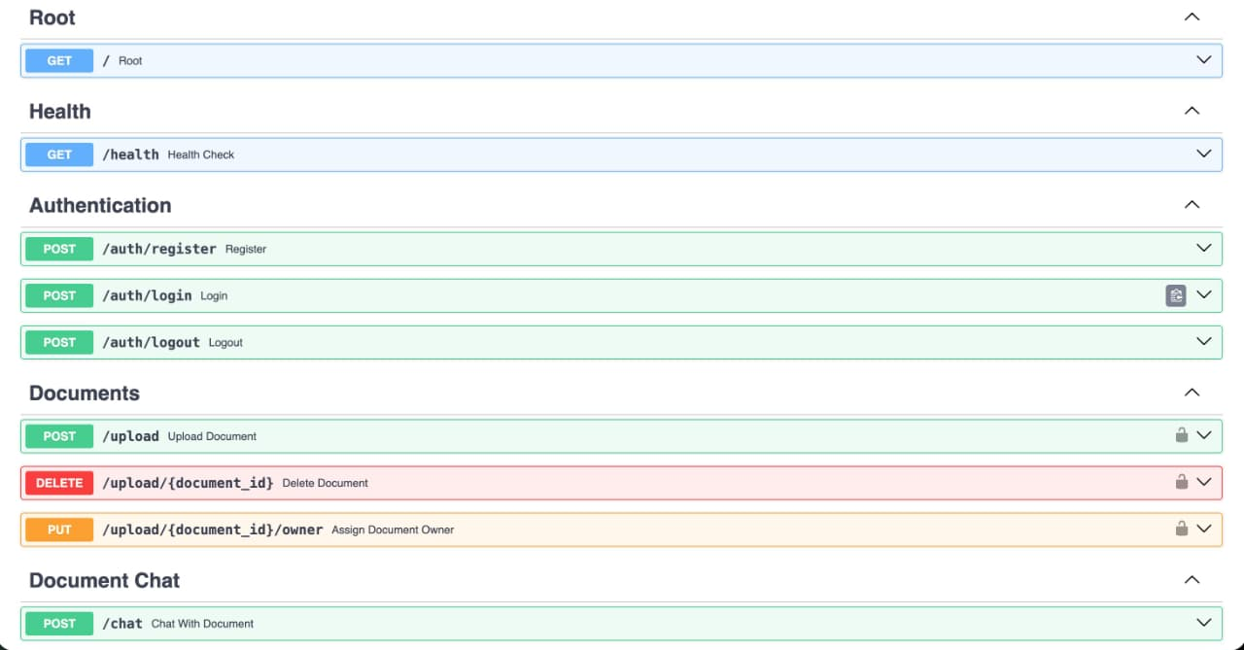
Backend Design

Slide 8
SELF-CORRECTION LOOP
Weak retrieval is corrected before the system answers
The system retries once with a narrower query, then refuses unsupported responses.
1. Retrieve
semantic chunks
2. Check
relevance score
3. Rewrite query
if score < 0.45
4. Cited answer
or refusal
Rewritten query focus: directly stated facts, named entities, and numerical evidence.
If a second retrieval remains weak, OmniBrain clearly says it cannot find sufficient evidence.
AXLERO SOLUTIONS | OMNIBRAIN
06
Notes:
[Sources]
Local implementation: backend/app/services/guardrail_service.py and backend/app/services/rag_service.py.

Slide 9
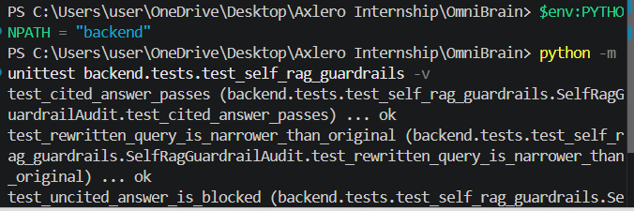
TEST EVIDENCE
Four guardrail checks pass deterministically
The test suite validates retry behavior and citation enforcement without depending on a live LLM response.
What the checks prove
•
Retry
Weak retrieval triggers a second search.
•
Rewrite
The retry query becomes more specific.
•
Citations
Uncited answers are blocked; cited ones pass.
AXLERO SOLUTIONS | OMNIBRAIN
07
Notes:
[Sources]
User-provided PowerShell screenshot; local test file backend/tests/test_self_rag_guardrails.py.

Slide 10
DEPLOYMENT MODEL
Docker Compose turns a multi-service AI application into a reproducible local environment
The backend depends on infrastructure services, while Streamlit supplies the research workspace.
FastAPI
PostgreSQL
MinIO
Qdrant
API / agent workflow
Users + metadata
Uploaded files
Vector search
docker compose up -d --build
Then open FastAPI docs on port 8000 and the Streamlit workspace on port 8501.
AXLERO SOLUTIONS | OMNIBRAIN
08
Notes:
[Sources]
Local SETUP.md and docker-compose.yaml.

Slide 11
DELIVERY STATUS
What is implemented now—and what comes next
The project already proves controlled routing and guarded retrieval; multi-modal reasoning is the next capability layer.
Implemented
Next milestones
•
Agents
•
Vision
Document and SQL specialist routes.
Dedicated VLM route for charts and figures.
•
Safety
•
Embeddings
Self-RAG retry, citations, and refusal.
Image embeddings for true multi-modal retrieval.
•
Audit
•
Observe
Routing and guardrail unit tests.
Langfuse + NeMo Guardrails evaluation layer.
AXLERO SOLUTIONS | OMNIBRAIN
09
Notes:
[Sources]
User project brief; local project report. Future modules are labelled as roadmap, not completed features.

Slide 12
PROJECT CONCLUSION
OmniBrain makes
research routing explicit,
evidence-grounded, and testable.
Document RAG
SQL routing
Self-RAG guardrails
The portfolio value is controlled AI behavior:
choose the right data source, validate evidence, retry weak retrieval, and refuse unsupported claims.
AXLERO SOLUTIONS | OMNIBRAIN
10
Notes:
[Sources]
User project brief; local project report and audit documentation.

