Slide 1
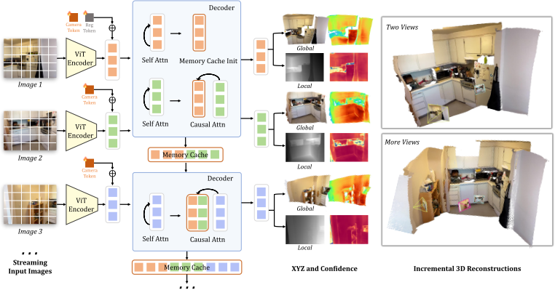
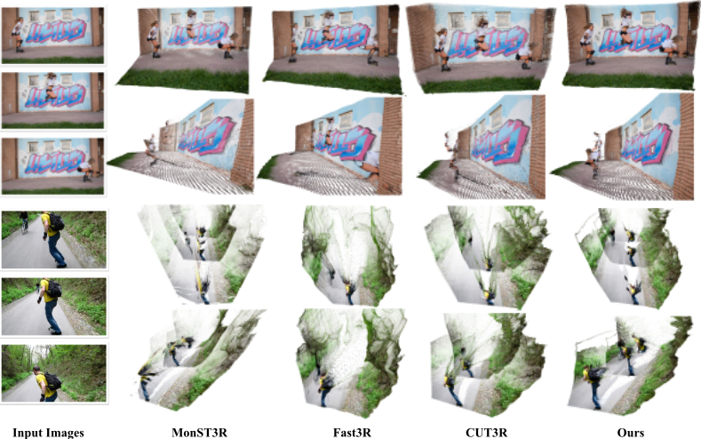
STREAM3R: SCALABLE SEQUENTIAL 3D RECONSTRUCTION WITH CAUSAL TRANSFORMER
Yushi Lan¹, Yihang Luo¹, Fangzhou Hong¹, Shangchen Zhou¹, Honghua Chen¹, Zhaoyang Lyu², Shuai Yang³, Bo Dai⁴, Chen Change Loy¹, Xingang Pan¹
¹S-Lab, Nanyang Technological University, Singapore; ²Shanghai Artificial Intelligence Laboratory; ³WICT, Peking University; ⁴The University of Hong Kong
Abstract
Method
•STREAM3R: decoder-only causal Transformer for 3D reconstruction
•Overcomes scalability limits—no global optimization needed
•Learns geometric priors from large-scale 3D data
•SOTA performance across benchmarks; LLM-style training ready
•Enables real-time, online 3D perception in streaming
Introduction
•Causal transformer for streaming 3D reconstruction
•Replaces bidirectional attention with cached history
•Single decoder with frame-wise self- and causal cross-attention
•Learnable [reg] token defines canonical global coordinate system
•3D reconstruction is key for autonomous driving, VR, and robotics.
•Traditional SfM/MVS vs. modern transformer methods (DUSt3R, MASt3R, etc.).
•Streaming 3D reconstruction remains challenging due to drift and cost.
•STREAM3R: causal decoder-only transformer for efficient online 3D reconstruction.
Experiments
•Trained on 12 diverse 3D datasets
•Two variants: STREAM3Rα (DUSt3R-based) and STREAM3Rβ (VGG-T + CausalAttn)
•AdamW, 64 batch, 1e-4 lr, 400K iters, multi-res crops, 8× A100
•Baselines: DUSt3R, MASt3R, Spann3R, CUT3R, SLAM3R, Fast3R, VGG-T
Results
Ablation
Analysis
•STREAM3R & CUT3R: same init, hyperparams, compute.
•STREAM3R converges faster—60% more steps/time.
•Headglobal: faster with STREAM3R; Headlocal similar.
•STREAM3R outperforms on depth & 3D at equal iterations.
•FlashAttention: linear memory; causal KV growth
•STREAM3R-W[5]: sliding window, stable depth
•Robust to degraded first-frame anchors
•7-Scenes: STREAM3R error 0.122→0.223 vs CUT3R 0.335
Conclusion
•Mono-depth: SOTA streaming method; beats VGG-T on Sintel/KITTI/NYU-v2
•Video depth: Beats DUSt3R-GA, MASt3R-GA, MonST3R-GA, CUT3R (+40% speed)
•3D reconstruction: >50× faster than CUT3R; beats SLAM3R on 7-scenes
•Efficiency: STREAM3Rβ-W[5] enables constant memory with only 5 frames
•STREAM3R: decoder-only transformer for dense 3D reconstruction.
•Reformulates reconstruction as causal sequential registration.
•Supports dual-coordinate pointmaps and novel-view synthesis.
•Achieves SOTA performance with faster inference.
•Bridges geometry and scalable sequence modeling.

