Slide 1
Modelling and Analysis of Complex Networks Exercise 9
Aoran Wang
University of Luxembourg

Slide 2
Contact Information
Office:
MNO E03-25-090
Email:
aoran.wang@uni.lu
Github:
wang422003

Slide 3
Organisation
Question-answering in class
Exercises after class (intended for groups of 2 students)
20 points considering the best 80% of all exercises
No written exam!
Moodle system: https://moodle.uni.lu
(course materials, schedule, exercises, etc.)
Submit the assignments via Moodle before the deadline

Slide 4
"One reviews the old to know the new"

Slide 5
Review
Machine Learning on Graphs
Supervised ML Pipeline
Node Classification
Importance-based features, structure-based features
Link Prediction
Distance-based features, local neighborhood overlap, global neighborhood overlap
Graph-level Features
Graphlet Kernel, Weisfeiler-Lehman Kernel

Slide 6
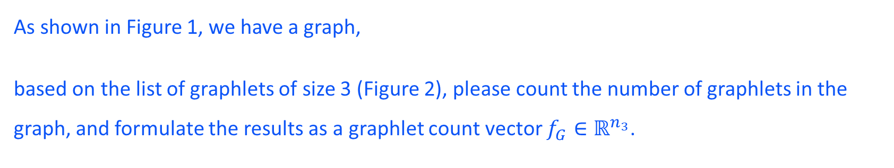




Review
Question 1
As shown in Figure 1, we have a graph,
based on the list of graphlets of size 3 (Figure 2), please count the number of graphlets in the graph, and formulate the results as a graphlet count vector $f_{G}∈ℝ^{n_{3}}$.
2
7
$$g_{1}$$
$$g_{2}$$
$$g_{3}$$
$$g_{4}$$
3
1
6
4
5
Figure 1
Figure 2
Notes:
1: 2
2: 4
3: 3
4: 4
5: 3
6: 16
7: 2
8: 6
9: 10 or 9
10: 2
11: 7 or 5
12: 4
13: 4 or 5
14: 9 or 7
15: 2
16: 2
17: 1
18: 3 or 5
19: 6
10: 3
21: 3
22: 17
23: 4
24: 5
25: 4
26: 2
27: 2 or 4
28: 2
29: 12
30: 2
31: 2
32: 2
33: 4
34: 5 or 7

Slide 7





Review
$$g_{1}$$
$$g_{2}$$
$$g_{3}$$
$$g_{4}$$
Question 1
2
7
3
1
6
4
5
$$f_{G} =$$
(2,
16,
45,
0)
Notes:
1: 2
2: 4
3: 3
4: 4
5: 3
6: 16
7: 2
8: 6
9: 10 or 9
10: 2
11: 7 or 5
12: 4
13: 4 or 5
14: 9 or 7
15: 2
16: 2
17: 1
18: 3 or 5
19: 6
10: 3
21: 3
22: 17
23: 4
24: 5
25: 4
26: 2
27: 2 or 4
28: 2
29: 12
30: 2
31: 2
32: 2
33: 4
34: 5 or 7

Slide 8
Review
Question 2
Based on the two graphs (Figure 1 and 2),
Please perform 2 steps of color refinement on this graph.
2
7
2
7
3
1
6
3
1
6
4
5
4
5
Figure 1
Figure 2
Notes:
1: 2
2: 4
3: 3
4: 4
5: 3
6: 16
7: 2
8: 6
9: 10 or 9
10: 2
11: 7 or 5
12: 4
13: 4 or 5
14: 9 or 7
15: 2
16: 2
17: 1
18: 3 or 5
19: 6
10: 3
21: 3
22: 17
23: 4
24: 5
25: 4
26: 2
27: 2 or 4
28: 2
29: 12
30: 2
31: 2
32: 2
33: 4
34: 5 or 7

Slide 9
k = 0
Assign initial colors
Aggregate neighboring colors
Hash aggregated colors
1,11
1,11
1
1
2
2
Figure 1
1
1
1
1,11
3
5
2
1,111
1,11111
1
1
2
2
1,11
1,11
Hash table
1,11
1,111
1,1111
1,11111
→
→
→
→
2
3
4
5
1,111
1,111
1
1
3
3
Figure 2
1,11
2
4
2
1
1
1
1,11
1,1111
1
1
2
2
1,11
1,11
Notes:
1: 2
2: 4
3: 3
4: 4
5: 3
6: 16
7: 2
8: 6
9: 10 or 9
10: 2
11: 7 or 5
12: 4
13: 4 or 5
14: 9 or 7
15: 2
16: 2
17: 1
18: 3 or 5
19: 6
10: 3
21: 3
22: 17
23: 4
24: 5
25: 4
26: 2
27: 2 or 4
28: 2
29: 12
30: 2
31: 2
32: 2
33: 4
34: 5 or 7

Slide 10
k = 1
1st iteration colors (k=1)
Aggregate neighboring colors
Hash aggregated colors
2,35
2,25
10
2
2
9
Figure 1
3
5
2
2,22
6
3,225
11
14
5,22223
2
2
9
2,35
2,25
10
Hash table
2,22
2,23
2,24
2,25
2,35
3,225
3,234
4,2233
5,22223
→
→
→
→
→
→
→
→
→
6
7
8
9
10
11
12
13
14
3,234
3,234
12
12
3
3
Figure 2
2
4
2
7
7
2,23
2,23
13
4,2233
2
2
8
8
2,24
2,24
Notes:
1: 2
2: 4
3: 3
4: 4
5: 3
6: 16
7: 2
8: 6
9: 10 or 9
10: 2
11: 7 or 5
12: 4
13: 4 or 5
14: 9 or 7
15: 2
16: 2
17: 1
18: 3 or 5
19: 6
10: 3
21: 3
22: 17
23: 4
24: 5
25: 4
26: 2
27: 2 or 4
28: 2
29: 12
30: 2
31: 2
32: 2
33: 4
34: 5 or 7

Slide 11
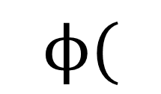

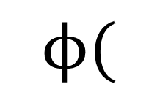

Review
1, 2, 3, 4, 5, 6, 7, 8, 9,10,11,12,13,14
$$ϕ($$
$$)$$
=[7, 5, 1, 0, 1, 1, 0, 0, 2, 2, 1, 0, 0, 1]
1, 2, 3, 4, 5, 6, 7, 8, 9,10,11,12,13,14
$$ϕ($$
$$)$$
=[7, 4, 2, 1, 0, 0, 2, 2, 0, 0, 0, 2, 1, 0]
Notes:
1: 2
2: 4
3: 3
4: 4
5: 3
6: 16
7: 2
8: 6
9: 10 or 9
10: 2
11: 7 or 5
12: 4
13: 4 or 5
14: 9 or 7
15: 2
16: 2
17: 1
18: 3 or 5
19: 6
10: 3
21: 3
22: 17
23: 4
24: 5
25: 4
26: 2
27: 2 or 4
28: 2
29: 12
30: 2
31: 2
32: 2
33: 4
34: 5 or 7

Slide 12
Brainstorming

Slide 13
Brainstorming
Question 3
What are the real-world applications of node classification / link prediction?

Slide 14
Brainstorming
Question 3

Slide 15
Brainstorming
Question 4
Given two graphs, if we run WL algorithm, what problem could emerge?
2
1
6
2
6
1
4
3
4
5
3
5
Figure 4
Figure 3

Slide 16
Assignment
Continue the assignment with pytorch / sklearn and networkx:
Based on the code scripts from the last assignment.
Answer the questions in the question sheet with your datasets.
Also submit the code ! (Attachment or link to your Github repository)

Slide 17
Q & A
Aoran Wang
University of Luxembourg
Email: aoran.wang@uni.lu

