Slide 1
Modelling and Analysis of Complex Networks Exercise 3
Aoran Wang
University of Luxembourg

Slide 2
Contact Information
Office:
MNO E03-25-090
Email:
aoran.wang@uni.lu
Github:
wang422003

Slide 3
Organisation
Question-answering in class
Exercises after class (intended for groups of 2 students)
20 points considering the best 80% of all exercises
No written exam!
Moodle system: https://moodle.uni.lu
(course materials, schedule, exercises, etc.)
Submit the assignments via Moodle before the deadline

Slide 4
"One reviews the old to know the new"

Slide 5
Review
Graph Models
Erdös-Rényi
Watts-Strogatz
Scale-free
Barabási-Albert

Slide 6
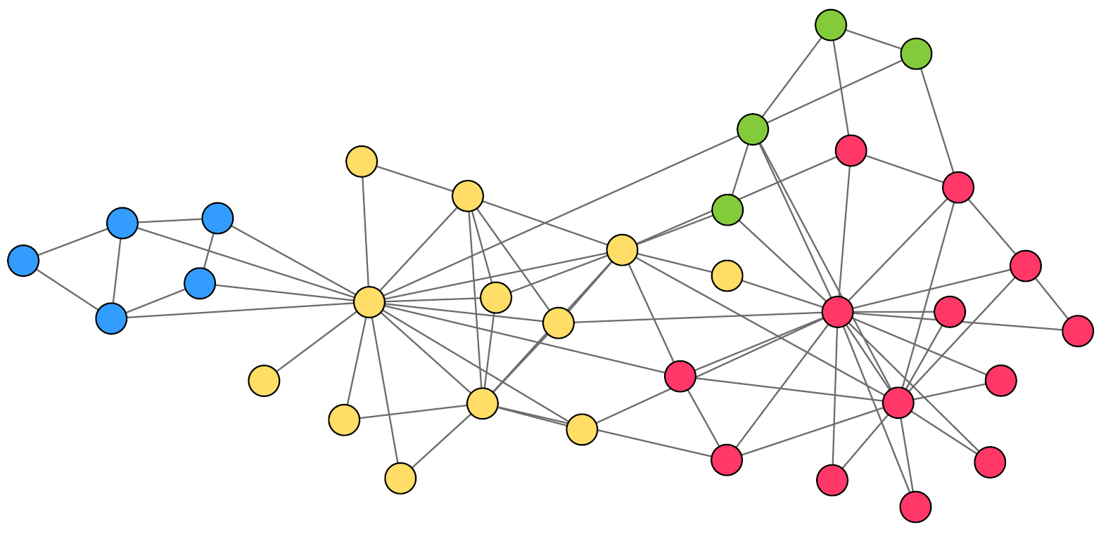
Review
Question 1
Based on the Watts-Strogatz model mentioned in the course,
Draw a network following the rules of creating a Watts-Strogatz model.
Why do we need Watts-Strogatz model?
20
21
19
23
7
8
18
24
2
3
1
9
25
5
12
10
4
6
22
27
11
26
17
34
28
16
14
29
13
15
33
30
32
31
Notes:
1: 2
2: 4
3: 3
4: 4
5: 3
6: 16
7: 2
8: 6
9: 10 or 9
10: 2
11: 7 or 5
12: 4
13: 4 or 5
14: 9 or 7
15: 2
16: 2
17: 1
18: 3 or 5
19: 6
10: 3
21: 3
22: 17
23: 4
24: 5
25: 4
26: 2
27: 2 or 4
28: 2
29: 12
30: 2
31: 2
32: 2
33: 4
34: 5 or 7

Slide 7
Review
Question 1
Exercises (intended for groups of 2 students)
20 points considering the best 80% of all exercises
No written exam!
Moodle system: https://moodle.uni.lu
(course materials, schedule, exercises, etc.)
Submit the assignments via Moodle before the deadline
Notes:
Open a new Typora notebook

Slide 8
Review
Question 2
A network is called scale-free when its degree distribution follows a Power-law distribution. Can we describe and study real networks with the observations from scale-free networks?
20
21
19
23
7
8
18
24
2
3
1
9
25
5
12
10
4
6
22
27
11
26
17
34
28
16
14
29
13
15
33
30
32
31
Notes:
1: 2
2: 4
3: 3
4: 4
5: 3
6: 16
7: 2
8: 6
9: 10 or 9
10: 2
11: 7 or 5
12: 4
13: 4 or 5
14: 9 or 7
15: 2
16: 2
17: 1
18: 3 or 5
19: 6
10: 3
21: 3
22: 17
23: 4
24: 5
25: 4
26: 2
27: 2 or 4
28: 2
29: 12
30: 2
31: 2
32: 2
33: 4
34: 5 or 7

Slide 9
Review
Question 2
Exercises (intended for groups of 2 students)
20 points considering the best 80% of all exercises
No written exam!
Moodle system: https://moodle.uni.lu
(course materials, schedule, exercises, etc.)
Submit the assignments via Moodle before the deadline
Notes:
Open a new Typora notebook

Slide 10
Review
Question 3
Based on the Barabási-Albert model mentioned in the course,
Draw a network following the rules of generating a Barabási-Albert model.
Why do we need Barabási-Albert model?
20
21
19
23
7
8
18
24
2
3
1
9
25
5
12
10
4
6
22
27
11
26
17
34
28
16
14
29
13
15
33
30
32
31
Notes:
1: 2
2: 4
3: 3
4: 4
5: 3
6: 16
7: 2
8: 6
9: 10 or 9
10: 2
11: 7 or 5
12: 4
13: 4 or 5
14: 9 or 7
15: 2
16: 2
17: 1
18: 3 or 5
19: 6
10: 3
21: 3
22: 17
23: 4
24: 5
25: 4
26: 2
27: 2 or 4
28: 2
29: 12
30: 2
31: 2
32: 2
33: 4
34: 5 or 7

Slide 11
Review
Question 3
Exercises (intended for groups of 2 students)
20 points considering the best 80% of all exercises
No written exam!
Moodle system: https://moodle.uni.lu
(course materials, schedule, exercises, etc.)
Submit the assignments via Moodle before the deadline
Notes:
Open a new Typora notebook

Slide 12
Brainstorming

Slide 13
Brainstorming
Question 4
Based on the graph models:
Which networks in real-world are similar to Erdös-Rényi, Watts-Strogatz, Scale-free and Barabási-Albert model?
What is the difference between correlation and causation?

Slide 14
Brainstorming
Question 4
Notes:
Open Typora notebook

Slide 15
Assignment
Continue the assignment with SNAP.PY and networkx:
Based on the code scripts from the last assignment.
Answer the questions in the question sheet with your datasets.
Also submit the code ! (Attachment or link to your Github repository)

Slide 16
Q & A
Aoran Wang
University of Luxembourg
Email: aoran.wang@uni.lu

