Slide 1
Modelling and Analysis of Complex Networks Exercise 11
Aoran Wang
University of Luxembourg

Slide 2
Contact Information
Office:
MNO E03-25-090
Email:
aoran.wang@uni.lu
Github:
wang422003

Slide 3
Organisation
Question-answering in class
Exercises after class (intended for groups of 2 students)
20 points considering the best 80% of all exercises
No written exam!
Moodle system: https://moodle.uni.lu
(course materials, schedule, exercises, etc.)
Submit the assignments via Moodle before the deadline

Slide 4
"One reviews the old to know the new"

Slide 5
Review
Graph Neural Networks
Limitations of shallow node encoding
Basics of deep learning
Deep learning for graphs
Graph Neural Networks (GNNs)

Slide 6
More
Watch the video about a Graph pooling operation for graph-level tasks DIFFPOOL:
https://www.youtube.com/watch?v=Uqc3O3-oXxM&t=171s .

Slide 7
DIFFPOOL
1. What is the key idea of this work?
2. What are the advantages of DIFFPOOL?

Slide 8
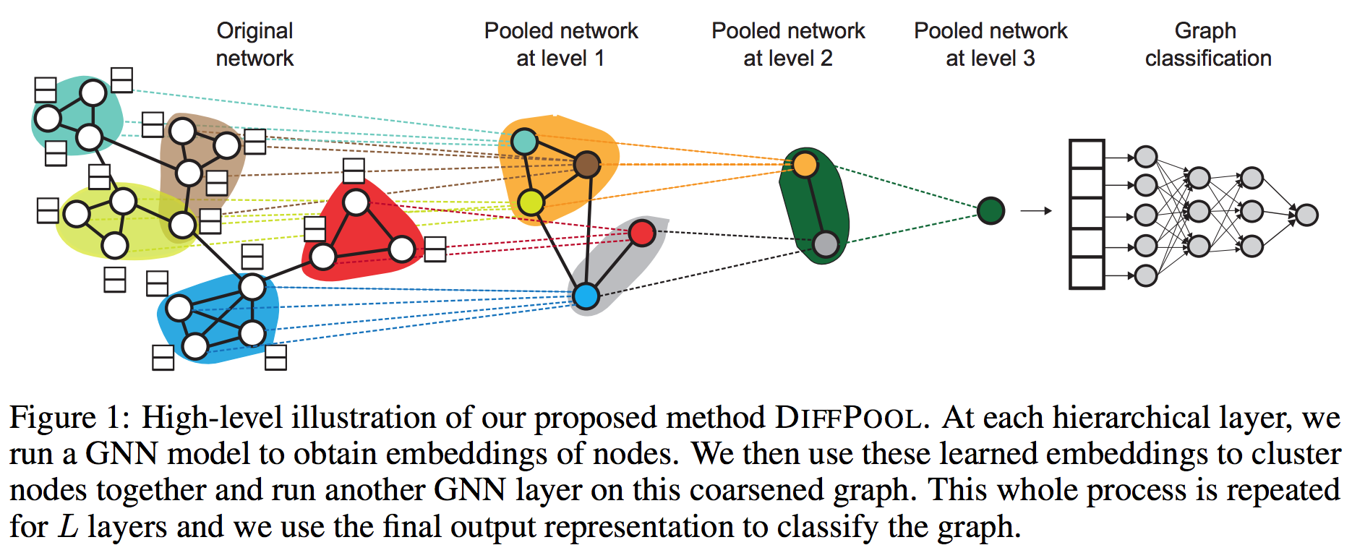
DIFFPOOL
Advantages of DIFFPOOL:
Can be adapted to various graph neural network architectures in an hierarchical and end-to-end fashion;
DIFFPOOL allows for developing deeper GNN models that can learn to operate on hierarchical representations.

Slide 9
More
Watch the video about graph generative models:
https://www.youtube.com/watch?v=IMpkHvQ0LA4 .

Slide 10
Graph Generative Models
1. Why do we need graph generative models?
2. Please summarize the goals of graph generative models.

Slide 11
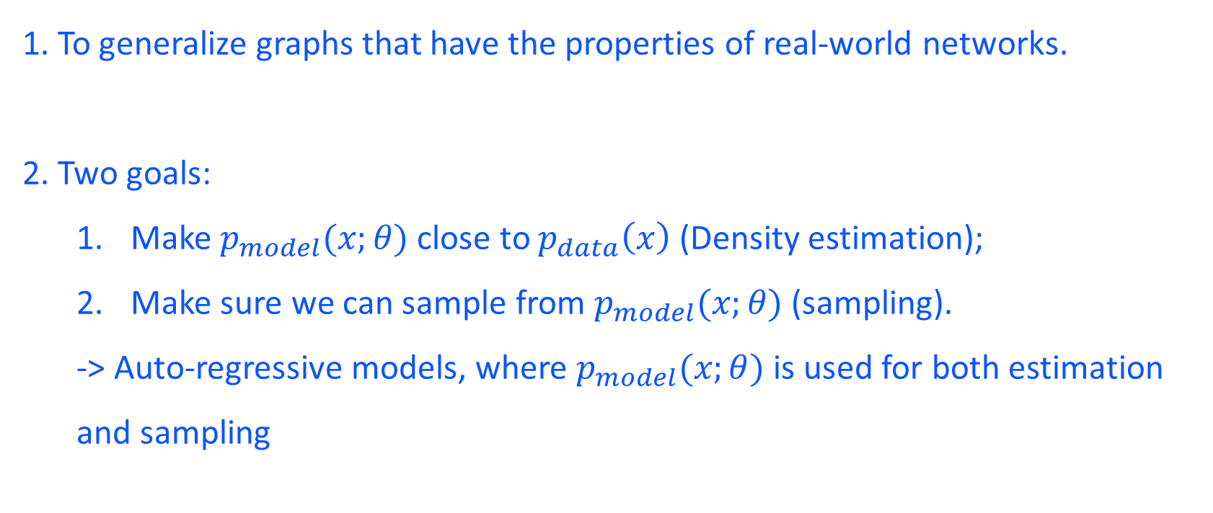
Graph Generative Models
1. To generalize graphs that have the properties of real-world networks.
2. Two goals:
Make $p_{model}(x;θ)$ close to $p_{data}\left(x\right)$ (Density estimation);
Make sure we can sample from $p_{model}(x;θ)$ (sampling).
-> Auto-regressive models, where $p_{model}(x;θ)$ is used for both estimation and sampling

Slide 12
Assignment
Continue the assignment with pytorch, pytorch-geometric and networkx:
Based on the code scripts from the last assignment.
Answer the questions in the question sheet with your datasets.
Also submit the code ! (Attachment or link to your Github repository)

Slide 13
Q & A
Aoran Wang
University of Luxembourg
Email: aoran.wang@uni.lu

