Slide 1
Modelling and Analysis of Complex Networks Exercise 7
Aoran Wang
University of Luxembourg

Slide 2
Contact Information
Office:
MNO E03-25-090
Email:
aoran.wang@uni.lu
Github:
wang422003

Slide 3
Organisation
Question-answering in class
Exercises after class (intended for groups of 2 students)
20 points considering the best 80% of all exercises
No written exam!
Moodle system: https://moodle.uni.lu
(course materials, schedule, exercises, etc.)
Submit the assignments via Moodle before the deadline

Slide 4
"One reviews the old to know the new"

Slide 5
Review
Cascade
Network cascades
Diffusion
Decision Based Models
Probabilistic Models – run forever / die out / reproductive number

Slide 6
More about cascade
Decision Based Models in Social Science: Opinion Dynamics
Opinions are the drivers of human behavior
Opinions play a crucial role in many global challenges
E.g., global financial crisis, growth of cities…
Can you give an example where opinion affects mass population?

Slide 7
The formation of opinion is a complex process:
Individual predisposition
The influence of positive and negative peer interaction
The information each individual is exposed to
And many others…

Slide 8
Existing one-dimensional models of opinion dynamics and extensions:
Discrete models:
The voter model / q-voter model
The majority rule model
Sznajd model
Continuous models:
Deffuant-Weisbuch
The Hegselmann-Krause model
Hybrid models:
The CODA model
And multi-dimensional models….

Slide 9
Discrete Models

Slide 10
Voter Model
Voter model is originally introduced to analyze competition of species.
In the model, each agent holds one of two discrete opinions (+1 or -1).
Agents are connected by an underlying graph.
At each time step:
A random agent i is selected along with one of its neighbours j.
i takes the opinion of j.

Slide 11
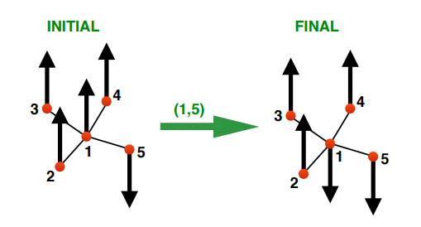
Voter Model
For example, we select node 1 and its neighbor node 5.
Node 1 takes the opinion of node 5:
Voter dynamics involve one neighbor only.

Slide 12
Voter Model
Recent development of Voter model:
Use power-law intervals between interactions.
Non-linear extension with the control of herding effect.
The introduction of a third ‘centrist’ opinion (0).

Slide 13
The Majority Rule Model
The Majority Rule Model model is originally introduced to describe public debates.
In the model, each agent holds one of two discrete opinions (+1 or -1).
Agents are connected by a complete graph.

Slide 14
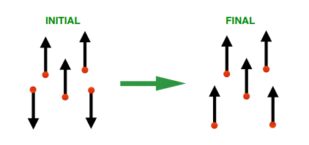
The Majority Rule Model
At each time step:
A group of r agents is selected randomly.
All of the r agents take the majority opinion within the group.
The group size can be fixed or taken at each time from a specific distribution.
If r is odd, then the majority opinion is always defined;
If r is even, there could be tied situations.
One solution: introduce a bias in favor of one opinion.

Slide 15
The Majority Rule Model
The MR model with opinion bias was originally applied to describe hierarchical voting in society.
Recent extensions:
Independent agents;
Collective opinions.

Slide 16
Social Impact and the Sznajd Model
Social impact theory states that the impact of a group of people on an individual depends mainly on three factors:
their number, their distance and their strength.
The Sznajd model:
A group of individuals with the same opinion can influence their neighbours more than one single individual.

Slide 17
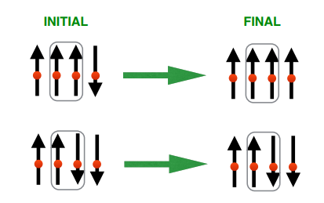
The Sznajd Model
In the model, each agent holds one of two discrete opinions (+1 or -1).
At each time step:
A pair of neighbouring agents is selected.
If their opinion coincides, all their neighbours take the opinion.
Otherwise, the neighbours take contrasting opinions.

Slide 18
The Sznajd Model
Extensions:
On a two dimensional lattice have also been studied, with four neighbours (a plaquette) having to agree in order to influence their other 8 neighbours.
With a third option (centrist / indifferent).
With “social temperature” -> disagreement by some individuals who choose to be or not to be contrarians at each update.

Slide 19
Q-Voter Model
Different from voter model, q-voter model selects a set of q neighbors.
If the neighbors agree, they influence one neighbor chosen at random, i.e. this agent copies the opinion of the group.
If the group does not agree, the agent flips its opinion with probability ϵ.
The voter model and Sznajd models are special cases of q-voter model.

Slide 20
Q-Voter Model
Q-voter model is analyzed for non-conformity and anti-conformity:
Non-conformity: some agents regardless of what the influencing group’s opinion is, will decide to flip their opinion with probability p.
Anti-conformity: some agents will not follow the opinion of the group, but the opposite one, with probability p.
(Observations?)

Slide 21
Continuous Models

Slide 22
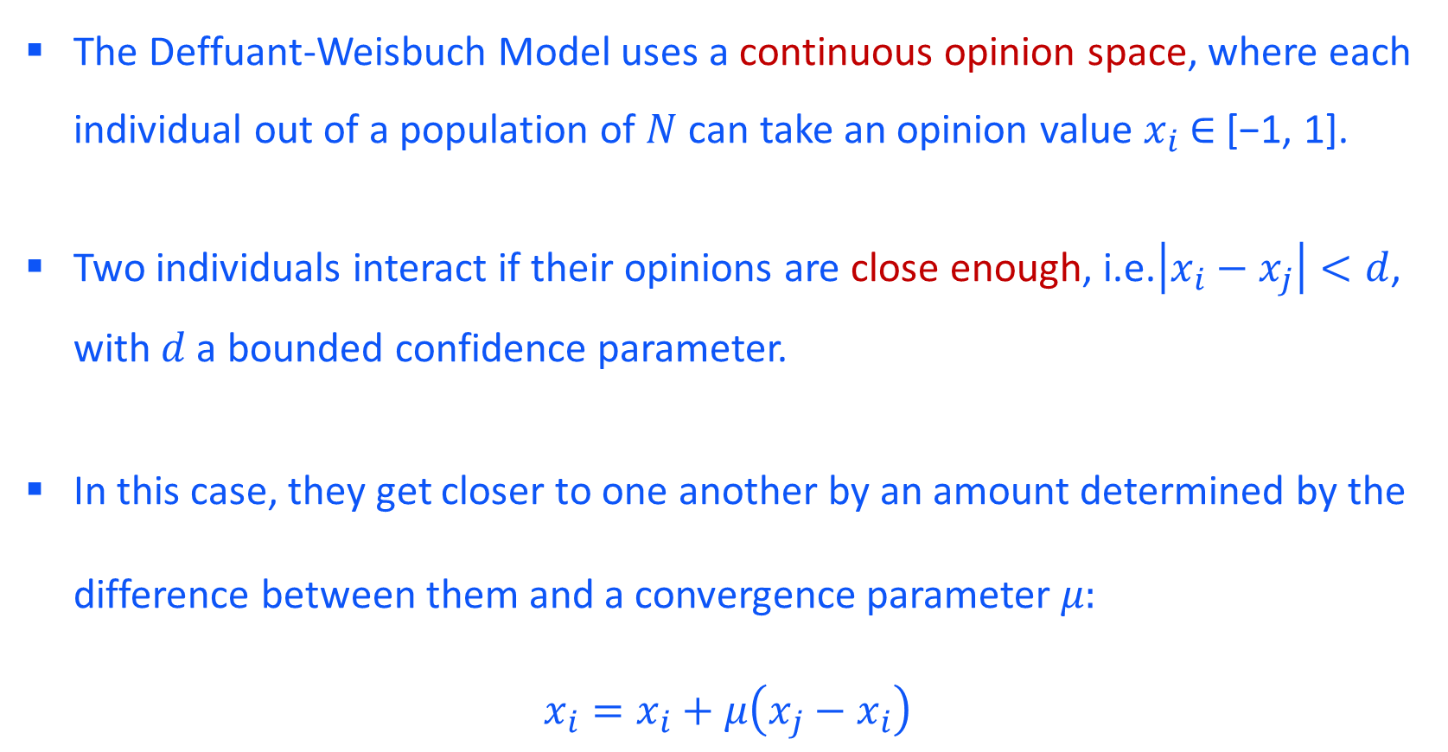
The Deffuant-Weisbuch Model
The Deffuant-Weisbuch Model uses a continuous opinion space, where each individual out of a population of $N$ can take an opinion value $x_{i}$ ∈ [−1, 1].
Two individuals interact if their opinions are close enough, i.e.$\left|x_{i}−x_{j}\right|<d$, with $d$ a bounded confidence parameter.
In this case, they get closer to one another by an amount determined by the difference between them and a convergence parameter $μ:$
$x_{i}=x_{i}+μ\left(x_{j}−x_{i}\right)$

Slide 23
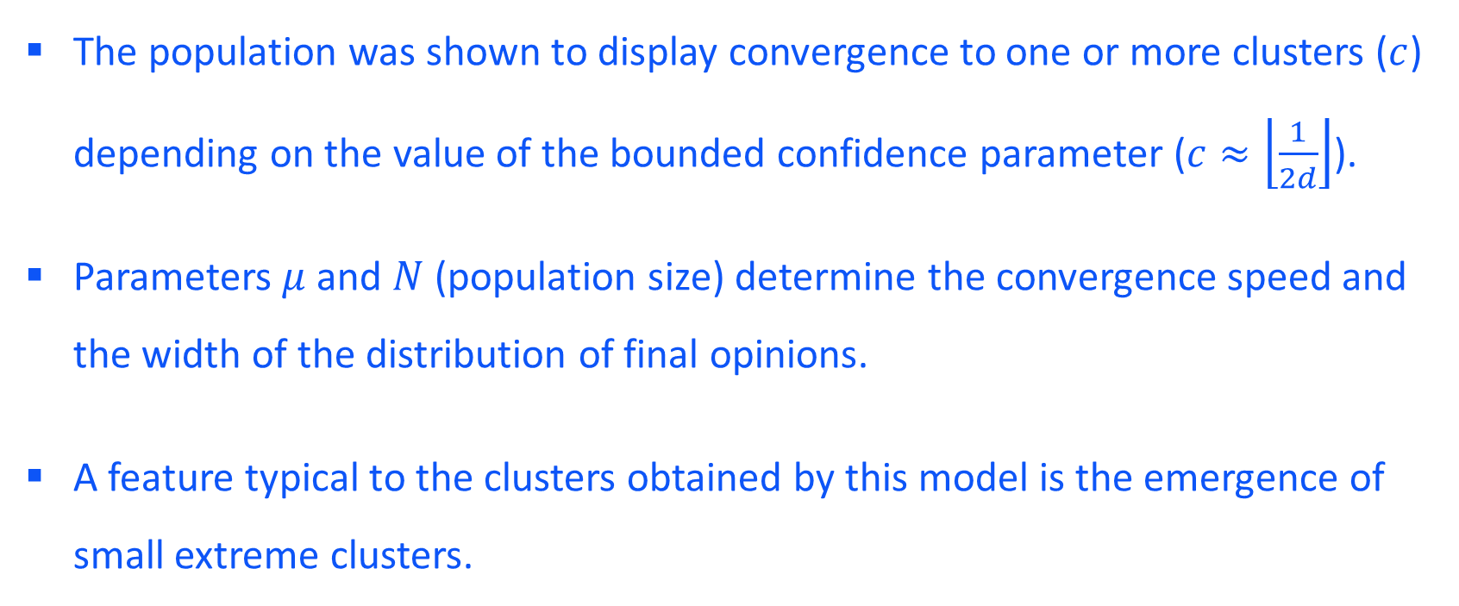
The Deffuant-Weisbuch Model
The population was shown to display convergence to one or more clusters ($c$) depending on the value of the bounded confidence parameter ($c≈\left\lfloor \frac{1}{2d}\right\rfloor$).
Parameters $μ$ and $N$ (population size) determine the convergence speed and the width of the distribution of final opinions.
A feature typical to the clusters obtained by this model is the emergence of small extreme clusters.

Slide 24
The Deffuant-Weisbuch Model
Recent Extensions:
With heterogeneous and adaptive confidence thresholds on 2D lattices.
Include disagreement in order to better describe the Social Judgment Theory.
Consider the bounded confidence parameter as an attribute of the individuals.

Slide 25
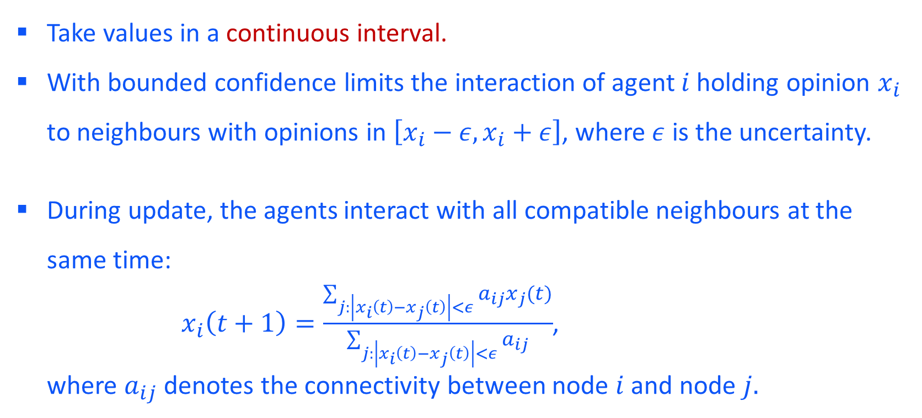
The Hegselmann-Krause Model
Take values in a continuous interval.
With bounded confidence limits the interaction of agent $i$ holding opinion $x_{i}$ to neighbours with opinions in $\left[x_{i}−ε,x_{i}+ε\right]$, where $ε$ is the uncertainty.
During update, the agents interact with all compatible neighbours at the same time:
$x_{i}\left(t+1\right)=\frac{\sum_{j:\left|x_{i}\left(t\right)−x_{j}\left(t\right)\right|<ε}{a_{ij}x_{j}(t)}}{\sum_{j:\left|x_{i}\left(t\right)−x_{j}\left(t\right)\right|<ε}{a_{ij}}}$,
where $a_{ij}$ denotes the connectivity between node $i$ and node $j.$

Slide 26
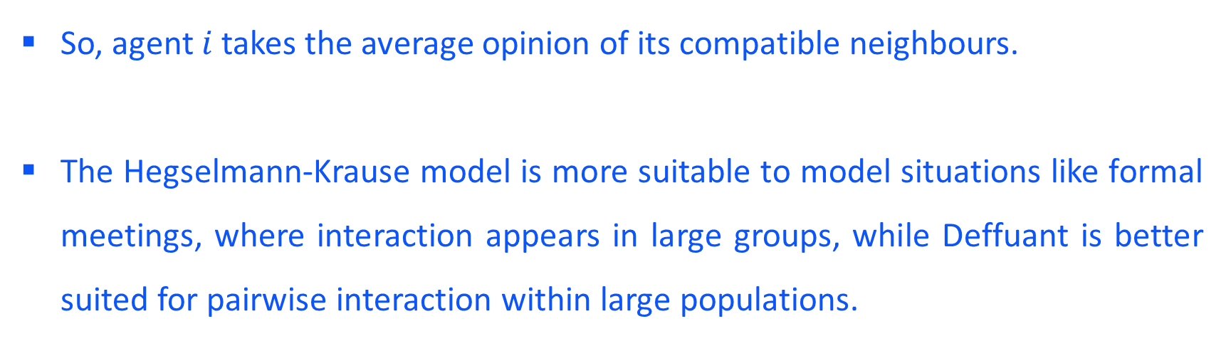
The Hegselmann-Krause Model
So, agent $i$ takes the average opinion of its compatible neighbours.
The Hegselmann-Krause model is more suitable to model situations like formal meetings, where interaction appears in large groups, while Deffuant is better suited for pairwise interaction within large populations.

Slide 27
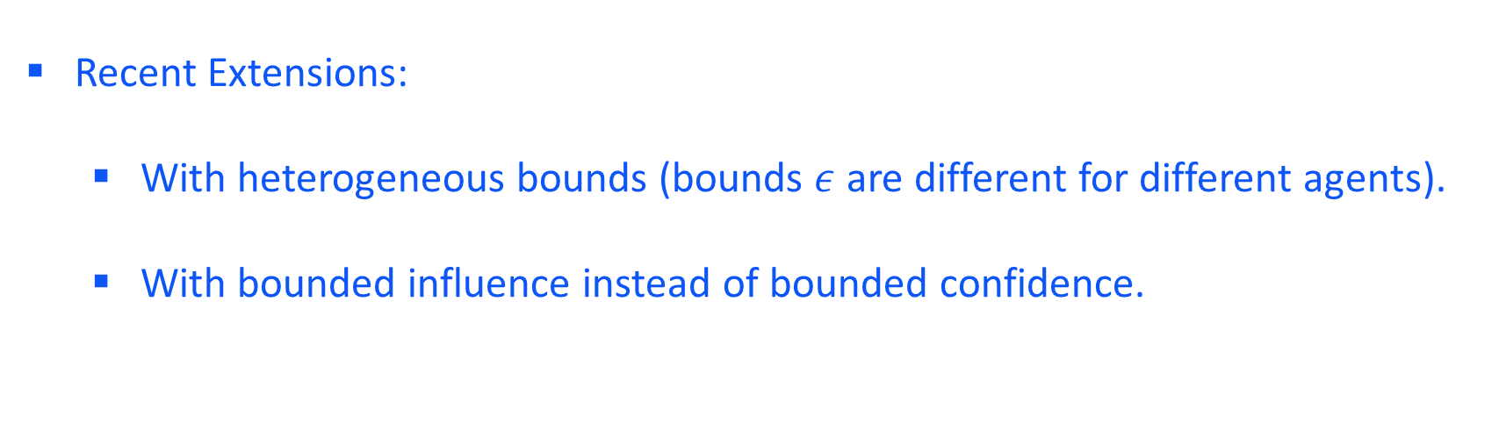
The Hegselmann-Krause Model
Recent Extensions:
With heterogeneous bounds (bounds $ε$ are different for different agents).
With bounded influence instead of bounded confidence.

Slide 28
Assignment
Write a report on CODA model:
Search for relevant documents describing Continuous Opinions and Discrete Actions (CODA) model;
Answer the following questions:
What characterize the origin CODA model?
Why is CODA a hybrid model?
How to update opinions?
Recent extensions?
Please cite the publications to support your report.
Submit the report as a .pdf file via Moodle.

Slide 29
Q & A
Aoran Wang
University of Luxembourg
Email: aoran.wang@uni.lu

