Slide 1
Modelling and Analysis of Complex Networks Exercise 1
Aoran Wang
University of Luxembourg

Slide 2
Contact Information
Office:
MNO E03-25-090
Email:
aoran.wang@uni.lu
Github:
wang422003

Slide 3
Organisation
Question-answering in class
Exercises after class (intended for groups of 2 students)
20 points considering the best 80% of all exercises
No written exam!
Moodle system: https://moodle.uni.lu
(course materials, schedule, exercises, etc.)
Submit the assignments via Moodle before the deadline

Slide 4
"One reviews the old to know the new"

Slide 5
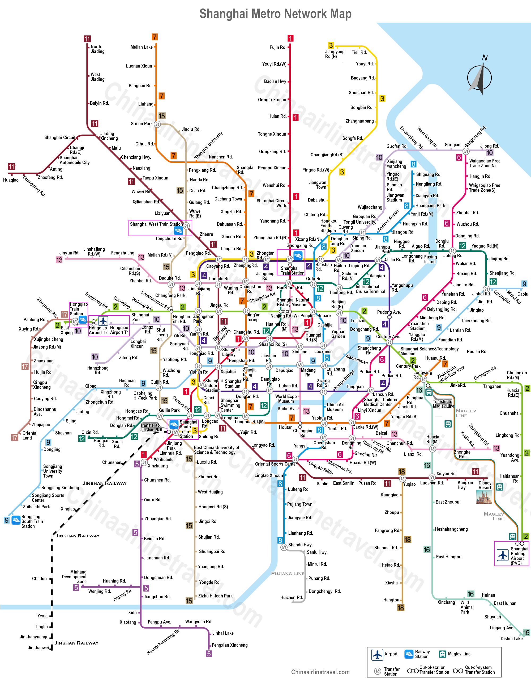
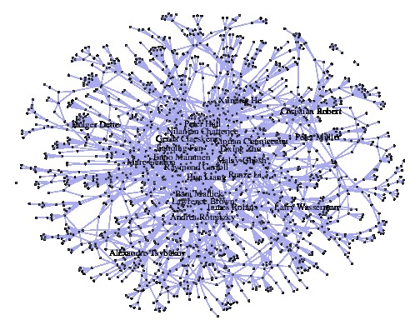
Review
Behind many systems there is an intricate wiring diagram, a network, defining the interactions between the components.
Shanghai Metro Network Map
Citation Network

Slide 6
Review
Question 1
Besides the examples mentioned in the course, please list three networks in the real-world, and
Describe the interactions between the components in the networks.
Choose one of the networks, and represent the network as a graph. Please draw a script of the graph, and represent the structure as an edge list or adjacency matrix.
Describe the characteristic of the network by answering the following questions: are the edges directed or not? Do the edges have weight? What are the maximum node degree and the average node degree? Is it a bipartite graph?

Slide 7
Review
Question 1
Notes:
Open a new Typora notebook

Slide 8
Review
Question 2
Follow up the edge lists and adjacency matrices we made in question 1:
Choose the edge list / adjacency matrix from one of your classmate, and reconstruct the graph from it.
What are the differences between your reconstructed graph and the one from your classmate? Why?

Slide 9
Review
Question 2
Notes:
Open a new Typora notebook

Slide 10
Brainstorming

Slide 11
Brainstorming
Question 3
Return to the three networks we just proposed, and answer the following questions:
What is the possible application of this network?
What could be the possible research questions? (Node level, edge level, and graph level)

Slide 12
Brainstorming
Question 3
Exercises (intended for groups of 2 students)
20 points considering the best 80% of all exercises
No written exam!
Moodle system: https://moodle.uni.lu
(course materials, schedule, exercises, etc.)
Submit the assignments via Moodle before the deadline
Notes:
Open Typora notebook

Slide 13
Assignment
Pick your favorite number:
1
2
3
4
5
6
7
8
9
10
Visit following link and download your datasets:
https://github.com/wang422003/Complex-Networks_exercise/tree/main/Datasets
Exercises (intended for groups of 2 students)
20 points considering the best 80% of all exercises
No written exam!
Moodle system: https://moodle.uni.lu
(course materials, schedule, exercises, etc.)
Submit the assignments via Moodle before the deadline

Slide 14
Assignment
Network feature exploration with SNAP.PY:
Install SNAP.PY and build a new project in IDE.
Read through the documentation of SNAP.PY.
Answer the questions in the question sheet with you datasets.
Also submit the code ! (Attachment or link to your Github repository)
Exercises (intended for groups of 2 students)
20 points considering the best 80% of all exercises
No written exam!
Moodle system: https://moodle.uni.lu
(course materials, schedule, exercises, etc.)
Submit the assignments via Moodle before the deadline

Slide 15
Q & A
Aoran Wang
University of Luxembourg
Email: aoran.wang@uni.lu

