Slide 1
Protocol Intelligence Report
Clinical Trial Design Benchmarking & Decision-Grade Evidence
Protocol: A Randomized, Double -blind, Single Dose, 2 -way Crossover Study to Assess Bronchospasm Potentially Induced by the Hydrofluoroolefin (HFO) Metered Dose Inhaler (MDI) Propellant as Compared with the Hydrofluoroalkane (HFA) MDI Propellant in Participants with Asthma, Well Controlled or Partially Controlled on Short -acting beta 2-agonists (SABA) with or without Low -Dose Inhaled Corticosteroids (ICS)
Condition: Asthma
Sponsor: AstraZeneca AB
Phase: Phase 3b | Study type: Interventional
Generated: 2026-03-19T18:05:11.302573Z UTC
Confidential — prepared for clinical development, trial design, and operational planning review.
Trial Design Explorer | Clinical Trial Planning Intelligence | Confidential draft
1 / 12

Slide 2
Executive Summary
Top-line read on precedent posture, evidence strength, and lead actions
Cohort size
Completed fit
Disrupted fit
Evidence
972
39.4%
41.4%
Strong
Overall posture: Mixed precedent posture
Protocol: A Randomized, Double -blind, Single Dose, 2 -way Crossover Study to Assess Bronchospasm Potentially Induced by the Hydrofluoroolefin (HFO) Metered Dose Inhaler (MDI) Propellant as Compared with the Hydrofluoroalkane (HFA) MDI Propellant in Participants with Asthma, Well Controlled or Partially Controlled on Short -acting beta 2-agonists (SABA) with or without Low -Dose Inhaled Corticosteroids (ICS)
Clinical focus: Asthma
Design fit vs completed precedent: 39.4% | vs disrupted: 41.4%
[Monitor] No strong design outlier was detected in the current benchmark snapshot.
Trial Design Explorer | Clinical Trial Planning Intelligence | Confidential draft
2 / 12

Slide 3
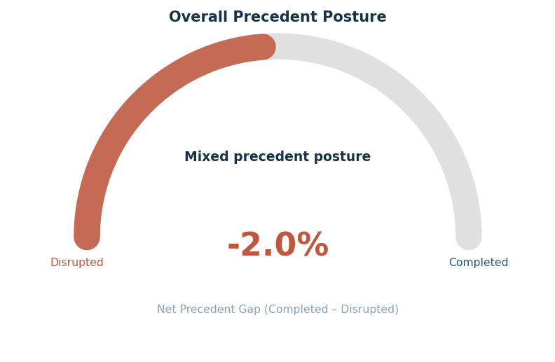
Precedent Posture
How the draft design compares to completed vs disrupted trial precedent
39.4%
Completed fit
41.4%
Disrupted fit
-2.0%
Net gap
Strong
Evidence strength
626
Completed studies
70
Disrupted studies
Trial Design Explorer | Clinical Trial Planning Intelligence | Confidential draft
3 / 12

Slide 4
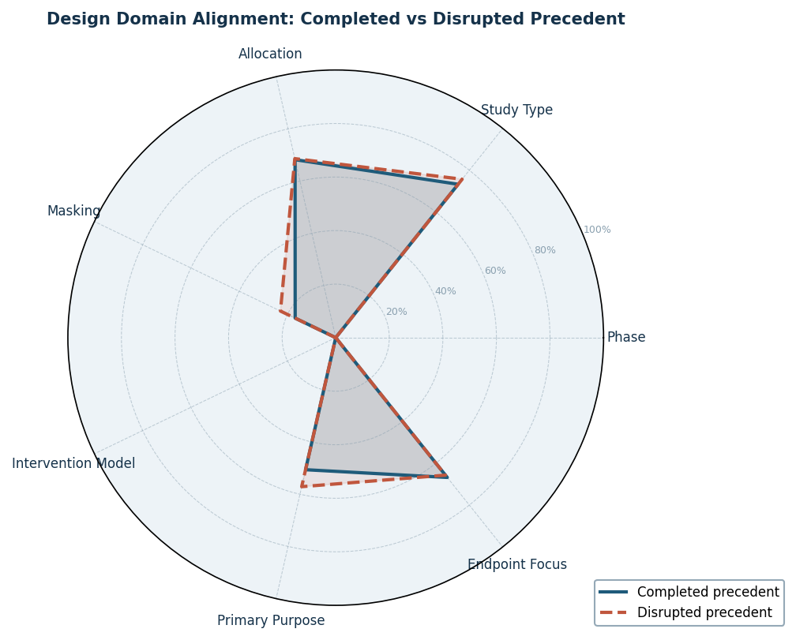
Design Domain Alignment
Alignment across design domains — completed vs disrupted precedent
Domain signals at a glance
Phase: Phase 3b — Weak precedent signal
Study Type: Interventional — Mixed precedent
Allocation: Randomized — Mixed precedent
Masking: Double — Mixed precedent
Intervention Model: Crossover Assignment — Weak precedent signal
Primary Purpose: Treatment — Mixed precedent
Endpoint Focus: Other — Mixed precedent
Trial Design Explorer | Clinical Trial Planning Intelligence | Confidential draft
4 / 12

Slide 5
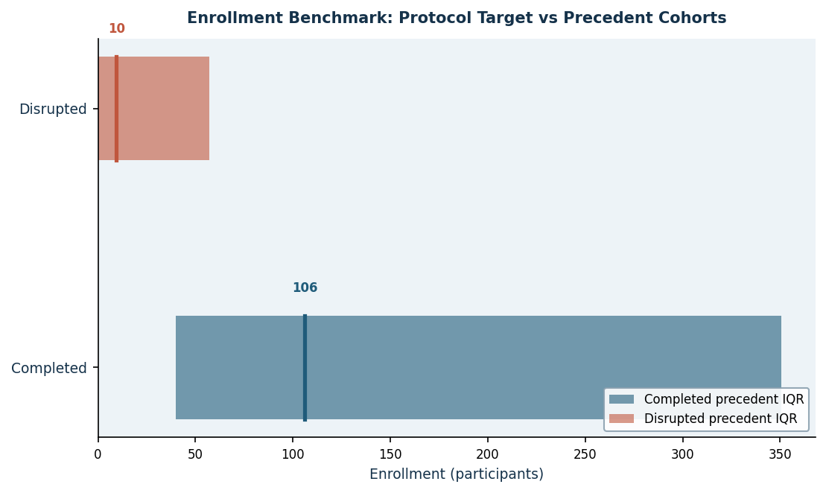
Enrollment Benchmark
Protocol target vs completed and disrupted precedent IQR ranges
Key numbers
Protocol target
n/a
Completed median
106.0
Completed P25–P75
40.0 – 350.5
Disrupted median
9.5
Disrupted P25–P75
0.0 – 57.0
Trial Design Explorer | Clinical Trial Planning Intelligence | Confidential draft
5 / 12

Slide 6
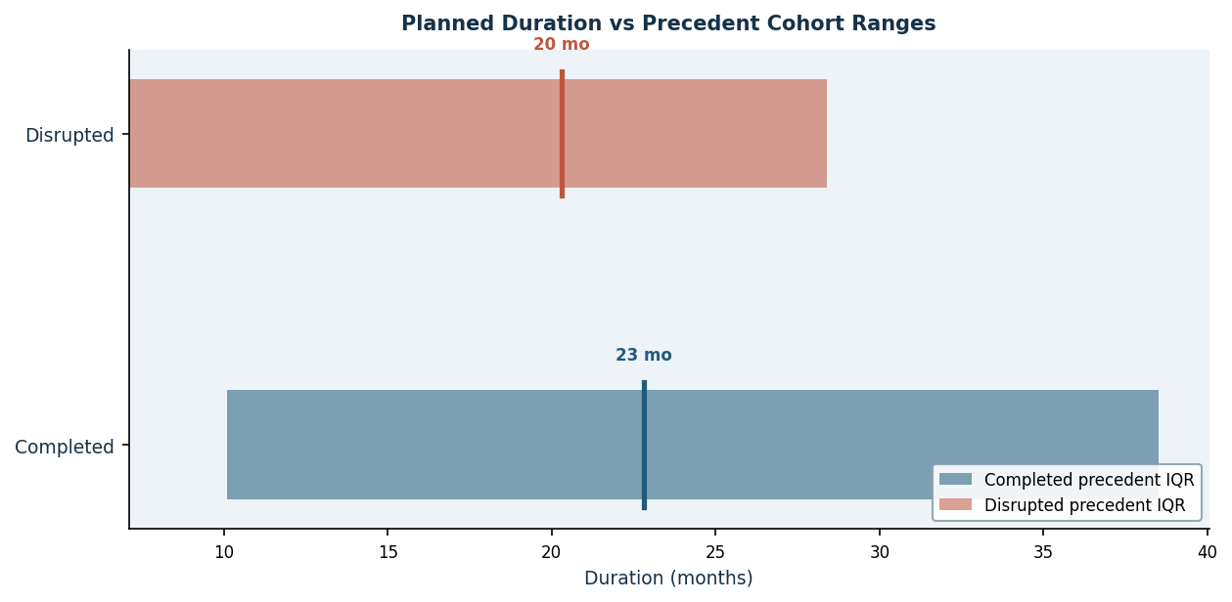
Trial Duration Analysis
Planned duration vs completed and disrupted precedent cohort ranges
Duration stats
Protocol plan (mo)
n/a
Completed median (mo)
23
Disrupted median (mo)
20
Trial Design Explorer | Clinical Trial Planning Intelligence | Confidential draft
6 / 12

Slide 7
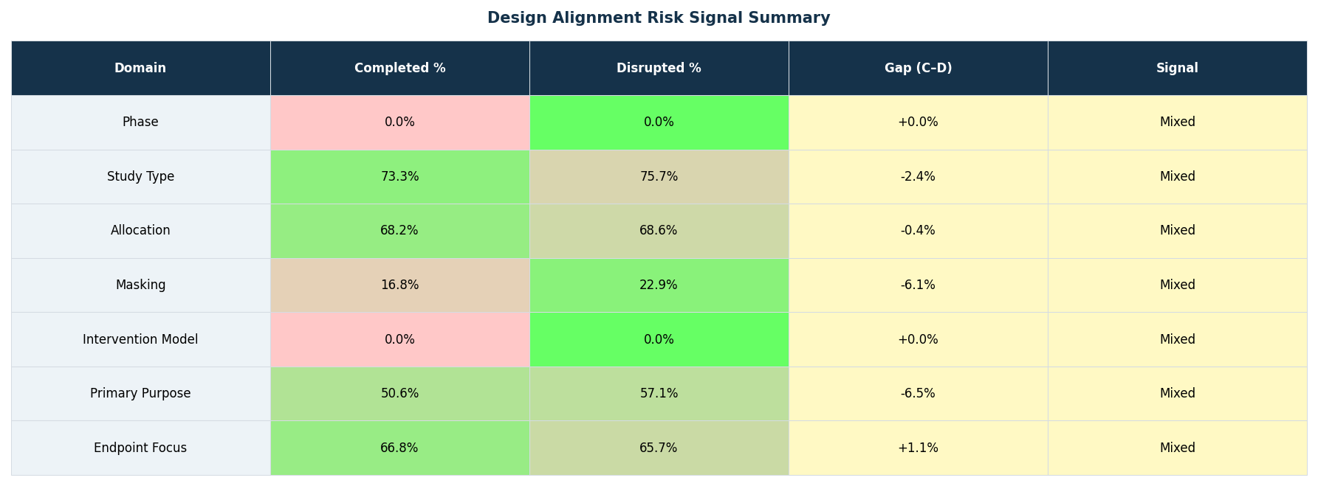
Design Differential Matrix
Domain-level protocol choice vs completed and disrupted precedent match rates
Trial Design Explorer | Clinical Trial Planning Intelligence | Confidential draft
7 / 12

Slide 8
Action Register
Priority-ordered design decisions, clarifications, and risk mitigations
Priority | Category | Action Type | Recommendation | Evidence
Monitor | Overall review | Monitor | No strong design outlier was detected in the current benchmark snapshot. | Continue with clinical, statistical, operational, and regulatory review before f
Trial Design Explorer | Clinical Trial Planning Intelligence | Confidential draft
8 / 12

Slide 9
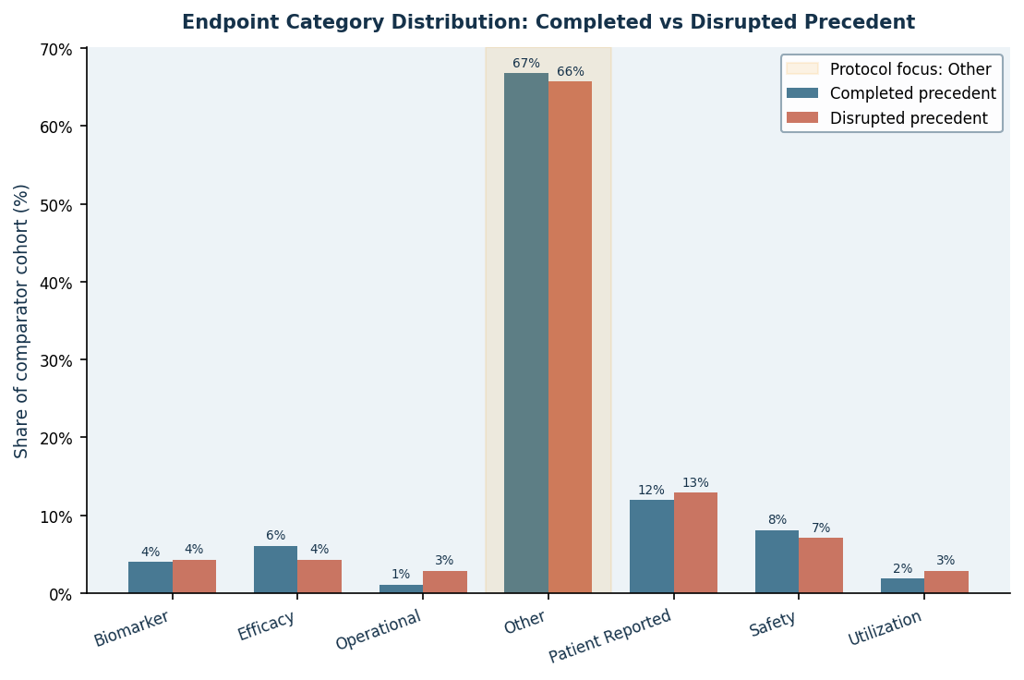
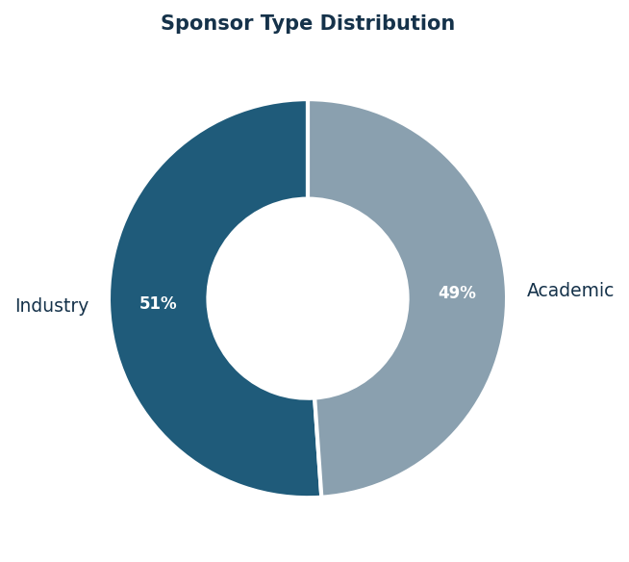
Endpoint Evidence
Endpoint category prevalence in completed vs disrupted precedent cohorts
Trial Design Explorer | Clinical Trial Planning Intelligence | Confidential draft
9 / 12

Slide 10
Literature Evidence (PubMed)
Peer-reviewed studies supporting the design rationale — sourced via NCBI PubMed
PMID | Authors (first) | Year | Journal | Title
39465893 | Rayner DG et al. | 2025 | JAMA | Inhaled Reliever Therapies for Asthma: A Systematic Review and Meta-An
36538979 | Nopsopon T et al. | 2023 | The Journal of allergy and cli | Comparative efficacy of tezepelumab to mepolizumab, benralizumab, and
32350100 | Hansen ESH et al. | 2020 | The European respiratory journ | Effect of aerobic exercise training on asthma in adults: a systematic
39421966 | Fedora K et al. | 2024 | Annals of medicine | Vitamin D supplementation decrease asthma exacerbations in children: a
37286218 | Makrufardi F et al. | 2023 | European respiratory review : | Extreme weather and asthma: a systematic review and meta-analysis.
38657997 | Kyriakopoulos C et al. | 2024 | European respiratory review : | Biologic agents licensed for severe asthma: a systematic review and me
39384302 | Manti S et al. | 2024 | European respiratory review : | Epidemiology of severe asthma in children: a systematic review and met
39549709 | Shackleford A et al. | 2025 | The Lancet. Respiratory medici | Clinical remission attainment, definitions, and correlates among patie
Source: PubMed / NCBI E-utilities (free access). All citations are auditable and traceable.
Trial Design Explorer | Clinical Trial Planning Intelligence | Confidential draft
10 / 12

Slide 11
Comparator Exemplars
Representative completed and disrupted precedent studies from the matched cohort
Comparator Lens | Status | NCT ID | Title | Enrollment | Sponsor
Completed Precedent | Completed | NCT01012739 | Efficacy, Safety, Tolerability, and Pharmacokinetics of Indacaterol Maleate Via | 35.0 | Novartis Pharmaceuticals
Completed Precedent | Completed | NCT01959412 | Crossover Study to Evaluate the Efficacy, Safety and Tolerability of Different D | 91.0 | Novartis Pharmaceuticals
Completed Precedent | Completed | NCT01820481 | Safety and Efficacy of WIN-901X in Asthma | 209.0 | Whanin Pharmaceutical Company
Completed Precedent | Completed | NCT00980200 | Efficacy and Safety Study in Subjects With Asthma | 75.0 | GlaxoSmithKline
Disrupted Precedent | Withdrawn | NCT01435902 | A Study of a New Asthma Medicine in Asthmatics Whose Asthma Worsens With Exercis | 0.0 | GlaxoSmithKline
Disrupted Precedent | Withdrawn | NCT01923272 | Non-Invasive Neurostimulation of the Vagus Nerve With the AlphaCore Device for t | 0.0 | ElectroCore INC
Disrupted Precedent | Withdrawn | NCT01845623 | A Study to Evaluate the Effects of Indacaterol Maleate (QAB149) as a New Formula | 0.0 | Novartis Pharmaceuticals
Disrupted Precedent | Withdrawn | NCT03680976 | Anti-Inflammatory Lipid Mediators in Asthma | 0.0 | Sally E. Wenzel MD
Active Context | Not Yet Recruiting | NCT06618105 | Bronchoprovocation Study to Demonstrate the Pharmacodynamic Bioequivalence of Al | 144.0 | Macleods Pharmaceuticals Ltd
Active Context | Enrolling By Invitation | NCT06820749 | A Study to Evaluate the Efficacy and Safety of HSK31858 Tablets in Patients with | 309.0 | Haisco Pharmaceutical Group Co., Ltd.
Trial Design Explorer | Clinical Trial Planning Intelligence | Confidential draft
11 / 12

Slide 12
Audit Trail & Methodology
Traceable record of all actions, extractions, comparisons, and exports
Source trials retrieved from ClinicalTrials.gov registry (API v2). Cohort selection uses ten PICO-aligned design dimensions (study type, phase, allocation, masking, intervention model, primary endpoint, intervention type, population, comparator, primary purpose) — sponsor is intentionally excluded. Protocol fields were extracted from uploaded documents using section-aware LLM chunking across the full document. All outputs are decision-support intelligence — they do not replace clinical, statistical, operational, or regulatory judgment.
Timestamp | Action | Actor | Details
2026-03-19T17:53:52 | Extract Protocol Profile | System | Extracted protocol profile from Prot_002.pdf.
2026-03-19T17:54:28 | Review Protocol Profile | User | Reviewer confirmed and saved protocol profile fields.
2026-03-19T17:54:43 | Build Design Similar Cohort | System | Fetched 1000 condition-matched trials for 'Asthma'. Design similarity filter se
2026-03-19T17:56:19 | Export Pdf Report | System | Generated trial_protocol_report.pdf.
2026-03-19T17:56:46 | Fetch Pubmed Evidence | System | Retrieved 8 PubMed articles for 'Asthma'.
2026-03-19T17:56:59 | Export Pdf Report | System | Generated trial_protocol_report.pdf.
2026-03-19T18:05:11 | Export Pptx Slides | System | Generated trial_protocol_slides.pptx.
Trial Design Explorer | Clinical Trial Planning Intelligence | Confidential draft
12 / 12

