Slide 1
Measuring Miscalibration
Dr. F.J. Rodenburg

Slide 2
Summary
Calibration accuracy: What do we mean by it?
Visual assessment: Quick, complete overview.
Numeric assessment: Quantifying miscalibration.
The end result: Towards a holistic view of risk.

Slide 3
1. Calibration
What do we mean by it?
A well-calibrated model produces predicted probabilities that closely match true probabilities of events.
For any predicted probability $\hat{p}$,
$$E\left[y | \hat{p}\right]≈\hat{p}.$$
Example: If a model predicts a probability of default of $\hat{p}=0.10$ for a certain set of observations, then we expect around $1$ in $10$ such observations to actually default.

Slide 4
1. Calibration
What do we mean by it?
How is that different from discrimination?
Discrimination measures how well a model ranks risk:
$${\hat{p}}_{i}>{\hat{p}}_{i+1} ∀ i ?$$
Calibration measures distance to the true risk:
$${\hat{p}}_{i}≈p_{i} ∀ i ?$$
Discrimination can be easily expressed (e.g., $c$-statistic, ROC curve, CAP curve). What about calibration?

Slide 5
2. Visual assessment
Calibration curve
  Smooth function fitted over the range of predicted values
  Bootstrapped confidence band
Goal:
  Reporting improvement (ease of use, ease of assessment)
  Complementary to numeric assessment.

Slide 6
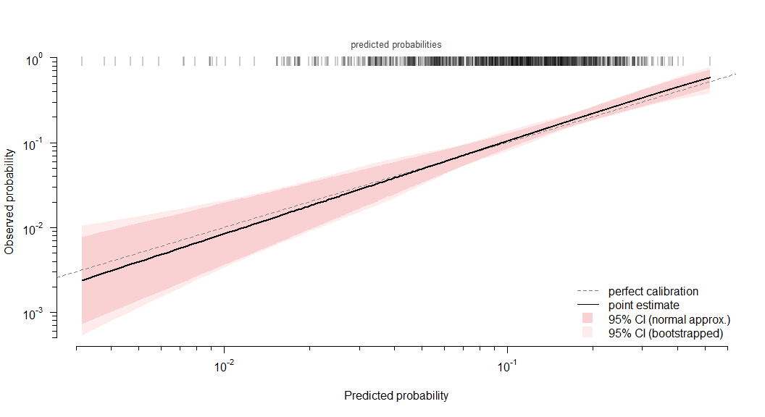
2. Visual assessment
Calibration curve (well-calibrated model):

Slide 7
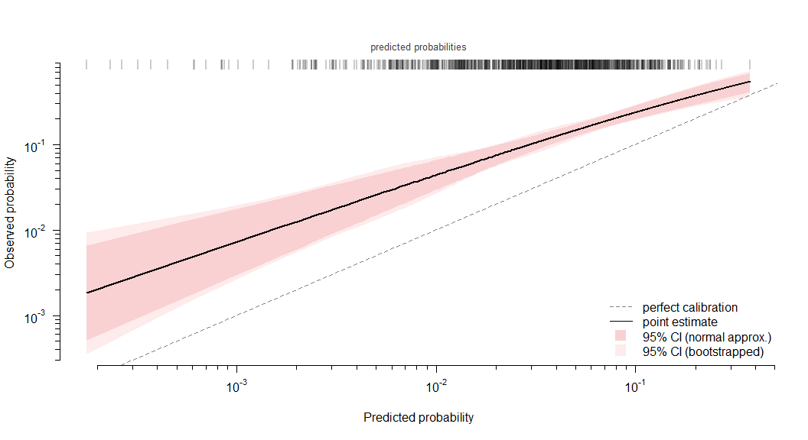
2. Visual assessment
Optimism:

Slide 8
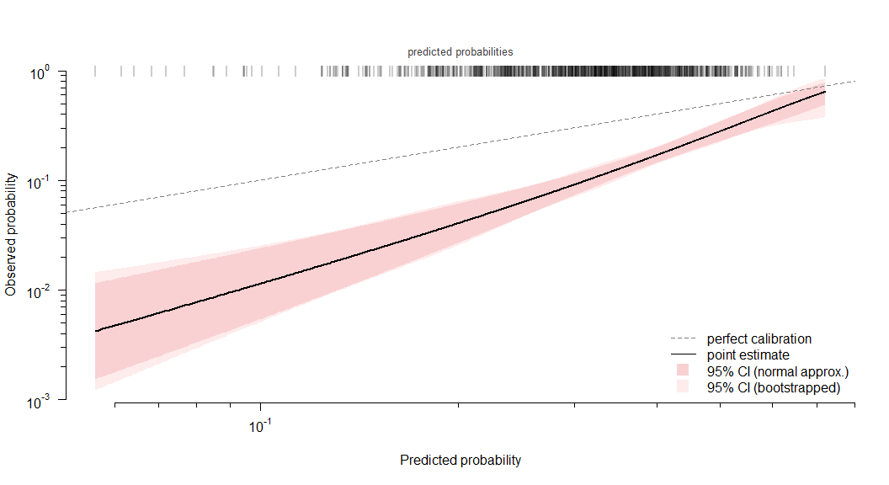
2. Visual assessment
Conservatism:

Slide 9
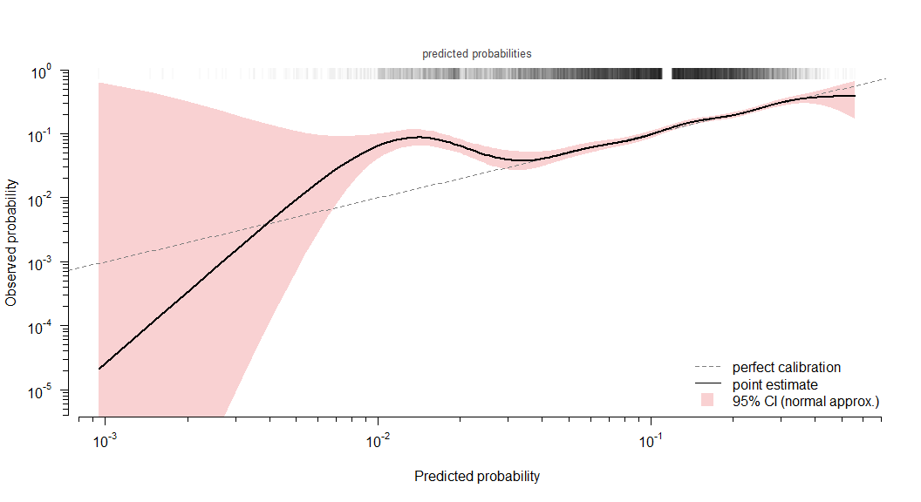
2. Visual assessment
Local miscalibration (at $\hat{p}≈1.5\%$):

Slide 10
2. Visual assessment
Summary:
  Efficient, easy-to-use assessment.
  Except for the curve-fitting procedure, no packages used!
  This is a complete manual implementation that can be easily translated to Python. (see implementation file)
  The curve uses an advanced model, but if no suitable Python alternative can be found, simpler LOESS-based smoothers are also common in literature.^{1,2}Penalized thin-plate spline logistic regression of $logit\left(\hat{p}\right)$ against the default ratio, using a generalized additive model (GAM). Justification for this model choice is included in the implementation file.

Slide 11
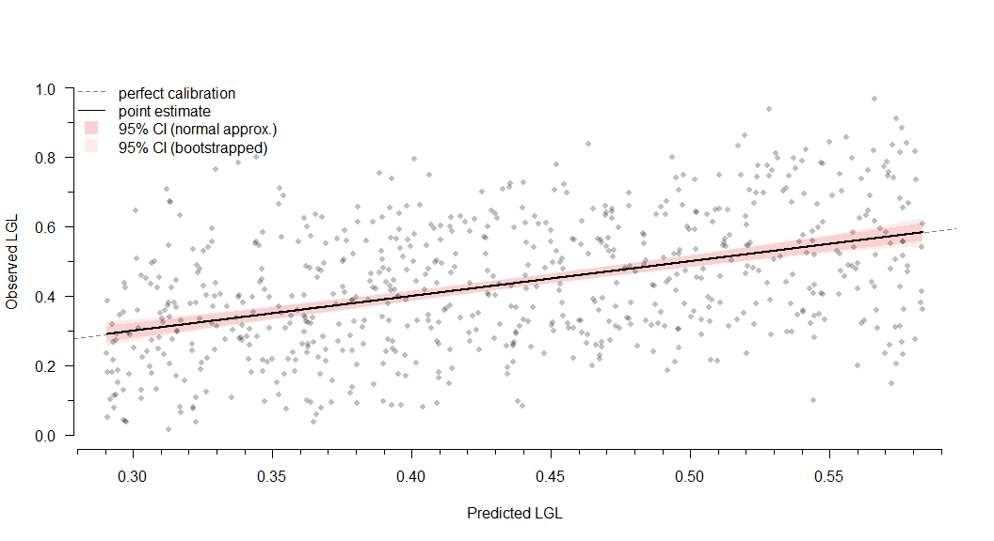
2. Visual assessment
Last example, LGL model:

Slide 12
2. Visual assessment
More examples in the implementation file.

Slide 13
3. Numeric assessment
How can we determine which model is closer to $\hat{p}=p$?
  Significance testing?
    $⟹$ detects miscalibration (yes/no)
    …but non-significant does not mean well-calibrated,
    …and significant does not tell how miscalibrated!
  Proportion of grades/observations?
    $⟹$ shows how widespread it is (prevalence)
    …but a low proportion can still be problematic,
    …and 100% miscalibrated, still doesn’t tell how much!

Slide 14
3. Numeric assessment
Neither significance, nor prevalence indicate magnitude.
To assess magnitude of miscalibration, a measure must reflect how far we are from perfect calibration ($\hat{p}=p$).
A measure optimized this way is a proper scoring rule.³
If its optimum is unique, it is strictly proper.
Strictly proper scoring rules are the gold standard, as they cannot be improved by moving to suboptimal predictions.

Slide 15
3. Numeric assessment
Strictly proper scoring rules for binary outcomes:

Slide 16
3. Numeric assessment
Strictly proper scoring rules for binary outcomes:
Score
Equation
Justification
Log
$log\left({\hat{p}}_{y}\right)$
Heavily penalizes overconfident predictions near the boundary.
Brier
${\left(y−\hat{p}\right)}^{2}$
Neutral penalization of errors across values of $\hat{p}$.
Spherical
$\frac{{\hat{p}}_{y}}{\left|\right|\hat{p}{\left|\right|}_{2}}$
Less intuitive, but rewards sharp predictions near $\hat{p}=p$.

Slide 17
3. Numeric assessment
Strictly proper scoring rules for non-binary outcomes:

Slide 18
3. Numeric assessment
Strictly proper scoring rules for non-binary outcomes:
Score
Equation
Justification
Log
$log\left(f\left(y\right)\right)$
Same as binary.
CRPS
$$∫​​(F\left(x\right)−H\left(x−y\right))^{2}dx$$
Generalization of Brier score. Rewards sharp predictions near $\hat{p}=p$.
(Note: $f$ is the (implied) PDF of the prediction at $\hat{p}$, $F$ its CDF. $H$ is the Heaviside step function.)

Slide 19
3. Numeric assessment
Continuous ranked probability score (CRPS):
$$\begin{matrix}\text{CRPS}\left(F,y\right) & =∫(F\left(x\right)−H\left(x−y\right))^{2} dx \\ \\ H\left(t\right) & =\left\{\begin{matrix}0 & t<0, \\ 1 & t≥0.\end{matrix}\right.\end{matrix}$$
What does that look like? (example, beta-regression for LGD)

Slide 20
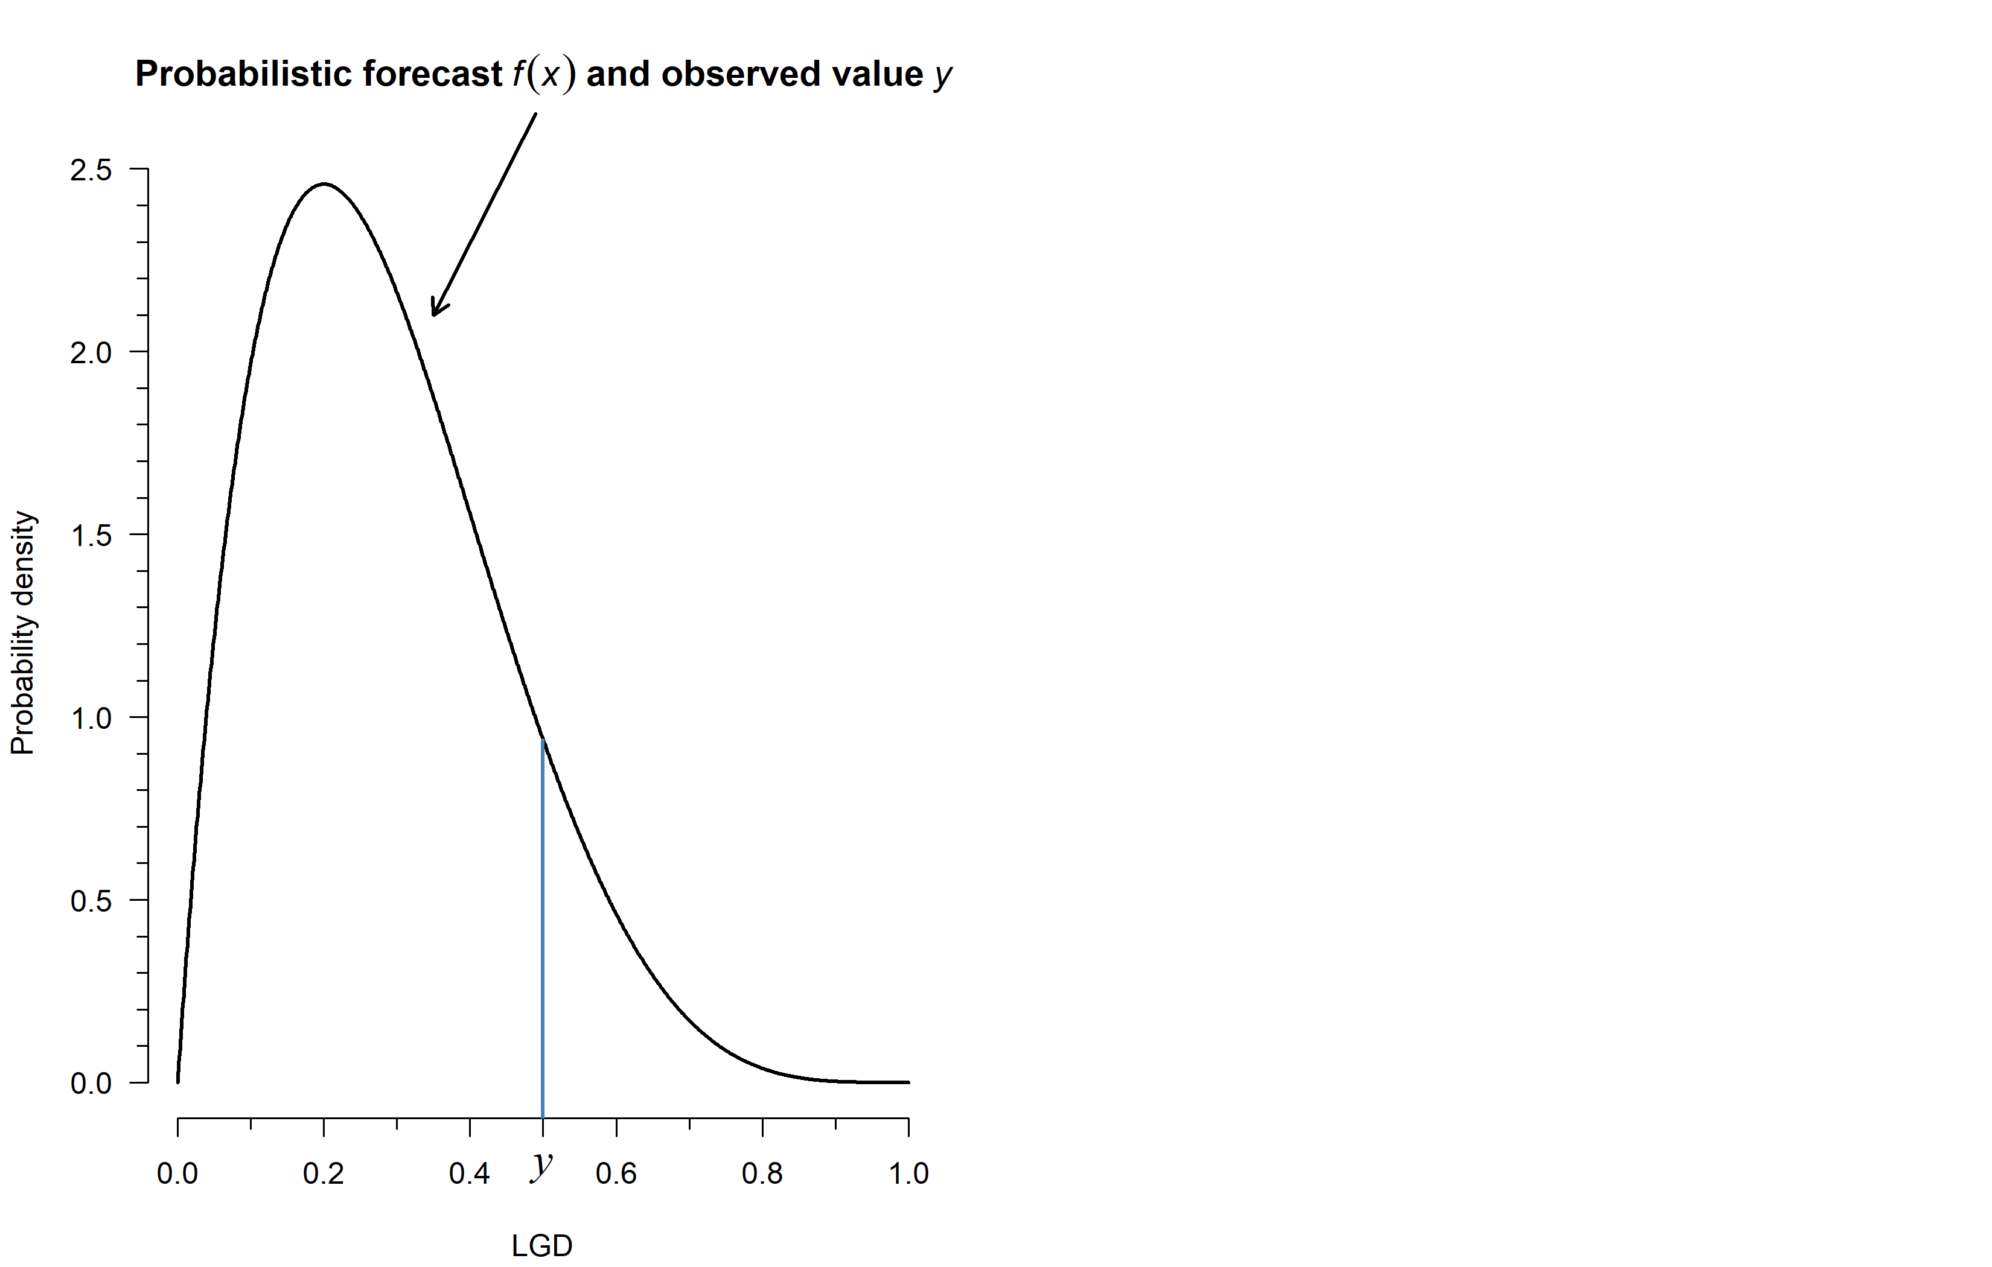

Slide 21
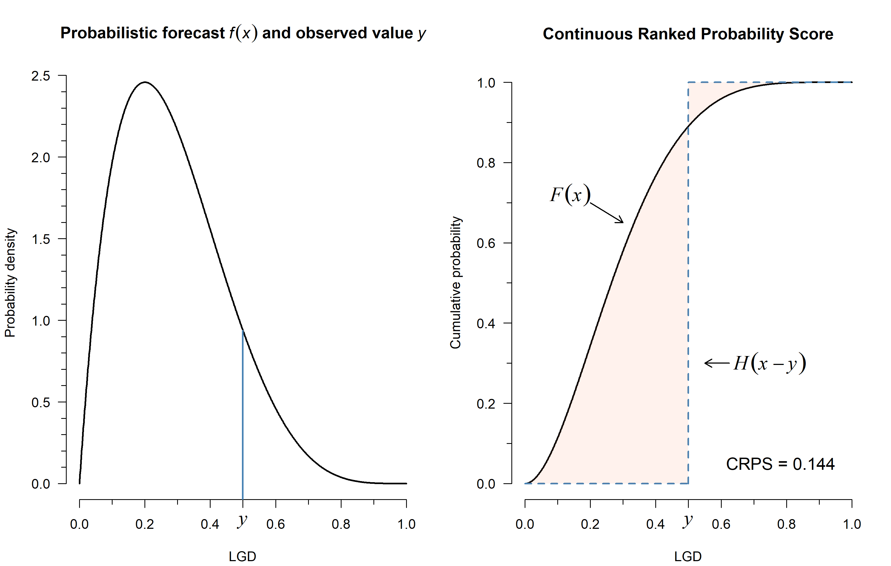

Slide 22
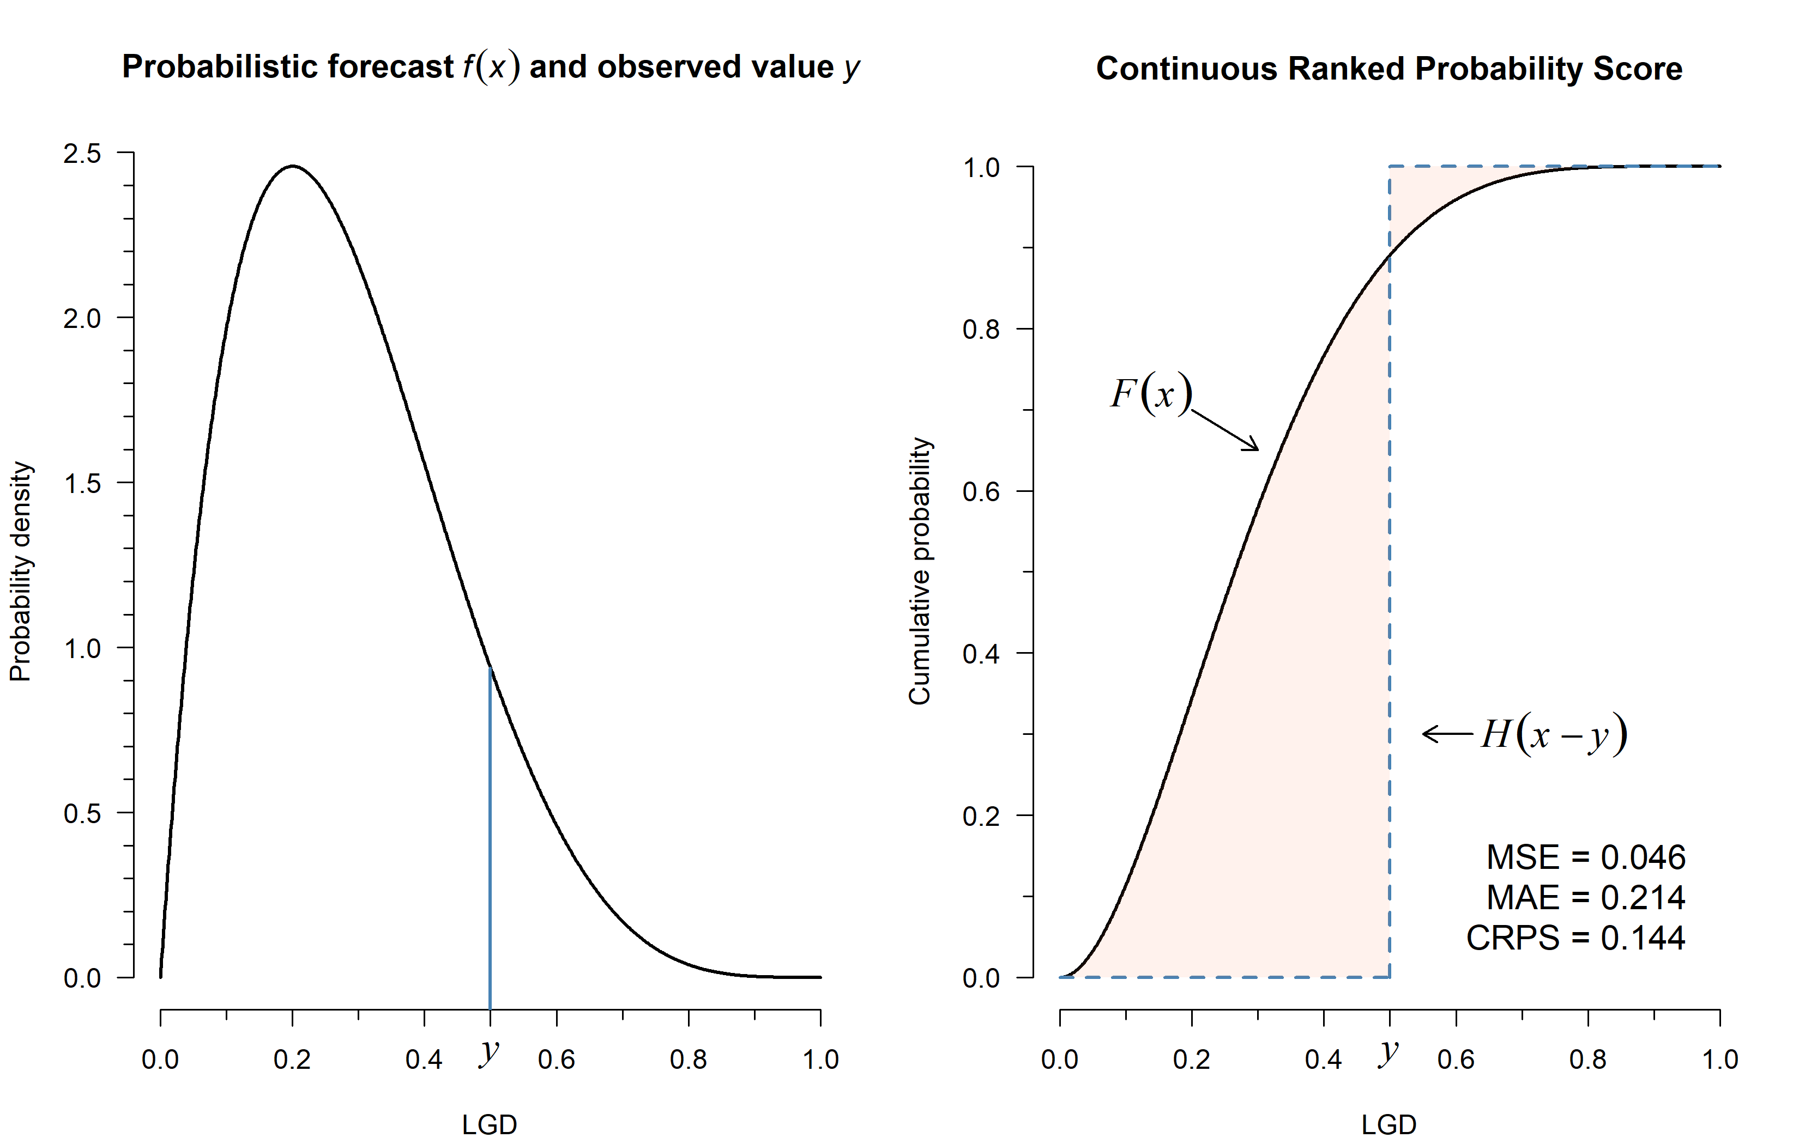

Slide 23
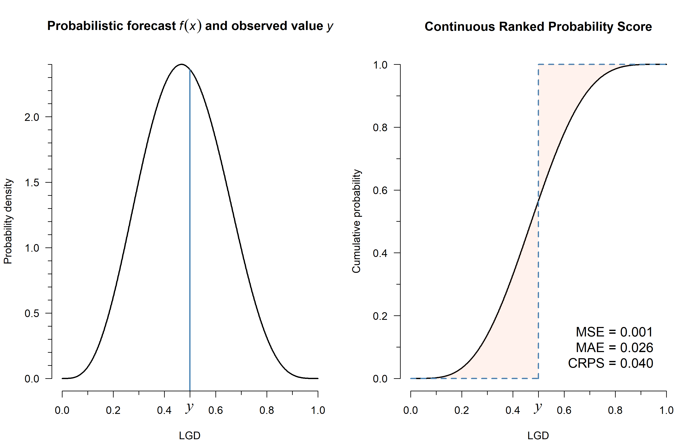

Slide 24
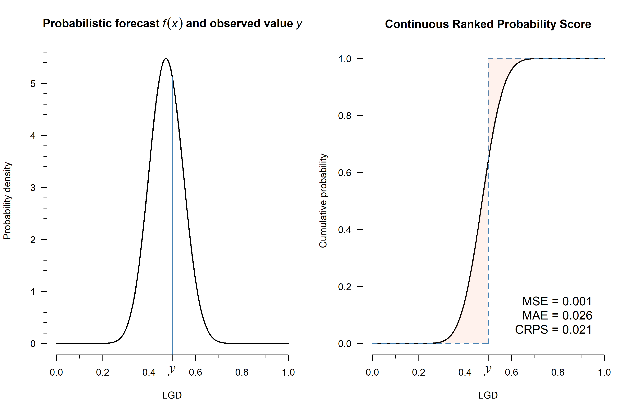

Slide 25
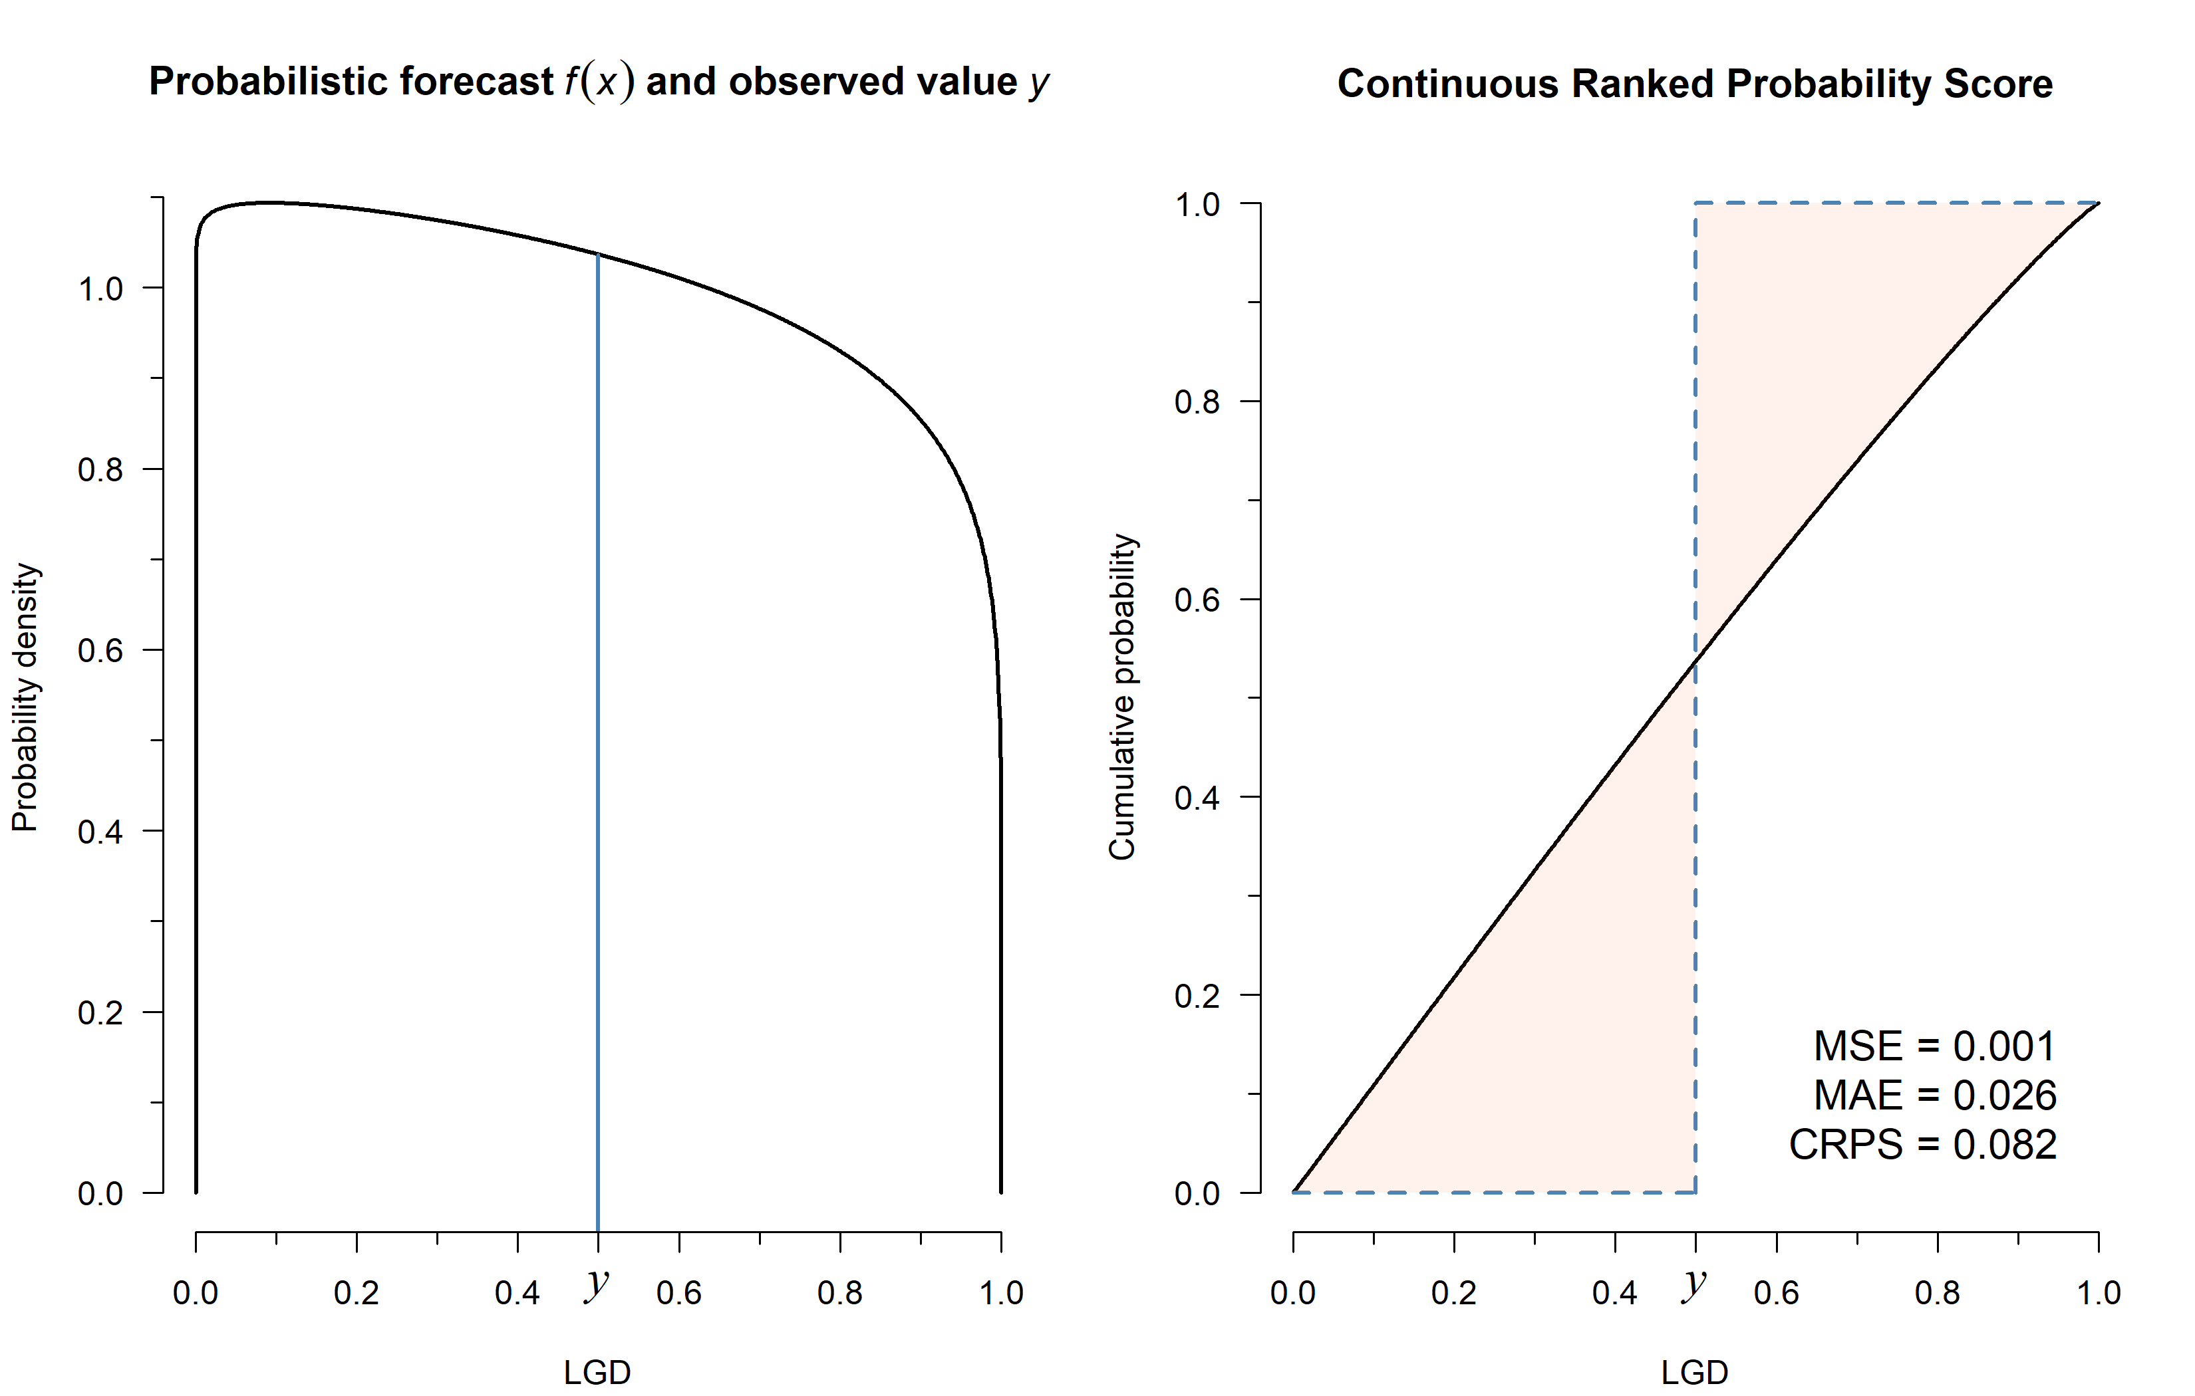

Slide 26
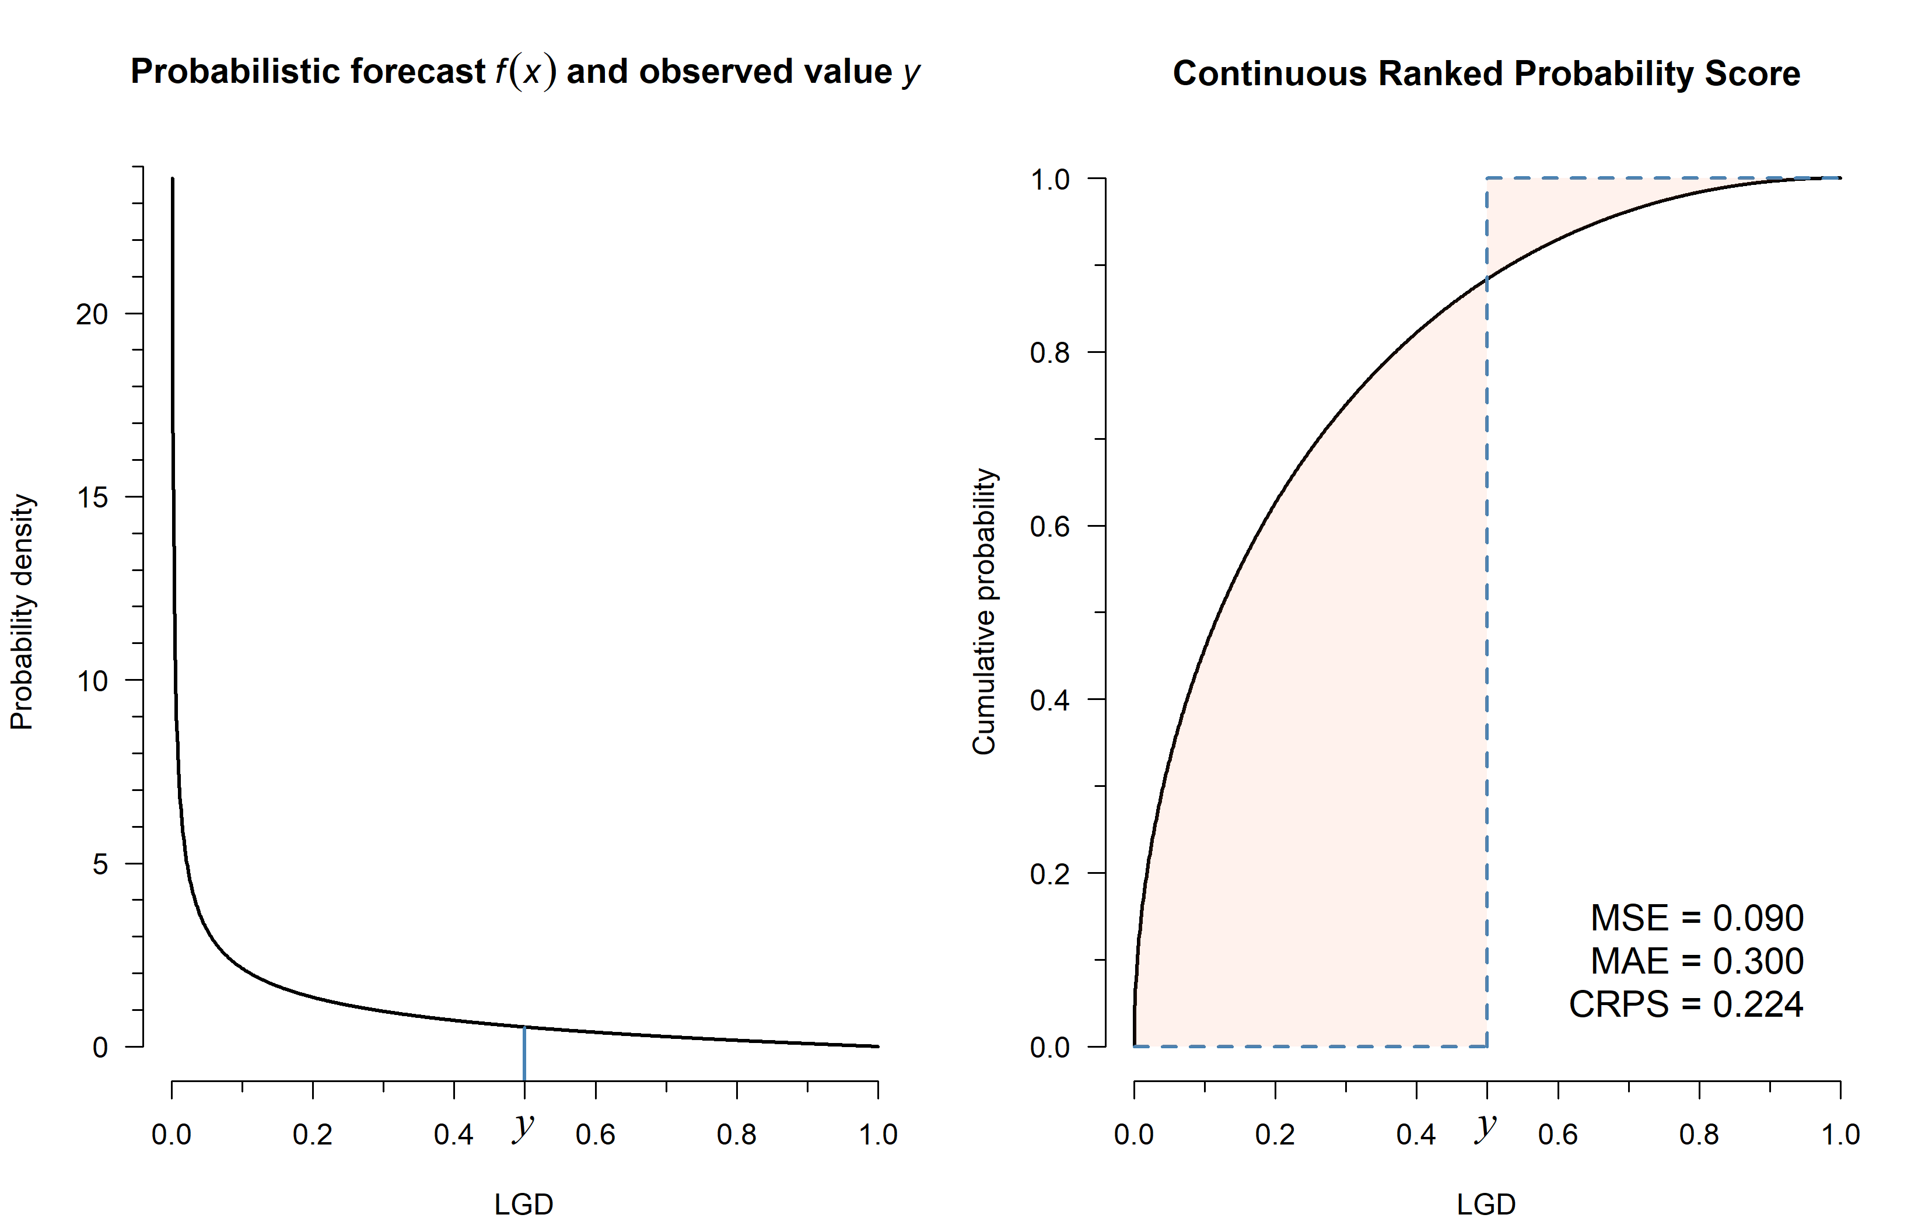

Slide 27
3. Numeric assessment
Continuous ranked probability score (CRPS) rewards:
  Being centered around the observed value
  Being confident (when correct)
Conversely, CRPS penalizes:
  Being centered around a different value
  Being confident (when wrong)
  Being too careful (diffuse predicted distribution)

Slide 28
3. Numeric assessment
CRPS is used extensively across many fields:
  Weather forecasting,^{4–7}
  Retail demand forecasting,^{8–10}
  Epidemiological models,^{11–13}
  Energy demand,^{14,15}
  …

Slide 29
3. Numeric assessment
Summary:
  A measure optimized in expectation by approaching perfect calibration is called a proper scoring rule.
  If its optimum is unique, it is strictly proper.
  This is the gold standard for measuring calibration.
  For binary outcomes (PD, CR), the log score can be used.
  For non-binary outcomes (LGL, final LGD, EAD), the gold standard is a full distributional scoring rule, like CRPS.

Slide 30
3. Numeric assessment
Summary:
  CRPS rewards calibration and sharpness.
  Requires a known CDF, an underlying distribution.
  Beta regression for LGL, zero-inflated beta for final LGD…
What if a model has no distribution (e.g., decision tree)?
  These can be converted into a probabilistic forecast.^{16,17}
  More work, requires data used in model development.
  However, only needs to be done once and can be reused.
  See example implementation. (presentation folder)

Slide 31
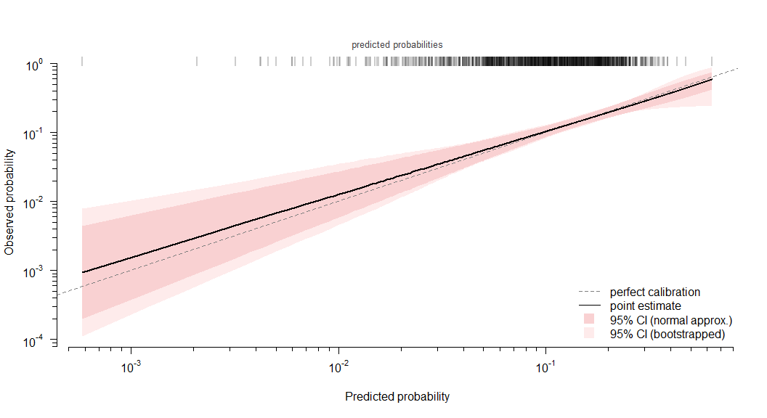
4. The end result
Calibration curve with correlation-adjusted strictly proper scoring rules.

Slide 32
Record-weighted:
- Brier score (lower is better): 0.100 (0.087, 0.114)
- Log score (higher is better): -0.340 (-0.381, -0.306)
Client-weighted:
- Brier score (lower is better): 0.103 (0.090, 0.115)
- Log score (higher is better): -0.350 (-0.383, -0.315)

Slide 33
References
1. Austin, P. C. & Steyerberg, E. W. Graphical assessment of internal and external calibration of logistic regression models by using loess smoothers. Statistics in Medicine 33, 517–535 (2013).
2. Harrell, F. E. Regression modeling strategies. (Springer International Publishing, 2015).
3. Gneiting, T. & Raftery, A. E. Strictly Proper Scoring Rules, Prediction, and Estimation. Journal of the American Statistical Association 102, 359–378 (2007).
4. Hersbach, H. Decomposition of the Continuous Ranked Probability Score for Ensemble Prediction Systems. Weather and Forecasting 15, 559–570 (2000).
5. Grimit, E. P., Gneiting, T., Berrocal, V. J. & Johnson, N. A. The continuous ranked probability score for circular variables and its application to mesoscale forecast ensemble verification. Quarterly Journal of the Royal Meteorological Society 132, 2925–2942 (2006).
6. Friederichs, P. & Thorarinsdottir, T. L. Forecast verification for extreme value distributions with an application to probabilistic peak wind prediction. Environmetrics 23, 579–594 (2012).
7. Zamo, M. & Naveau, P. Estimation of the Continuous Ranked Probability Score with Limited Information and Applications to Ensemble Weather Forecasts. Mathematical Geosciences 50, 209–234 (2017).
8. Kolassa, S. Evaluating predictive count data distributions in retail sales forecasting. International Journal of Forecasting 32, 788–803 (2016).
9. Makridakis, S. et al. The M5 uncertainty competition: Results, findings and conclusions. International Journal of Forecasting 38, 1365–1385 (2022).
10. Petropoulos, F. et al. Forecasting: theory and practice. International Journal of Forecasting 38, 705–871 (2022).
11. Riebler, A. & Held, L. Projecting the future burden of cancer: Bayesian ageperiodcohort analysis with integrated nested Laplace approximations. Biometrical Journal 59, 531–549 (2017).
12. Bracher, J., Ray, E. L., Gneiting, T. & Reich, N. G. Evaluating epidemic forecasts in an interval format. PLOS Computational Biology 17, e1008618 (2021).
13. Bosse, N. I. et al. Scoring epidemiological forecasts on transformed scales. PLOS Computational Biology 19, e1011393 (2023).
14. Kaack, L. H., Apt, J., Morgan, M. G. & McSharry, P. Empirical prediction intervals improve energy forecasting. Proceedings of the National Academy of Sciences 114, 8752–8757 (2017).
15. Berrisch, J. & Ziel, F. Multivariate probabilistic CRPS learning with an application to day-ahead electricity prices. International Journal of Forecasting 40, 1568–1586 (2024).
16. Breiman, L., Friedman, J. H., Olshen, R. A. & Stone, C. J. Classification And Regression Trees. (Routledge, 2017). doi:10.1201/9781315139470.
17. Meinshausen, N. Quantile regression forests. J. Mach. Learn. Res. 7, 983–999 (2006).

