Slide 1

THE HEALTH INSURANCE MANAGEMENT PLATFORM
One platform to manage, treat and insure — built for Gabon and the CIMA zone.
2026

Slide 2

Health insurance management is still fragmented
Silos and spreadsheets
Manual CIMA compliance
Every department runs its own tool. Nothing talks to the next, everything gets re-typed.
Rates, benefits and regulatory documents kept up to date by hand.
Slow reimbursements
No real-time view
Weeks of back-and-forth between the insured, the provider and the claims handler.
The loss ratio is discovered after the fact, never live.
MEDASSUR+ — the health insurance management platform

Slide 3
One platform, a place for every stakeholder
A single data engine. Tailored access for everyone — on web and on mobile.
Insurer / Broker
Super Admin
Insured member
MEDASSUR+
Physician
Policyholder
Healthcare provider
MEDASSUR+ — the health insurance management platform

Slide 4
The management console
MEDASSUR+ — the health insurance management platform

Slide 5
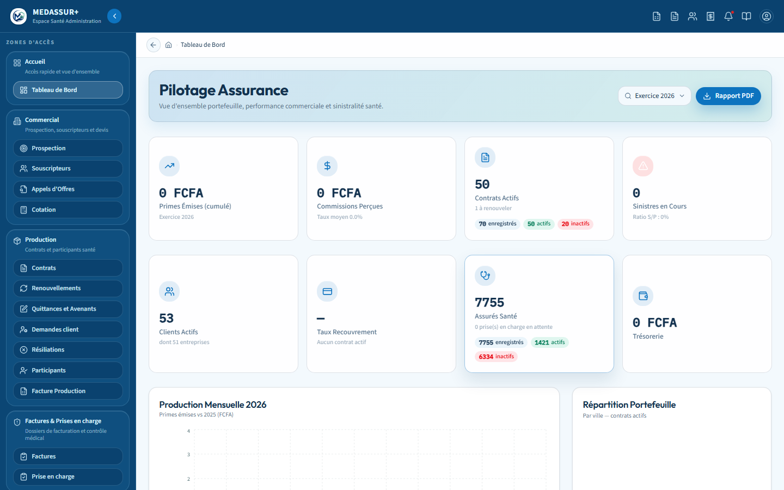
A dashboard that runs the whole operation, at a glance
Active policies, insured population, client portfolio
Collections and cash position tracked day to day
Real data, never an estimate
MEDASSUR+ — the health insurance management platform

Slide 6
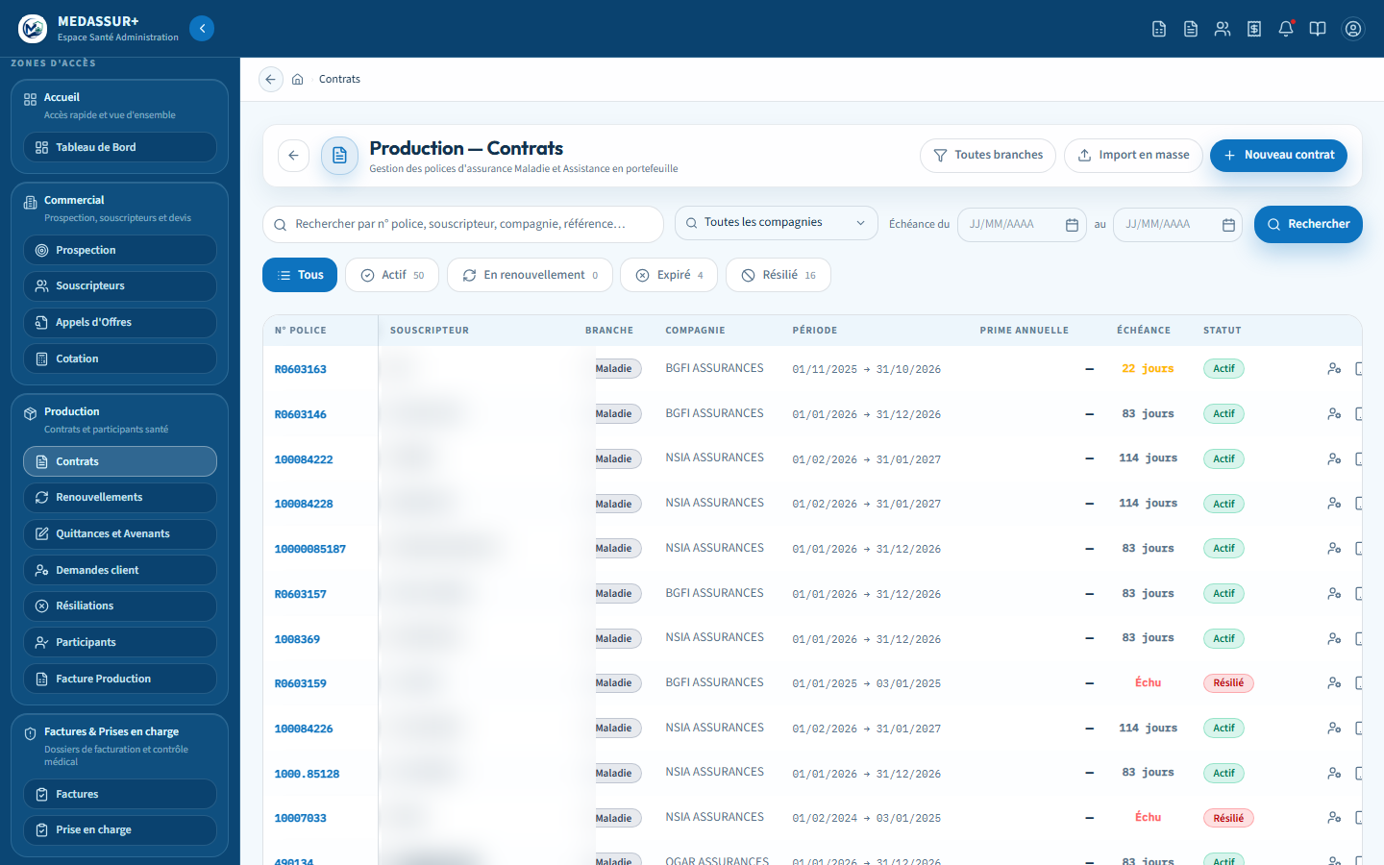
The full policy lifecycle, start to finish
Underwriting → population → benefits → endorsements → renewals, in one screen
New: an Assistance policy can now pool the population of several Health policies for the same policyholder
Premium recalculated automatically across the combined population
MEDASSUR+ — the health insurance management platform

Slide 7
Invoices and claims under control, in real time
Multi-line entry
Instant search for the provider and the insured, line by line.
Caps checked live
Benefit rates and caps checked at entry, never after the fact.
Documents generated automatically
Statement and settlement true to the client's own paper model.
MEDASSUR+ — the health insurance management platform

Slide 8


Your documents, your brand — pixel for pixel
Receipts, statements, settlements, endorsements: the client's own paper template, reproduced exactly
The broker's or insurer's logo replaces plain text, large and sharp, on every document
Electronic signature and QR verification on the documents that require it
Receipt — broker's identity
Endorsement — insurer's identity
MEDASSUR+ — the health insurance management platform

Slide 9
Statistics that drive the decision, not delay it
690 M+ FCFA
Loss ratio
PDF / Word
in claims tracked and analyzed continuously
computed per policy and per period, live
reports generated on demand, with real charts included
MEDASSUR+ — the health insurance management platform

Slide 10
Artificial intelligence
MEDASSUR+ — the health insurance management platform

Slide 11
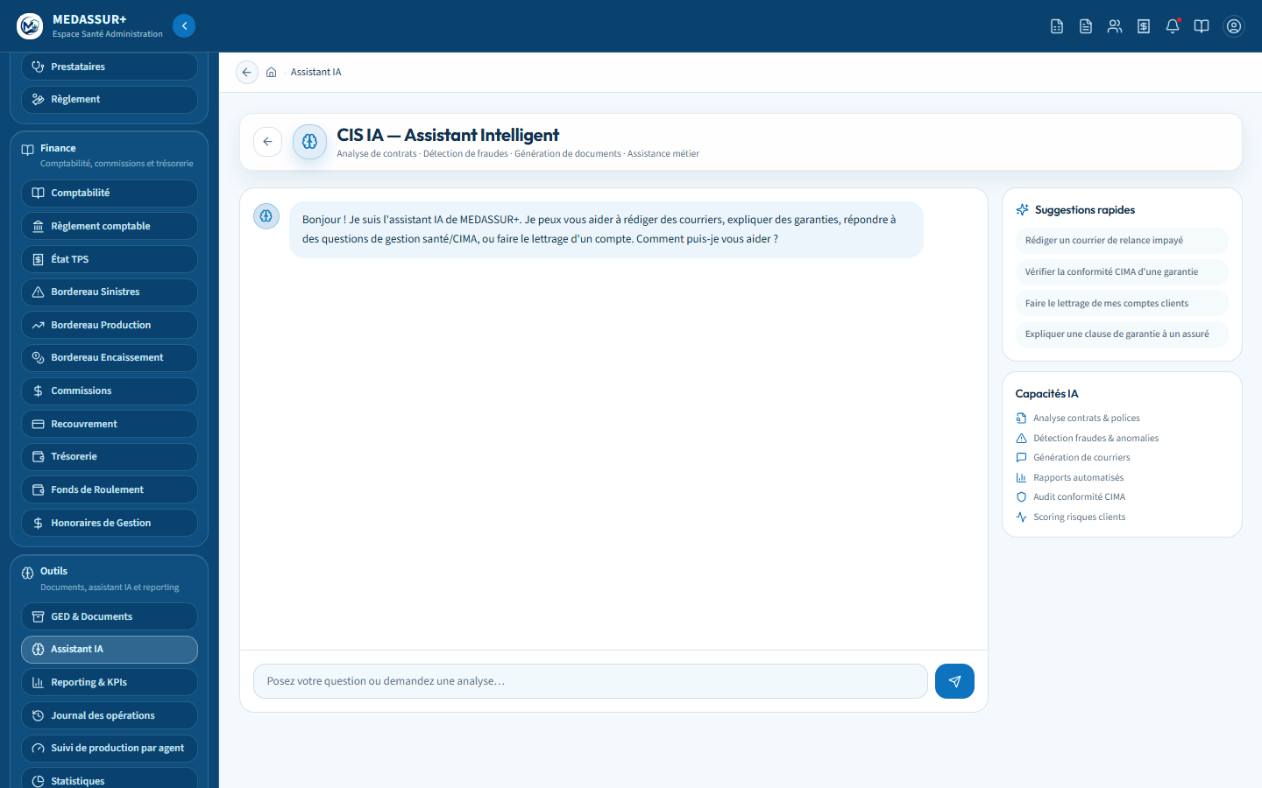
An AI copilot for your teams, built into the app
Drafts letters, explains a benefit, helps reconcile an account
Answers CIMA compliance questions, right from the screen
Never invents a figure: points to the right screen for any real data
MEDASSUR+ — the health insurance management platform

Slide 12
An agent that answers insured members and providers, 24/7
Reviews a file
Prescription, estimate, caps — a decision is suggested from the real benefits.
Reads live data
Benefits, consumption and family history, in real time.
Knows its limits
Hands off to a human claims handler with a full summary whenever needed.
MEDASSUR+ — the health insurance management platform

Slide 13
Security, compliance and trust
Multi-tenant, fully isolated
Every insurer, broker or mutual sees only its own data — isolation enforced at the database level itself.
Electronic signature and QR
Every signed document carries a QR code; a public verification page confirms its authenticity.
CIMA Code compliant
Rates, benefits and regulatory documents kept up to date inside the application.
MEDASSUR+ — the health insurance management platform

Slide 14
A channel for every stakeholder
MEDASSUR+ — the health insurance management platform

Slide 15
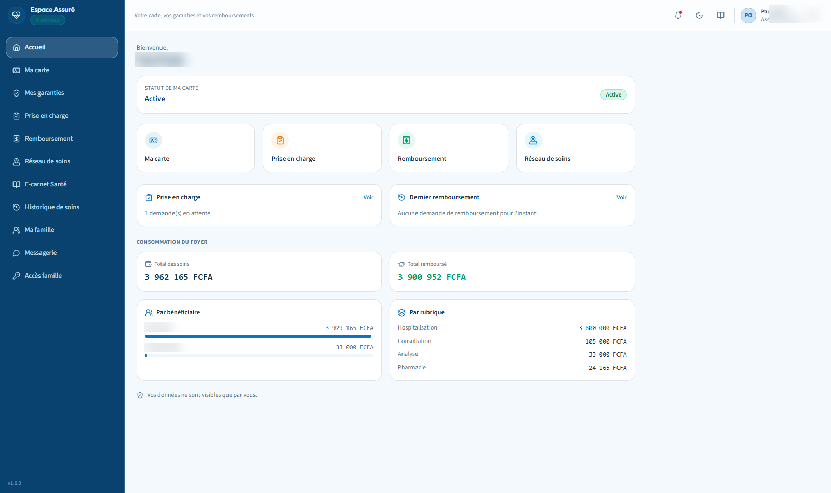
Member Portal — their card, their benefits, one click away
Insurance card, benefits and status at a glance
Prior-authorization and reimbursement requests online
Household spend detailed by beneficiary and by benefit type
MEDASSUR+ — the health insurance management platform

Slide 16
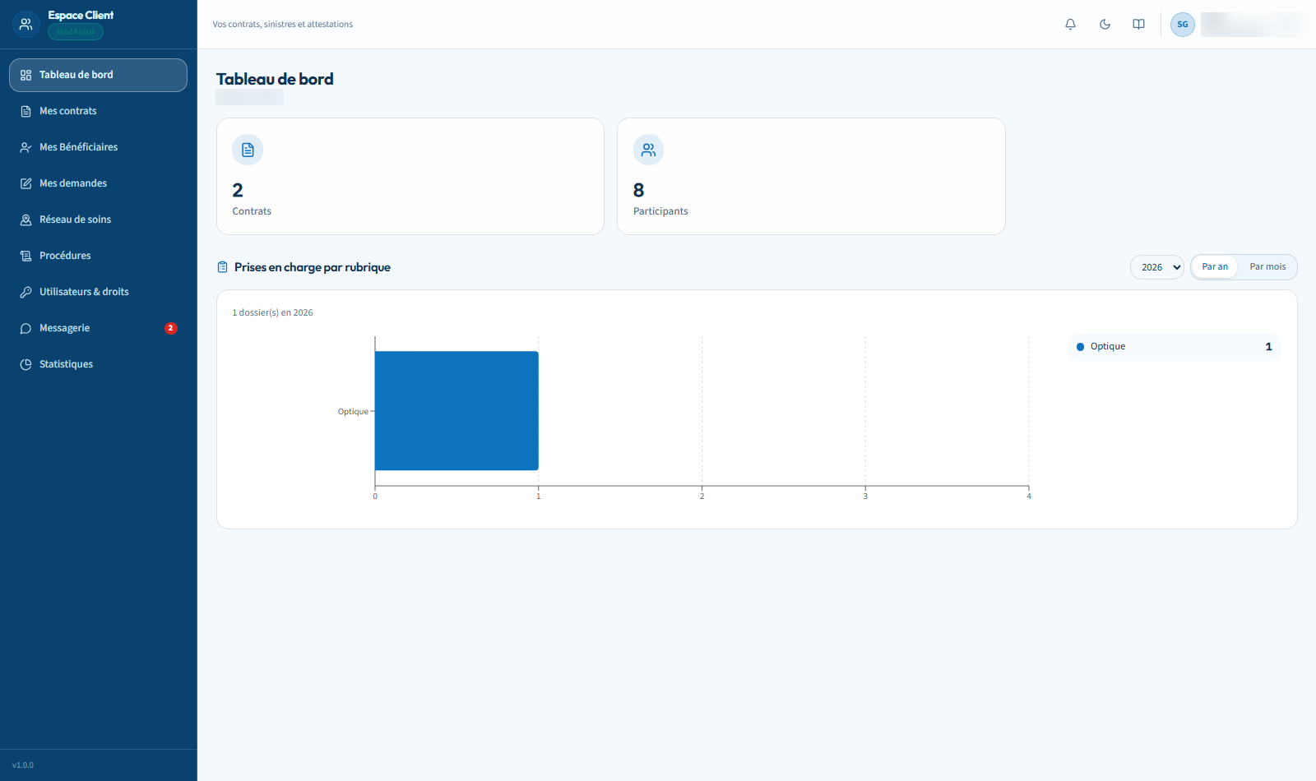
Policyholder Portal — the whole client company, self-service
Policies, beneficiaries and requests in one place
Staff additions and departures in a few clicks
Company consumption statistics, by benefit type
MEDASSUR+ — the health insurance management platform

Slide 17
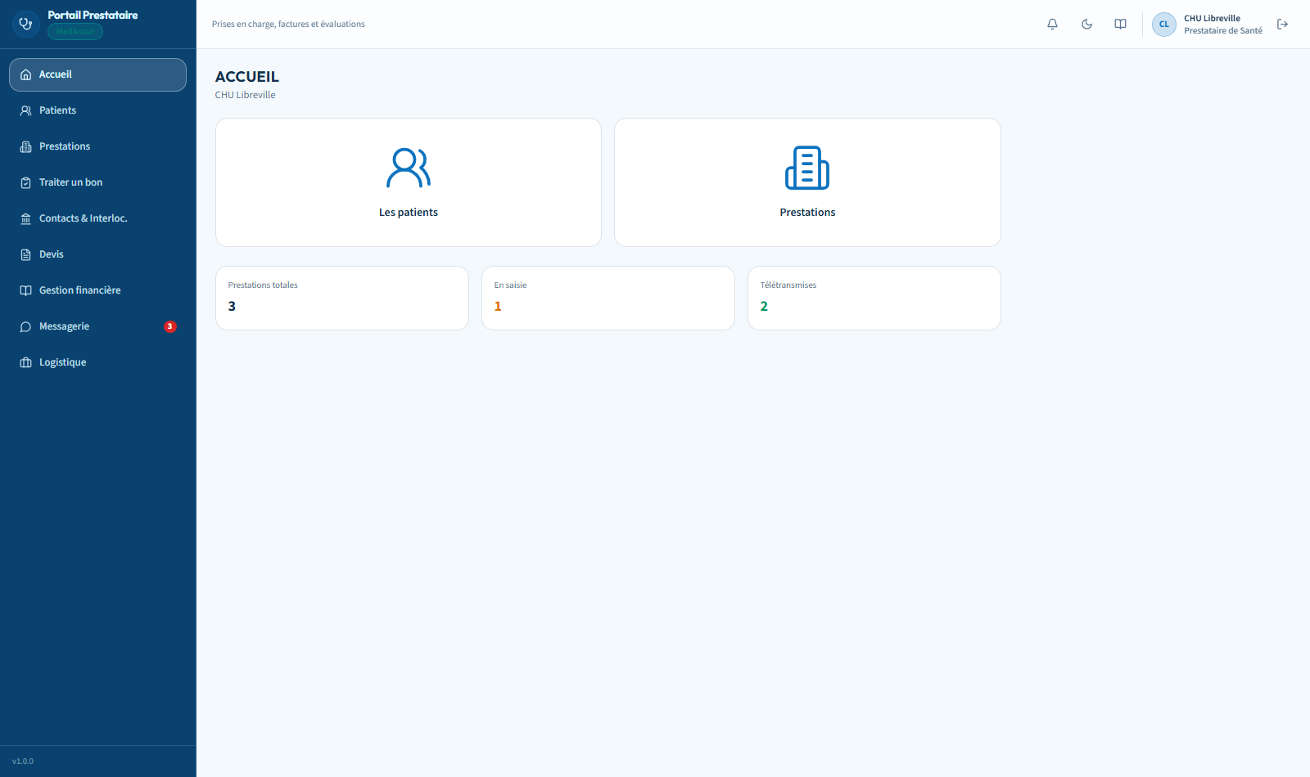
Provider Portal — billing and claims submission made simple
Patients, services and estimates in one workspace
Processing referrals and submitting invoices electronically
Real-time financial tracking and settlement statements
MEDASSUR+ — the health insurance management platform

Slide 18
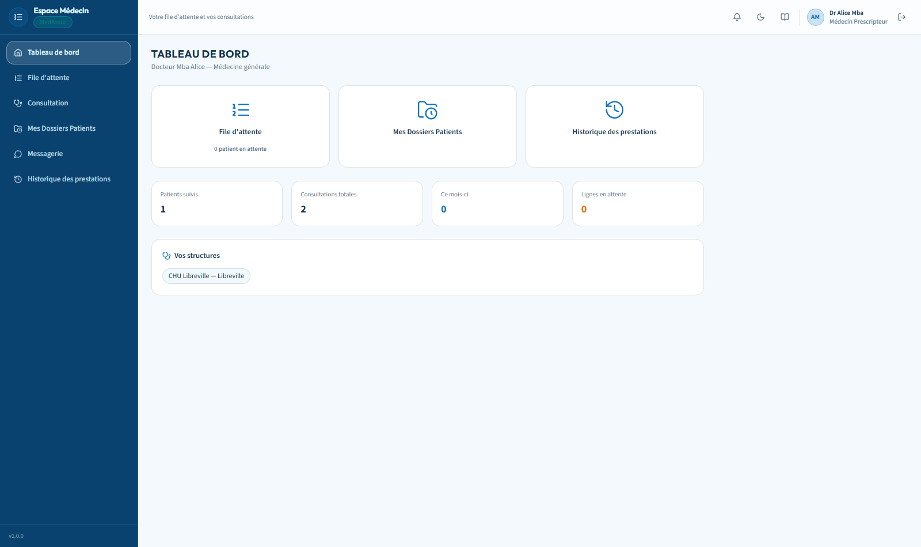
Physician Portal — prescriptions, fully digital
Up-to-date queue and patient records
Consultation and prescription entered directly online
Full history of the patient's care
MEDASSUR+ — the health insurance management platform

Slide 19
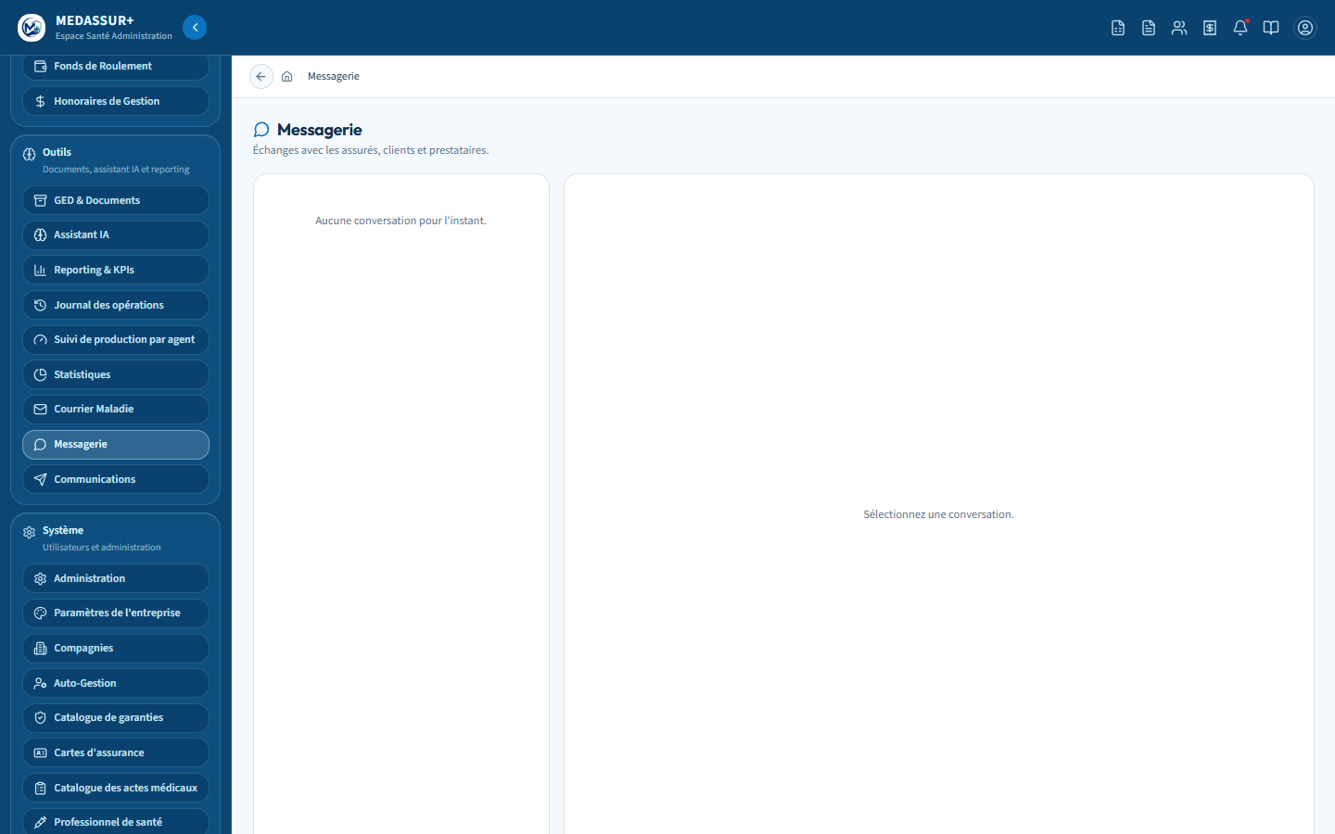
One unified inbox for every conversation
Insured members, policyholders, providers and claims handlers in a single thread
Several attachments in one send, merged automatically into one document
Automatic follow-up when a file is waiting on a missing document
MEDASSUR+ — the health insurance management platform

Slide 20
In their pocket
MEDASSUR+ — the health insurance management platform

Slide 21
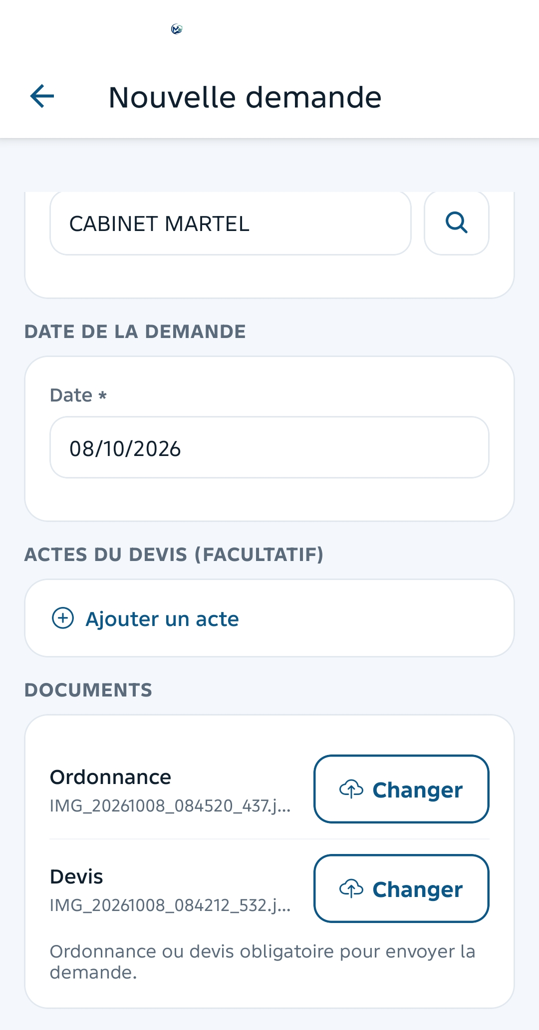
The mobile app — insurance in their pocket
Insurance card, benefits and provider network, offline included
Prior-authorization and reimbursement requests, photo attached
Digital health record for the whole family
MEDASSUR+ — the health insurance management platform

Slide 22
MEDASSUR+ in production, today
7,755
50
6
690 M+
insured members managed in production
active policies run in real time
business portals, a single data engine
FCFA in claims tracked
MEDASSUR+ — the health insurance management platform

Slide 23
What sets MEDASSUR+ apart
All-in-one
AI built in
Back office, portals and mobile on a single data engine.
Into every step of the process, not a bolt-on gadget.
Document fidelity
Built for Gabon
Every document reproduces the client's exact brand.
And the CIMA zone — not a generic platform adapted afterwards.
MEDASSUR+ — the health insurance management platform

Slide 24
What's coming next
More channels for the conversational agent (WhatsApp, email)
Electronic signature and QR extended to every document
New management reports by agency and by insurer
MEDASSUR+ — the health insurance management platform

Slide 25

Let's talk about your portfolio
contact@medassur.ga · medassur.cloud

