Slide 1
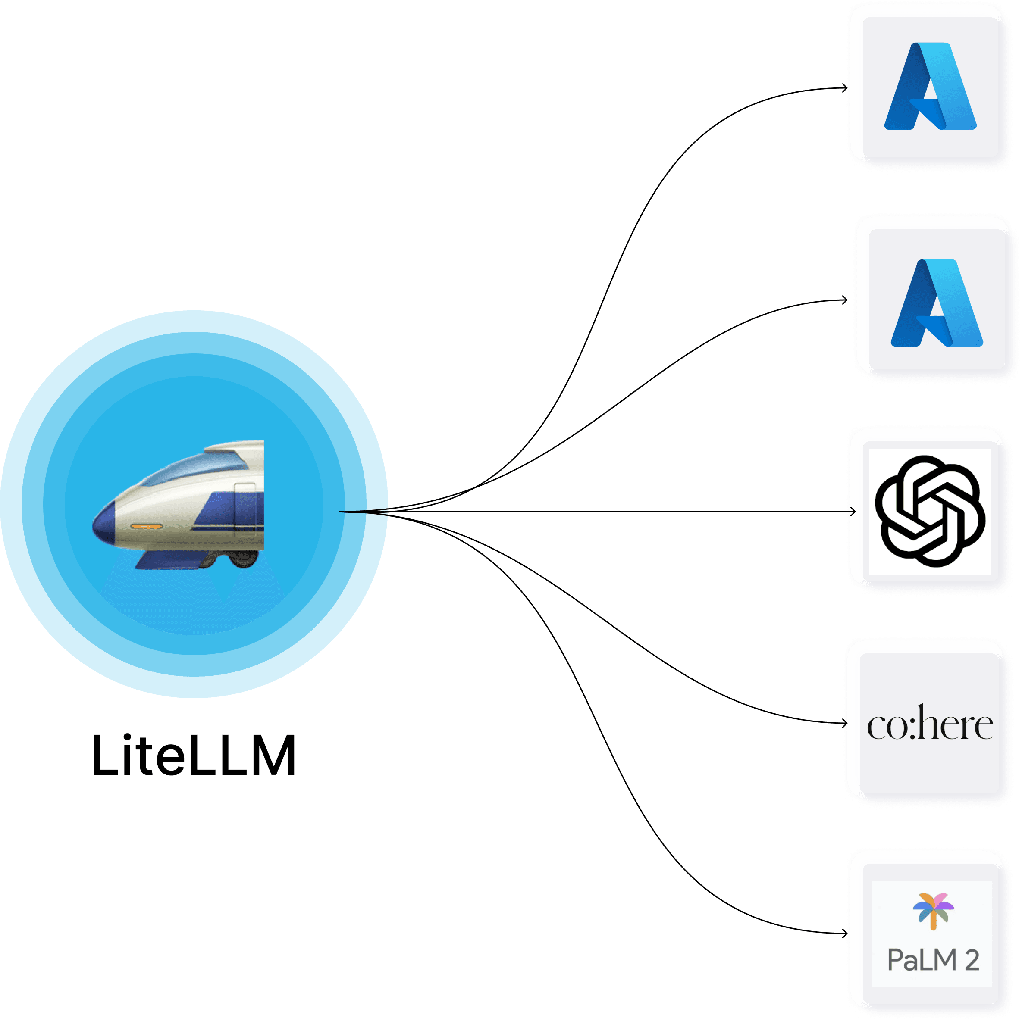





Slide 3


Oracle Cloud Infrastructure (Paris Region)
Fault Domain 3
VCN
Public Subnet
Compute & Visual Nodes
LLM compartment
Availability Domain 1
GPU VM
vLLM
Availability Domain 1
Fault Domain 2
GPU VM
vLLM
Fault Domain 1
CPU VM
LiteLLM

