Slide 1
Sklearn-UG
Francesco Bellotti, Univ. Genova

Slide 2
Sklearn-UG
https://scikit-learn.org/stable/user_guide.html

Slide 3
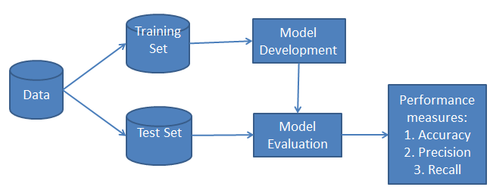
The workflow for supervised learning

Slide 4
1.Linear_models
https://scikit-learn.org/stable/modules/linear_model.html
https://scikit-learn.org/stable/modules/linear_model.html#ordinary-least-squares
Make_regression

Slide 5
2.plot-random-dataset
Make_classification

Slide 6
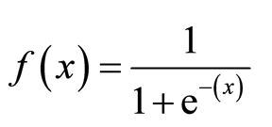
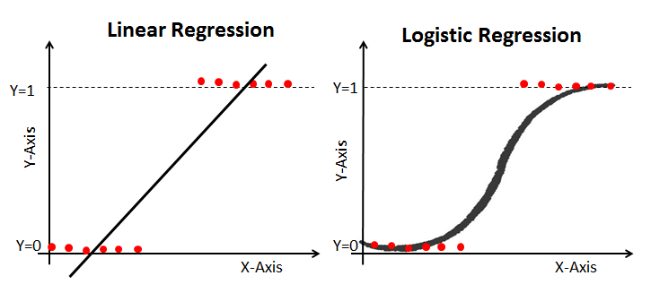
3-logit.diabete
https://www.datacamp.com/community/tutorials/understanding-logistic-regression-python
Logistic regression is a statistical method for predicting binary classes.
Logistic Regression predicts the probability of occurrence of a binary event utilizing a logit function.
3 types of logistic regression
Binary
Multinomial
Ordinal
Classification report depicted
Roc curve

Slide 7
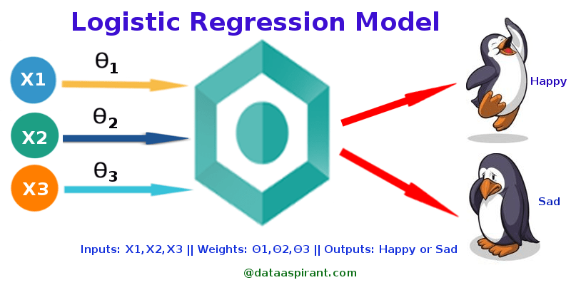
Logistic regression
https://towardsdatascience.com/logistic-regression-detailed-overview-46c4da4303bc

Slide 8
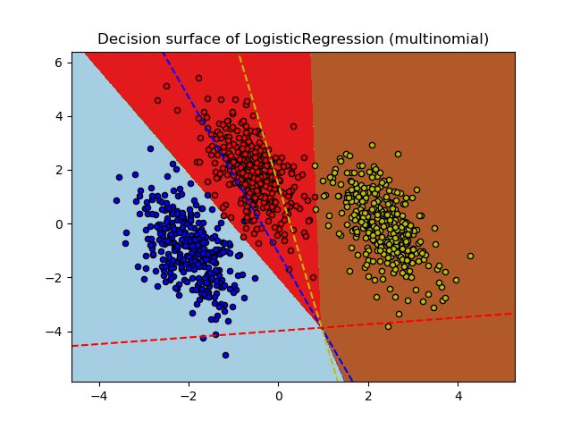
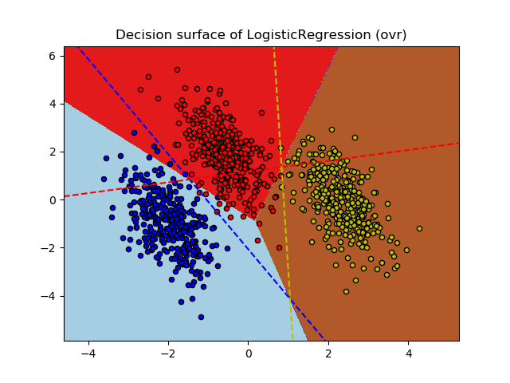
4-logit.multinomial
https://scikit-learn.org/stable/auto_examples/linear_model/plot_logistic_multinomial.html#sphx-glr-auto-examples-linear-model-plot-logistic-multinomial-py

Slide 9
4-logit.multinomial
Plot decision boundaries, with mesh grids
Np.where() to get the indexes

Slide 10
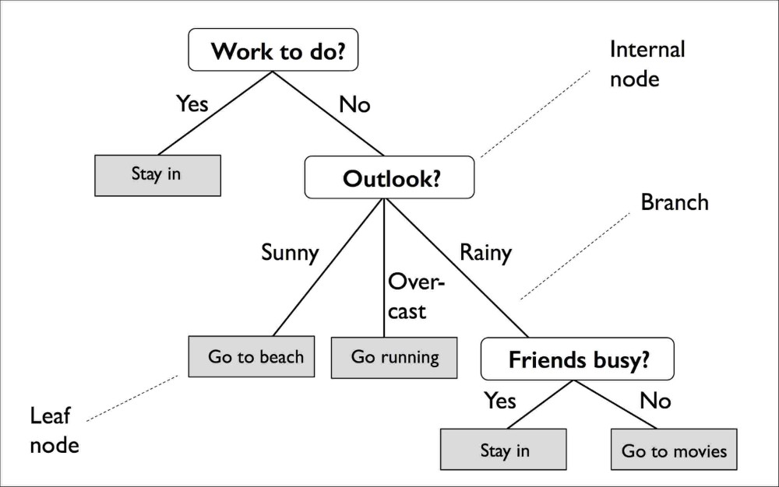
Decision tree
Pic taken from:
https://towardsdatascience.com/https-medium-com-lorrli-classification-and-regression-analysis-with-decision-trees-c43cdbc58054

Slide 11
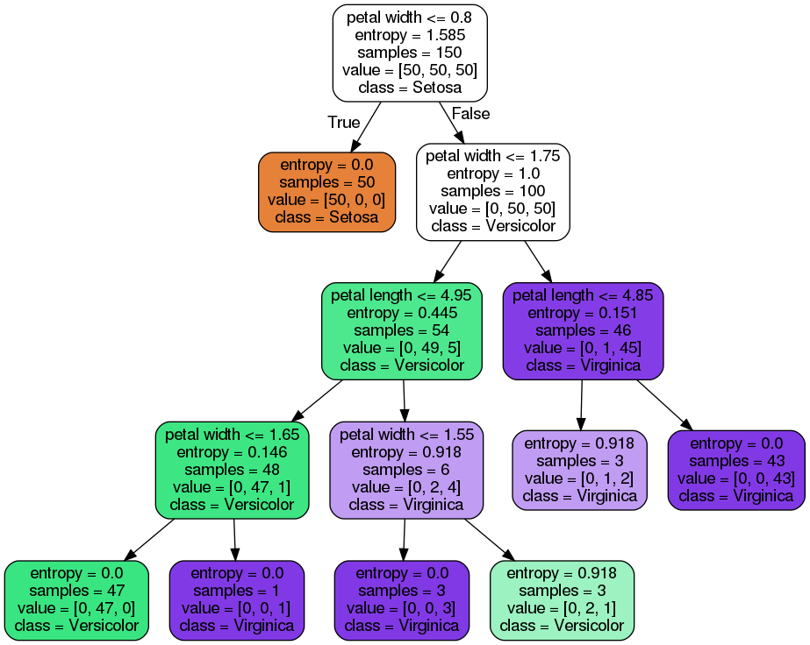
Decision tree
Pic taken from:
https://towardsdatascience.com/https-medium-com-lorrli-classification-and-regression-analysis-with-decision-trees-c43cdbc58054

Slide 12
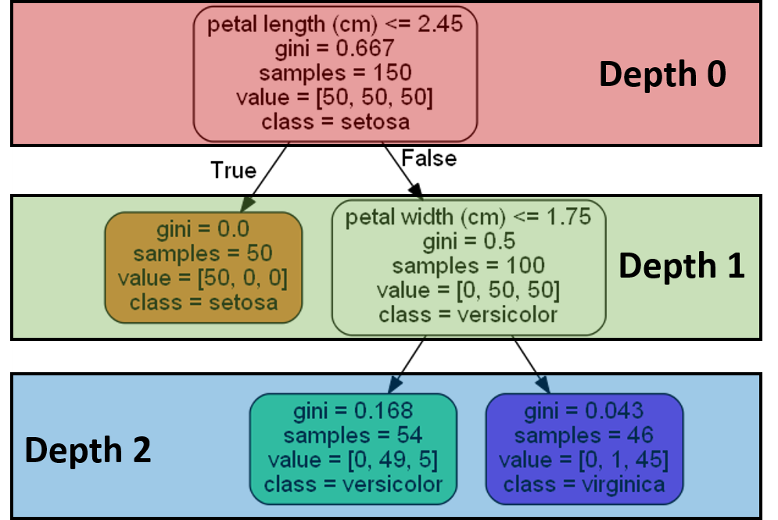
5a- Decision Tree
https://towardsdatascience.com/scikit-learn-decision-trees-explained-803f3812290d

Slide 13
DT parameters
criterion : This parameter determines how the impurity of a split will be measured. Default “gini”, otherwise “entropy”
splitter: This is how the decision tree searches the features for a split. The default value is set to “best”. For each node, the algorithm considers all the features and chooses the best split. If you set to “random,” then a random subset of features will be considered. The split will be made by the best feature within the random subset. The size of the random subset is given by the max_features parameter.
Max_depth: Not limiting the growth of a DT may lead to over-fitting.
min_samples_split: The minimum number of samples a node must contain in order to consider splitting. Default: two. Regularization.
min_samples_leaf: The minimum number of samples needed to be considered a leaf node. The default value is set to one. Use it to limit the growth of the tree.
https://scikit-learn.org/stable/modules/generated/sklearn.tree.DecisionTreeClassifier.html

Slide 14
Towards random forests
The real power of decision trees unfolds more so when cultivating many of them — while limiting the way they grow — and collecting their individual predictions to form a final conclusion.
In other words, you grow a forest, and if your forest is random in nature, using the concept of bagging and with splitter = "random", we call this a Random Forest.
‘Splitter’ from best (default) to random (a random set of features)

Slide 15
5b Decision Tree
https://github.com/suvoooo/Machine_Learning/blob/master/DecsTree/notebooks/Bank_Data_Analysis.ipynb
https://victorzhou.com/blog/information-gain/
Information gain, entropy, two or more target classes
https://towardsdatascience.com/entropy-how-decision-trees-make-decisions-2946b9c18c8
Example: Decision Tree
Information gain: compare splits on a categorical feature (two examples provided in the page)
Generalizing, among all the possible spilts (by category or, if continuous variable, threshold), choose the one with the maximum reduction of entropy

Slide 16
https://blog.quantinsti.com/gini-index/
Example computations with Gini index
Choose the feature with the minimum gini index

Slide 17
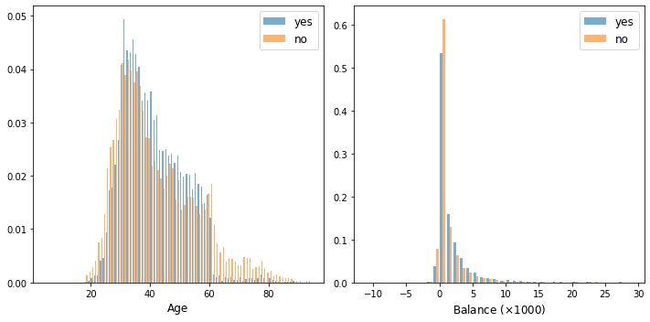
5bb-DT bank deposit
Histogram plot with pyplot, plthist()
Then, also catplot()

Slide 18
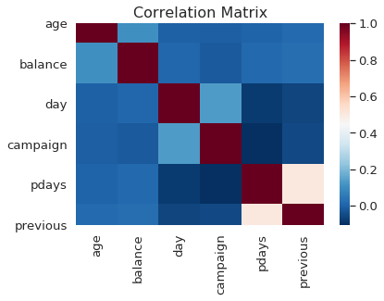
Sns heatmap on a correlation matrix

Slide 19
convert the categorical variabels ('object type') to dummy variables in Pandas DF
Map() on a Pandas series, to map labels into 0/1
use len() to get the nr. of samples
GridSearchCV with the best params
Score() on a (training/testing)set
Graphviz library to save pic of a tree
plt.bar for feature importance
plt.savefig() to save a pic

Slide 20
5c DT regression
https://towardsdatascience.com/https-medium-com-lorrli-classification-and-regression-analysis-with-decision-trees-c43cdbc58054
Predicted value for each leaf node is the average prediction of the samples included in that node
https://scikit-learn.org/stable/modules/generated/sklearn.tree.DecisionTreeRegressor.html
MSE as impurity metrics
score() r2 criterion
https://scikit-learn.org/stable/modules/model_evaluation.html#r2-score
argsort() function on an array, to get the sorting indexes
Notes:
For every possible split (of a categoriacal or continuous variable), you compute the MSE of the resulting nodes (For every node compute the average of the predictions, then compute the MSE, assigning to each node this average value) and find the best split (the one leading to the minimum MSE)

Slide 21
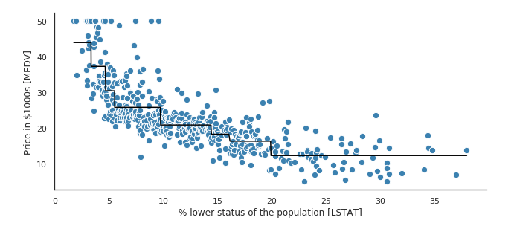

Slide 22
5d
https://scikit-learn.org/stable/auto_examples/tree/plot_tree_regression.html#sphx-glr-auto-examples-tree-plot-tree-regression-py
Overfit

Slide 23
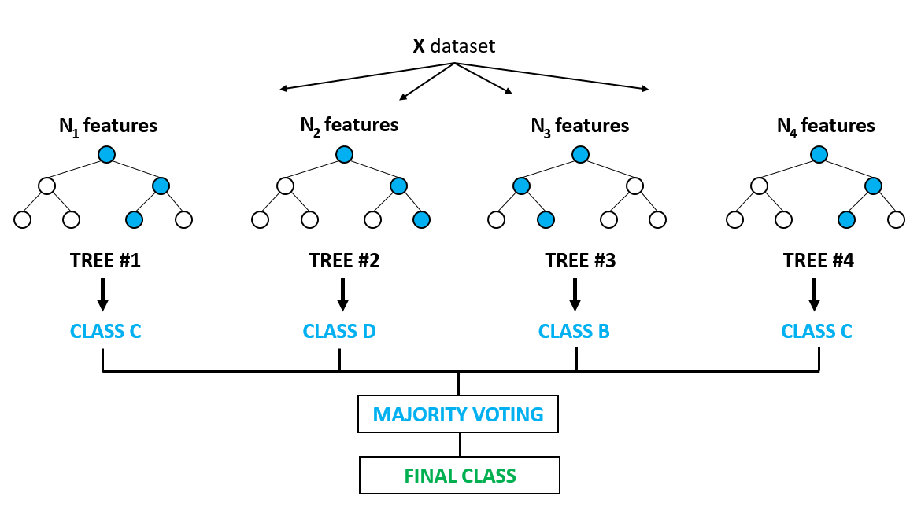
Random forest
Pic from: https://medium.com/@ar.ingenious/applying-random-forest-classification-machine-learning-algorithm-from-scratch-with-real-24ff198a1c57
https://www.stat.berkeley.edu/~breiman/RandomForests/cc_home.htm
N samples in each training set obtained by selection of the original samples, with replacement
m features chosen at random at each node

Slide 24
Random forests
https://stackabuse.com/random-forest-algorithm-with-python-and-scikit-learn/
Ensemble learning is a type of learning where you join different types of algorithms or same algorithm multiple times to form a more powerful prediction model. The random forest algorithm combines multiple algorithm of the same type i.e. multiple decision trees, resulting in a forest of trees
Use of tree regularization parameters (particularly, max_fetaures)

Slide 25
Random forest
In case of a regression problem, for a new record, each tree in the forest predicts a value for Y (output). The final value can be calculated by taking the average of all the values predicted by all the trees in forest.
In case of a classification problem, each tree in the forest predicts the category to which the new record belongs. Finally, the new record is assigned to the category that wins the majority vote.
https://scikit-learn.org/stable/modules/generated/sklearn.ensemble.RandomForestClassifier.html

Slide 26
Advantages
The random forest algorithm relies on the power of "the crowd"; therefore the overall biasedness of the algorithm is reduced
This algorithm is very stable. Even if a new data point is introduced in the dataset the overall algorithm is not affected much since new data may impact one tree, but it is very hard for it to impact all the trees
Random forests does not overfit
The random forest algorithm works well when you have both categorical and numerical features.

Slide 27
Disadvantages
Complexity
Time
Space

Slide 28
Naive Bayes
https://www.datacamp.com/community/tutorials/naive-bayes-scikit-learn
A straightforward and fast classification algorithm, which is suitable for a large chunk of data. Naive Bayes classifier is successfully used in various applications such as spam filtering, text classification, sentiment analysis, and recommender systems. It uses Bayes theorem of probability for prediction of unknown class.

Slide 29
Naive Bayes
Naive Bayes classifier assumes that the effect of a particular feature in a class is independent of other features. For example, a loan applicant is desirable or not depending on his/her income, previous loan and transaction history, age, and location. Even if these features are interdependent, these features are still considered independently. This assumption simplifies computation, and that's why it is considered as naive.

Slide 30

P(h): the probability of hypothesis h being true (regardless of the data). This is known as the prior probability of h.
P(D): the probability of the data (regardless of the hypothesis). This is known as the prior probability.
P(h|D): the probability of hypothesis h given the data D. This is known as posterior probability.
P(D|h): the probability of data d given that the hypothesis h was true. This is known as posterior probability.

Slide 31
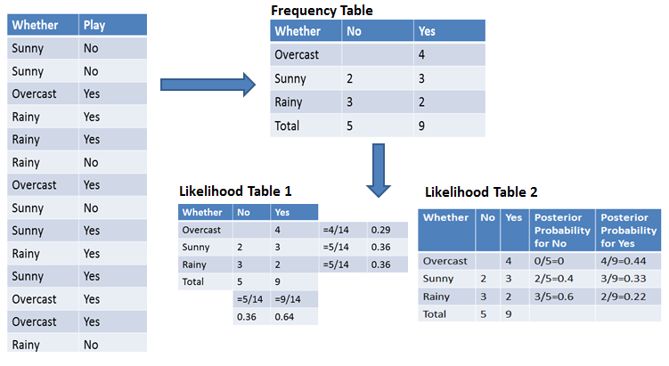
Single feature
Feature
Target classes
P(sunny/no)
P(rainy/yes)
Prior prob.
Post prob. P(D/H)

Slide 32
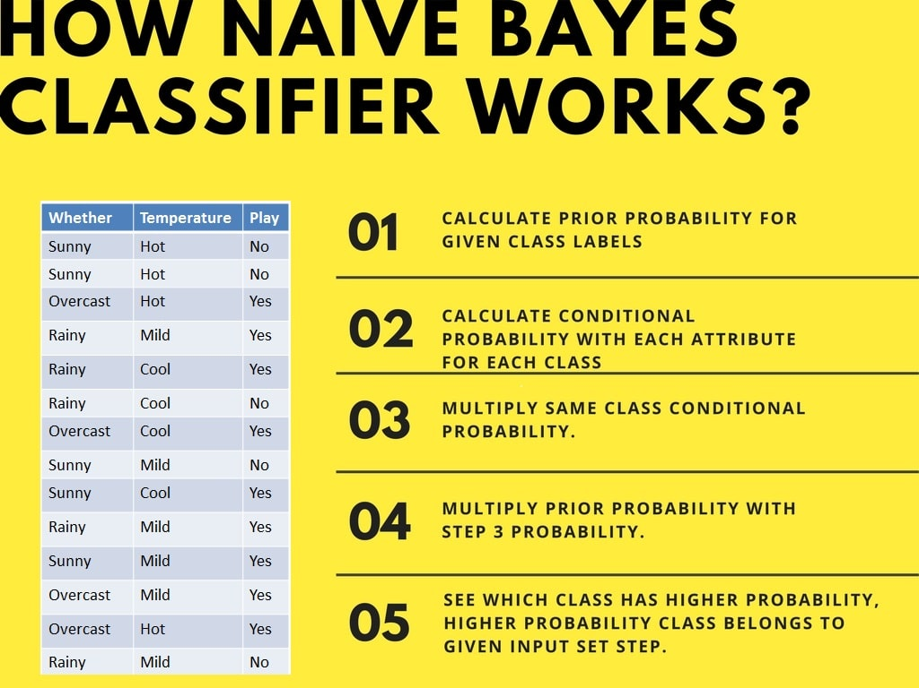
Multiple features

Slide 33
Multiple labels
See code

Slide 34
GaussianNB
https://scikit-learn.org/stable/modules/generated/sklearn.naive_bayes.GaussianNB.html
Supports partial_fit() – all bayesian predictors
Bernoulli Naive Bayes : It assumes that all our features are binary such that they take only two values. Means 0s can represent “word does not occur in the document” and 1s as "word occurs in the document" . If data is not binary, internally Binarization preprocessing will happen
Multinomial Naive Bayes : Its is used when we have discrete data (e.g. movie ratings ranging 1 and 5 as each rating will have certain frequency to represent). In text learning we have the count of each word to predict the class or label.
Gaussian Naive Bayes : Because of the assumption of the normal distribution, Gaussian Naive Bayes is used in cases when all our features are continuous. For example in Iris dataset features are sepal width, petal width, sepal length, petal length. So its features can have different values in data set as width and length can vary. We can’t represent features in terms of their occurrences. This means data is continuous. Hence we use Gaussian Naive Bayes here.
https://www.quora.com/What-is-the-difference-between-the-the-Gaussian-Bernoulli-Multinomial-and-the-regular-Naive-Bayes-algorithms

Slide 35
Zero probability problem
Laplacian correction – add a sample of the empty class + one for every other class

Slide 36
Advantages
It is not only a simple approach but also a fast and accurate method for prediction.
Naive Bayes has very low computation cost.
It can efficiently work on a large dataset.
It performs well in case of discrete response variable compared to the continuous variable.
It can be used with multiple class prediction problems.
It also performs well in the case of text analytics problems.
When the assumption of independence holds, a Naive Bayes classifier performs better compared to other models like logistic regression.

Slide 37
Disadvantages
The assumption of independent features. In practice, it is almost impossible that model will get a set of predictors which are entirely independent.
If there is no training tuple of a particular class, this causes zero posterior probability. In this case, the model is unable to make predictions. This problem is known as Zero Probability/Frequency Problem.

Slide 38
Encoding categorical features
https://towardsdatascience.com/encoding-categorical-features-21a2651a065c
LabelEncoder
OneHotEncoder
Pandas get_dummies()

Slide 39
Examples
https://medium.com/@awantikdas/a-comprehensive-naive-bayes-tutorial-using-scikit-learn-f6b71ae84431
Example of lambda function on pandas series
Map() to filter some lines
Map() to remove puntuation (RegExp), tokenizer
Text processing

Slide 40
Ridge and lasso regression
https://www.analyticsvidhya.com/blog/2016/01/ridge-lasso-regression-python-complete-tutorial/
Ridge and Lasso regression are powerful techniques generally used for creating parsimonious models in presence of a ‘large’ number of features. Here ‘large’ can typically mean either of two things:
Large enough to enhance the tendency of a model to overfit (as low as 10 variables might cause overfitting)
Large enough to cause computational challenges. With modern systems, this situation might arise in case of millions or billions of features

Slide 41
Ridge Regression:
Performs L2 regularization, i.e. adds penalty equivalent to square of the magnitude of coefficients
Minimization objective = LS Obj + α * (sum of square of coefficients)
Lasso Regression:
Performs L1 regularization, i.e. adds penalty equivalent to absolute value of the magnitude of coefficients
Minimization objective = LS Obj + α * (sum of absolute value of coefficients)

Slide 42
Key difference
Ridge: It includes all (or none) of the features in the model. Thus, the major advantage of ridge regression is coefficient shrinkage and reducing model complexity.
Lasso: Along with shrinking coefficients, lasso performs feature selection as well. As we observed earlier, some of the coefficients become exactly zero, which is equivalent to the particular feature being excluded from the model.
Traditionally, techniques like stepwise regression were used to perform feature selection and make parsimonious models. But with advancements in Machine Learning, ridge and lasso regression provide very good alternatives as they give much better output, require fewer tuning parameters and can be automated to a large extend.

Slide 43
Typical use cases
Ridge: It is majorly used to prevent overfitting. Since it includes all the features, it is not very useful in case of exorbitantly high #features, say in millions, as it will pose computational challenges.
Lasso: Since it provides sparse solutions, it is generally the model of choice (or some variant of this concept) for modelling cases where the #features are in millions or more. In such a case, getting a sparse solution is of great computational advantage as the features with zero coefficients can simply be ignored.

Slide 44
Presence of highly correlated features
Ridge: It generally works well even in presence of highly correlated features as it will include all of them in the model but the coefficients will be distributed among them depending on the correlation.
Lasso: It arbitrarily selects any one feature among the highly correlated ones and reduced the coefficients of the rest to zero. Also, the chosen variable changes randomly with change in model parameters. This generally doesn’t work that well as compared to ridge regression.
This disadvantage of lasso can be observed in the example we discussed above. Since we used a polynomial regression, the variables were highly correlated. ( Not sure why? Check the output of data.corr() ). Thus, we saw that even small values of alpha were giving significant sparsity (i.e. high #coefficients as zero).

Slide 45
Feature selection
https://www.datacamp.com/community/tutorials/feature-selection-python
Filter methods
Independent of the ML algo
Wrapper methods
The ML algo performance is used to assess feature selection
Embedded methods
Feature selection is already inside the ML algo

Slide 46

Filter methods
Features give rank on the basis of statistical scores which tend to determine the features' correlation with the outcome variable. Correlation is a heavily contextual term, and it varies from work to work.

Slide 47
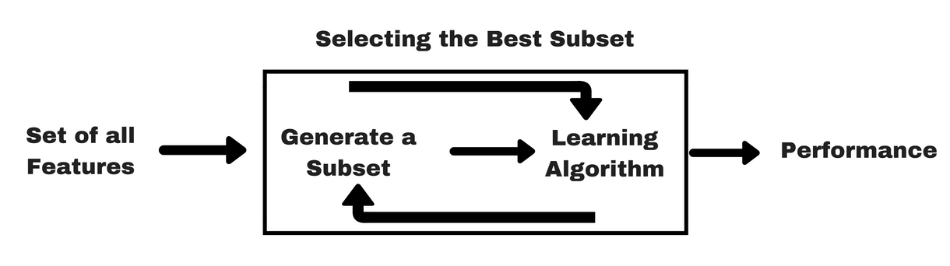
Wrapper methods

Slide 48
Forward Selection: The procedure starts with an empty set of features [reduced set]. The best of the original features is determined and added to the reduced set. At each subsequent iteration, the best of the remaining original attributes is added to the set.
Backward Elimination: The procedure starts with the full set of attributes. At each step, it removes the worst attribute remaining in the set.

Slide 49
RFE
Recursive Feature elimination: Recursive feature elimination performs a greedy search to find the best performing feature subset. It iteratively creates models and determines the best or the worst performing feature at each iteration. It constructs the subsequent models with the left features until all the features are explored. It then ranks the features based on the order of their elimination. In the worst case, if a dataset contains N number of features RFE will do a greedy search for 2^{N} combinations of features.

Slide 50
Embedded methods
Embedded methods are iterative in a sense that takes care of each iteration of the model training process and carefully extract those features which contribute the most to the training for a particular iteration. Regularization methods are the most commonly used embedded methods which penalize a feature given a coefficient threshold.
This is why Regularization methods are also called penalization methods that introduce additional constraints into the optimization of a predictive algorithm (such as a regression algorithm) that bias the model toward lower complexity (fewer coefficients).

Slide 51
Preprocessing
Missing values
Categorical features
Numerical features
(Custom transformations)
Feature scaling
(Normalization)
https://towardsdatascience.com/preprocessing-with-sklearn-a-complete-and-comprehensive-guide-670cb98fcfb9

Slide 52
Missing values
Do I have missing values?
How are they expressed in the data?
Should I withhold samples with missing values?
Or should I replace them?
If so, which values should they be replaced with?
If they are completely at random, they don’t give any extra information and can be omitted. On the other hand, if they’re not at random, the fact that a value is missing is itself information and can be expressed as an extra binary feature.
MissingIndicator class

Slide 53
Inputation
SimpleImputer in numpy
DF.fillna() in pandas
For all the rest, please see the code

Slide 54
Scaling and standardizing
https://www.kaggle.com/discdiver/guide-to-scaling-and-standardizing

Slide 55
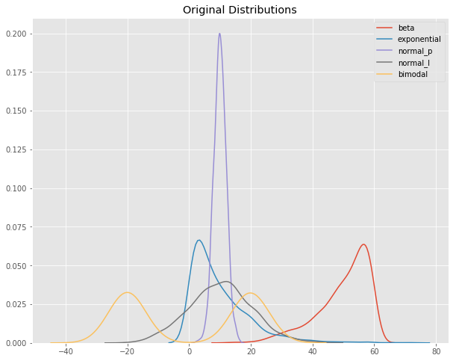
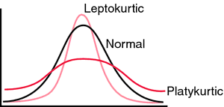
Orignal distributions
Create 1,000 samples out of each distribution, and put them in the dataset
Original denisty estimation plots

Slide 56
PCA
https://towardsdatascience.com/pca-using-python-scikit-learn-e653f8989e60

Slide 57
PCA
Principal component analysis aims at reducing a large set of variables to a small set that still contains most of the information in the large set.
Goals: better data visualization and speed up ML analysis
https://blog.umetrics.com/what-is-principal-component-analysis-pca-and-how-it-is-used
https://builtin.com/data-science/step-step-explanation-principal-component-analysis
https://www.datacamp.com/community/tutorials/principal-component-analysis-in-python

Slide 58
Feature selection and PCA
Height
Weight

Slide 59
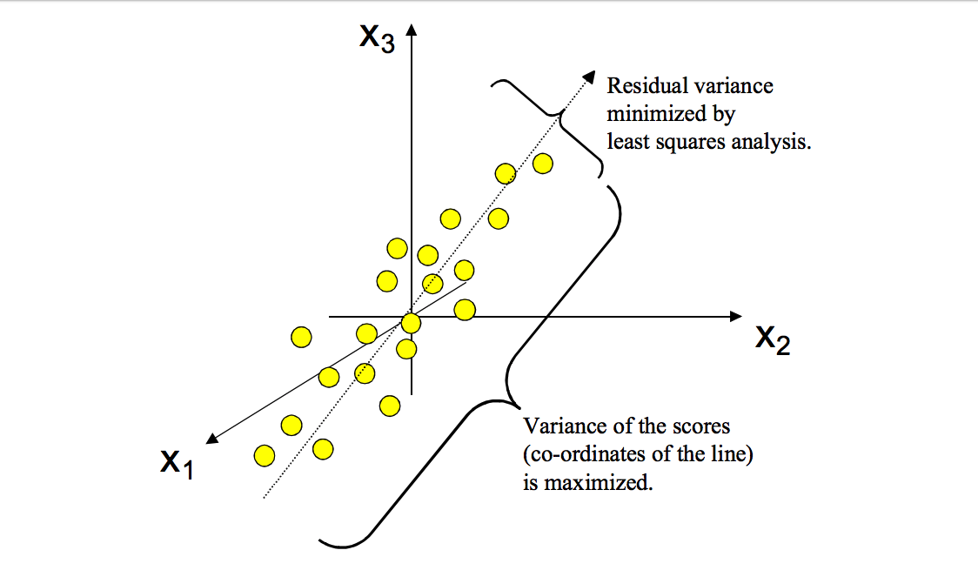
PCA
Preliminary step: standardization
Maximize the variance of the projection coordinates

Slide 60
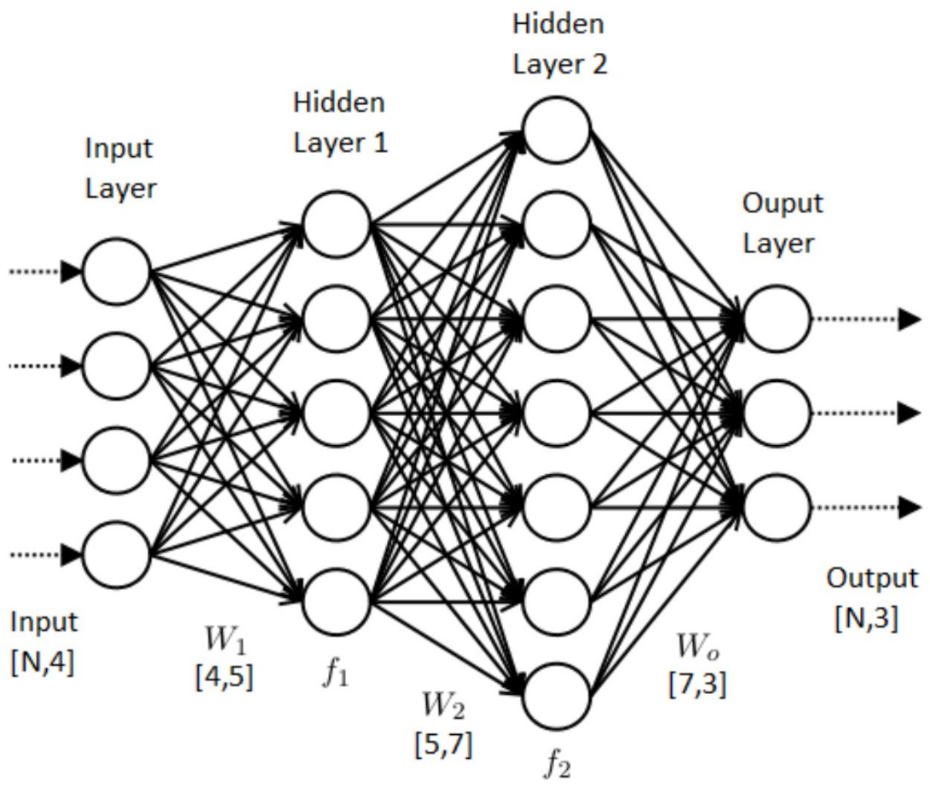
Neural netowork (digression, if needed)
Notes:
See 3-logit diabete, if needed, with a previous observation on regression https://scikit-learn.org/stable/modules/linear_model.html

