Slide 1
Sklearn-UG
Francesco Bellotti, Univ. Genova

Slide 2
Sklearn-UG

Slide 3
1.Linear_models
https://scikit-learn.org/stable/modules/linear_model.html
https://scikit-learn.org/stable/modules/linear_model.html#ordinary-least-squares
Make_regression

Slide 4
2.plot-random-dataset
Make_classification

Slide 5
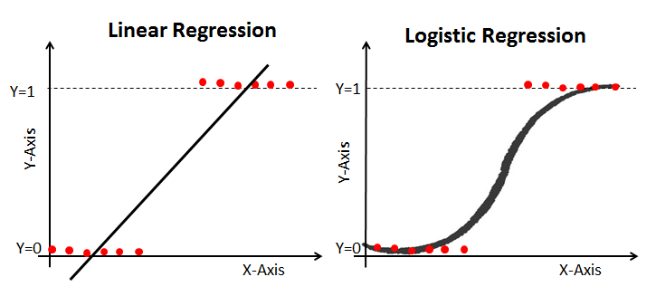
3-logit.diabete
https://www.datacamp.com/community/tutorials/understanding-logistic-regression-python
Logistic regression is a statistical method for predicting binary classes.
Logistic Regression predicts the probability of occurrence of a binary event utilizing a logit function.
3 types of logistic regression
Binary
Multinomial
Ordinal
Classification report depicted
Roc curve

Slide 6
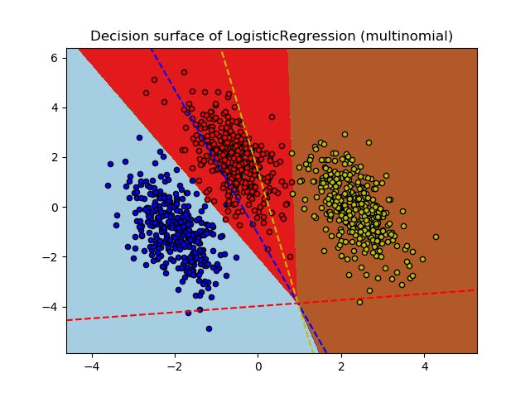
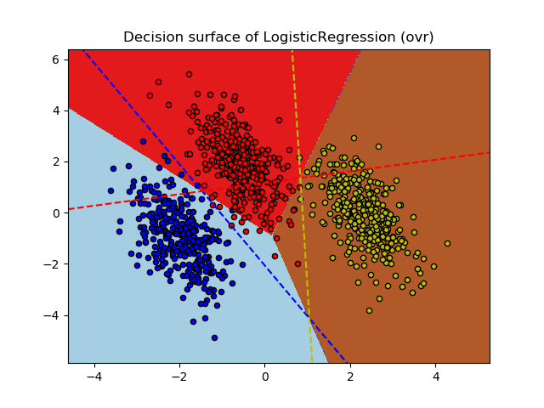
4-logit.multinomial
https://scikit-learn.org/stable/auto_examples/linear_model/plot_logistic_multinomial.html#sphx-glr-auto-examples-linear-model-plot-logistic-multinomial-py

Slide 7
4-logit.multinomial
Plot decision boundaries, with mesh grids
Np.where() to get the indexes

