Slide 1
Pandas
Francesco Bellotti, Univ. Genova

Slide 2
Pandas, a py library to support data analysis
For example, say you want to explore a dataset stored in a CSV on your computer. Pandas will extract the data from that CSV into a DataFrame — a table, basically — then let you do things like:
Calculate statistics and answer questions about the data, like
What's the average, median, max, or min of each column?
Does column A correlate with column B?
What does the distribution of data in column C look like?
Clean the data by doing things like removing missing values and filtering rows or columns by some criteria
Visualize the data with help from Matplotlib. Plot bars, lines, histograms, bubbles, and more.
Store the cleaned, transformed data back into a CSV, other file or database
https://www.learndatasci.com/tutorials/python-pandas-tutorial-complete-introduction-for-beginners/

Slide 3
How does pandas fit into the data science toolkit?
Pandas is built on top of the NumPy package, meaning a lot of the structure of NumPy is used or replicated in Pandas. Data in pandas is often used to feed statistical analysis in SciPy, plotting functions from Matplotlib, and machine learning algorithms in Scikit-learn.

Slide 4
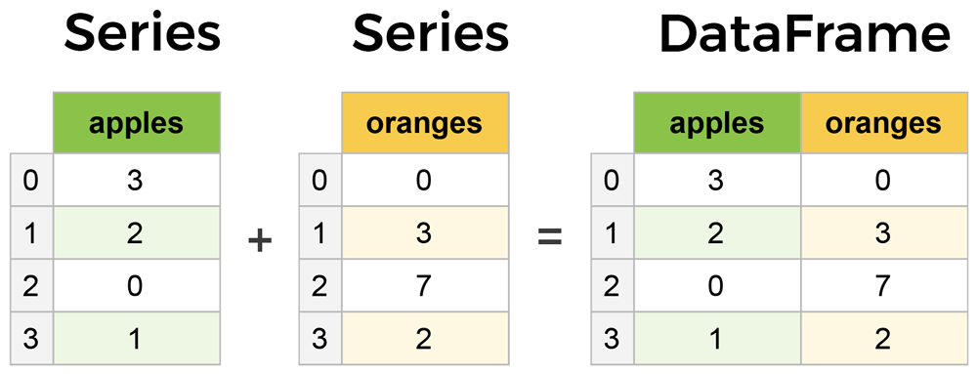
Core components of pandas: Series and DataFrames
Note always the index

Slide 5
Create dataframes from scratch
Dataframe() constructor
E.g. With a dictionary
Default index
User-specified index
locate records with indices (one or more)
purchases.loc['June'] # June is a person name
(iloc for integer index)
Movies.loc['Prometheus':'Sing']
Movies.iloc[1:4]

Slide 6
Read data
From .csv
df = pd.read_csv('purchases.csv')
From .json
df = pd.read_json('purchases.json')
From .sql

Slide 7
Converting back to a CSV, JSON, or SQL
df.to_csv('new_purchases.csv')
df.to_json('new_purchases.json')
df.to_sql('new_purchases', con)

Slide 8
Most important DataFrame operations
movies_df = pd.read_csv("IMDB-Movie-Data.csv", index_col="Title")
movies_df.head()
movies_df.tail(2)
movies_df.info() # How many non null entries per column, incl. index. Column type
movies_df.shape # (1000, 11)

Slide 9
Handling duplicates
temp_df = movies_df.append(movies_df)
temp_df.shape # (2000, 11)
temp_df = temp_df.drop_duplicates()
temp_df.shape (1000, 11)
temp_df.drop_duplicates(inplace=True)
temp_df = movies_df.append(movies_df) # make a new copy
temp_df.drop_duplicates(inplace=True, keep=False)
temp_df.shape (1000, 11) #keep can be first, last, False

Slide 10
Column clean-up
movies_df.columns #gets the list of columns
movies_df.rename(columns={
'Runtime (Minutes)': 'Runtime',
'Revenue (Millions)': 'Revenue_millions'
}, inplace=True)
movies_df.columns = ['rank', 'genre', 'description', 'director', 'actors', 'year', 'runtime', 'rating', 'votes', 'revenue_millions', 'metascore']
Better, with list comprehension:
movies_df.columns = [col.lower() for col in movies_df]

Slide 11
How to work with missing values
When exploring data, you’ll most likely encounter missing or null values, which are essentially placeholders for non-existent values. Most commonly you'll see Python's None or NumPy's np.nan, each of which are handled differently in some situations.
There are two options in dealing with nulls:
Get rid of rows or columns with nulls
Replace nulls with non-null values, a technique known as imputation

Slide 12
movies_df.isnull()
movies_df.isnull().sum()
movies_df.dropna() #drop entire row
movies_df.dropna(axis=1) #drop entire column

Slide 13
Imputation
Imputation is a conventional feature engineering technique used to keep valuable data that have null values.
There may be instances where dropping every row with a null value removes too big a chunk from your dataset, so instead we can impute that null with another value, usually the mean or the median of that column.
revenue = movies_df['revenue_millions']
revenue.head() # Very useful the ‘Title’ index…
revenue_mean = revenue.mean()
revenue.fillna(revenue_mean, inplace=True)
movies_df.isnull().sum() # Do the check

Slide 14
Better impuation
Imputing an entire column with the same value like this is a basic example. It would be a better idea to try a more granular imputation by Genre or Director.
For example, you would find the mean of the revenue generated in each genre individually and impute the nulls in each genre with that genre's mean.
Left as an exercise

Slide 15
Understand your variables
movies_df.describe()
Also for categorical variables:
movies_df['genre'].describe()
movies_df['genre'].value_counts().head(10)
To see the most frequent values of a categorical feature

Slide 16
Relationships between continuous variables
By using the correlation method .corr() we can generate the relationship between each continuous variable:
movies_df.corr()
Correlation tables are a numerical representation of the bivariate relationships in the dataset.
Positive numbers indicate a positive correlation — one goes up the other goes up — and negative numbers represent an inverse correlation — one goes up the other goes down. 1.0 indicates a perfect correlation.
Examining bivariate relationships comes in handy when you have an outcome or dependent variable in mind and would like to see the features most correlated to the increase or decrease of the outcome. You can visually represent bivariate relationships with scatterplots (seen below in the plotting section).

Slide 17
DataFrame slicing, selecting, extracting
genre_col = movies_df['genre']
type(genre_col)
pandas.core.series.Series
genre_col = movies_df[['genre']]
Create a DataFrame from a DataFrame
type(genre_col)
pandas.core.frame.DataFrame
subset = movies_df[['genre', 'rating']]
subset.head()

Slide 18
Getting data by rows
For rows, we have two options:
.loc - locates by name (string index)
.iloc- locates by numerical index
prom = movies_df.loc["Prometheus"]
prom = movies_df.iloc[1]
movie_subset = movies_df.loc['Prometheus':'Sing'] #includes ‘Sing’
movie_subset = movies_df.iloc[1:4] #does not include 4
movie_subset

Slide 19
Conditional selections
condition = (movies_df['director'] == "Ridley Scott") # True False True, etc.
condition.head()
movies_df[movies_df['director'] == "Ridley Scott"]
Select movies_df where movies_df director equals Ridley Scott.
movies_df[movies_df['rating'] >= 8.6].head(3) # Numerical values

Slide 20
Richer conditions
movies_df[(movies_df['director'] == 'Christopher Nolan') | (movies_df['director'] == 'Ridley Scott')].head()
movies_df[movies_df['director'].isin(['Christopher Nolan', 'Ridley Scott'])].head()
movies_df[
((movies_df['year'] >= 2005) & (movies_df['year'] <= 2010))
& (movies_df['rating'] > 8.0)
& (movies_df['revenue_millions'] < movies_df['revenue_millions'].quantile(0.25))
]

Slide 21
Applying functions
It is possible to iterate over a DataFrame or Series as you would with a list, but doing so — especially on large datasets — is very slow.
An efficient alternative is to apply() a function to the dataset. For example, we could use a function to convert movies with an 8.0 or greater to a string value of "good" and the rest to "bad" and use this transformed values to create a new column.

Slide 22
Applying functions
def rating_function(x):
if x >= 8.0:
return "good"
else:
return "bad“
movies_df["rating_category"] = movies_df["rating"].apply(rating_function)

Slide 23
Applying functions
You can also use anonymous functions as well. This lambda function achieves the same result as rating_function:
movies_df["rating_category"] = movies_df["rating"].apply(lambda x: 'good' if x >= 8.0 else 'bad')

Slide 24
Applying functions
Overall, using apply() will be much faster than iterating manually over rows because pandas is utilizing vectorization.
Vectorization: a style of computer programming where operations are applied to whole arrays instead of individual elements —Wikipedia
A good example of high usage of apply() is during natural language processing (NLP) work. You'll need to apply all sorts of text cleaning functions to strings to prepare for machine learning.

Slide 25
Rename()
Rename columns through a dictionary mapping
movies_df.rename(columns={
'Runtime (Minutes)': 'Runtime',
'Revenue (Millions)': 'Revenue_millions'
}, inplace=True)

Slide 26
Brief Plotting
import matplotlib.pyplot as plt
plt.rcParams.update({'font.size': 20, 'figure.figsize': (10, 8)}) # set font and plot size to be larger
PLOTTING TIP
For categorical variables utilize Bar Charts* and Boxplots.
For continuous variables utilize Histograms, Scatterplots, Line graphs, and Boxplots.

Slide 27
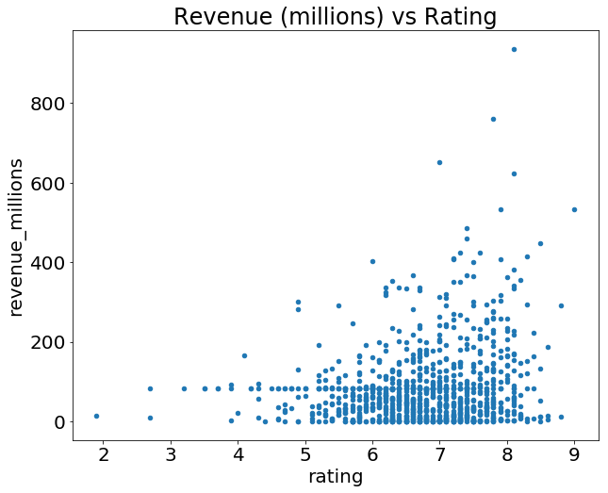
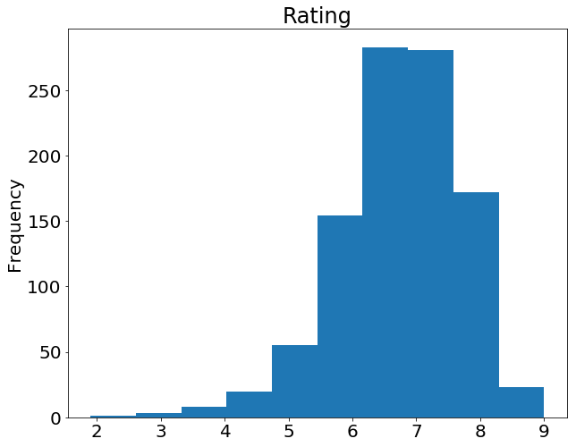
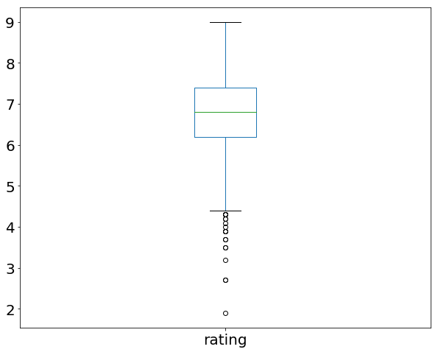
Plotting
Scatterplot:
movies_df.plot(kind='scatter', x='rating', y='revenue_millions', title='Revenue (millions) vs Rating')
Histogram:
movies_df['rating'].plot(kind='hist', title='Rating')
Compare with:
movies_df['rating'].describe()
BoxPlot:
movies_df['rating'].plot(kind="box");

Slide 28
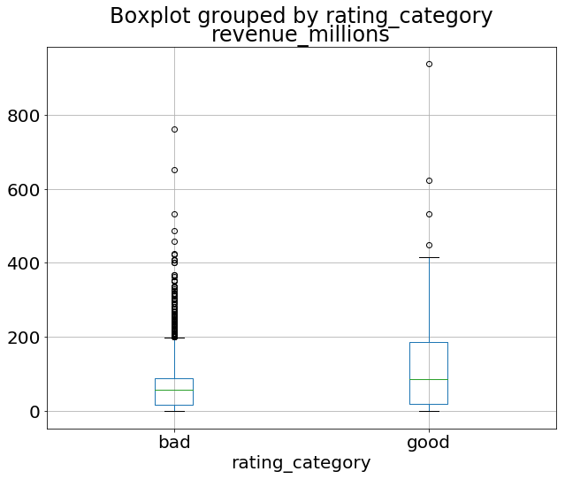
Plotting
movies_df.boxplot(column='revenue_millions', by='rating_category')

Slide 29
Plotting
Histogram of a categorical variable
movies_df['rating_category'].value_counts().plot(kind='bar', title='Rating category')

