Slide 1
Numpy, quickstart
Francesco Bellotti, Univ. Genova

Slide 2
Introduction
NumPy’s main object is the homogeneous multidimensional array. It is a table of elements (usually numbers), all of the same type, indexed by a tuple of non-negative integers. In NumPy dimensions are called axes (or dimensions).
For example, the coordinates of a point in 3D space [1, 2, 1] has one axis. That axis has 3 elements in it, so we say it has a length of 3.
In the example pictured below, the array has 2 axes. The first axis has a length of 2, the second axis has a length of 3.
[[ 1., 0., 0.],
[ 0., 1., 2.]]
NumPy’s array class is called ndarray. It is also known by the alias array. Note that numpy.array is not the same as the Standard Python Library class array.array, which only handles one-dimensional arrays and offers less functionality.
https://numpy.org/devdocs/user/quickstart.html

Slide 3
Basics
Attributes of an ndarray (alias: array) object
ndarray.ndim (number of axes/dmensions)
ndarray.shape (size of the array in each dimension/axis)
ndarray.size
ndarray.dtype (type of the elements)
Etc.
Array creation, np.arange(10)
Reshape
Arithmetic operators on arrays apply elementwise. A new array is created and filled with the result.
Unlike in many matrix languages, the product operator * operates elementwise in NumPy arrays. The matrix product can be performed using the @ operator (in python >=3.5) or the dot function or method

Slide 4
Basics
When operating with arrays of different types, the type of the resulting array corresponds to the more general or precise one (a behavior known as upcasting).
Many unary operations, such as computing the sum of all the elements in the array, are implemented as methods of the ndarray class.
By default, these operations apply to the array as though it were a list of numbers, regardless of its shape. However, by specifying the axis parameter you can apply an operation along the specified axis of an array:

Slide 5
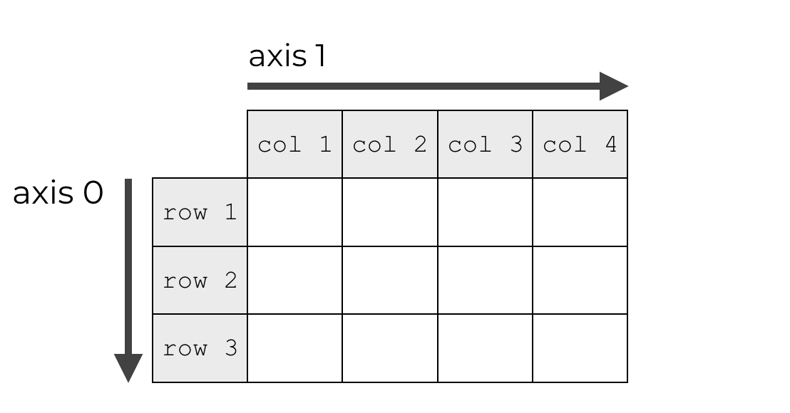
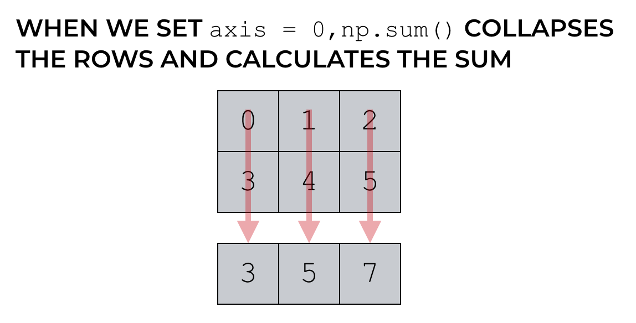
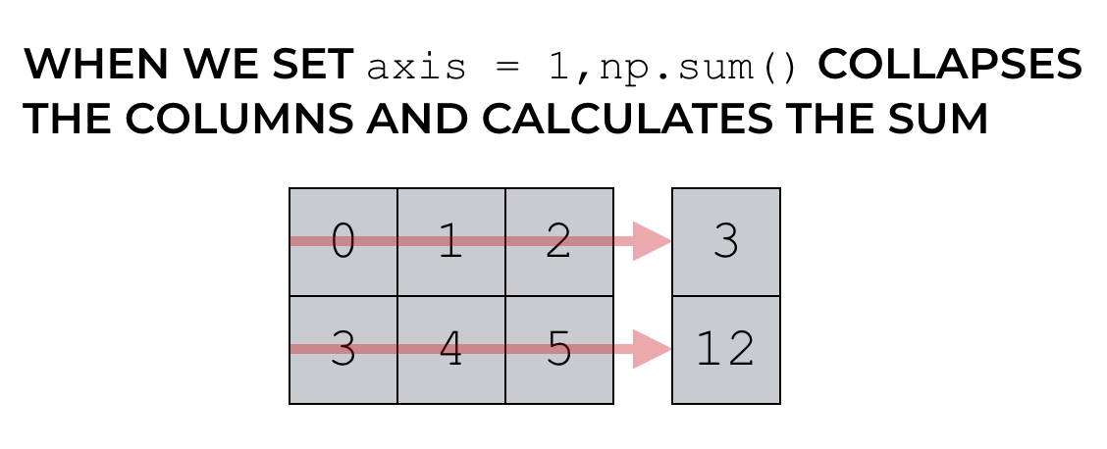
Axes

Slide 6
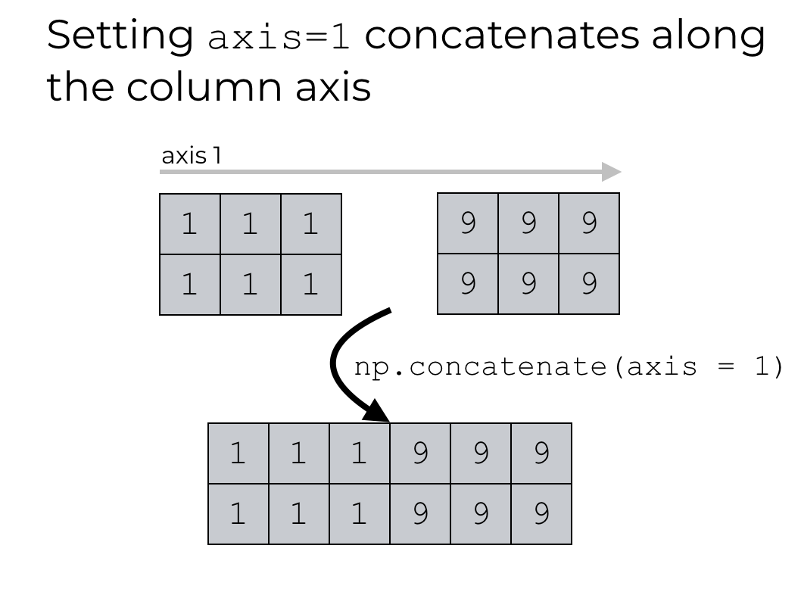
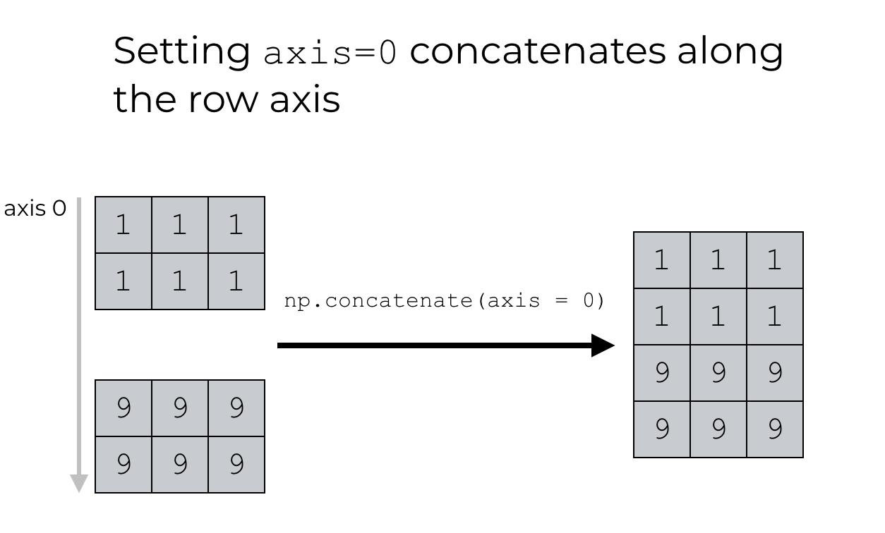
Concatenate()

Slide 7
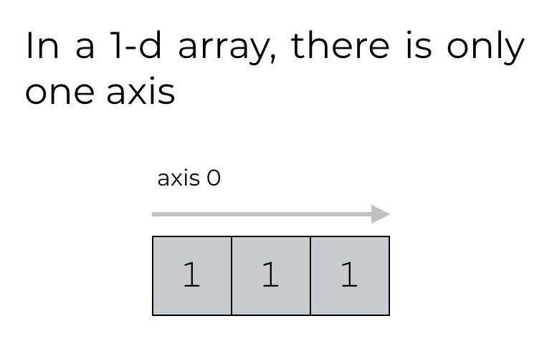
1d arrays

Slide 8
Universal functions
NumPy provides familiar mathematical functions such as sin, cos, and exp. In NumPy, these are called “universal functions”(ufunc). Within NumPy, these functions operate elementwise on an array (multidim), producing an array (multidim) as output.

Slide 9
Indexing, slicing and iterating
One-dimensional arrays can be indexed, sliced and iterated over, much like lists and other Python sequences
np.fromfunction, to create multidimensional arrays, with values obtained through a function
When fewer indices are provided than the number of axes, the missing indices are considered complete slices:
The expression within brackets in b[i] is treated as an i followed by as many instances of : as needed to represent the remaining axes. NumPy also allows you to write this using dots as b[i,...].
The dots (...) represent as many colons as needed to produce a complete indexing tuple.

Slide 10
Indexing, slicing and iterating
Iterating over multidimensional arrays is done with respect to the first axis:
for row in b:
... print(row)
However, if one wants to perform an operation on each element in the array, one can use the flat attribute which is an iterator over all the elements of the array:
for element in b.flat:
... print(element)
The reshape function returns its argument with a modified shape, whereas the ndarray.resize method modifies the array itself
If a dimension is given as -1 in a reshaping operation, the other (missing) dimension(s) are automatically calculated
Several arrays can be stacked together along different axes:
np.vstack(), np.hstack()
The function column_stack stacks 1D arrays as columns into a 2D array. It is equivalent to hstack only for 2D arrays

Slide 11
Copying and views
Simple assignments make no copy of objects or their data
(i.e. the underlying object is the same).
Python passes mutable objects as references, so function calls make no copy.
View or Shallow Copy
Different array objects can share the same data. The view method creates a new array object that looks at the same data.
Different shapes are possible
Slicing an array returns a view of it
The copy method makes a complete copy of the array and its data.
Sometimes copy should be called after slicing if the original array is not required anymore. For example, suppose a is a huge intermediate result and the final result b only contains a small fraction of a, a deep copy should be made when constructing b with slicing:

