Slide 1
Managerial Economics Introduction
Franz Ostrizek

Slide 2
What is the Course About?
Understand markets and the position of firms within them.

Slide 3

Example:
AI Technology

Slide 4
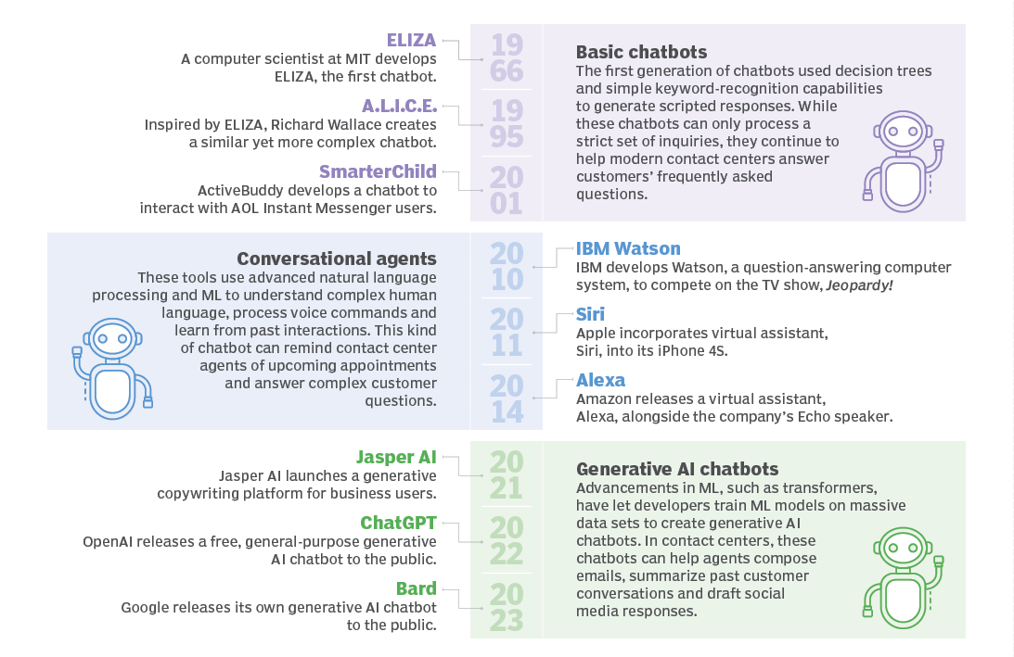

Slide 5
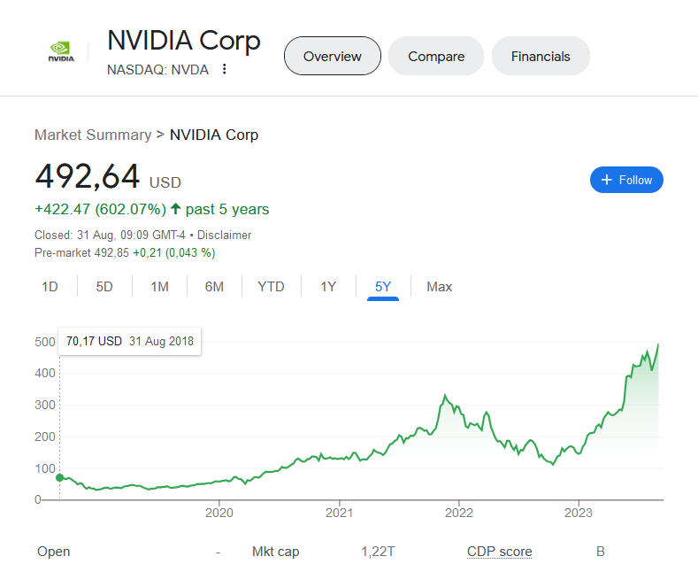

Slide 6
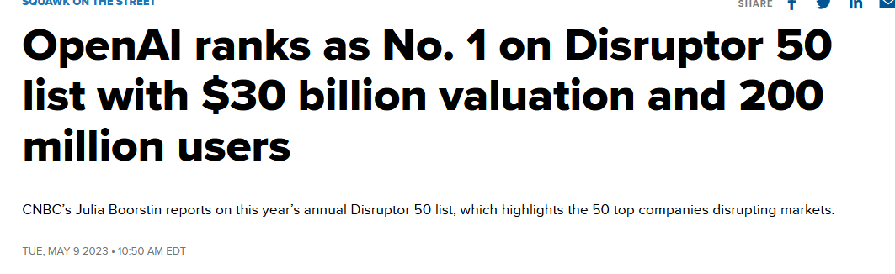

Slide 7
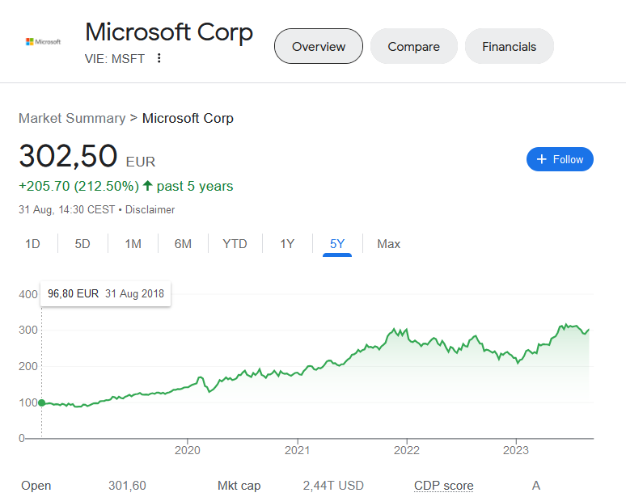

Slide 8
Course Content
Competitive Markets: Demand and Supply
Market Structures: Monopoly and Oligopoly
Game Theory
Sequential Game: Entry, Outsourcing, and Cooperation
Market Failures: Externalities
Market Design: Auctions and Platforms
Notes:
Entry and Exit?
Make or Buy? (Nvidia video case?)
Information?

Slide 9

Example:
Climate Change
and Policy

Slide 10
Class Structure
Before Class
Preparatory readings/videos/exercises
Some optional to “catch up”
No need to read the slides
In Class
Lecture
Discussion and in-class examples
Feel free to use a laptop… to take notes and participate
Bring some electronic device with an internet connection for in-class games
After Class
I’ll post/link further reading (not required for the exam)

Slide 11
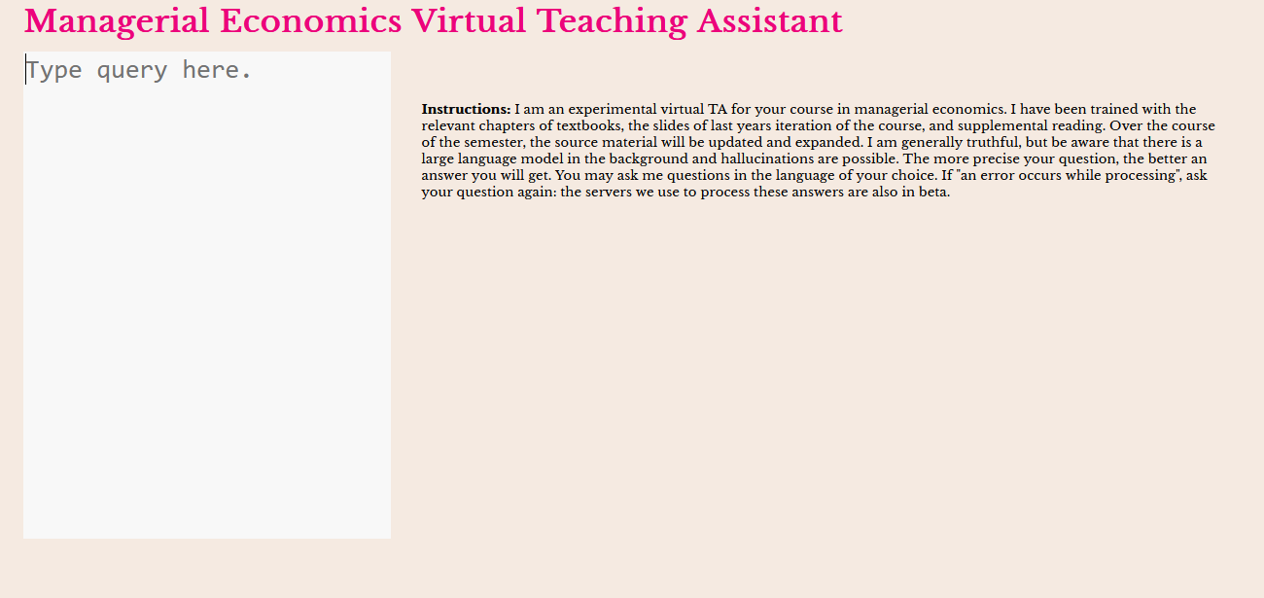

Slide 12
Evaluation
50%: in-class final exam
Largely Multiple-Choice Format
50%: Portfolio
Collection of short written works, produced over the semester
Some as group projects, some individual
See syllabus:
Use Demand-Supply analysis to decide whether a new plant is profitable
Use game theory to analyse corporate take-over offers.
2-3 more

