Slide 1
Managerial Economics Competitive Markets: Supply and Demand
Franz Ostrizek

Slide 2
Where do Prices come from?
It is the rare thing, Euthydemus, which is the precious one, and water is cheapest, even though [...] it is the best.
- Plato, Euthydemus
Diamond-Water Paradox
Why are diamonds, which are useless, very valuable, but water, which is essential, cheap?
More generally, what are the forces determining the price of a product?

Slide 3
Lecture Plan
Trading Experiment
Markets: Supply and Demand
Analyzing the Experiment
Shocks and Policies
Firms in Competitive Markets: Understanding Supply

Slide 4
Trading Experiment

Slide 5
Experiment: Setting
I need 8 volunteers
Some of you are sellers
unit production cost for a limited number of units
Trying to maximize your profit: price obtained – cost
Others are buyers
given valuation for some units
Trying to maximize surplus: valuation for unity – price paid
Don’t need to sell/buy all your units, but trade to maximize your total profits/surplus!

Slide 6
Experiment: Instructions
Rules
Forbidden to buy & then resell!
I will record trading prices.
You’ll have 5 minutes to trade; free-form!

Slide 7
Markets: Supply and Demand

Slide 8
Demand Curve
Price
Total quantity demanded at a given price
Everything else held constant
If the price decreases:
Current purchasers may buy more
New purchasers may enter the market
Demand
quantity

Slide 9
Demand Curve
Price | Quantity
4 | 20
8 | 10
16 | 5
Price
16
8
4
0 5 10 15 20
Quantity

Slide 10
Supply Curve
Price
Total quantity supplied at given price
Everything else held constant
If the price increases
Current firms may sell/produce more
Inactive firms may (re)enter the market
What determines exactly how much a competitive firm supplies?
Detailed answer next time
Supply
quantity

Slide 11
Market Equilibrium
Perfect Competition
Key Assumptions
Many small and independent buyers and sellers
Homogeneous product of known quality
Information about prices
Good first approximation for many markets, never perfect
price
Supply
p*
Demand
Q*
quantity

Slide 12
Finding Equilibrium
Excess supply
price
Supply
p_{H}
p*
p_{L}
Demand
Excess demand
Q*
quantity
In the long run, a “perfectly competitive market” tends towards equilibrium

Slide 13
Finding Equilibrium
How do markets find equilibrium?
Price too low: competition among buyers
Price too high: competition among sellers
Does this always work?
Can depend on institutions
Short run vs. long run
Lags and leads – hog-cycles
General equilibrium: can be more complex
price
Supply
p*
Demand
Q*
quantity

Slide 14
Taking Stock
Know how to identify perfectly competitive markets
Demand curve represents at every price total quantity demanded at that price
Usually slope down
Supply curve represents at every price total quantity supplied at that price
Usually slope up
Market price is determined by the intersection of supply and demand curves
Individual firms and consumers have no influence on the price
Notes:
Examples for perfectly competitive
How good of an approximation: ranking (?) wooclap question

Slide 15
Analyzing the Experiment

Slide 16
Data
2 of each type: 8 market participants
Work out your guess of what the typical trading price was
You can construct supply/demand curves
Or use any other method you are willing to explain
 | Unit Cost/Value | # Chips
Buyer A | 55 | 3
Buyer A | 10 | 2
Buyer B | 25 | 3
Buyer B | 20 | 2
Seller C | 15 | 4
Seller C | 25 | 3
Seller D | 10 | 3
Notes:
CHANGE: Improve structure: need to be able to have the data and the submission on one slide
Work by discussing in PAIRS (or groups of three if at the end of a row)
In 10 minutes I will collect a piece of paper with:
Your guess on the price/prices at which trading took place (and quantity traded if you want).
The explanation of your reasoning. You might want to start constructing the INDIVIDUAL demand and supply of your type of trader.
Then think about other types, and the AGGREGATE supply and demand.
Or try to use other more intuitive methods!
HAND OUT BLANK SHEETS – you have 10 minutes (most)

Slide 17

Demand of Buyer A
Valuation | # Chips
55 | 3
10 | 2
Price
55
10
$$D_{A}(p)$$
0 1 2 3 4 5
Quantity

Slide 18

Demand of Buyer B
Valuation | # Chips
25 | 3
20 | 2
Price
25
20
$$D_{B}(p)$$
0 1 2 3 4 5
Quantity

Slide 19

Aggregating Demand
$$D\left(p\right)=D_{A}\left(p\right)+D_{B}(p)$$
Price
Buyer A
55
25
20
10
Buyer B
Buyer B
Buyer A
0 1 2 3 4 5 6 7 8 9 10
Quantity
Notes:
Explain better: FIXING the price, add up quantity demanded/supplied
D(p)=D_1(p)+D_2(p)….

Slide 20
Supply of Seller C
Cost | # Chips
15 | 4
25 | 3
Price
25
15
0 1 2 3 4 5 6 7
Quantity

Slide 21
Supply of Seller D
Cost | # Chips
10 | 3
Price
10
0 1 2 3
Quantity

Slide 22
Aggregating Supply
Price
25
15
Seller C
10
Seller C
Seller D
0 1 2 3 4 5 6 7 8 9 10
Quantity

Slide 23
Excel Demo

Slide 24
Equilibrium
demand
Price
30
25
20
15
10
supply
0 1 2 3 4 5 6 7 8 9 10
Quantity

Slide 25
Questions about the Experiment
What prices emerged in the experiment?
Does it fit with the theory on supply and demand?
Questions we will examine in the next lectures:
Is the outcome efficient?
Is the outcome fair?
What happens if participants collude or have market power?
Notes:
Learning points:
Model is not descriptive. In the model there is neither haggling, nor learning.
But predicts well!
It works at getting the MEAN right , but predicts no price dispersion due to initial trading. Can improve the model by modelling bargaining…
Is outcome efficient? Surplus maximization.
Attempts of monopolization. Enforcement.
What if speculation is allowed?

Slide 26
Taking Stock
To construct aggregate market demand start with individual demands
For each price add up the individual demands to obtain the aggregate demand
Same procedure for supply

Slide 27
Digging Deeper: Shocks and Policies

Slide 28
Shocks and Policies
Supply and demand curves plot price-quantity relationship holding everything else constant
Changes in “everything else” shift the curves
Supply curve shifts because of changes in
Technology
Input prices
Policy
Expectations about the future
Demand curve shifts because of changes in
Income
Tastes
Price of substitute or complement goods
Expectations about the future
Notes:
RESTRUCTURE: 2 basic examples, then lessons for supply and demand analysis:
Never reason from a price change
Policy can get in the way
Market forces may find a way
Looking at it in the right space

Slide 29
Example: Wheat and War
In 2021, Ukraine exported $5.87B in Wheat, making it the 5th largest exporter of Wheat in the world.
Russia attacked Ukraine on Feb 24, 2022
What is the impact in the wheat market?
Negative supply shock: curve shifts in
Increase in EQ price
Decrease in EQ quantity

Slide 30
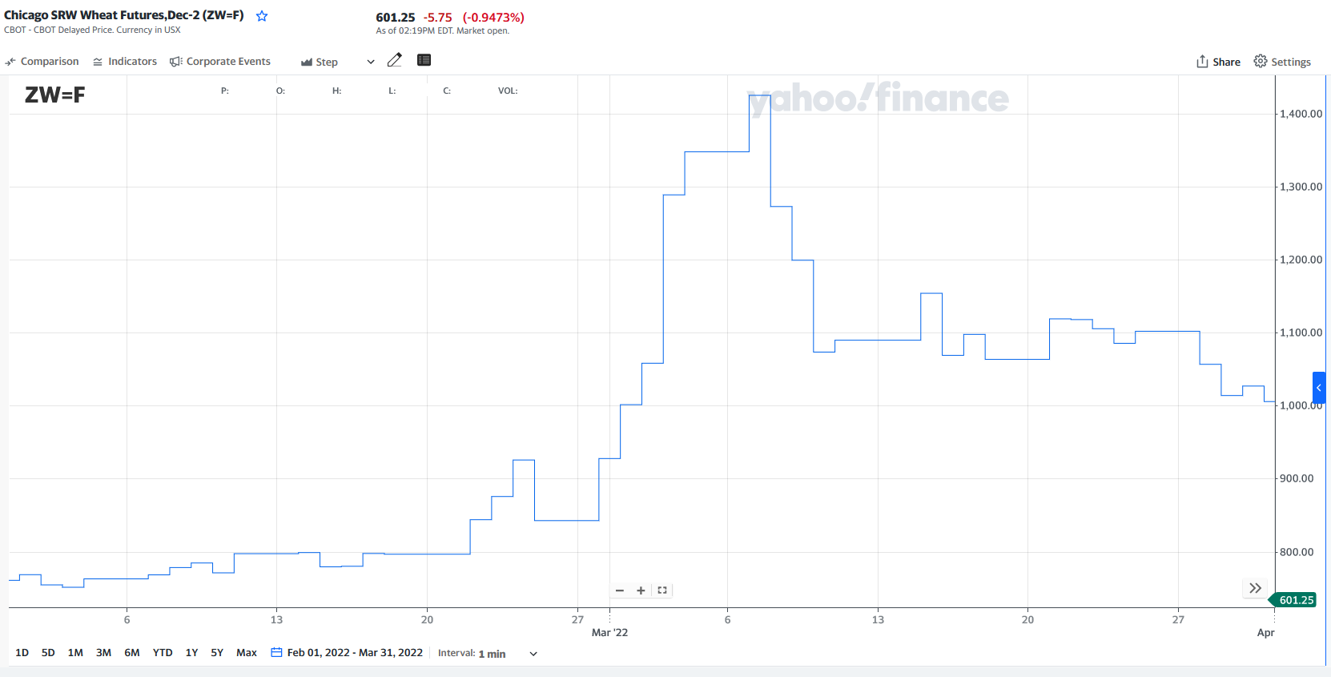
What do the Markets say?

Slide 31
Venezuela
Increase in oil revenue led to growth >10% in 2006
Still, unprecedented shortages of basic food including chicken and other meat
How is that possible?

Slide 32
The Effect of Price Controls
Final equilibrium without price control
Price of chicken
Price cap
Shortage
Initial equilibrium
Quantity of chicken
Q_{S}
Q_{D}

Slide 33
Firms in Competitive Equilibrium: Understanding Supply

Slide 34
Supply Curve
What determines how much a competitive firm supplies?
Recall: Price is determined by Demand and Supply
Competitive firm is a price-taker.
Question to be answered: Given a price, how much does a firm want to supply?

Slide 35

Objective of the Firm
Supply curve corresponds to production/sale decision of firms
Need to understand the objective of firms

Slide 36
Profit Maximization
Generally, assume profit maximization
Profit = Revenue – Cost
Economic Profit not necessarily equal to accounting profit
E.g. costs of fully depreciated capital
Principle of Optimality (equimarginal principle): at the optimal quantity Marginal Revenue = Marginal Cost

Slide 37
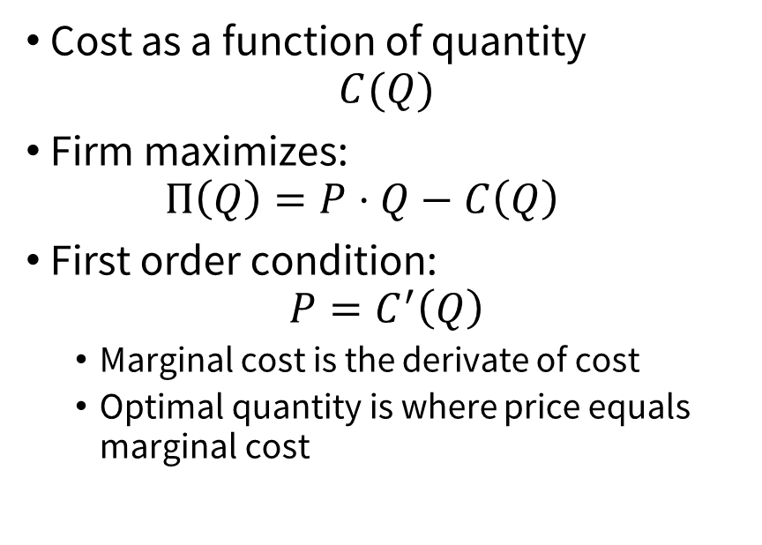
The Firm’s Problem in a Competitive Market
Intuitively
Formally
In a perfectly competitive market, firms are price takers
Marginal Revenue = Price
The optimal level of production is a quantity such that
Marginal Cost = Price
Cost as a function of quantity
$$C(Q)$$
Firm maximizes:
$$Π\left(Q\right)=P⋅Q−C\left(Q\right)$$
First order condition:
$$P=C^{′}\left(Q\right)$$
Marginal cost is the derivate of cost
Optimal quantity is where price equals marginal cost
37
Notes:
Where else could revenue come from??

Slide 38
Timing of Production Decisions
time
Build factory?
How much to produce?

Slide 39
Timing of Production Decisions: Short Run
Short Run
time
Build factory?
How much to produce?

Slide 40
Timing of Production Decisions: Long Run
Long Run
time
Build factory?
How much to produce?

Slide 41
Short-Run vs Long-Run Perspectives
Short Run
Long Run
Typically, in the short run:
the plant has already been built (capital is fixed)
Material and energy costs variable
Labor? Depends on country and industry
The firm decides how much to produce
Typically, in the long run:
All costs are variable
The firm decides whether to enter/exit the market

Slide 42
What is “long”? What is “short”?
Depends on your analysis
Can be useful to define a new timeframe as soon as:
- A fixed cost becomes variable
- A new type of decision has to be made
Guides the approach to the strategic decision

Slide 43
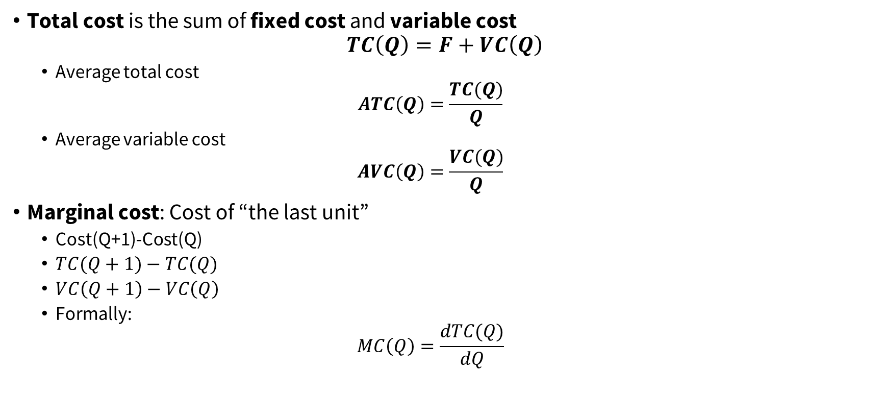
Cost Functions
Total cost is the sum of fixed cost and variable cost
$$TC\left(Q\right)=F+VC\left(Q\right)$$
Average total cost
$$ATC\left(Q\right)=\frac{TC(Q)}{Q}$$
Average variable cost
$$AVC\left(Q\right)=\frac{VC(Q)}{Q}$$
Marginal cost: Cost of “the last unit”
Cost(Q+1)-Cost(Q)
$TC(Q+1)−TC(Q)$
$VC\left(Q+1\right)−VC\left(Q\right)$
Formally:
$$MC\left(Q\right)=\frac{dTC(Q)}{dQ}$$

Slide 44
Curves
Price, Cost
(€/unit)
MC
ATC
AVC
Output
Properties of these curves?

Slide 45
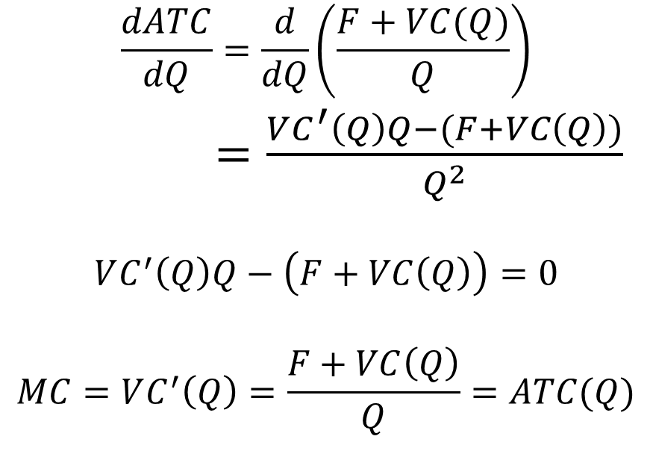
Proof
Formal
Intuitively
$$\frac{dATC}{dQ}=\frac{d}{dQ}\left(\frac{F+VC(Q)}{Q}\right)$$ $=\frac{VC^{′}\left(Q\right)Q−(F+VC\left(Q\right))}{Q^{2}}$
$$VC^{′}\left(Q\right)Q−\left(F+VC\left(Q\right)\right)=0$$
$$MC=VC^{′}\left(Q\right)=\frac{F+VC\left(Q\right)}{Q}=ATC(Q)$$
If the cost of the next unit is smaller than the average cost so far, adding it reduces the average.
If the cost of the next unity is greater than the average cost so far, adding it increases the average.
So, the average cost is flat (lowest) when it equals marginal cost
45
Notes:
TODO: Align properly (do one multiline equation

Slide 46

Short Run Production at P^{HIGH}?
Price, Cost
(€ /unit)
MC
ATC
P^{HIGH}
AVC
Q¹
Q³
Q⁵
Q⁶
Output
Q²
Q⁴

Slide 47

Short Run Production at P^{MIDDLE}?
Price, Cost
(€ /unit)
MC
ATC
AVC
P^{MID}
Q¹
Q²
Q³
Q⁴
Q⁵
Output

Slide 48

Short Run Production at P^{LOW}?
Price, Cost
(€ /unit)
MC
ATC
AVC
P^{LOW}
Q¹
Q²
Q³
Q⁴
Output

Slide 49
The Short-Run Supply Curve
Price, Cost
(EUR/unit)
MC
AVC
Output
If P ≥ AVC produce at Q such that MC(Q)=P

Slide 50

The Short-Run Supply Curve: Formally
In the short run fixed cost do not matter: maximize
$PQ – VC(Q)$
Marginal analysis: choose quantity Q such that
$P = MC (Q)$
But I should at least make positive profits:
$PQ – VC (Q) ≥ 0$
This means $P ≥ AVC (Q)$
50

Slide 51

The Long-Run Supply Curve: Formally
In the long run fixed cost do matter: maximize
$PQ –TC(Q)$
Marginal analysis: choose quantity Q such that
$P = MC (Q)$
But I should at least make positive profits:
$PQ –TC \left(Q\right)≥ 0$
This means:
$P≥ATC \left(Q\right)$
51

Slide 52
The Long-Run Supply Curve
Price, Cost
(EUR/unit)
MC
ATC
Output
If P ≥ ATC produce at Q such that MC(Q)=P

Slide 53
Recall: Short-Run Supply
Price, Cost
(EUR/unit)
MC
AVC
Output
If P ≥ AVC produce at Q such that MC(Q)=P

Slide 54
Taking Stock
How to construct short-run and long-run supply
In the short run produce if P ≥ AVC and then produce at quantity Q such that MC(Q) = P.
Firms should sometimes produce even if the price they obtain is lower than their average total cost
They lose money overall but start reimbursing their fixed cost
In the long run produce if P ≥ ATC and then produce at quantity Q such that MC(Q) = P.

