Slide 1
Capstone Project
“Finding your next vacation spot”
Franziska Metge

Slide 2

Problem Description
We live in a world of travelers but we also live in a world of individuals with divers interests. It would be preposterous to assume that everybody enjoys exactly the same cities. Some people might enjoy cities with a good night life, while others want to travel to cities with a diverse cultural landscape.

Slide 3
Solution
A program which is able to find cities a user might find enjoyable based on an input city and venue landscape.
Results:
  table listing the similar cities,
  heat-map visualizing the similarity of these cities by venue occurrence
  scatter-plot using the cities coordinates
This material will enable the user to confidently select their next travel destination.

Slide 4
Data
Population data from UN
Coordinates pulled using geopy
Venue information pulled using Foursquare API
One-hot encoding using pandas.get_dummies () and pandas.groupby()
Population data from UN
City | Population Size | Country
Adrar | 200834.0 | Algeria
Ain Defla | 450280.0 | Algeria
Ain Temouchent | 299341.0 | Algeria
ALGIERS | 2712944.0 | Algeria
Final input table (one-hot encoding summarized by city
City | Population Size | Country | Latitude | Longitude | ATM | ... | Fast Food | ... | Zoo Exhibit
Ain Temouchent | 299341.0 | Algeria | 35.26 | -1.14 | 0 |  | 1 |  | 0
ALGIERS | 2712944.0 | Algeria | 36.77 | 3.06 | 0 | ... | 0 | ... | 0
Annaba | 442230.0 | Algeria | 36.89 | 7.75 | 0 |  | 0 |  | 0
Bejaı̈a | 559981.0 | Algeria | 36.75 | 5.06 | 0 |  | 0 |  | 0

Slide 5
Methods
Exploratory data analysis
  View city landscape in lower dimensonal space: PCA, t-SNE
  Look at number of venues per city: Histogram, Scatter-plot
find_next_vacation()
  Calculates distance matrix using the pdist from the scipy.spatial.distance package
  Returns k cities most similar in table format
  Visualizes results in heat map and scatter plot
get_information_on_next_vacation()
  Uses Foursquare API to look up venues of a selected city
  Returns list of venues in table format

Slide 6
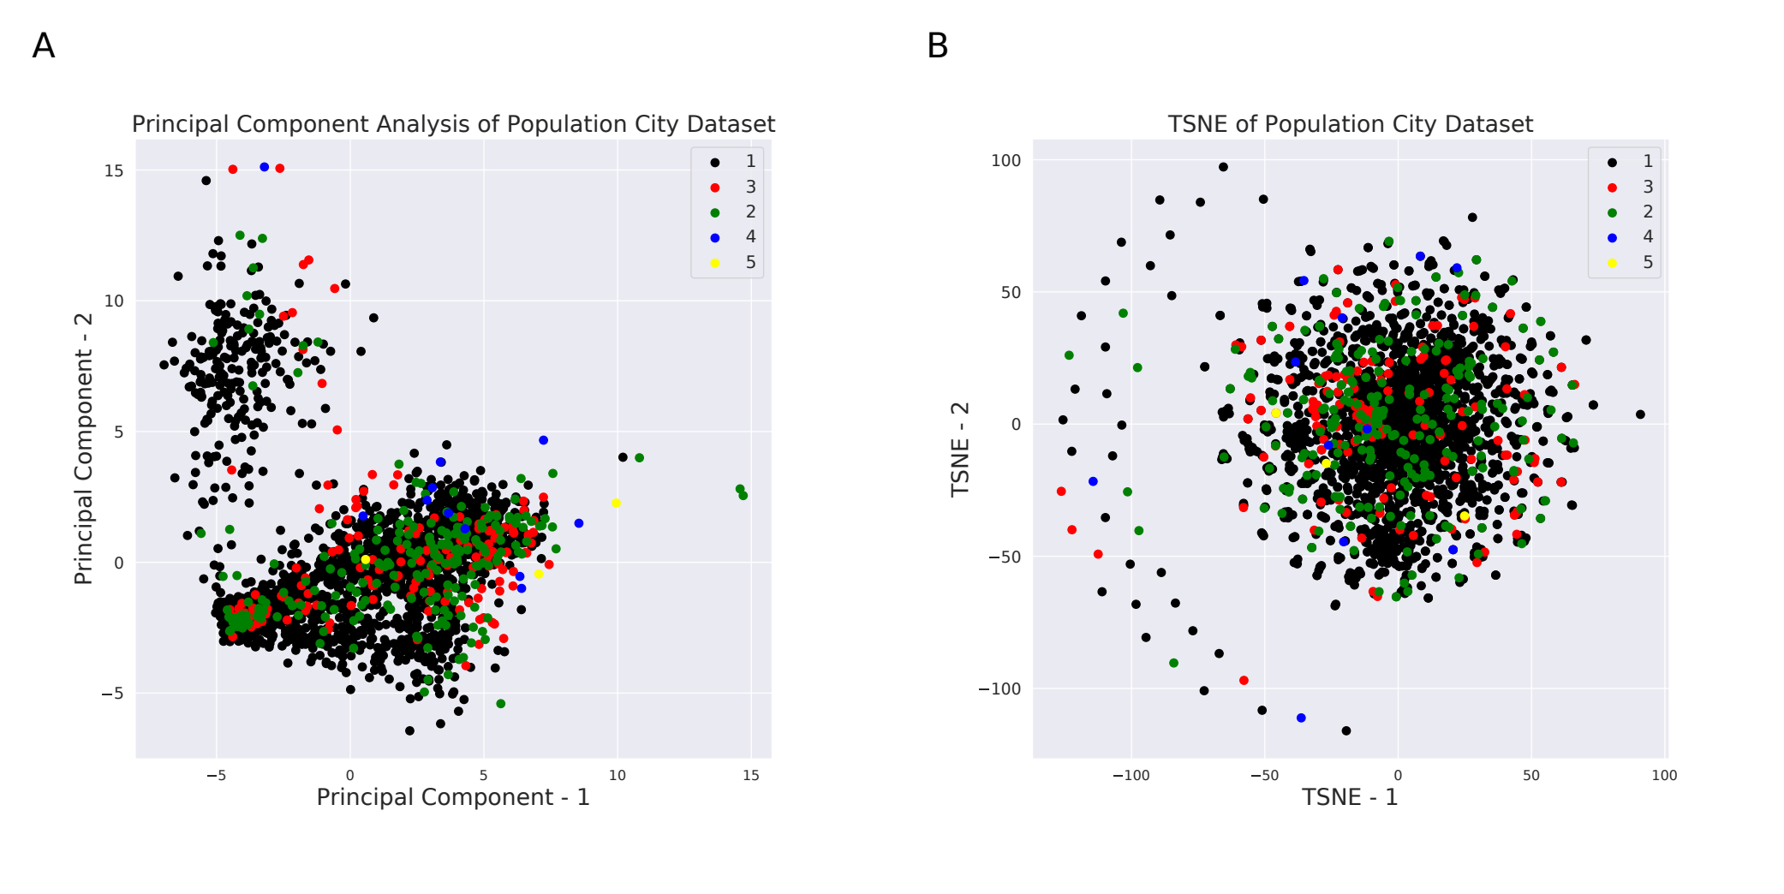
Results (PCA and t-SNE Embedding)
Both embedding show one dense cluster and a sparse cluster of cities
Clustering is not driven by population size

Slide 7
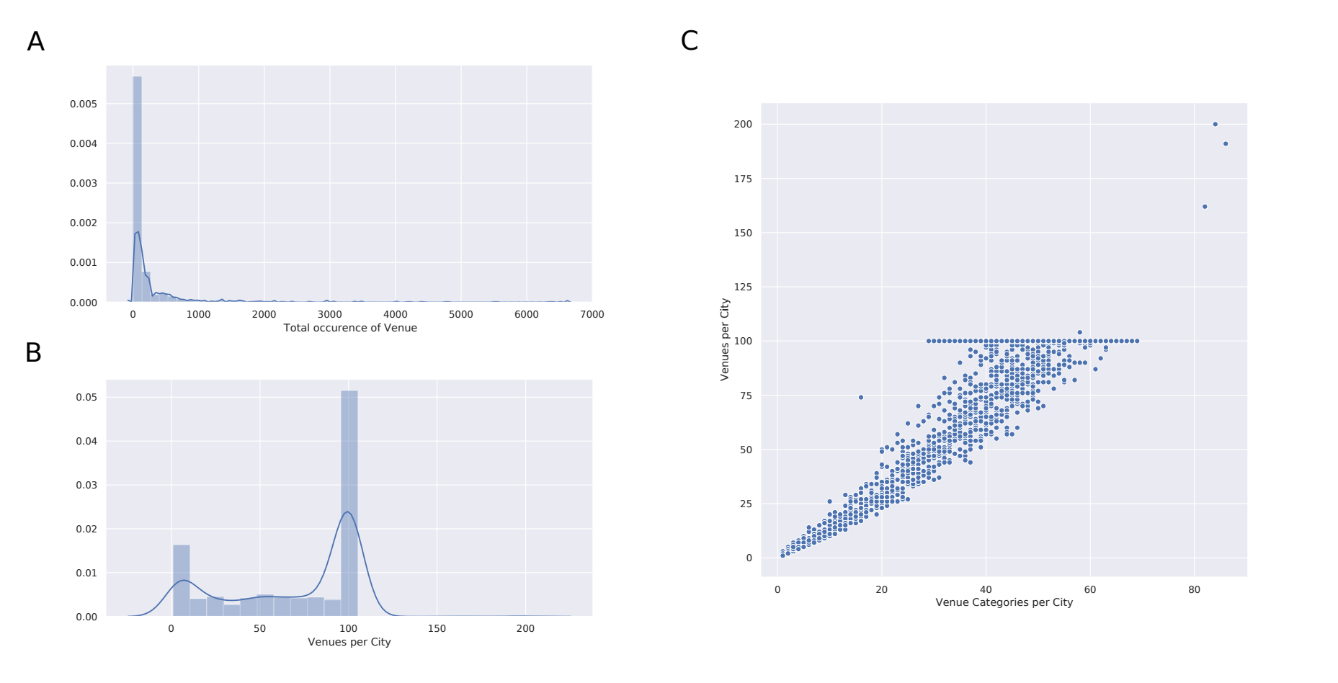
Results (Histogram and Scatter plot)
Majority of venue types occur seldom, while few categories appear more than 6000 times, such as coffee shops and hotels
Some cities have no reported venues. Foursquare limit of 100 venues per city becomes evident
Larger number of venues correlates with higher diversity of types of venues (R = 0.95)

Slide 8
Results (return table)
Function call:
  future_vacation_destination_Berlin = find_next_vacation(’BERLIN’, population_venue_data, 10, ’euclidean’)
Return table:
City | Population Size | Country | Latitude | Longitude | Art Gallery | ... | Coffee Shop | ... | Park | BERLIN
BERLIN | 3613495 | Germany | 52.517 | 13.3888 | 2 |  | 10 |  | 5 | 0.0
Toronto | 2956024 | Canada | 43.653 | -79.3839 | 1 |  | 11 |  | 7 | 14.071
Portland (OR) | 639863 | United States of America | 45.520 | -122.674 | 0 | ... | 13 | ... | 4 | 14.560
s-Gravenha | 514861 | The Netherlands | 52.074 | 4.26968 | 0 |  | 6 |  | 5 | 14.696
Pare Pare | 142391 | Indonesia | -4.005 | 119.623 | 0 |  | 10 |  | 0 | 14.730

Slide 9
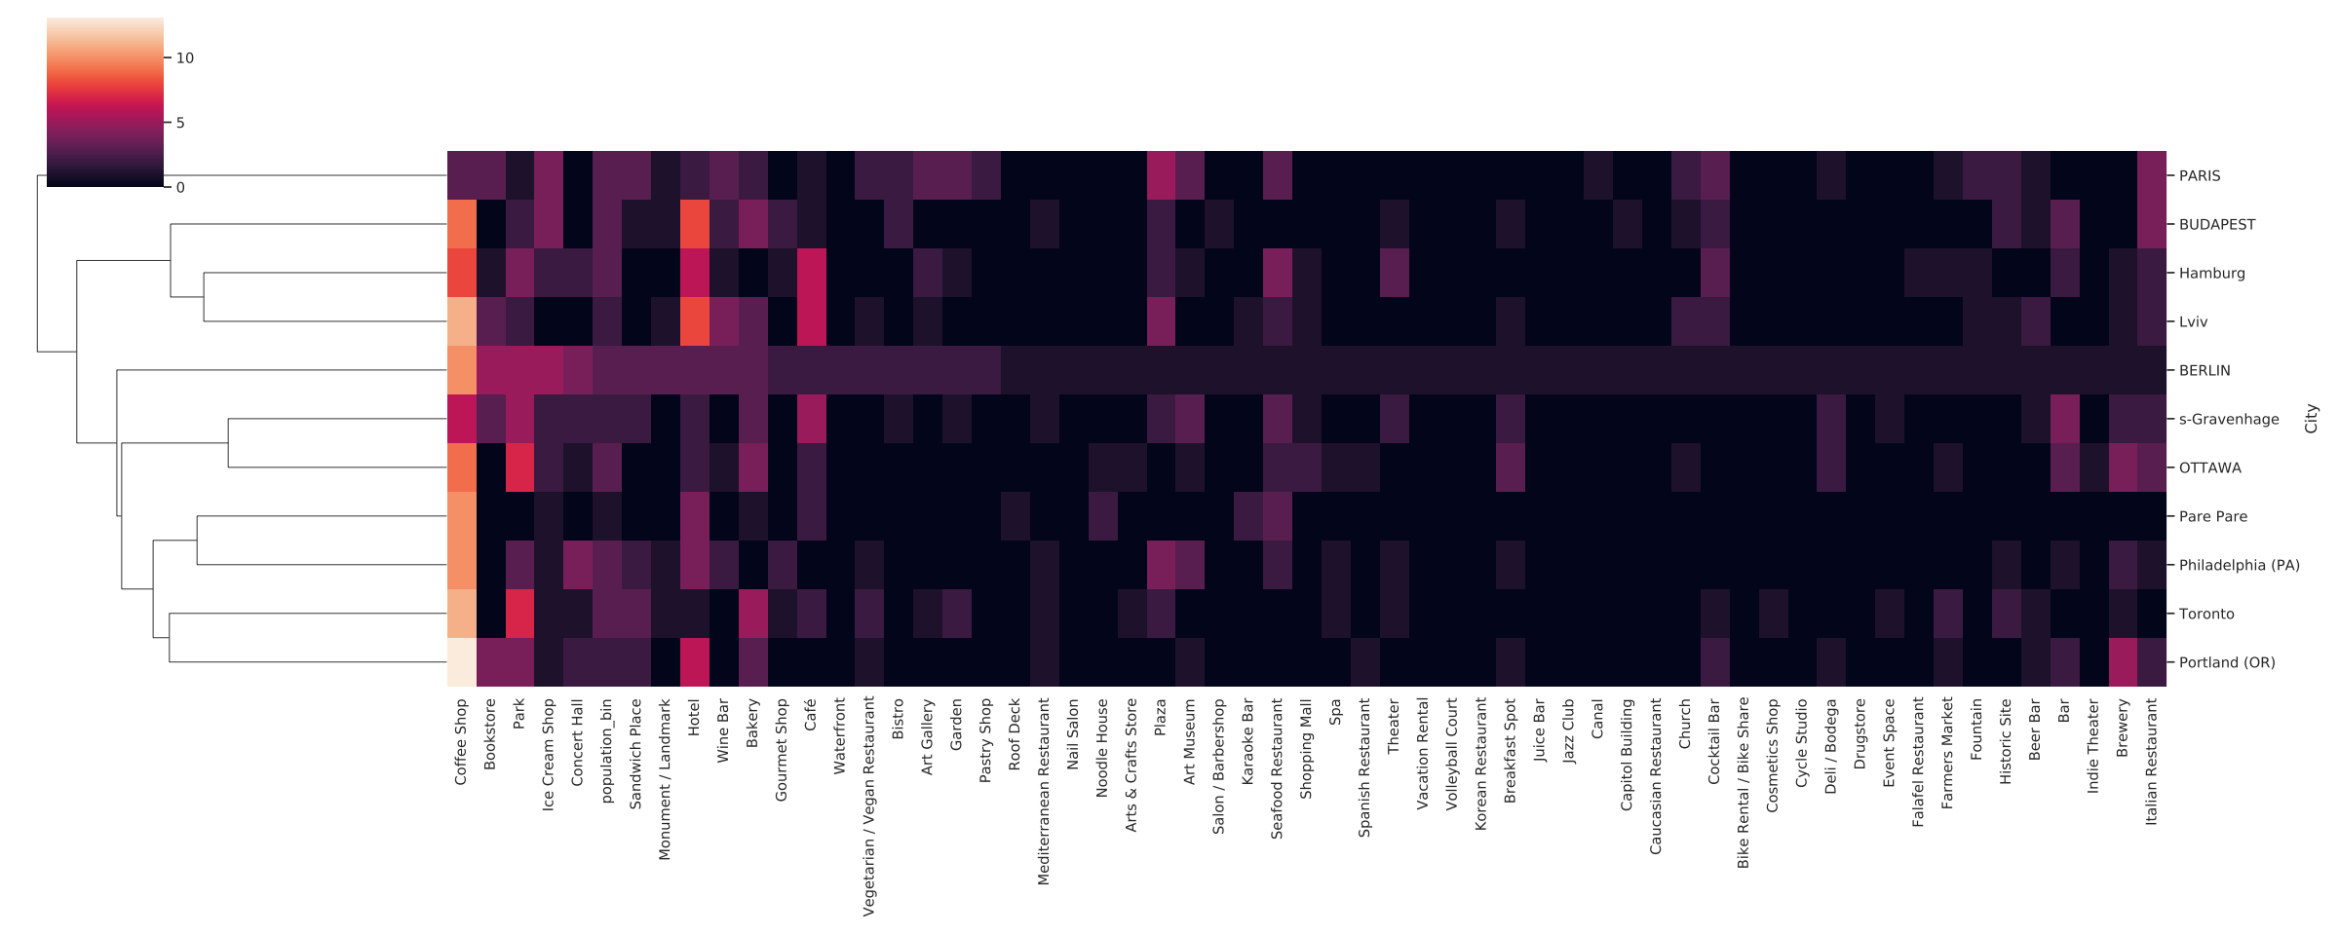
Results (Heat map)
Heat map of number of venues per category per city
Rows are ordered based on hierarchical clustering
Columns are ordered from most to least abundant venue category in Berlin

Slide 10
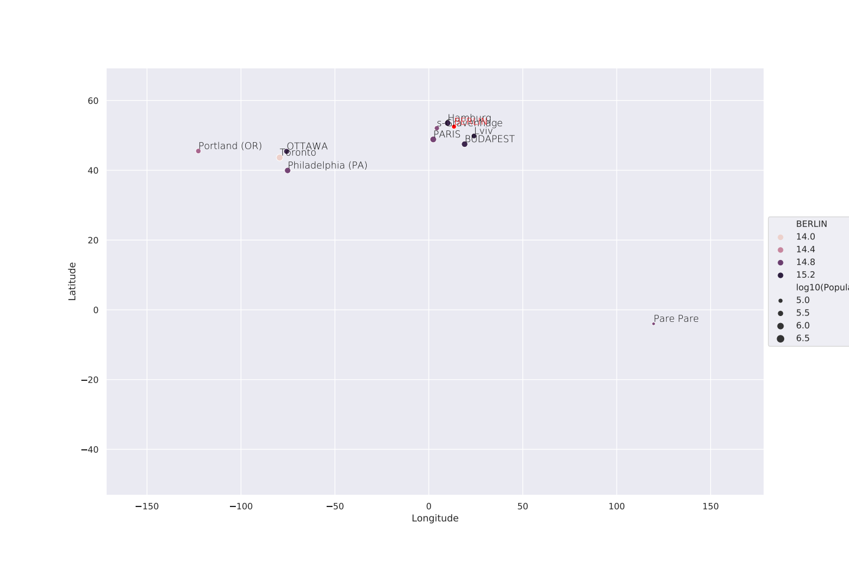
Results (Scatter plot)
“BERLIN” result cities form two cluster; one European and one North American

Slide 11
Results (return table 2)
Function call:
  future_vacation_destination_info = get_information_on_next_vacation( ’s-Gravenhage’, future_vacation_destination_Berlin, 20)
Return table:
City | City Latitude | City Longitude | Venue | Venue Latitude | Venue Longitude | Venue Category
s-Gravenhage | 52.07494555 | 4.26968022053 | De Kaasspeciaalzaak Ed Boele | 52.07856369 | 4.269423625 | Deli / Bodega
s-Gravenhage | 52.07494555 | 4.26968022053 | cafe madeleine | 52.07875093 | 4.276190053 | Tea Room
s-Gravenhage | 52.07494555 | 4.26968022053 | Zondag lunchroom | 52.07963034 | 4.268465460 | Café
s-Gravenhage | 52.07494555 | 4.26968022053 | Restaurant Rakang Thai | 52.07710976 | 4.278414389 | Thai Restaurant
s-Gravenhage | 52.07494555 | 4.26968022053 | Emma | 52.07672963 | 4.282775738 | Bar

Slide 12
Conclusion
In this Capstone project I developed a method to recommend future travel destinations to a user based on the similarity of their input city
In the return tables, the user obtains a comprehensive overview of similar cities as well as the venue landscape in the similar cities
The heat map representation of that venue landscape is more condensed and thus easier to interpret
The scatter plots representation of the similar cities helps the user to easily place the cities in a geographical relationship
I demonstrated that it is possible to find potential vacation destinations based on their venue landscape
With a little bit more work this could easily become a valuable app for travel agencies or travel websites

