Slide 1
DATA ANALYSIS PROJECT: Company STRATEGY 2020
Rockbuster Stealth

Slide 2
KEY QUESTIONS
Customer Setup:
Which countries are Rockbuster customers based in?
Where are customers with a high l ifetime value based?
Sales Figures:
Which movies contributed the most/least to revenue gain?
Do sales figures vary between geographic regions?
Rental Duration:
What was the average rental duration for all videos?

Slide 3
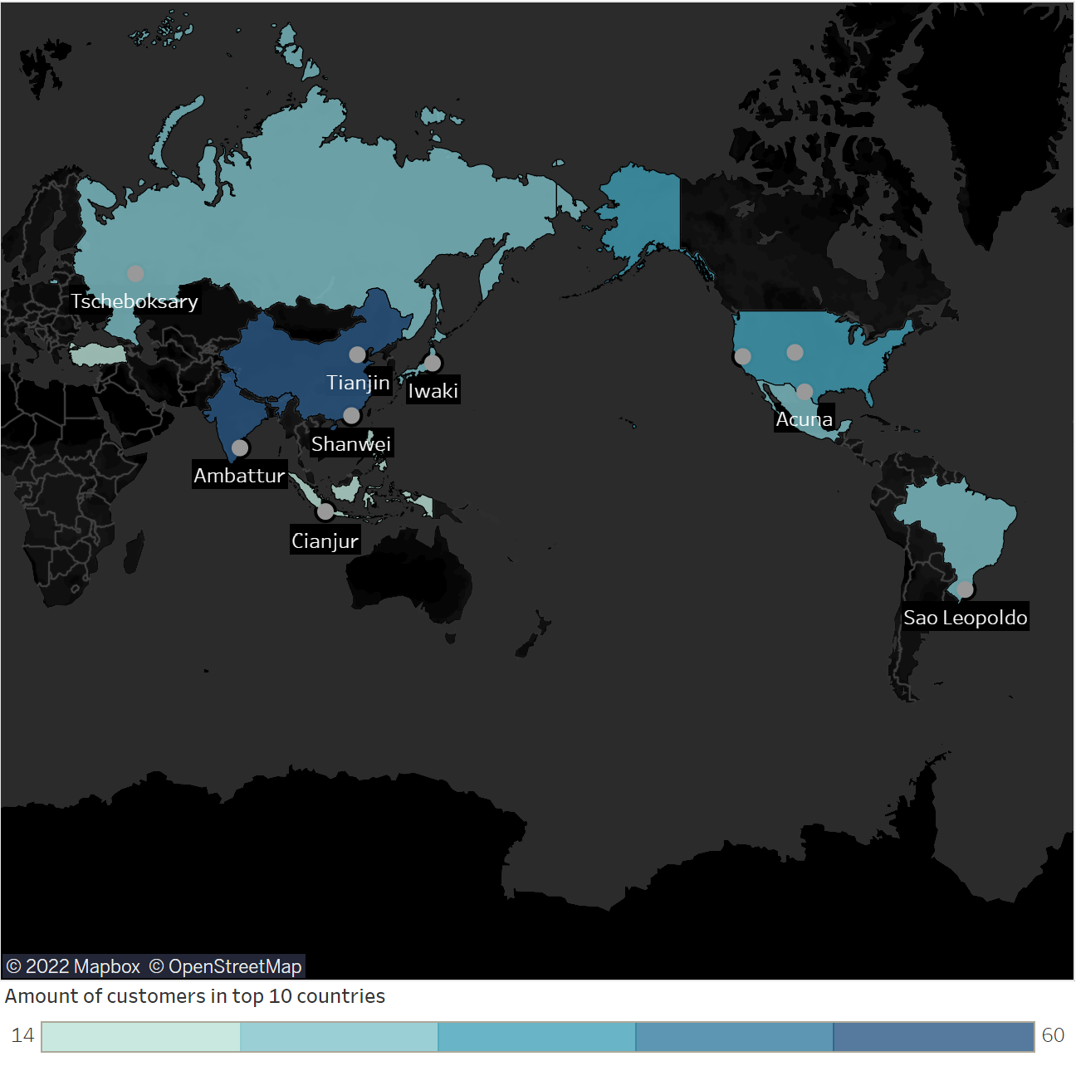
global customers setup
Top 10 countries and cities:
Top 5 customers:
First Name | Last Name | City | Country | Revenue
Arlene | Harvey | Ambattur | India | 111.76
Kyle | Spurlock | Shanwei | China | 109.71
Marlene | Welch | Iwaki | Japan | 106.77
Glen | Talbert | Acua | Mexico | 100.77
Clinton | Buffort | Auroroa | United States | 98.76
Sales figures in geographic regions:
Country | Total Revenue
United States | 256.35
China | 198.52
India | 111.76
Japan | 106.77
Mexico | 100.77

Slide 4
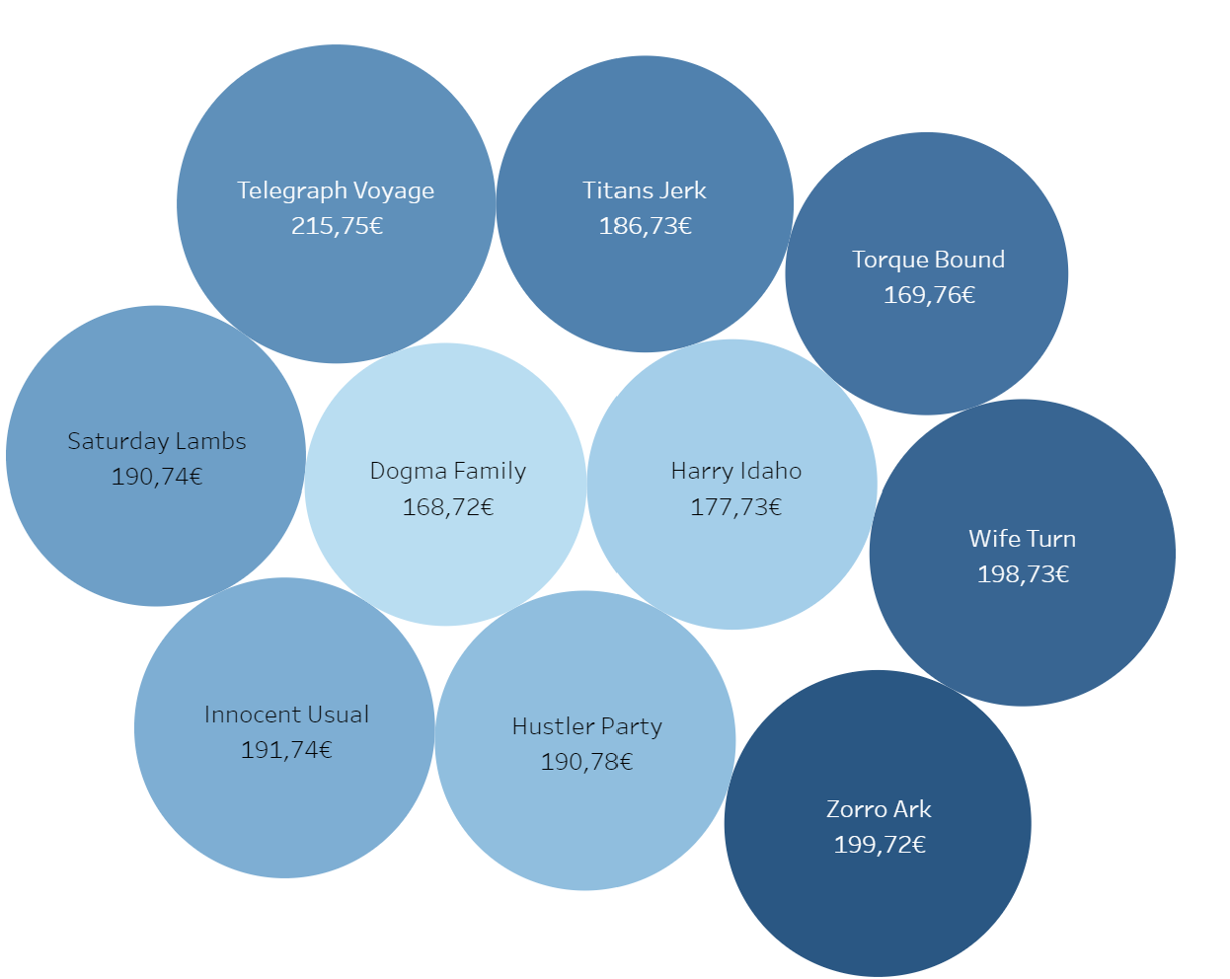
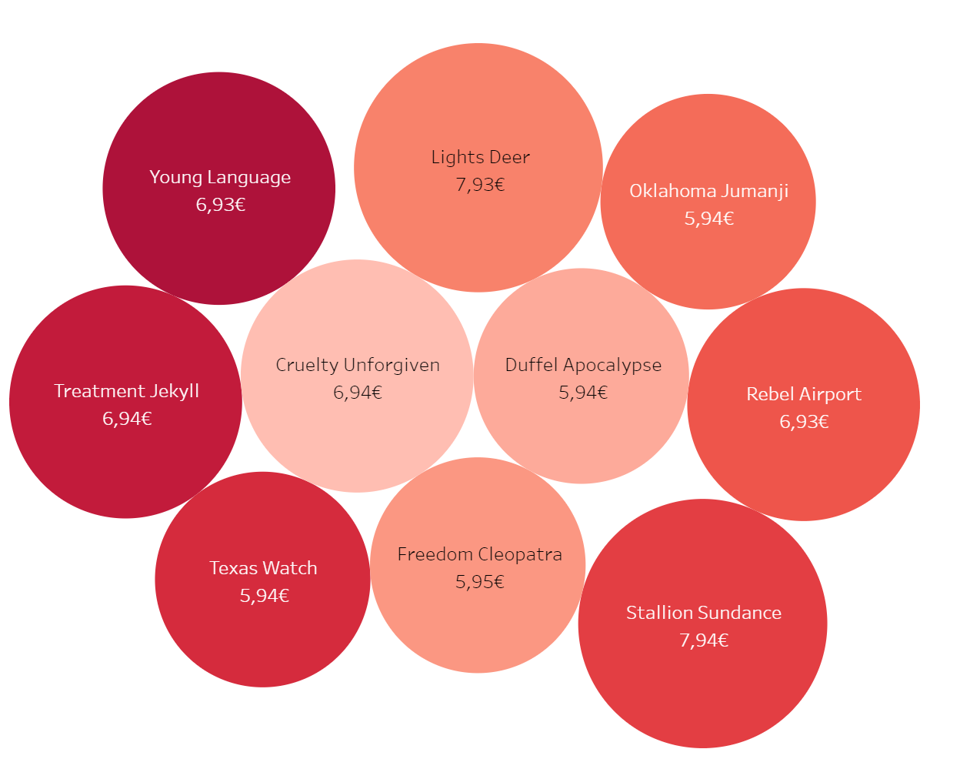
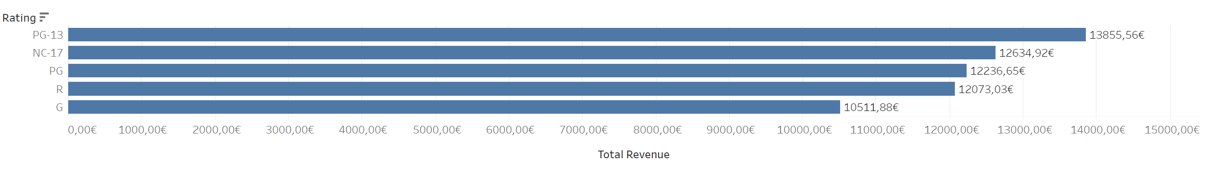
FilMS: ACHIEVED REVENUE
Highperformers.
Lowperformers.
Rockbusters total Revenue is : 61.312.64 €
This revenue was gained with a total rental duration of:
72056 days
PG-13 rated files sell 1.3 times as well as G-rated films.

Slide 5
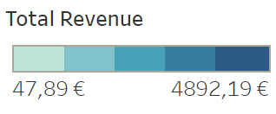
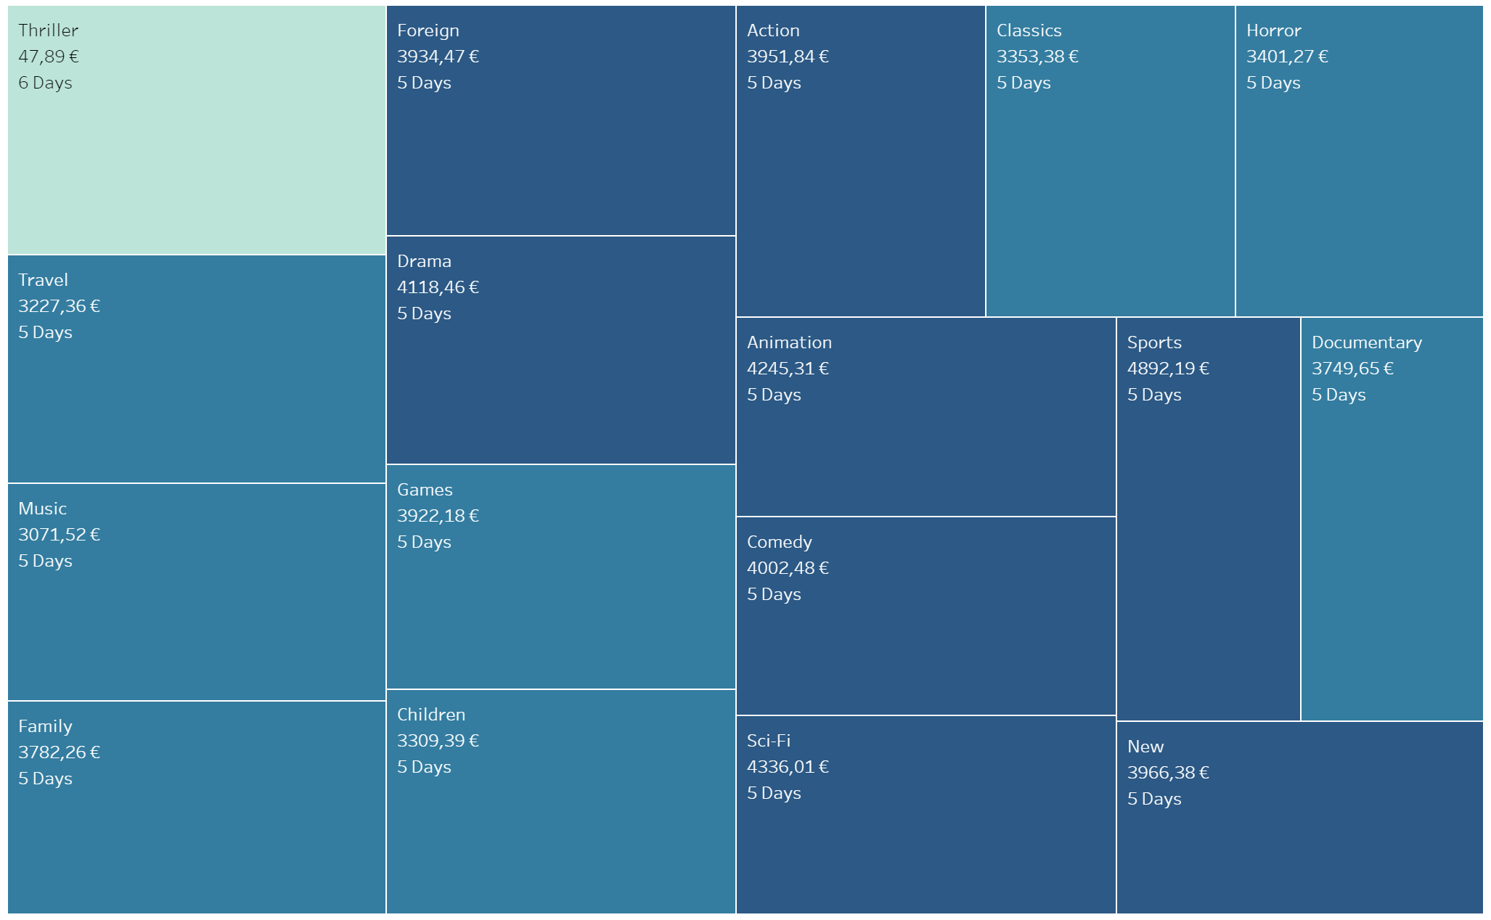
RENTAL DURATION
Although the overall average rental duration is about the same, the turnover figures of the genres differ greatly.
Total Amount of Rental Transactions:
14.596
Total Amount of Rental Days:
72.056
Average Rental Duration:
4.985
Maximum Rental Duration:
7
Minimum Rental Duration:
3

Slide 6
sUMMARY and Recommendation
CUSTOMER SETUP
SALES FIGURES
RENTAL DURATION
Focus the marketing budget on the leading countries:
United States
China
India
Japan
Mexico
Reward the top 5 customers.
Offer more films with PG-13 rating.
Investigate further why some films are more popular than others.
The overall average rental duration is the same for all Genres.
Focus the marketing budget on the leading Genres.
Investigate further if Genres have different popularity in different regions.

Slide 7
THANK YOU
Franziska Aman​
FranziskaAman@rockbuster.com
19.12.2019

