Slide 1
Constructive Real Algebra
Franziskus Wiesnet
University of Trento, University of Verona and Ludwig-Maximilians University Munich

Slide 2
Hilbert’s 17th Problem

Slide 3

Hilbert’s 17th Problem
Let $K$ be a real closed field and $f∈K(\vec{X})$ such that $∀_{\vec{x}∈K}f\left(\vec{x}\right)>0$. Then $f$ is a sum of squares in $K(\vec{X})$.
Proven by Emil Artin in 1927 using Krull‘s Lemma and the real closure of an ordered field.

Slide 4
Krull’s Lemma

Slide 5


Krull’s Lemma
(in terms of ordered fields):
$$⋂\left\{S | S is an order on K(\vec{X})\right\}⊆\sum{K{(\vec{X})}^{2}}$$
Definition.
A subset $S∈2^{K}$ of a field $K$ is a preorder if
$K^{2}⊆S$
$S+S⊆S$
$S×S⊆S$
It is called an order, if additionally
$$∀_{x∈K}\left(x∈S∨−x∈S\right)$$

Slide 6
Krull Functional

Slide 7

A takes a subset $S∈2^{K(\vec{X})}$ and returns
either the information that some given $f_{1},…,f_{k}∈K(\vec{X})$ are not all in $S$
or gives a witness that $S$ is not an order on $K(\vec{X})$.
Krull Functional

Slide 8


In Artin’s proof:
“Let $S$ be an proper order of a field $K$, then the real closure of $K$ w.r.t. $S$ exists.”
We want something like:
“Let $S$ be a subset of a field $K.$ Then either the real closure of $K$ w.r.t. $S$ exists, or $S$ is not an order on $K$.”

Slide 9
candidate of an ordered field

Slide 10

Definition.
A
$K=(K,+,⋅,−,^{−1},0,1,≡,P)$
consists of
A set $K$
Two binary operators $+,⋅:K×K→K$
Two unary operators $−,^{−1}:K→K$
Two elements $0,1∈K$
One binary predicate $≡∈2^{K}$
One unary predicate $P∈2^{K}$.
It is called a ordered field, if
$\left(K,+,⋅,−,^{−1},0,1\right)$ is a field
$P$ is an order on $K$
$≡$ is a congruence relation.
candidate of an ordered field

Slide 11
Main Theorem

Slide 12


Let $K=(K,+,⋅,−,^{−1},0,1,≡,P)$ be a candidate of an ordered field and $f∈K[X]$.
Then there exists a candidate of an ordered field
$$L=\left(L,+,⋅,−,^{−1},0,1,≡,Q\right)$$
together with a map $θ:K→L$ such that the following hold:
If either $L$ is not an ordered field or $θ$ is not a homomorphism of an ordered field, then $K$ is not an ordered field.
Either $K$ is not an ordered field, or
$$θ\left(f\right)=\tilde{f}\prod_{i=0}^{l}{(X−x_{i})}$$
for $\tilde{f}∈L[X]$ and $x_{1},…,x_{l}∈L$ such that if there are $a,b∈L$ with $\tilde{f}\left(a\right)\tilde{f}\left(b\right)≤0$, then $K$ is not an ordered field.

Slide 13
The Algorithm

Slide 14

The Algorithm
Let $K=(K,+,⋅,−,^{−1},0,1,≡,P)$ and $f∈K[X]$ be given. We define $Ξ\left(K,f\right)=(L,θ,\left[x_{1},…,x_{n}\right])$ for some candidate of an ordered field $L$, a map $θ:K→L$ and $x_{1},…,x_{n}∈L$, or $Ξ\left(K,f\right)=error$, as follows

Slide 15

If $f$ is constant, return $(K,id_{K},[])$.
Let $Ξ\left(K,f′\right)=(K_{0},θ_{0},\left[u_{1},…,u_{k}\right])$ and $f_{0}≔θ_{0}(f)$.
Check if there is an $i$ with $f_{0}\left(u_{i}\right)≡0.$
If yes, compute $\frac{f_{0}}{X−u_{i}}=:h$ and $Ξ\left(K_{0},h\right)=(K_{1},θ_{1},\left[v_{1},…,v_{k}\right])$ and return $\left(K_{1},θ_{1}∘θ_{0},[v_{1},…,v_{k},u_{i}]\right)$.

Slide 16
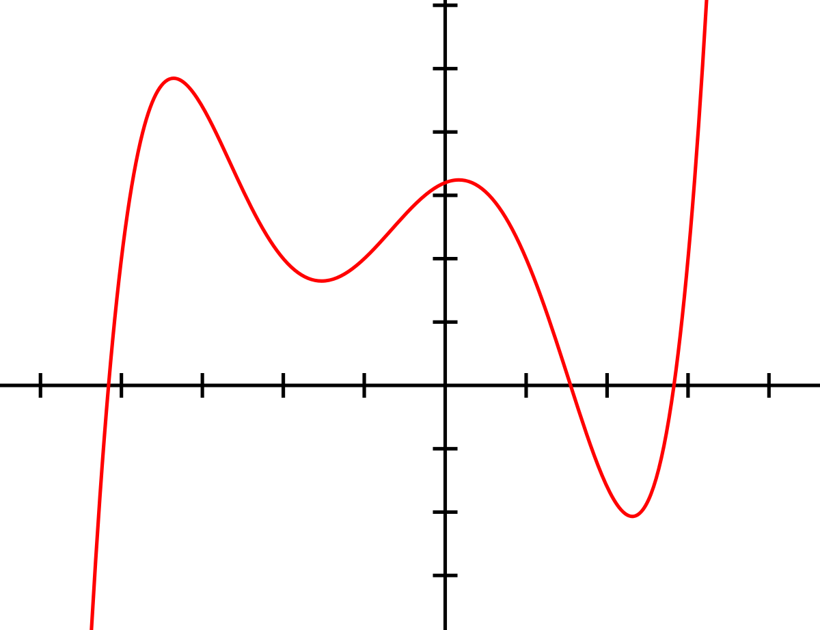







Let $Z\left(f_{0}\right)$ be a bound for the zeros of $f_{0}$ and define $u_{0}≔−Z(f_{0})$ and $u_{k+1}≔−Z(f_{0})$.
We order $u_{0},…,u_{k+1}$ so wlog $u_{0}≤u_{1}≤…≤u_{k}≤u_{k+1}$.
Check if there is an $i$ with $f_{0}\left(u_{i}\right)f_{0}\left(u_{i+1}\right)<0$ and if no, return $(K_{0},θ_{0},\left[ \right])$.
Let $i$ be minimal with $f_{0}\left(u_{i}\right)f_{0}\left(u_{i+1}\right)<0$ and we define $a≔u_{i}, b≔u_{i+1}$.
$$f$$
$$u_{0}$$
$$u_{1}$$
$$u_{2}$$
$$u_{3}$$
$$u_{4}$$
$$u_{5}$$

Slide 17







We define a subset $α∈2^{K\left[X\right]}$ as follows:
Given $g∈K[X]$ try to compute $Rem\left(g,f_{0}\right)=g_{1}$ the reminder of $g$ divided by $f_{0}$.
If this is not possible, then $g∉α$.
If $g_{1}≡0$, $g∈α$.
Compute $Ξ\left(K_{0},g_{1}\right)$. If the result is error, then $g∉α$.
Let $Ξ\left(K_{0},g_{1}\right)=(K_{1},θ_{1}, \left[v_{1},…,v_{l}\right])$ and try to order $θ_{1}\left(a\right),θ_{1}\left(b\right),v_{1},…,v_{l}$.
If not possible, $g∉α.$
W.l.o.g. $θ_{1}\left(a\right)≤v_{1}≤…≤v_{\tilde{l}}≤θ_{1}(b)$ and for some $\tilde{l}≤l$ and we overwrite $v_{0}≔θ\left(a\right)$ and $v_{\tilde{l}+1}=θ(b)$.
Check if there is exactly one $j$ with $θ_{1}\left(f_{0}\right)\left(v_{j}\right)θ_{1}\left(f_{0}\right)\left(v_{j+1}\right)<0$. If no, then $g∉α$.
Check if $θ_{1}\left(f_{0}\right)\left(\frac{v_{j}+v_{j+1}}{2}\right)>0$. If yes, then $g∈α$. Otherwise $g∉α$.
$$f$$
$$g_{1}$$
$$a$$
$$v_{1}$$
$$v_{2}$$
$$b$$

Slide 18








Let $α_{0}≔α∩−α$ and if $1∈α_{0}$, return error.
We define a candidate of an ordered field $K_{2}≔(K_{2},+,⋅,−,^{−1},0,1,≡,P_{2})$ as follows:
$$K_{2}≔K_{0}\left[X\right]×(K_{0}\left[X\right]∖α_{0})$$
$$\frac{x_{1}}{y_{1}}=\frac{x_{2}}{y_{2}}:⇔x_{1}y_{2}−x_{2}y_{1}∈α_{0}$$
$$P_{2}≔\left\{\frac{x}{y}∈K_{2} | xy∈α\right\}$$
$$\frac{x_{1}}{y_{1}}+\frac{x_{2}}{y_{2}}≔\left\{\begin{aligned}\frac{x_{1}y_{2}+x_{2}y_{1}}{y_{1}y_{2}} if y_{1}y_{2}∉α_{0} \\ \frac{{x_{1}y_{2}+x}_{2}y_{1}}{1} if y_{1}y_{2}∈α_{0}\end{aligned}\right.$$
$$\frac{x_{1}}{y_{1}}⋅\frac{x_{2}}{y_{2}}≔\left\{\begin{aligned}\frac{x_{1}x_{2}}{y_{1}y_{2}}if y_{1}y_{2}∉α_{0} \\ \frac{{x_{1}x}_{2}}{1}if y_{1}y_{2}∈α_{0}\end{aligned}\right.$$
$${\left(\frac{x}{y}\right)}^{−1}≔\left\{\begin{aligned}\frac{y}{x}if x∉α_{0} \\ \frac{0}{1}if x∈α_{0}\end{aligned}\right.$$
$$−\frac{x}{y}≔\frac{−x}{y}$$

Slide 19



We define the map: $θ_{2}:K_{0}→K_{2},x↦\frac{x}{1}$
We compute $h≔\frac{θ_{2}(f_{0})(Y)}{Y−\frac{X}{1}}∈K_{2}[Y]$.
Let $Ξ\left(K_{2},h\right)=\left(K_{3},θ_{3},\left[w_{1},…,w_{m}\right]\right),$ then we return
$$\left(K_{3},θ_{3}∘θ_{2}∘θ_{0},\left[w_{1},…,w_{m},θ_{3}\left(\frac{x}{1}\right)\right]\right)$$

Slide 20
Next challenges in Artin’s proof

Slide 21

Next challenges in Artin’s proof
Sturm’s Theorem
Constructive way to find the minimal polynomial of a field extension
Prime factorization of and $f∈K[\vec{X}]$

Slide 22
Thank you for your attention!

