Slide 1
An algorithmic approach to the existence of ideal objects in commutative algebra
Thomas Powell, Peter Schuster, Franziskus Wiesnet
TU Darmstadt, Università di Verona, Università di Trento/LMU München

Slide 2
Motivation

Slide 3

Motivation
We consider proofs of $A$in the following form:
Zorn’s lemma
assume $¬A$
maximal object
contradiction

Slide 4




Krull’s lemma:
Let $A$ be a ring, then
$$\bigcap{\{P⊆A|P is a prime ideal\}}⊆\sqrt{0}$$
No maximal object in the output
$$\{x∈A|∃n:x^{n}=0\}$$
$$=$$
Proof sketch:
Assume there is an $a∉\sqrt{0}. T$hen the set
$$\left\{I⊆A|I=\sqrt{\left(I\right)}∧a∉I\right\}$$
is non-empty and thus has a maximal object by Zorn‘s lemma.
This maximal object is a prime ideal and therefore
$$a∉\bigcap{\left\{P⊆A | P is a prime ideal\right\}}.$$
Maximal object in the proof but
not used explicitly
Notes:
Kurz erklären, was Radialideal sind.

Slide 5
Idea

Slide 6
Idea
Explicit maximal objects
Proof with maximal objects
Approximate explicit maximal objects
How are the maximal objects used?
Algorithm to compute an approximate explicit maximal object
Algorithm reflecting the computational content of the proof
Notes:
This is what we have done in our paper and comes from our own.

Slide 7
Realisation

Slide 8

Realisation
For a set $X$ we have $⊳⊆𝒫_{fin}\left(X\right)×X$ and $Q⊆X$ given.
$\left\langle S\right\rangle$ is the closure of $S$ w.r.t. $⊳$.
I.e. if $A⊳x$ for some finite $A⊆\left\langle S\right\rangle ,$ then $x∈\left\langle S\right\rangle$.
For a subset $S⊆X$ we write $Q(S)$ for $∀_{x∈S}Q(x)$.
Notes:
Relation between finite subsets and elements of X.
We write Q(x) for x\in Q

Slide 9

Example:
In the case that $X$ is an ring, we can define $A⊳x$ by $c_{1}a_{1}+…+c_{k}a_{k}=x$ for some $c_{i}∈X$ and $a_{i}∈A$ and
$Q\left(x\right)≔\left(x≠1\right)$.

Slide 10


Definition.
We say that $M⊆X$ is maximal w.r.t. $⊳$ and $Q$ if
M is closed w.r.t. $⊳,$
$Q(M)$,
$¬Q\left(\left\langle M,x\right\rangle \right)$ for all $x∉M$.
Theorem. Suppose that $Q\left(\left\langle ∅\right\rangle \right)$. Then there exists some $M⊆X$ which is maximal w.r.t. $⊳$ and $Q.$

Slide 11
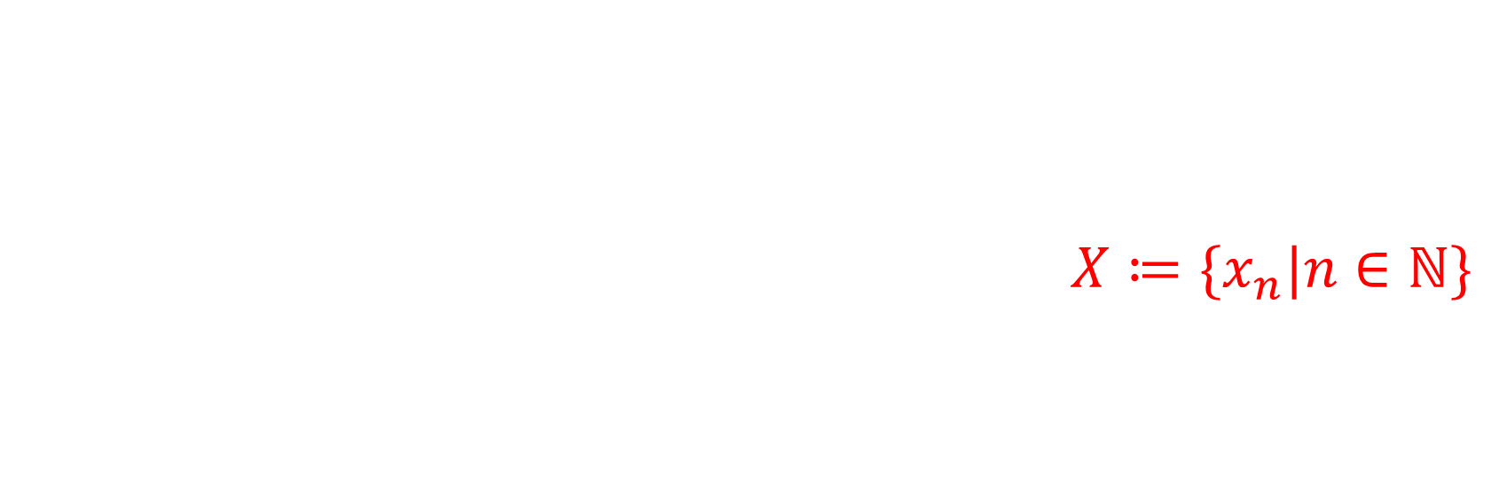
For a constructive analysis of the theorem, we make the following assumptions:
The set $X$ is countable (or finite), i.e. $X≔\{x_{n}|n∈ℕ\}$
The relation $A⊳x$ can be encoded as a $Σ_{1}^{0}$- formula.
$Q\left(x\right)$ can be encoded as a $Π_{1}^{0}$- formula.
Notation. For $A⊆X$ we define $\left[A\right](n)≔\{x_{i}∈A|i<n\}$.

Slide 12




Lemma.
$Q\left(\left\langle A\right\rangle \right)$ is a $Π_{1}^{0}$- formula, i.e.
$$Q\left(\left\langle A\right\rangle \right)⇔∀_{p}R_{A}(p)$$
for some decidable predicate $R_{A}(p)$ on $𝒫_{fin}\left(X\right)×ℕ$.
Lemma.
Let $M⊆X$ be given with
$$x_{n}∈M⇔Q\left(\left\langle \left[M\right]\left(n\right),x_{n}\right\rangle \right).$$
$$x_{n}∈M⇒∀_{p}R_{\left[M\right]\left(n\right)∪\left\{x_{n}\right\}}\left(p\right),$$
$$x_{n}∉M⇒∃_{q}{¬R}_{\left[M\right]\left(n\right)∪\left\{x_{n}\right\}}\left(q\right).$$
Then $M$ is a maximal set.
Notes:
It is sufficient, to restrict to an initial segment of the set M.
We are doing a Skomalisation.

Slide 13

Definition.
An explicit maximal object w.r.t. $⊳$ and $Q$ is a set $M⊆X$ together with a function $f:X∖M→ℕ$ such that
$x_{n}∈M⇒R_{\left[M\right]\left(n\right)∪\left\{x_{n}\right\}}(p)$
$x_{n}∉M⇒$ $¬R_{\left[M\right]\left(n\right)∪\left\{x_{n}\right\}}\left(f\left(n\right)\right)$
for all $n,p∈ℕ$.

Slide 14

Definition.
Let $\left(ω,φ\right)$ be functionals which take $M⊆X$ and $f:X∖M→ℕ$ as input and each returns a natural number.
An approximate explicit maximal object w.r.t. $⊳$, $Q$ and $\left(ω,φ\right)$ is a set $M⊆X$ together with a function $f:X∖M→ℕ$ such that
$x_{n}∈M⇒R_{\left[M\right]\left(n\right)∪\left\{x_{n}\right\}}(p)$
$x_{n}∉M⇒$ $¬R_{\left[M\right]\left(n\right)∪\left\{x_{n}\right\}}\left(f\left(n\right)\right)$
but now only for $n≤ω\left(M,f\right)$ and $p=φ\left(M,f\right)$.

Slide 15
The Algorithm

Slide 16




The Algorithm
State based:
$$s_{0}↦s_{1}↦s_{2}↦…↦s_{k}$$
$$s_{i}:ℕ→\left\{∗\right\}+ℕ$$
$$M\left[s_{i}\right]≔\left\{x_{n}\right|s_{i}\left(n\right)=∗\}$$
$f\left[s_{i}\right]\left(n\right)≔s_{i}(n)$ for $n∈X∖M[s_{i}]$

Slide 17

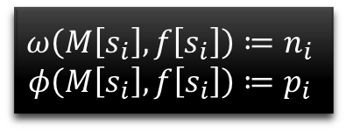


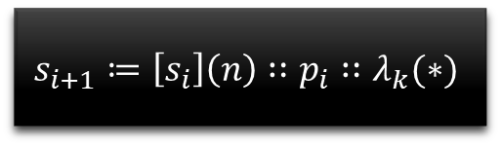


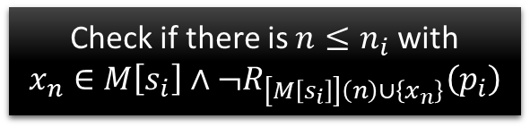

Start with
$$s_{0}≔λ_{k}(∗)$$
* * * * * *
Given $s_{i}$
Example: Maximal ideal in $ℤ/6ℤ$
$ω≡6$
$φ$ given by the Euclidean algorithm
$$φ\left(M,f\right)= \left[\sum_{m∈M}{k_{m}m}=\gcd\left(M\right)\right]$$
$$ω\left(M\left[s_{i}\right],f\left[s_{i}\right]\right)≔n_{i}$$
$$φ\left(M\left[s_{i}\right],f\left[s_{i}\right]\right)≔p_{i}$$
$$6$$
„
„
$$[1∗1=1]$$
Check if there is $n≤n_{i}$ with
$$x_{n}∈M\left[s_{i}\right]∧¬R_{\left[M\left[s_{i}\right]\right]\left(n\right)∪\left\{x_{n}\right\}}\left(p_{i}\right)$$
Yes
No
* [1] * * * *
$$s_{i+1}≔\left[s_{i}\right]\left(n\right)∷p_{i}∷λ_{k}(∗)$$
Return $s_{i}$

Slide 18


Start with
$$s_{0}≔λ_{k}(∗)$$
Given $s_{i}$
Example: Maximal ideal in $ℤ/6ℤ$
$ω≡6$
$φ$ given by the Euclidean algorithm
$$φ\left(M,f\right)= \left[\sum_{m∈M}{k_{m}m}=\gcd\left(M\right)\right]$$
* [1] * * * *
$$ω\left(M\left[s_{i}\right],f\left[s_{i}\right]\right)≔n_{i}$$
$$φ\left(M\left[s_{i}\right],f\left[s_{i}\right]\right)≔p_{i}$$
$$6$$
„
„
$$[−1∗2+1∗3=1]$$
Check if there is $n≤n_{i}$ with
$$x_{n}∈M\left[s_{i}\right]∧¬R_{\left[M\left[s_{i}\right]\right]\left(n\right)∪\left\{x_{n}\right\}}\left(p_{i}\right)$$
Yes
No
* [1] * [-1,1] * *
$$s_{i+1}≔\left[s_{i}\right]\left(n\right)∷p_{i}∷λ_{k}(∗)$$
Return $s_{i}$

Slide 19

Start with
$$s_{0}≔λ_{k}(∗)$$
Given $s_{i}$
Example: Maximal ideal in $ℤ/6ℤ$
$ω≡6$
$φ$ given by the Euclidean algorithm
$$φ\left(M,f\right)= \left[\sum_{m∈M}{k_{m}m}=\gcd\left(M\right)\right]$$
* [1] * [-1,1] * *
$$ω\left(M\left[s_{i}\right],f\left[s_{i}\right]\right)≔n_{i}$$
$$φ\left(M\left[s_{i}\right],f\left[s_{i}\right]\right)≔p_{i}$$
$$6$$
„
„
$$[−1∗4+1∗5=1]$$
Check if there is $n≤n_{i}$ with
$$x_{n}∈M\left[s_{i}\right]∧¬R_{\left[M\left[s_{i}\right]\right]\left(n\right)∪\left\{x_{n}\right\}}\left(p_{i}\right)$$
Yes
No
* [1] * [-1,1] * [0,-1,1]
$$s_{i+1}≔\left[s_{i}\right]\left(n\right)∷p_{i}∷λ_{k}(∗)$$
Return $s_{i}$

Slide 20


Start with
$$s_{0}≔λ_{k}(∗)$$
Given $s_{i}$
Example: Maximal ideal in $ℤ/6ℤ$
$ω≡6$
$φ$ given by the Euclidean algorithm
$$φ\left(M,f\right)= \left[\sum_{m∈M}{k_{m}m}=\gcd\left(M\right)\right]$$
* [1] * [-1,1] * [0,-1,1]
$$ω\left(M\left[s_{i}\right],f\left[s_{i}\right]\right)≔n_{i}$$
$$φ\left(M\left[s_{i}\right],f\left[s_{i}\right]\right)≔p_{i}$$
$$6$$
„
„
$$[1∗2=2]$$
Check if there is $n≤n_{i}$ with
$$x_{n}∈M\left[s_{i}\right]∧¬R_{\left[M\left[s_{i}\right]\right]\left(n\right)∪\left\{x_{n}\right\}}\left(p_{i}\right)$$
Yes
No
maximal ideal:
$$\{0,2,4\}$$
$$s_{i+1}≔\left[s_{i}\right]\left(n\right)∷p_{i}∷λ_{k}(∗)$$
Return $s_{i}$

Slide 21
Case study:
Krull’s lemma

Slide 22


Krull’s lemma
Theorem.
Let $X$ be a countable ring. Suppose that $r$ lies in the intersection of all prime ideals of $X$. Then $r$ is nilpotent.
Output: An $n∈ℕ$ such that $r^{n}=0$.
Imput: Witness that r lies in each prime ideal.
Given by a functional
$$ψ: 𝒫\left(X\right)→\left\{0,1,2\right\}+\left\{3,4,5\right\}×ℕ^{3}$$

Slide 23



Input functional:
$$ψ: 𝒫\left(X\right)→\left\{0,1,2\right\}+\left\{3,4,5\right\}×ℕ^{3}$$
$$ψ\left(S\right)=0⇒0_{X}∉S$$
$$ψ\left(S\right)=1⇒1_{X}∈S$$
$$ψ\left(S\right)=2⇒r∈S$$
$$ψ\left(S\right)=\left(3,i,j,k\right)⇒\left(x_{i}+x_{j}=x_{k}\right)∧x_{i},x_{j}∈S∧x_{k}∉S$$
$$ψ\left(S\right)=\left(4,i,j,k\right)⇒\left(x_{i}x_{j}=x_{k}\right)∧x_{i}∈S∧x_{k}∉S$$
$$ψ\left(S\right)=\left(5,i,j,k\right)⇒\left(x_{i}x_{j}=x_{k}\right)∧x_{i},x_{j}∉S∧x_{k}∈S$$

Slide 24

We define $\{a_{1},…,a_{k}\}⊳x$ by $c_{1}a_{1}+…+c_{k}a_{k}=x$ for some $c_{i}∈X$ and $Q\left(x\right)≔\left(∀_{e}x≠r^{e}\right)$.

Slide 25

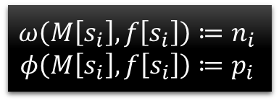


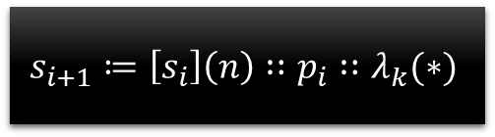

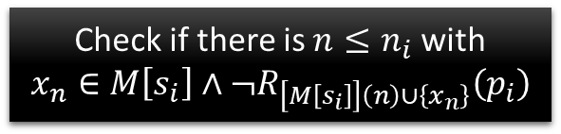

Start with
$$s_{0}≔λ_{k}(∗)$$
We define $\{a_{1},…,a_{k}\}⊳x$ by $c_{1}a_{1}+…+c_{k}a_{k}=x$ for some $c_{i}∈X$ and $Q\left(x\right)≔\left(∀_{e}x≠r^{e}\right)$.
Given $s_{i}$
Main idea:
Using the Krull functional $ψ$ we can define $ω$ and $φ$ such that the algorithm terminates in a state $s_{n}$ with $0∉M[s_{n}]$.
Therefore, from the witness $f\left[s_{n}\right]\left(0\right)$, we get an $e$ with $r^{e}=0$.
Using Krull’s lemma corresponds to the construction of a functional $ψ$.
$$ω\left(M\left[s_{i}\right],f\left[s_{i}\right]\right)≔n_{i}$$
$$φ\left(M\left[s_{i}\right],f\left[s_{i}\right]\right)≔p_{i}$$
Check if there is $n≤n_{i}$ with
$$x_{n}∈M\left[s_{i}\right]∧¬R_{\left[M\left[s_{i}\right]\right]\left(n\right)∪\left\{x_{n}\right\}}\left(p_{i}\right)$$
Yes
No
$$s_{i+1}≔\left[s_{i}\right]\left(n\right)∷p_{i}∷λ_{k}(∗)$$
Return $s_{i}$

