Slide 1
ITSE 3242: Systems Programming Program execution and translation
Notes:
<number>

Slide 2
Objective
Discuss Program execution steps.
Understand what different phases of the program translation perform
Understand different types of object codes and how they are related with program translation
Understand how linking works
Understand how loading works

Slide 3
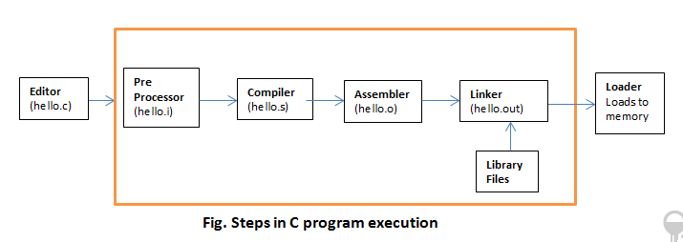
Program Translation
Programs written in any high level programming language need to pass through different phases before they can be directly executed by the computer.
Program execution in C involves the following steps.

Slide 4
Stages of Compilation
Starting with one or more C source code files,
The files are first sent to the C Pre-processor.
The pre-processor is responsible for doing textual replacement on #define.
De-comment the program
Copy the contents of included header files.
The fully expanded C code is passed to the compiler, the compiler, is responsible for
syntax checking and
code generation.

Slide 5
Stages of Compilation
The assembler converts the assembly code generated by the compiler and generates an object code.
If there are multiple sources of code in the program the linker,
needs to resolve how to find this codes and
link them to produce the executable code .
The executable code then can be loaded to memory by the loader and executed.

Slide 6
Compiler Drivers
swap.c
#include<stdio.h>
#include"head.h"
void swap(){
int temp = array[0];
array[0] = array[1];
array[1] = temp;
}
void display(){
printf("\nElement 0 : %d \n",array[0]);
printf("\nElement 1 : %d \n\n",array[1]);
}
head.h
extern int array[];
main.c
#include<stdio.h>
#include"head.h"
void swap();
void display();
int array[2] = {25,50};
void main(){
printf("\nBefore Swap\n");
display();
swap();
printf("\nAfter Swap\n");
display();
}

Slide 7
Compiler Drivers
A compiler driver invokes the language Pre-processor, compiler, assembler and linker as needed on behalf of the user.
In C gcc is a compiler drivers.
A command like below will initiate the compiler driver.
$ gcc main.c swap.c –o outFile
The driver first runs the C pre-processor (cpp),
which translates the C source file main.c into an intermediate file main.i.
Next, the driver runs the C compiler (cc1) or cc,
which translates main.i into an assembly language file main.s.
Then, the driver runs the assembler (as),
which translates main.s into a re-locatable object file main.o.

Slide 8
Compiler Drivers
The driver goes through the same process to generate swap.o.
Finally, it runs the linker program ld, which combines main.o and swap.o to create the executable object file outFile.
To run the executable outFile, we type its name on the Unix shell’s command line:
$ ./outFile

Slide 9
Compiler Drivers
Different command options can be given to control the compilation process of the given programs for the cc and gcc compiler drivers.
-c: only compile and assemble
-S: only compile
-E: only pre-processing
- o outFileName: give name to output file
-v print information about the compile process
-pipe: use pipes rather than temporary files
Options for debugging
-g produce debugging information
-Q makes compiler print out each function name as it is compiled, and print some statistics

Slide 10
Compiler Drivers
Examples:
$ gcc –c –v test.i
This will compile and assemble the source file test.i into test.o and prints information about the compilation process at the same time.
$ gcc –pipe –o test test.c
This will create the executable file test in the current directory but instead of creating intermediate files for each process of compilation, it will use pipes as a means of giving the output of one process to the input of the next process.

Slide 11
Compiling
The compiler takes our source code, checks to make sure it has legal syntax, and then generates machine code (or assembly code).
This machine code may be optimized,
The output of the compiler is an object file, which is denoted by the .o extension when using gcc.
There is one object file produced per source code file.
An object file contains machine code, but any function call to code that is in a different source file is left unresolved.
The address the code should jump to is unknown at this stage.

Slide 12
Compiling
The work of the compiler is generally divided into different phases.
Conceptually, these phases operate in sequence taking the output from the previous phase as its input.
Components of a compiler are:
Lexical analysis
Syntax analysis
Semantic analysis
Intermediate code generation
Code optimization
Code generation

Slide 13
Phases of Compiling
Lexical analysis (Scanning): This is the initial part of reading and analysing the program text:
The text is read and divided into tokens, each of which corresponds to a symbol in the programming language.
E.g. A variable name, a keyword or number.
Additionally, it will filter out whatever separates the tokens (the so-called white-space)
E.g. x3 = y + 3;
Token | Type
x3 | identifier
= | Assignment operator
y | identifier
+ | Addition operator
3 | number
; | ;

Slide 14
Phases of Compiling
Syntax analysis (Parsing): This phase takes the list of tokens produced by the lexical analysis
Arranges these in a tree-structure (called the syntax tree) that reflects the structure of the program.
This phase is often called parsing.
Parser tries to arrange the tokens using the syntax defined by that language.
It also reports a syntax error if the given code violates the defined grammar of the language.

Slide 15
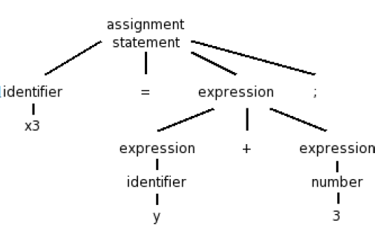
Phases of Compiling
For example let’s assume that we have the following grammar definition for the above problem in the language.
<assignment> -> id = expression;
<expression> -> number | id | expression + expression | expression * expression |
expression – expression |
expression / expression

Slide 16
Phases of Compiling
Semantics Analysis (Type checking):
This phase analyses the syntax tree to determine if the program violates certain requirements related to the semantics (meaning of the program).
It also attaches meaning to the program.
Example:
if a variable is used but not declared or
if it is used in a context that does not make sense given the type of the variable,

Slide 17
Phases of Compiling
Intermediate code generation: The program is translated to a simple machine independent intermediate language.
One common intermediate language representation is Three-Address Code.
These are primitive instructions that have one operator and (up to) three operands, all of which are addresses.
One address is the destination, which receives the result of the operation; the other two addresses are the sources of the values to be operated on.
Example: x5 = (x1 + x2) * x3 / x4;
Temp1 = x1+x2;
Temp2 = Temp1 * x3;
Temp3 = Temp2 / x4;
x5 = Temp3;

Slide 18
Phases of Compiling
Code optimization: The code optimizer will try to optimize the code to make it more efficient on resource usage.
Code optimization is not a critical phase in compiling but some compilers implement it to make the programs more effective.
The code optimizer tries to apply basic code optimization algorithms to improve the performance of the program.
Example: x5 = (x1 + x2) * x3 / x4;
Temp1 = x1+x2;
Temp2 = Temp1 * x3;
x5 = Temp2 / x4;

Slide 19
Phases of Compiling
Code generation: The intermediate language is translated to assembly language (a textual representation of machine code) for specific machine architecture.
Assembling: The assembly-language code is translated into binary representation and addresses of variables, functions, etc., are determined.

Slide 20
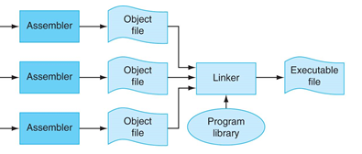
Linker
Linking is the process of collecting and combining various pieces of code and data into a single file.
Linking is performed automatically by programs called linkers.
Linkers play a crucial role in software development because they enable
Separate compilation. Decompose large programs into smaller, more manageable modules that can be modified and compiled separately.
When we change one of these modules, we simply recompile it and relink the application, without having to recompile the other files.
Understanding linkers will help you build large programs.

Slide 21
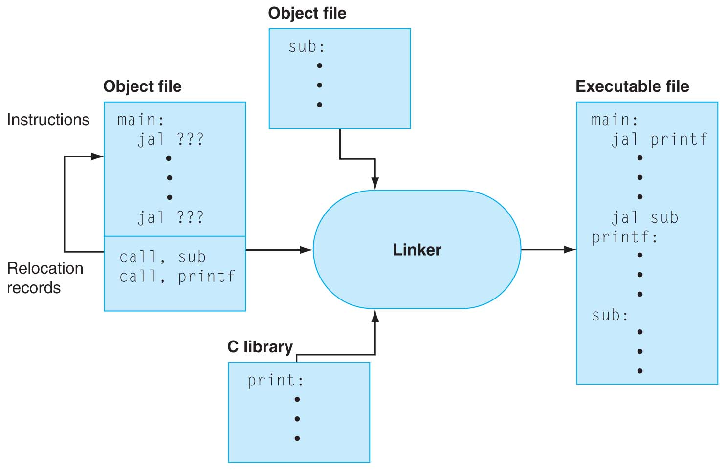
Linker cont.…
Linking can be performed at
Compile time: when the source code is translated into machine code;
Load time: when the program is loaded into memory and executed by the loader; and
run time, by application programs.

Slide 22
Linker cont.…
Code in an object file can come from one of three places:
1. The actual source code
2. Libraries and external references
3. Automatically generated info from compilation and assembling
The job of the linker is to assemble the code from these three places and create the final executable program file.
Object files come in three forms:
Re-locatable object file. Contains binary code and data in a form that can be combined with other re-locatable object files at compile time to create an executable object file.
Executable object file. Contains binary code and data in a form that can be copied directly into memory and executed.
Shared object file. A special type of re-locatable object file that can be loaded into memory and linked dynamically, at either load time or run time.
Compilers and assemblers generate re-locatable object files (including shared object files). Linkers generate executable object files.

Slide 23
Object Files
Object files are merely collections of blocks of bytes.
Some of these blocks contain
program code,
others contain program data, and
others contain data structures that guide the linker and loader.
Object file format
object file header: size and position of the other pieces of the object file
text segment: the machine code (representing the program)
data segment: binary representation of the data in the source file
relocation information: identifies lines of code that need to be “handled”
symbol table: list of this file’s labels and data that can be referenced

Slide 24
Linker cont.…
To build the executable, the linker must perform three main tasks:
Copy: Code and data from each object file to the executable.
Symbol resolution: Object files define and reference symbols.
The purpose of symbol resolution is to associate each symbol reference with exactly one symbol definition and resolves external references
External reference: reference to a symbol defined in another object file.
References can be in either code or data
code: a(); /* reference to symbol a */
data: int *xp=&x; /* reference to symbol x */

Slide 25
Linker cont.…
Relocation: Compilers and assemblers generate code and data sections that start at address 0.
The linker Relocates symbols from their relative locations in the .o files to new absolute positions in the executable.
Updates all references to these symbols to reflect their new positions.

Slide 26
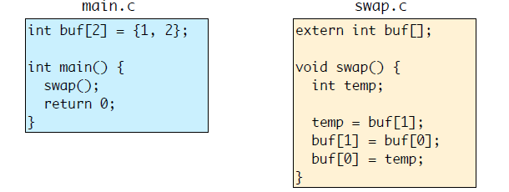
Linker cont.…
.
Resolve: Find the definition of each undefined reference in an object file
E.g., The use of swap() in main.o needs to be resolved to definition found in swap.o
Relocate: Assign code and data into absolute locations, and update references
swap.c compiled without knowing where buf will be in memory.
Linker must allocate buf (defined in main.o) into some memory location, and update uses of buf in swap.o to use this location.

Slide 27
Linking
Step 1: Take text segment from each .o file and put them together.
Step 2: Take data segment from each .o file, put them together, and concatenate this onto end of text segments.
Step 3: Relocate and Resolve References
Go through un-resolved references and resolve them
Fill in all absolute addresses
.o file 1
a.out
text 1
data 1
Relocated text 1
info 1
Linker
Relocated text 2
Relocated data 1
.o file 2
Relocated data 2
text 2
data 2
info 2

